Slide 1
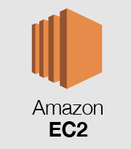
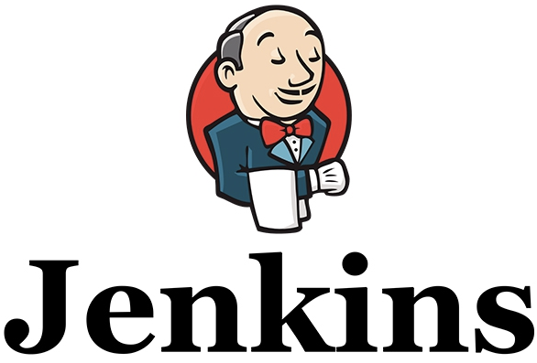

CI/CD pipeline
triggers CI/CD
Release
Push
Build, Test, Deploy
Development
Pull request
Topics

Slide 2




AWS S3 image storage
AWS S3
AWS S3
2. Store the image
in AWS S3 (async)
2. Download the image
3. Store the image’s
URI in DB (async)
1. Request an image
1. Send an image
Client
Server
DB
Client
3. Send the image
Server
Upload
Download
Downloading from public storage
AWS S3
3. Client gets the image
1. Request an image
Client
2. Send the location of the image
Server

Slide 3

Kafka broker
Topic: email
Sticky partitioner
(Batch size: 400)
Group:
email_senders
Partition
Consumer
Email producers
Partition
Consumer
Consumers take turns consuming the messages for load balancing
Kafka broker
Topic
Group
Kafka producer producer
Partition
Consumer
Partition
Consumer

