Slide 1
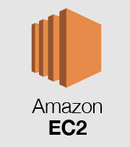


CI/CD pipeline
triggers CI/CD
Release
Push
Development
Testing & Deploy
Pull request
Topics

Slide 2




AWS S3 image storage
AWS S3
AWS S3
3. Client gets the image
Server stores the image in AWS S3
and its URI in DB
1. Request an image
Client
Server
DB
Client
2. Send the URI of the image
Server

