Slide 1



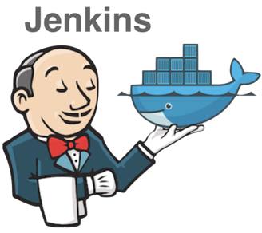


Trigger build
Pull
Deploy
Push

Slide 2
server.js
(main)
SSL certificate
Room manager
(manages sockets)
Routes
React routes
Service

Slide 3



1. Join webRTC
2. New peer
Signaling server
3. User1 sends an offer to User2
4. User2 answers to User1
Also, ICE candidates are transmitted
User1
User2
5. send media stream
STUN server let users know their public IP, which is included in ICE candidates

Slide 4
peerJS
1. Send User2’s information to User1
User1
2. calls User2 / sends media stream
User2
3. answers User1’s call / sends media stream

