Slide 1



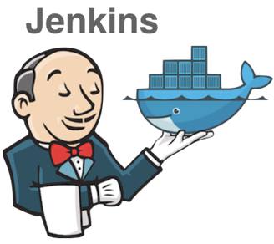

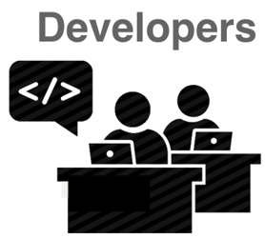
Trigger build
Pull
Deploy
Push

Slide 2
server.js
(main)
SSL certificate
Room manager
(manages sockets)
Routes
React routes
Service

Slide 3


1. Join webRTC
2. New peer
3. User1 sends an offer
to User2, and ice candidate
4. User2 answers to User1
User1
User2
5. send media stream

Slide 4
peerJS
1. Send User2’s information to User1
User1
2. calls User2 / sends media stream
User2
3. answers User1’s call / sends media stream

