Slide 1


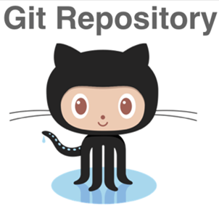
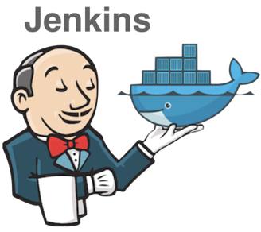

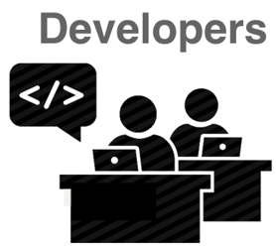
Trigger build
Pull
Deploy
Push

Slide 2
server.js
(main)
SSL certificate
Room manager
(manages sockets)
Routes
React routes
Service

