Slide 1
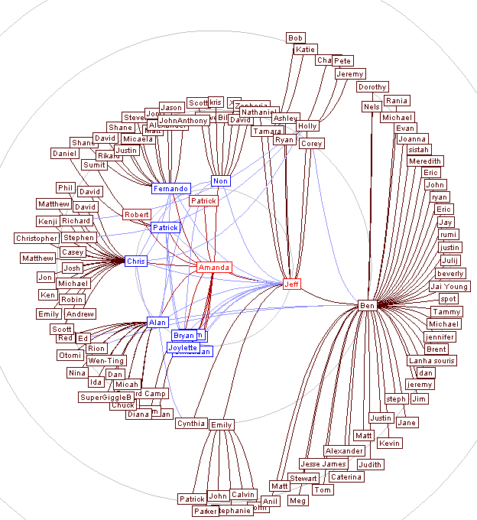
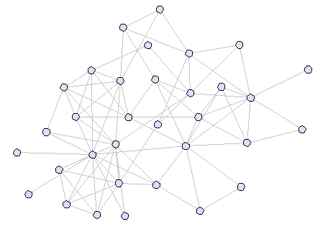
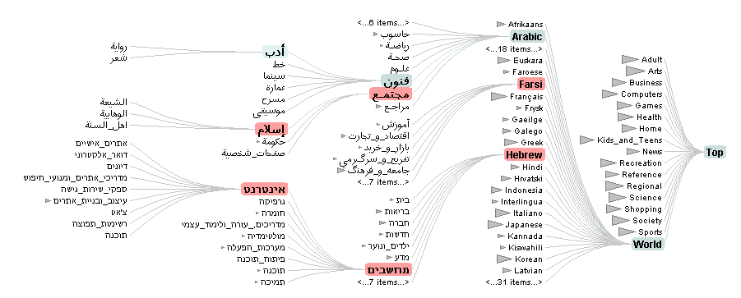
prefuse a visualization toolkit

Slide 2
prefuse
a user interface toolkit for interactive information visualization
  built in Java using Java2D graphics library
  data structures and algorithms
  pipeline architecture featuring reusable, composable modules
  animation and rendering support
  architectural techniques for scalability

Slide 3
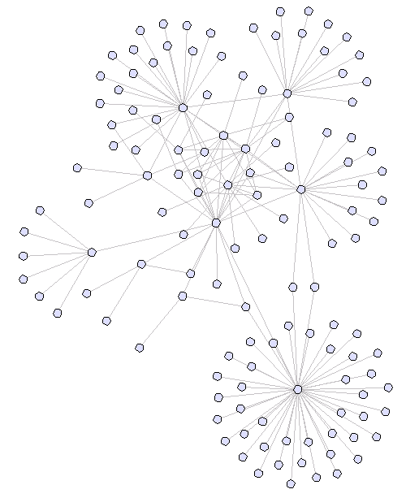
here is a graph…
At this point it is purely abstract (i.e. assume we haven’t given it any visual appearance yet)
The graph could be a…
file system
computer network
web site
biological taxonomy
social network
Before we can visualize it, we first need means to represent and import this data.

Slide 4
abstract graph data
Provided graph data structures:
  package edu.berkeley.guir.prefuse.graph
  Node, Edge, TreeNode, Graph, Tree
  Node and Edge are both instances of the Entity interface, and can have any number of attributes.
Loading and saving graph data:
  package edu.berkeley.guir.prefuse.graph.io
  GraphReader, GraphWriter interfaces
  XMLGraphReader, TabDelimitedTreeReader, and other provided modules

Slide 5
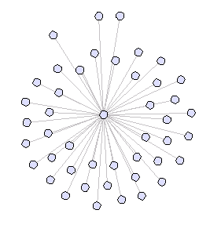
filtering the graph
we now need to select which parts of the graph to visualize… this process is called filtering
abstract data
visual analogues
(Node, Edge)
(NodeItem, EdgeItem)

Slide 6

visual analogues
Filtered graph data is mapped to VisualItems – visual analogues of abstract data.
  NodeItem: analogue of nodes in the graph
  EdgeItem: analogue of edges in the graph
  AggregateItem: represents group of nodes and edges
  can be found in package edu.berkeley.guir.prefuse
Together they form a mirror of the filtered subset of the original data, and are the subject of all subsequent processing (e.g. layout, rendering).
NodeItems
EdgeItems
AggregateItems

Slide 7
the item registry
The ItemRegistry is the central data structure in prefuse. It manages the mapping between VisualItems and the original graph data, and provides queues for quickly iterating over filtered items. It also centralizes access to other components, such as the RendererFactory and on-screen Displays.
Manages creation of all VisualItem instances. Give the registry an Entity, and it will return you a corresponding VisualItem.
A java.util.Comparator instance is used to order the rendering queues of items, determining in what order things are drawn.
Supports management of focus items (clicked nodes, search results, etc)
ItemRegistry
Comparator
NodeItems
EdgeItems
…
getItem(Entity entity, boolean create)
getItems()
getDisplay(int)
getRendererFactory()
getFocusManager()

Slide 8
rendering
Renderers are responsible for drawing items and computing bounding boxes. It is the responsibility of the RendererFactory to return the desired Renderer for a given VisualItem. These live in the package edu.berkeley.guir.prefuse.render.
RendererFactory
Renderer
getRenderer(VisualItem)
render(Graphics2D, VisualItem)
getBounds(VisualItem)
locatePoint(Point2D, VisualItem)
Provided Renderers include:
ShapeRenderer
TextRenderer
TextImageRenderer
EdgeRenderer
SubtreeAggregateRenderer

Slide 9
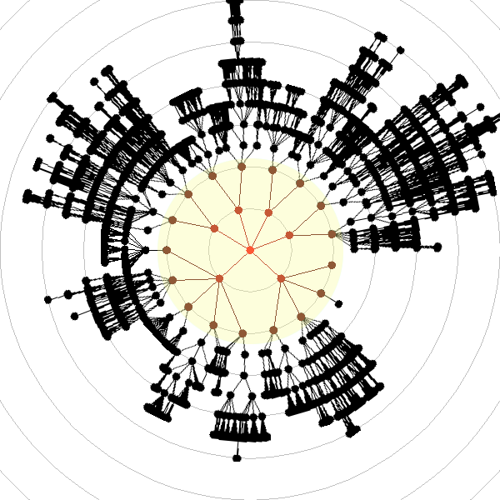
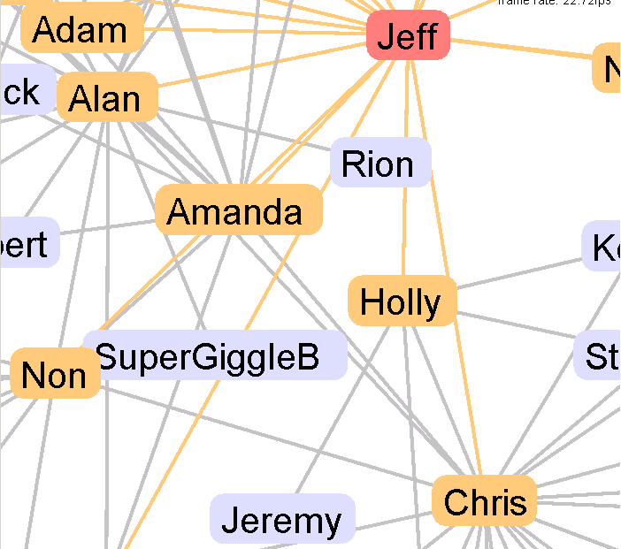
display
The Display class provides on-screen drawing and interaction with the visualized data set.
Display
subclasses javax.swing.JComponent
renders VisualItems to the screen
provides user interface callbacks
  through ControlListener interface
  through prefusex.controls package classes
custom decoration with prePaint() and postPaint()
custom tool-tip handling
supports on-screen text editing
graphics transforms, including pan and zoom
ControlListener
itemClicked(VisualItem, MouseEvent)
itemDragged(VisualItem, MouseEvent)
itemKeyPressed(VisualItem, KeyEvent)
…

Slide 10
animation and activities
ActivityManager schedules and runs Activities of specified duration (possibly infinite), step rate, and start time.
Enables animation and time-based processing.
Runs in a separate thread of execution, and provides a protected environment for running Actions.
edu.berkeley.guir.prefuse.activity
ActivityManager
schedule(Activity)
scheduleNow(Activity)
scheduleAt(Activity, long startTime)
scheduleAfter(Activity, Activity)
Activity
ActivityListener
long duration, stepTime, startTime
activityScheduled(Activity)
isScheduled()
activityStarted(Activity)
cancel()
activityStepped(Activity)
run(long elapsedTime)
activityFinished(Activity)
addActivityListener(ActivityListener)
activityCancelled(Activity)

Slide 11
actions: graph processing
Graph processing (filtering, layout, attribute assignment, etc) is achieved by constructing a pipeline of processing modules called Actions. These ActionLists are then submitted to the ActivityManager for execution. Actions can be found in edu.berkeley.guir.prefuse.action
ActionList extends Activity
Action
Actions
run(ItemRegistry, double f)
isEnabled()
setEnabled(boolean)
provided Actions include….
Filters: GraphFilter, TreeFilter, FisheyeTreeFilter, FisheyeGraphFilter
Layout: ForceDirectedLayout, RadialLayout, SquarifiedTreeMapLayout, …
Assignment: ColorFunction, SizeFunction, FontFunction
Interpolation: ColorInterpolator, LinearInterpolator, PolarInterpolator

Slide 12
action pipeline examples
Filter all graph nodes and edges
  ActionList filter = new ActionList(registry);
  filter.add(new GraphFilter());
  filter.runNow();
Filter a “fisheye” view (of depth 2) of a tree and its edges
  ActionList filter = new ActionList(registry);
  filter.add(new FisheyeTreeFilter(-2));
  filter.runNow();
Perform a radial (circular) layout and assign node colors
  ActionList layout = new ActionList(registry);
  layout.add(new RadialGraphLayout());
  layout.add(new ColorFunction());
  layout.runNow();
Perform a 1 second animation between configurations
  ActionList animate = new ActionList(registry, 1000, 20);
  layout.add(new LocationAnimator());
  layout.add(new ColorAnimator());
  animate.setPacingFunction(new SlowInSlowOutPacer());
  animate.runNow();

Slide 13
customizing actions
The Action interface is designed to let developers easily create custom Actions to accomplish their goals. In addition, many actions are very easily customized to a particular application. For example, the ColorFunction includes two methods getColor(VisualItem item) and getFillColor(VisualItem item) that subclasses can override to perform application specific code. The FontFunction and SizeFunction actions are similar.
public class MyColorFunction extends ColorFunction {
public Paint getColor(VisualItem item) {
// custom code here, just return the desired color
}
public Paint getFillColor(VisualItem item) {
// custom code here, just return the desired color
}
}

Slide 14
writing applications
So how do you build an app with prefuse?
before touching any code: design visual appearance, layout, interactive behaviors
determine input/output of graph data
initialize ItemRegistry and Display(s)
select (or implement custom) Renderers and RendererFactory
construct the various ActionLists necessary
using existing library of Actions, or with custom-built modules (or sub-components like Force functions)
write user interface callbacks to orchestrate the ActionLists

Slide 15
other features include…
complete physics force simulation engine
  including n-body (e.g. gravity/anti-gravity) solver, spring forces, drag forces, wall forces, and multiple numerical integration options
  edu.berkeley.guir.prefusex.layout.ForceDirectedLayout, edu.berkeley.guir.prefusex.force
keyword search support using a prefix tree
  indexes nodes, allowing for very fast searches of selected attributes
  edu.berkeley.guir.prefuse.util.KeywordSearchFocusSet
automatic image loading and caching
  including optional scaling to improve memory and computational costs.
  edu.berkeley.guir.prefuse.render.ImageFactory
animation pacing functions (e.g., slow-in slow-out, there and back)
  edu.berkeley.guir.prefuse.activity.Pacer, edu.berkeley.guir.prefuse.activity.SlowInSlowOutPacer
graphical fisheye and bifocal distortion techniques
  can be used to navigate large spaces (similar in principle to MacOS X dock)
  edu.berkeley.guir.prefusex.distortion
database connectivity (working, but still under construction)
  edu.berkeley.guir.prefuse.graph.external

