Slide 1
FIFA Fédération Internationale de Football Association kaggle dataset
By –Venkatesh Prasad
Cs544-final project

Slide 2
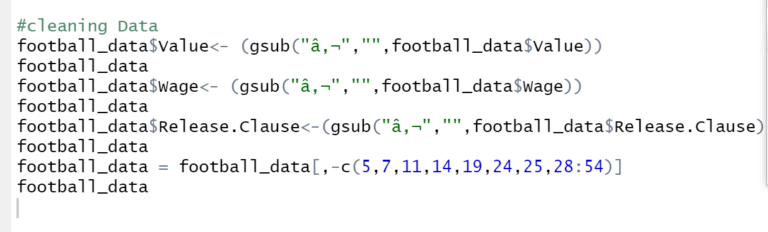
Preparation of data
Initial data “football_data” has many elements which we do not need as we progress through in my project like
Player photo
Country flag
Club logo
LS to RB (individual position stamina of player)
Real. Face (pes game intel)

Slide 3
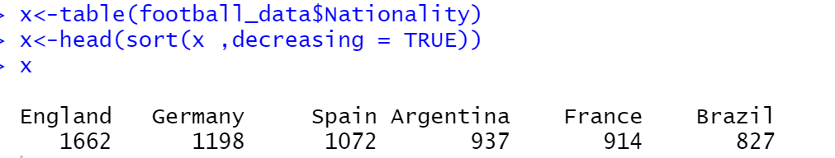
Nation producing players
Which country produces most of the players who play football (American soccer).
Sorting table x in decreasing
Order would fetch the number of
Players produced by each nation
INTEL:
England out numbered the number of player of France and Brazil together .
This also concludes that in England and Germany people have a lot of craze for the game of football

Slide 4
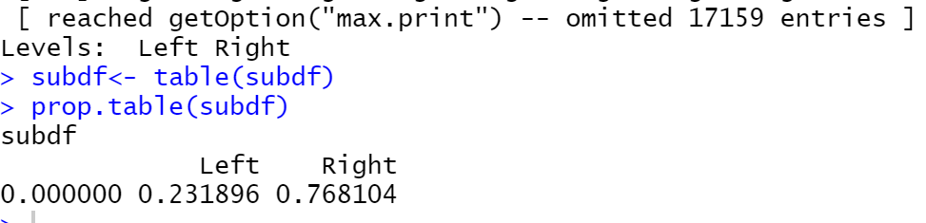
Preferred foot
Players can be either right or left footed , and the undefined footed are the goalkeepers which need not master any foot.
It makes a difference ,player who are left footed maintain right side of the pitch which lets them to curl the ball to the farther side of the good
Left footed player are less predictable and are very much demanding in the current market .
As players occupy both side equally
That makes preferred left foot more
valuable .

Slide 5
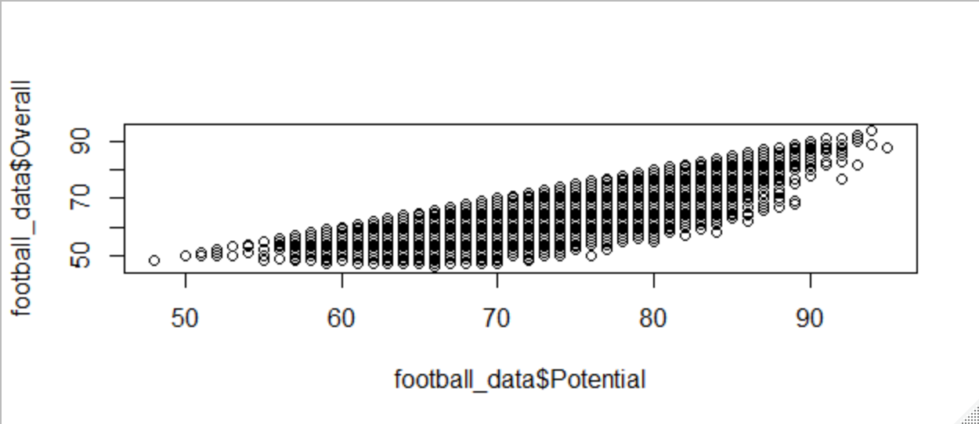
Overall vs potential
Overall is the actual output that that players produce in the past time and potential is the hypothetical output producing capability of the player which is predicted using the medical data or training program data .which would exclude the hypothetical medical injury .
The below scatterplot justifies that player is always less than or equal to what is expected from the player and there are few players who’s
are expected to produce some times fail due
opponent strategy may find themselves in far
right side ,as more potential is discovered
less time played by the player

Slide 6
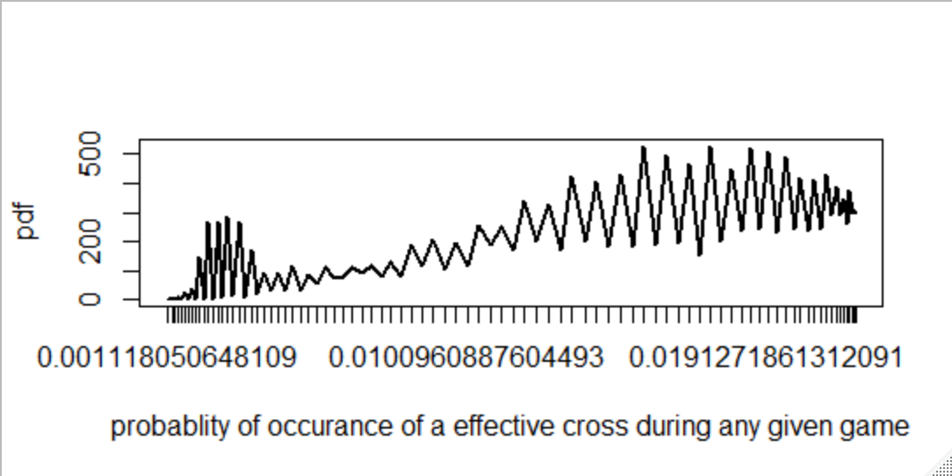
Distribution
Plotting pdf and cdf for the distribution using dnorm to the ability of a player in a give match to pass a cross ball to another player in actual run time .
The crossing increases with ever correct cross the make as their previous steps.

Slide 7
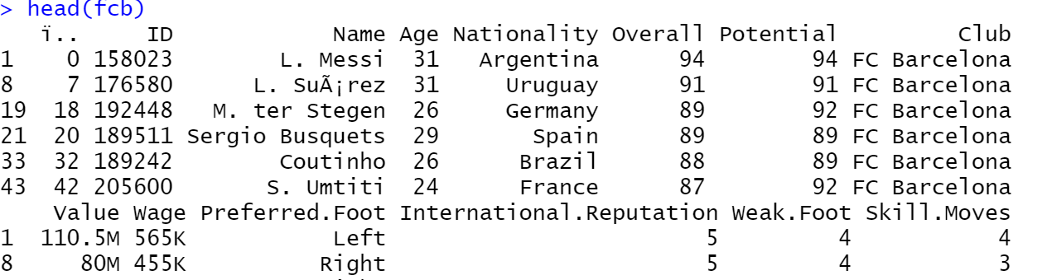
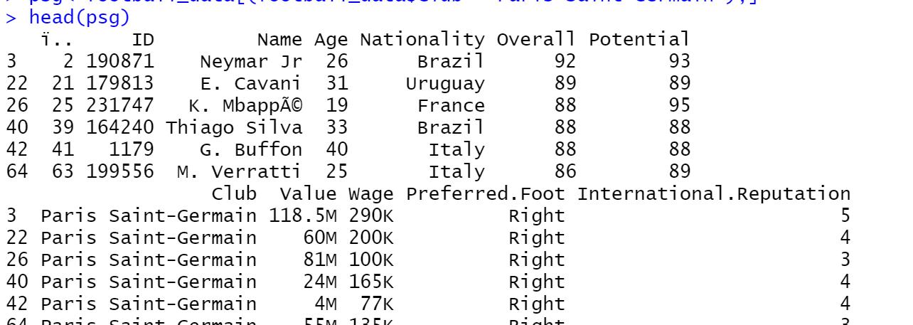
France and Barcelona
Barcelona is a world class club winners to many trophies and these are the players in FCB
Paris saint Germaine is a French club having young talents

Slide 8
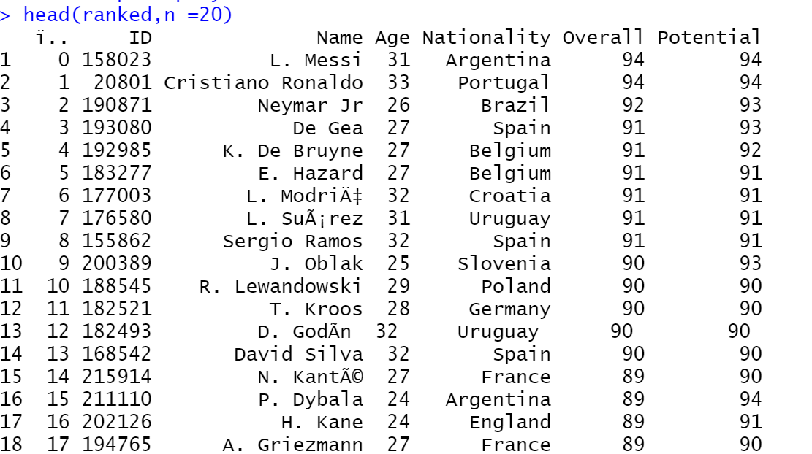
Ranked players
World class football experience comes from the player’s having their stats up in their sheet
Goalkeepers with clean sheets like de Gea

Slide 9
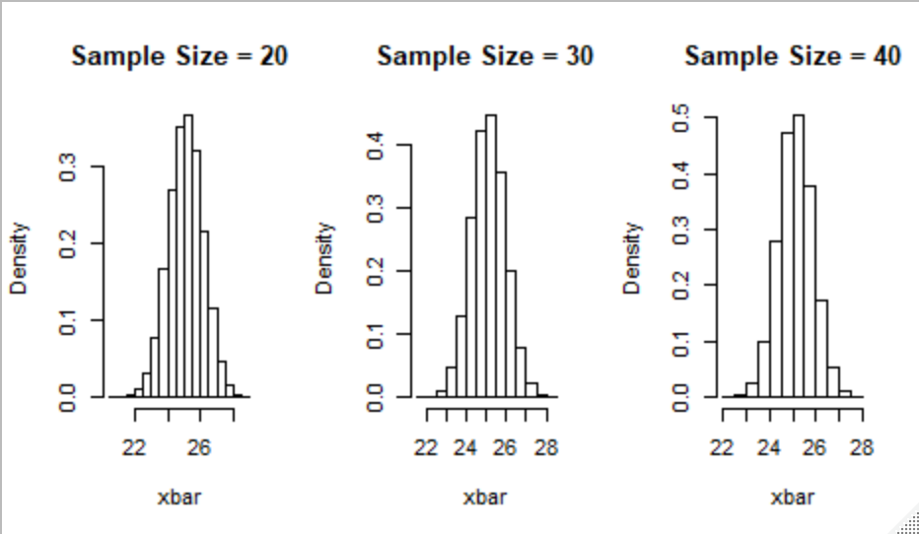
Normal distribution

Slide 10
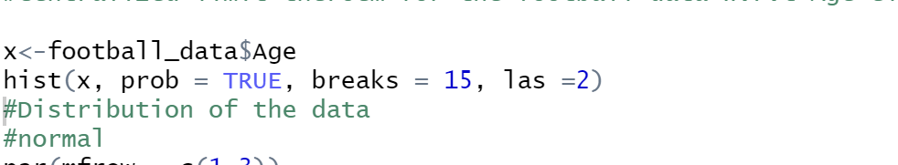
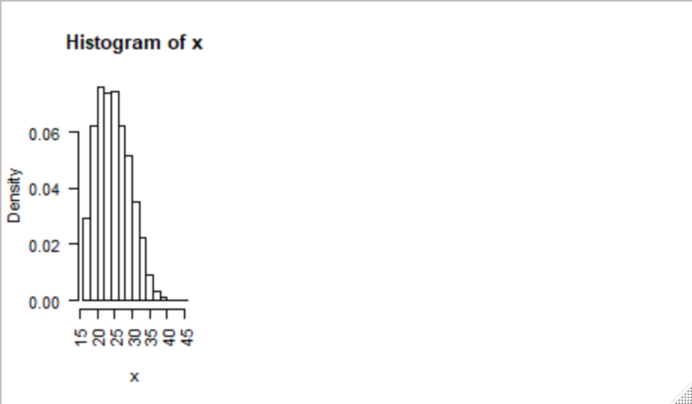
Central limit theorem

Slide 11
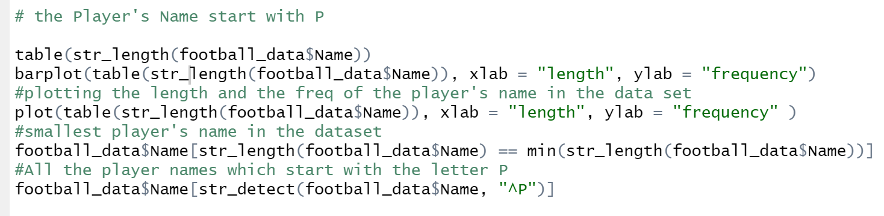
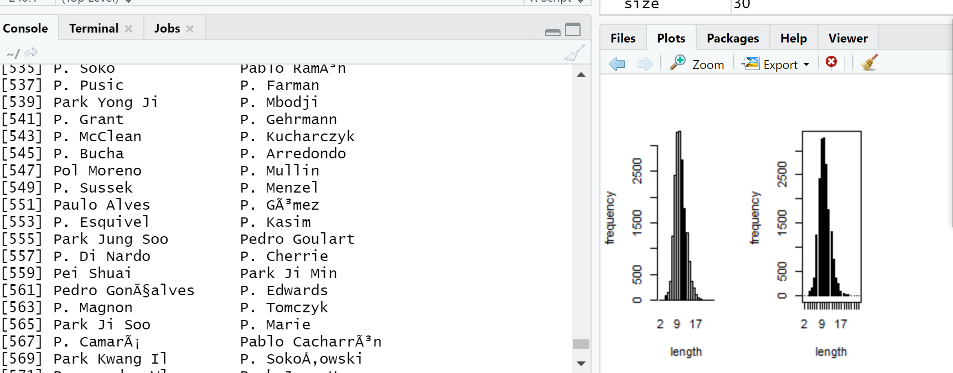
String operations

