Slide 1


GUJARAT TECHNOLOGICAL UNIVERSITY
Shree Swaminarayan Institute of Technology
BHAT, GANDHINAGAR , 382424
Let’sTexify
BACHELORS OF ENGINEERING IN
COMPUTER ENGINEERING
Presented by : AjayKumar Pandya Enrollment No: 201250107501
Course : [B.E. SEM-VIII] Computer Engineering
Internal Guide: Prof Darshankumar Solanki
Dept: Computer Engineering.

Slide 2
Contents
Abstract
Introduction
Objective
Motivation
Background Theory
Application Areas
Problem Statement
Proposed Work and Methodology
Future Work
Conclusion
References

Slide 3
Abstract
Nowadays everything is getting in digital format, So to make everything digital we need to put manual efforts. Suppose, I have a document (ex. A book’s page) and I need to make it in a digital document so I need to write everything manually. But if we have a solution which can identify the texts from an image, that would be a very easy and faster process. That's why I have decided to choose this project as my final year project.
Extracting text from an image is a difficult task
The main purpose of this project is to develop a system that extracts text and its related information from images
Text on images contains useful data or information for annotation, indexing, and structuring of images
However, the problem of text extraction is extremely challenging due to variations of text in images.
Various systems have been proposed in the past for detection and extraction of text from images. The main aim is to extract the character data from the images.
Keywords
Image Processing, Text Extraction, OCR, Computer Vision.

Slide 4
Introduction
Today the most information is available either on paper or in the form of photographs or videos. Large information is stored in images.
To convert all the available information we need to apply some manual effort, like Data entry.
The current technology is restricted to extracting text against clean backgrounds.
Thus, there is a need for a system to extract text from general backgrounds

Slide 5
Objective
The technique of extracting the features is useful when you have a large data set and need to reduce the number of resources without losing any important or relevant information. Feature extraction helps to reduce the amount of redundant data from the data set.
In the end, the reduction of the data helps to build the model with less machine effort and also increases the speed of learning and generalization steps in the machine learning process.
Extraction helps to get the best feature from those big data sets by selecting and combining variables into features, thus, effectively reducing the amount of data.

Slide 6
Motivation
Though tremendous strides have been made in character recognition but it is still considered to be a difficult problem when the data is rotated and non-uniform in scale.
The basic Text extraction system was invented to convert the data available on papers in to computer process able documents, so that the documents can be editable and reusable.
For example, first the image may be divided into smaller regions that contain the individual characters, second the individual characters are recognized, and finally the result is pieced back together.

Slide 7
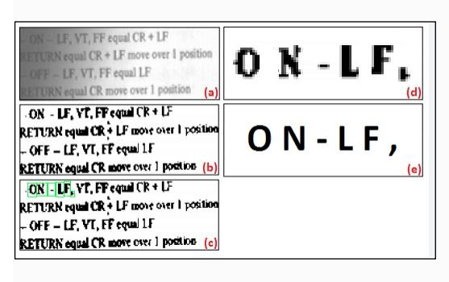
Background Theory
How does OCR works?
Image acquisition
Pre-Preprocessing
Text identification
Pattern matching
Postprocessing

Slide 8
Background Theory
What is Image Processing?
Image processing is analysis and manipulation of a digitized image, so as to enhance its quality with the help of mathematical operations by using any kind of signal processing where the input is a picture or an image or a video frame.
Image Processing is set of computational techniques for analyzing, enhancing, compressing, and reconstructing images.
Image processing generally involves three steps:
Importing and Loading the image by using image acquisition tools.
Analyzing and manipulating image to extract the information.
Output the result. The result might be the image or a picture altered in some way or it may be a report based on analysis of the image.

Slide 9
Background Theory
Famous OCR Libraries
Tesseract
Easy OCR
ABBYY
Google’s Vision
Nanonets
Ocular, etc.

Slide 10
Applications Areas
OCR
Legal Documentations
Pharmaceutical
Word Processing
Healthcare
Banking
Security

Slide 11
Problem Statement
Problem Definition
As we can see in our daily lives, people take images of some documents when they have no other source to take that document with them, but later they have to read each and every word from it.
I thought to make a project in which we can just take an image and process it to extract the text present in the image. It saves a lot of time to read the text from an image.
It also minimizes manual efforts. Saves time and yet accurate.

Slide 12
PROPOSED WORK AND METHODOLOGY
Methodology
Pre-processing module
Noise Removal
Filtering
Normalization
Text Recognition Module
Segmentation
Feature Extraction and Classification
Post-processing Module
Grouping
Error-detection and correction

Slide 13
R: - Let’s Textify R1: - Image to Text R1.1: - Recipe Management Input: - Recipe Name Output: - Create, Update or Delete and Show recipe. Process: - Creates a recipe with given Recipe name. Able to update and delete it too. Also shows the recipe list for selection. R1.1: - Image Teaching Input: - Image ROI, Pre-Processing and recognition parameters. Output: - Extracted Text based on parameters given Process: - Performs the Pre-Processing on image after cropping the Image. Now Pre-Processed will be passed to Recognition algorithm and then the post-Processing will do its work and OCR text will be viewed on the screen. R1.2: - Compare OCR Input: - Image with and without pre-processing Output: - Shows the Pre-Processed and A normal cropped image with its OCR output Process: - Performs OCR on both the images and show the comparing result on the screen Team ID: 319260 CHAPTER-5: SYSTEM REQUIREMENTS STUDY Gujarat Technological University 16 SSIT
System Requirement Specification

Slide 14
R1.2: - Preview Input: - An Image with all the params saved in teaching screen Output: - Show the Image and extracted text on the screen with continuous moving images Process: - Performs OCR on the images and shows the result on the screen. R2: - PDF to Word R2.1: - Converts a PDF file to word Input: - PDF File Output: - Converted Word File Process: - Takes a PDF file as a Input and converts it to word by doing the copy pasting the texts and images on the same page. R3: - QR code reader R3.1: - Converts a QR code image to readable text Input: - Image file Output: - Extracted text from an image Process: - Takes an image file as a Input and converts it to text. R4: - About Shows the about form in the application. R5: - Exit Exits the application

Slide 15
From the next slide we are going to see the diagrams of the application that I have created.
Diagrams

Slide 16
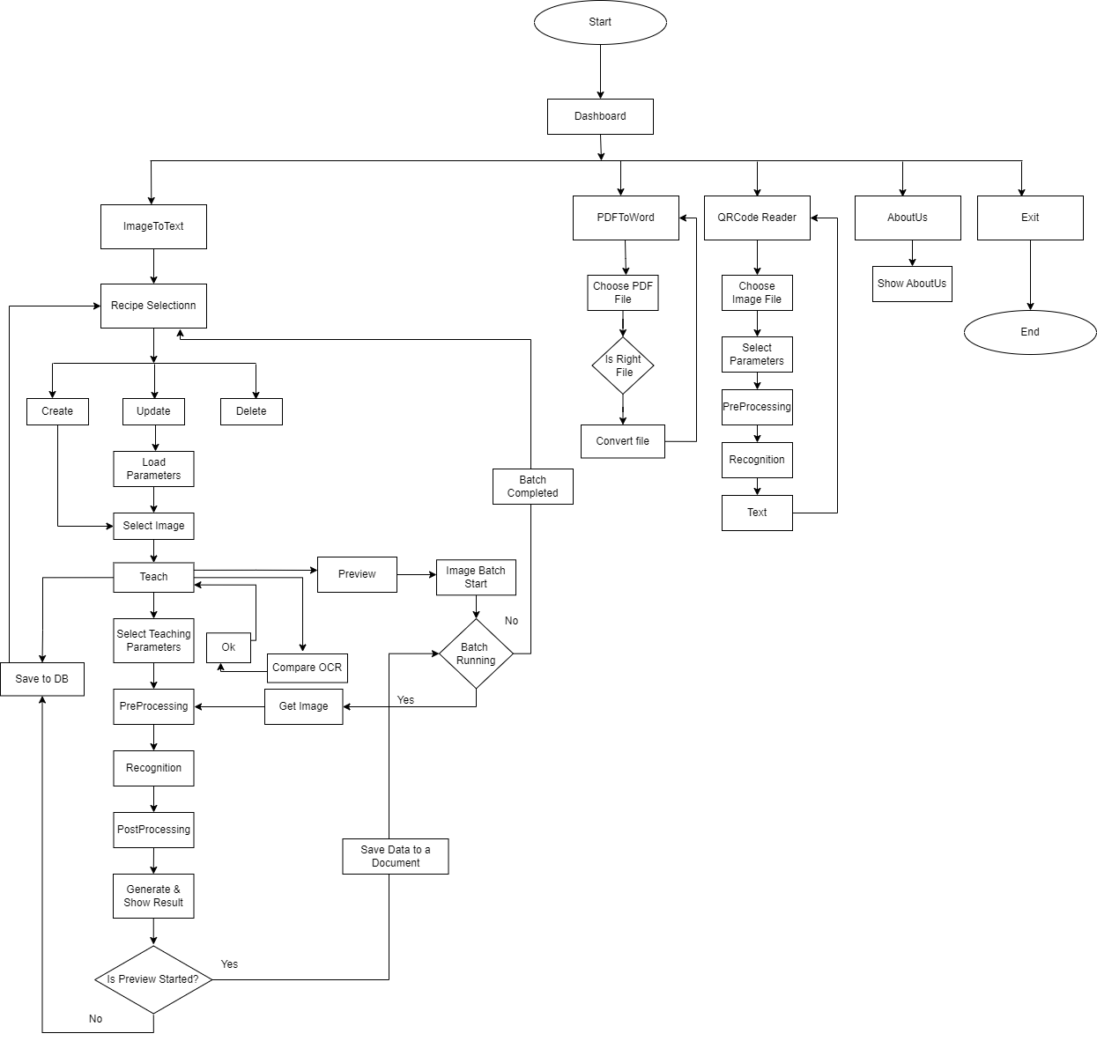
Flow Diagram

Slide 17
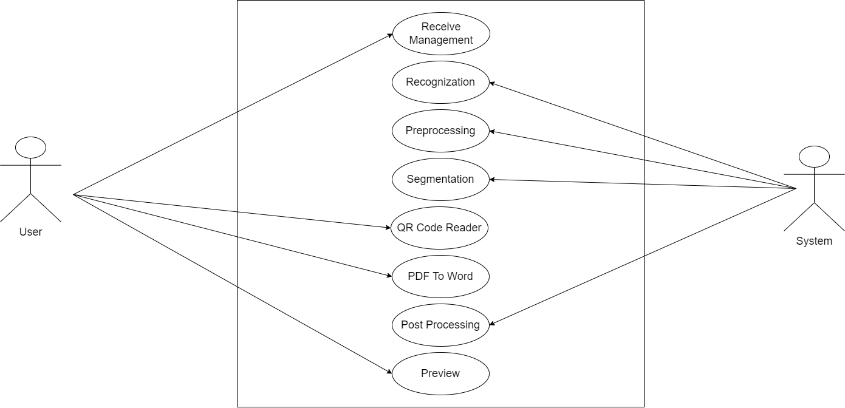
Use Case Diagram

Slide 18
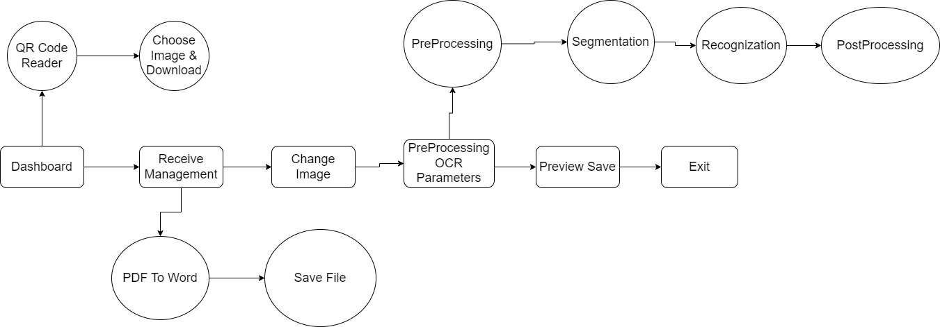
Data Flow Diagram

Slide 19
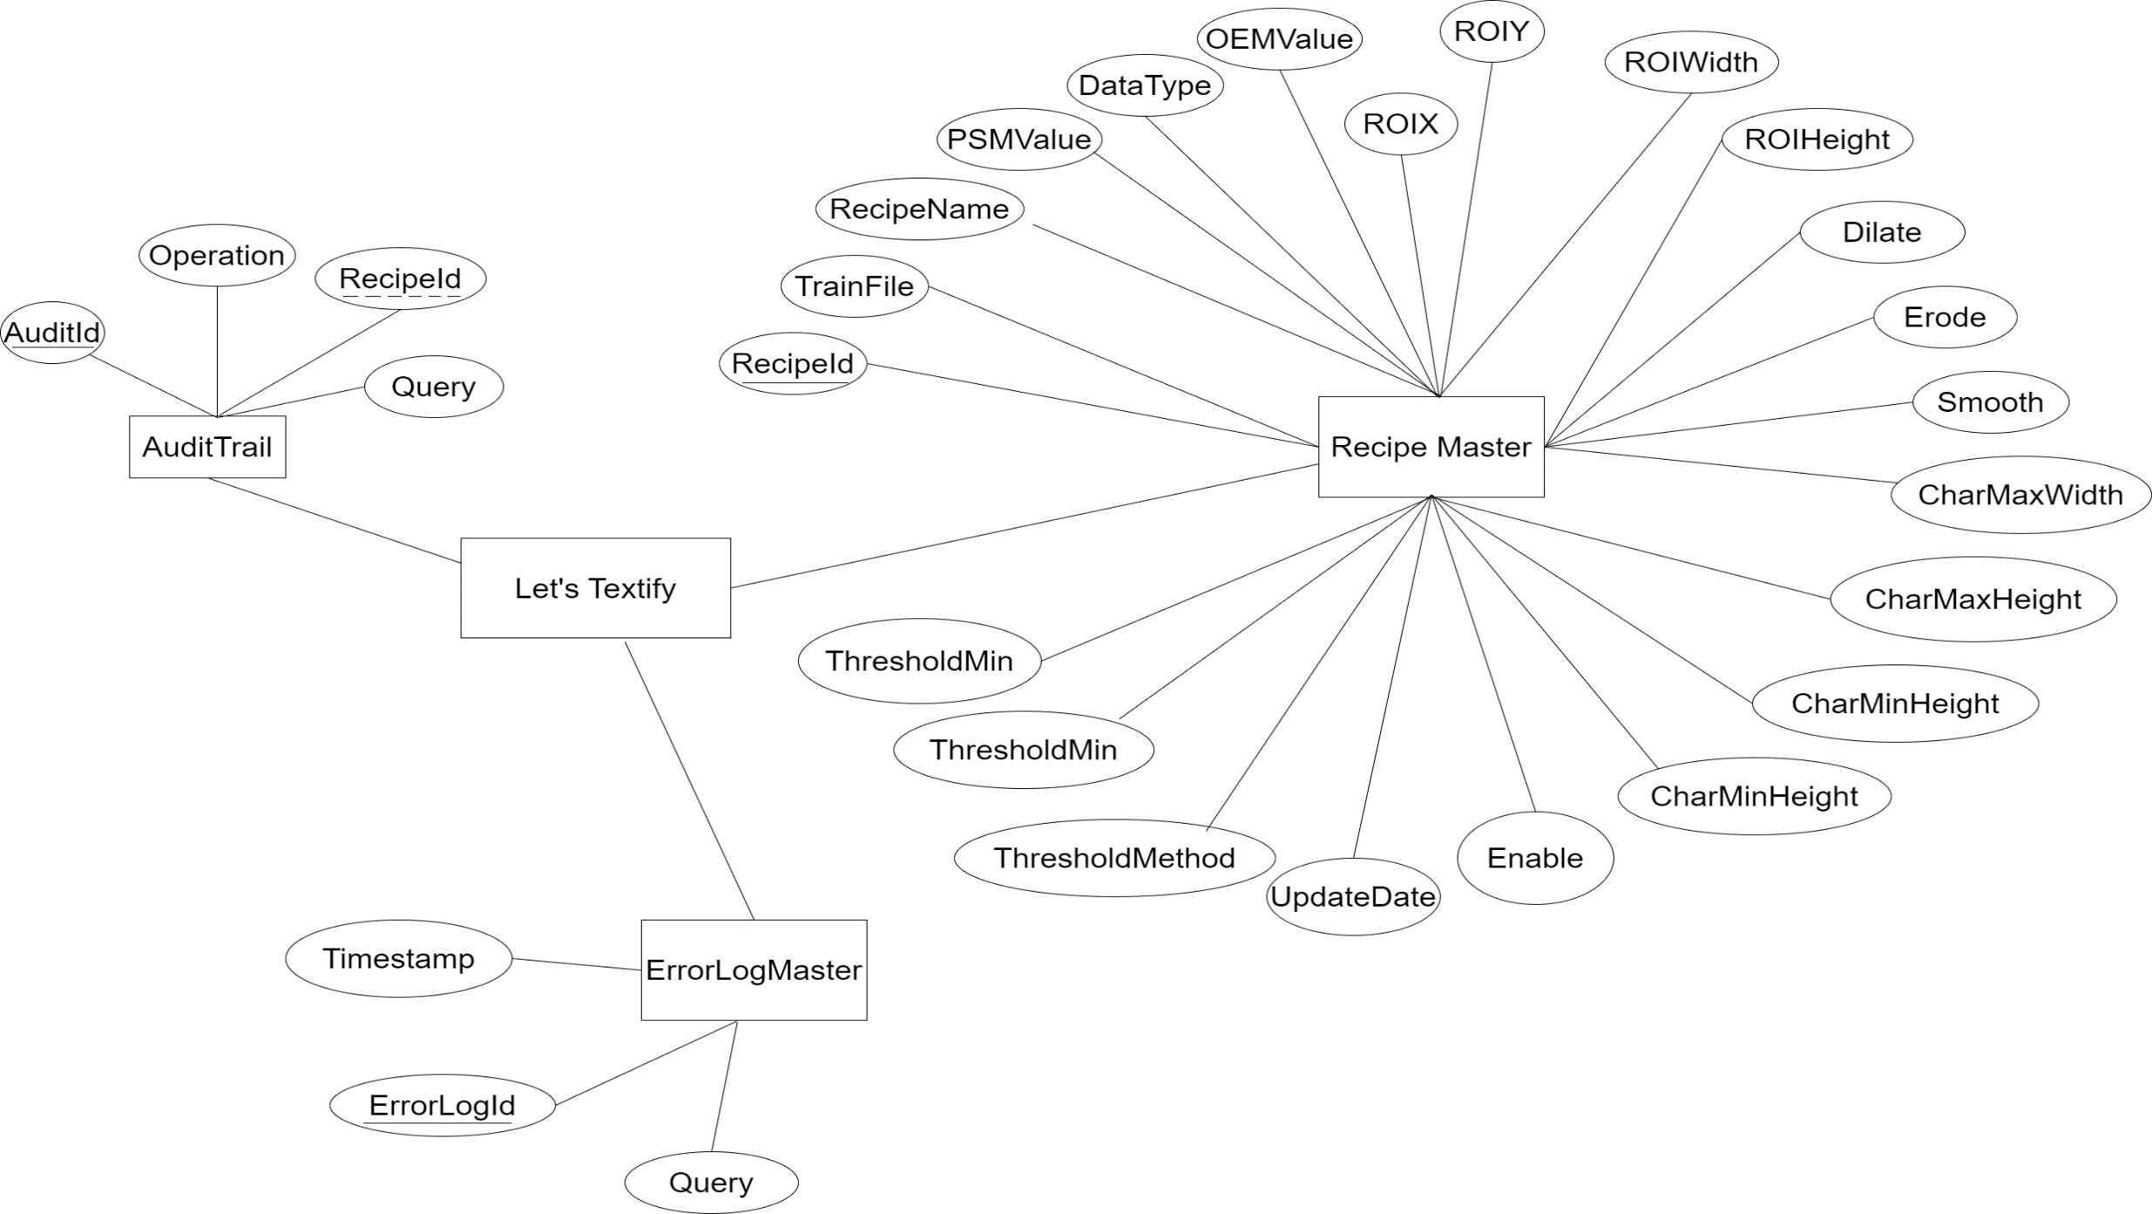
ER Diagram

Slide 20
From the next slide we are going to show the screenshots of the application that I have created.
Screenshots

Slide 21
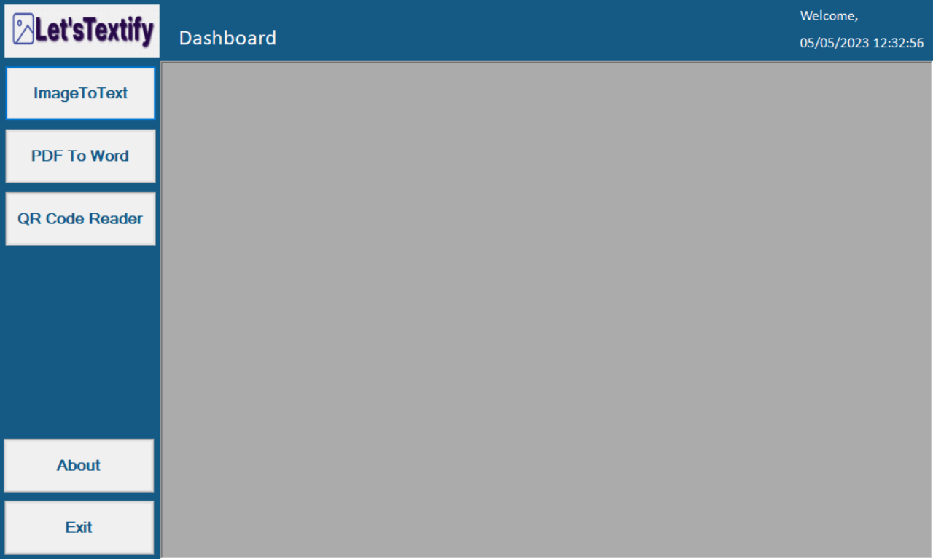
Dashboard

Slide 22
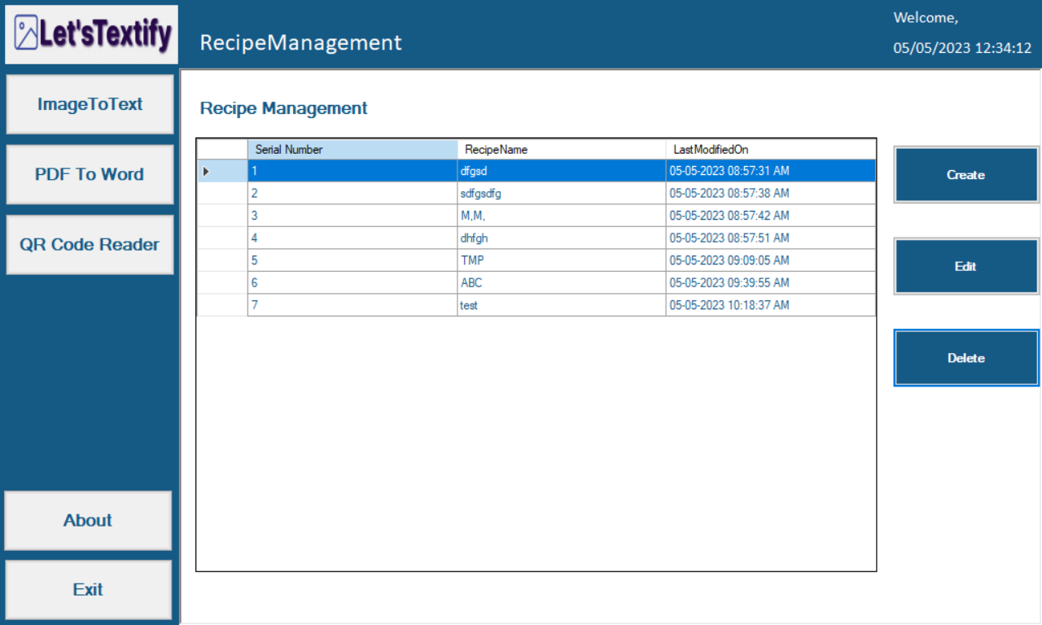
Recipe Management

Slide 23
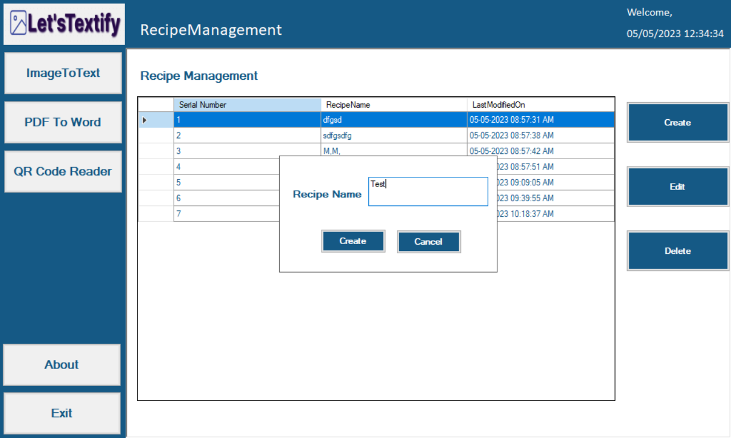
Create Recipe

Slide 24
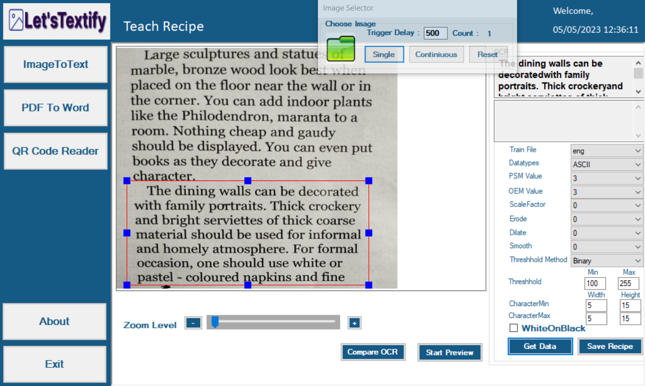
Teach Recipe

Slide 25
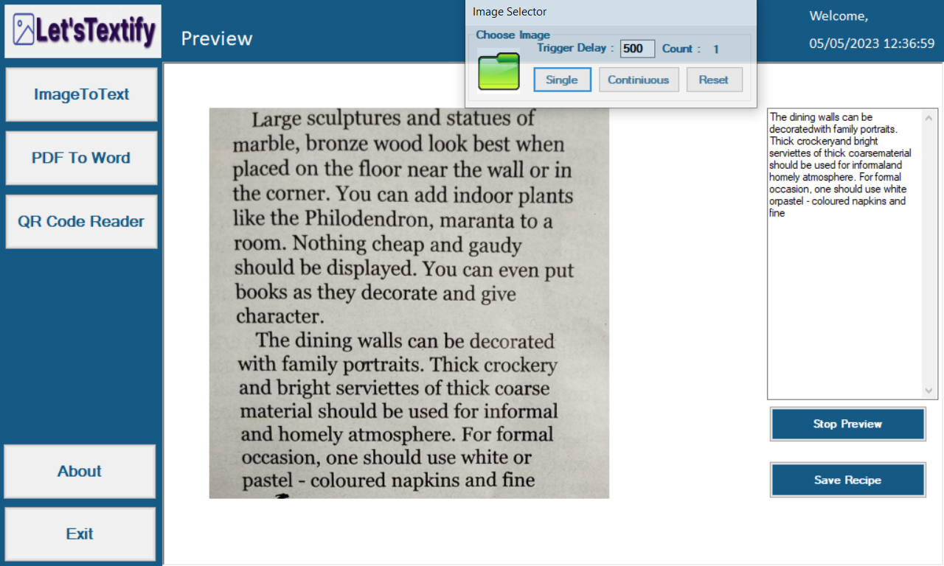
Preview

Slide 26
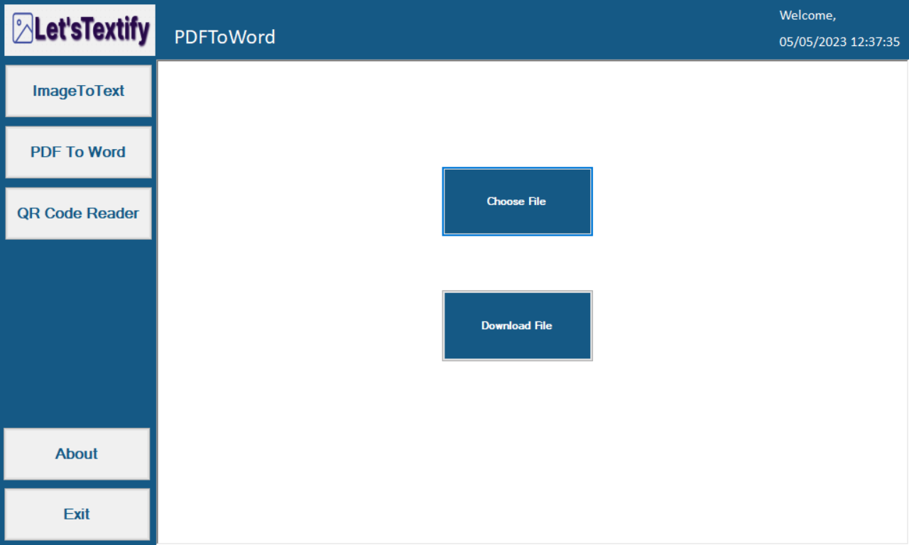
PDF To Word

Slide 27
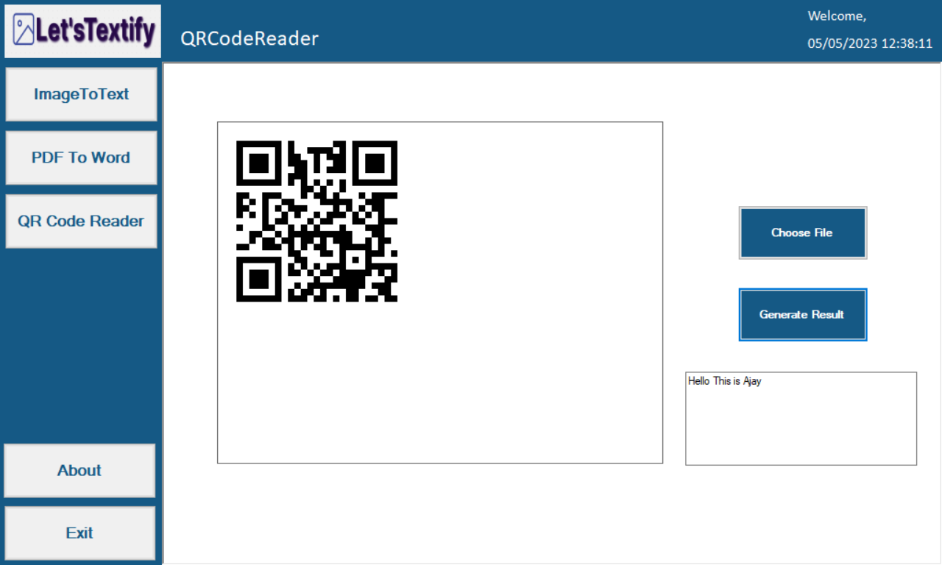
QR Code Reader

Slide 28
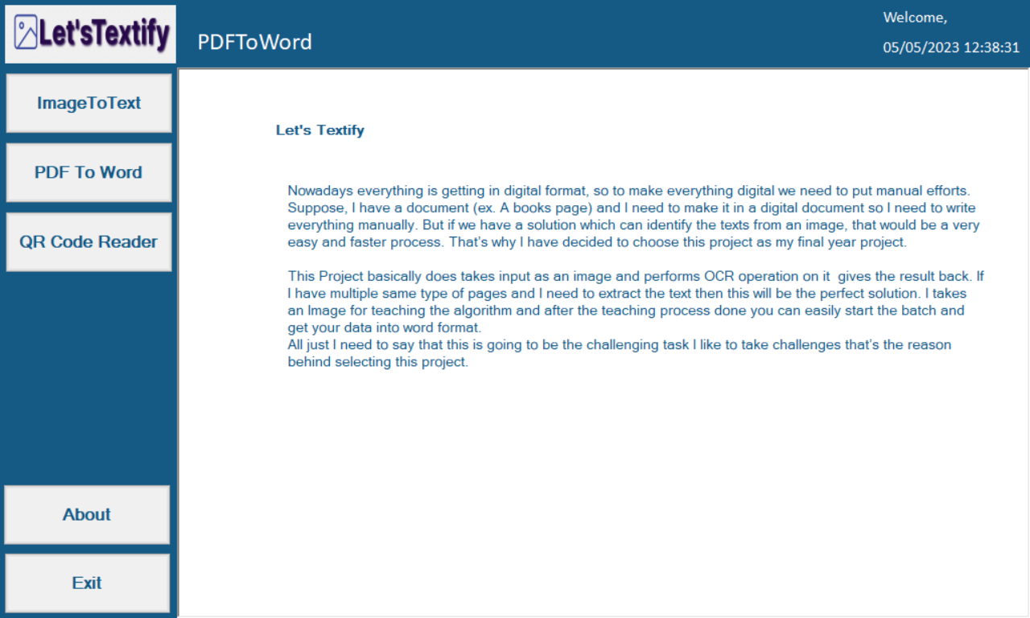
About

Slide 29
Conclusion
Image enhancement is fundamentally enlightening the interpretability or awareness of information in images for human listeners and providing better input for other automatic image processing systems.
OCR processing is a powerful tool for preparation of expert knowledge and the combination of inaccurate information from different sources.
The intended rules are an attractive result to improve the quality of edges as much as possible.

Slide 30
Thank You!

