Slide 1
Astrology Class 9
Murali Vadavalli
Sadguru Tapovana
12-Jun-2022

Slide 2
Sun
Key word: Power as personality
  What is our power / talent?
  What is our territory?
  What is the power we want?
  What do we want to do with it?
  How does power develop?
    Environmental influences
    Nature vs Nurture
    Parents and family
    Individuality
The influence we have or want to have over environment

Slide 3
Sun
Father
Parents and Family
Home/social life centered on you
Ambitions
Confidence and Ego
Egotists, Domineering people
  Ego is like a black-hole e.g. Narcissism
Craving for importance
  We want the world to revolve around us
Power struggles - everywhere

Slide 4
Sun
Influential people
Our bosses; we as bosses
We nurture ego: crave for importance
Power is a major addiction
  Stories of rakshasas
Power makes us insensitive
Ego refuses to budge and change
  E.g. Ravana, Duryodhana

Slide 5
Sun
Without a strong Sun, success is not possible
It tells how bright or influential our life is
Health
Remedy
  External control
  Observe, be conscious of, examine
  What is the source of this?

Slide 6
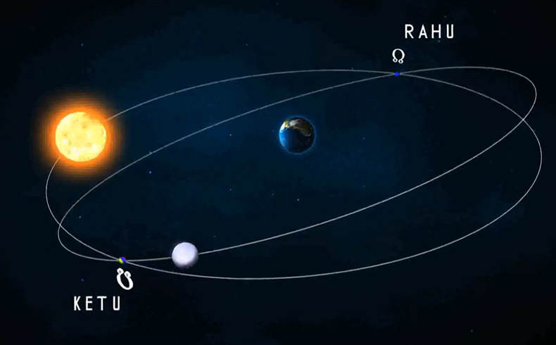
Moon’s Nodes – Rahu and Ketu

Slide 7
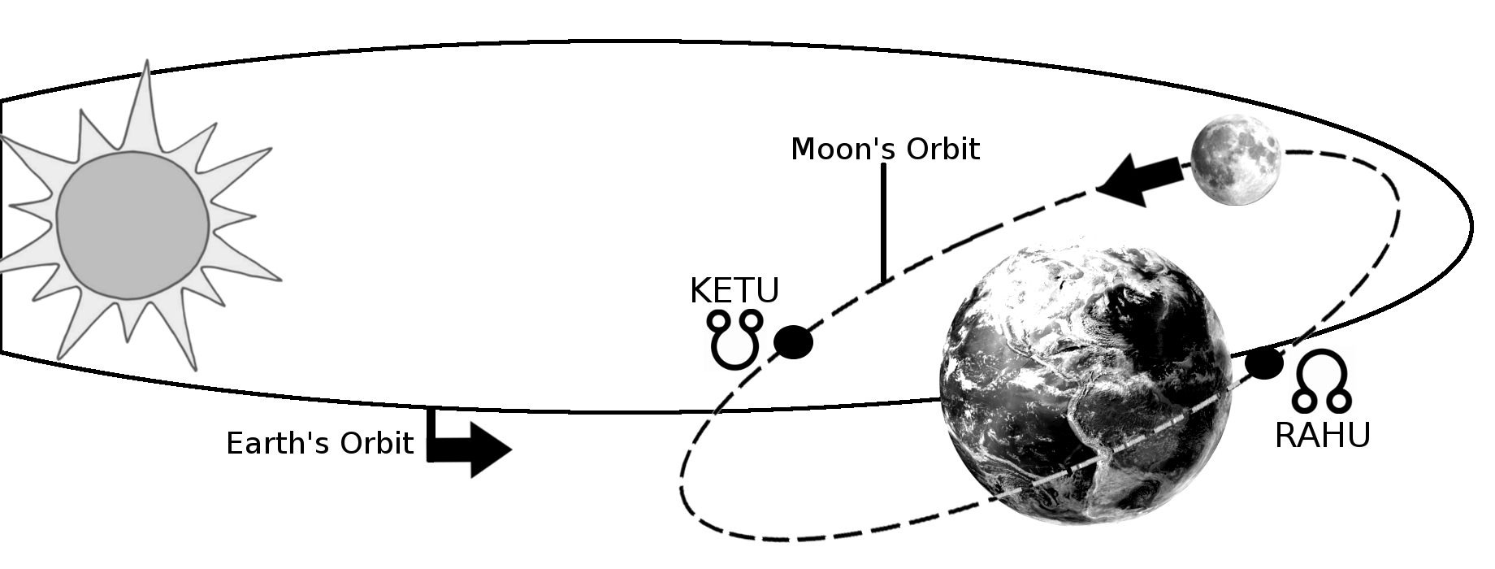
Moon’s Nodes – Rahu and Ketu

Slide 8
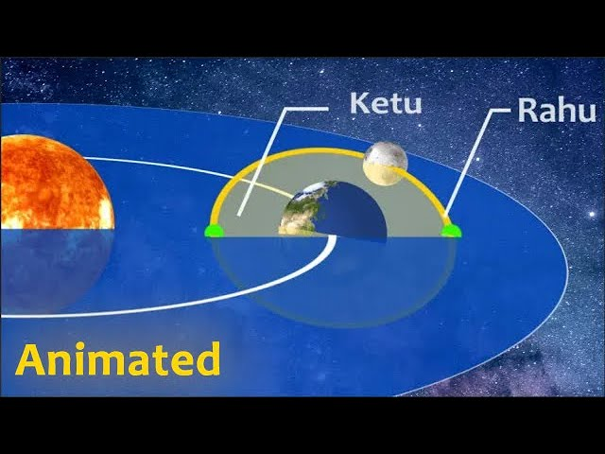
Moon’s Nodes – Rahu and Ketu

Slide 9
Rahu & Ketu
Shadowy – unclear, not-fully formed, confusing situations
Rahu – the holding energy
Ketu – the releasing energy
Sanivad rAhu, kujavat kEtu
No independent nature; reflect the nature of the sign ruler
Lot of different interpretations
Residual karma

Slide 10
Rahu & Ketu
Occult interests, weird beliefs
Weird experiences
Psychological / psychiatric issues; inner fears
Not normal
Example experience; people
Ketu – losses
Rahu – efforts to gain

Slide 11
Rahu & Ketu
Very prominent in Indian Astrology
Sarpa doshas
Kala sarpa yoga

Slide 12
Exercise
Study the characteristics / kArakatvAs in standard texts
Study what body parts and health aspects ruled by these planets
Study the spiritual lectures on these planets
9thhouse.org

