Slide 1
Astrology Class 10.1
(9thhouse.org)
Murali Vadavalli
Sadguru Tapovana
19-Jun-2022
26-Jun-2022

Slide 2
Houses / bhAvas
House - What is our orientation to an energy – planet / sign?
  E.g. What is our orientation to a person?
  A life situation is nothing but an orientation
  The zodiac and planets are ‘personalized’ at our birth moment
bhAva – your personal meaning
  can be translated as orientation

Slide 3
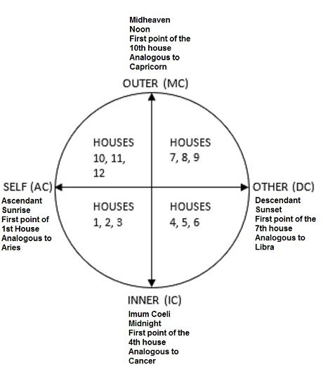
Houses – the 4 cardinal points

Slide 4
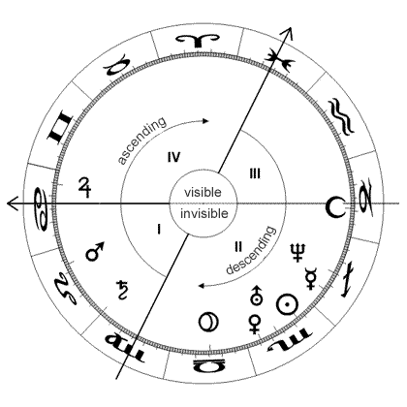
Houses – the 4 cardinal points

Slide 5
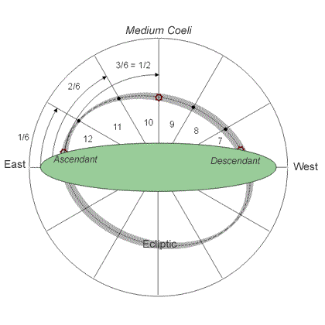
Houses – the 12 divisions

Slide 6
Houses – the 4 cardinal points
Ascendant / Lagna / AC
  The individual life / identity
7th house / DC
  The relations / public image
10th house or MC
  Social standing / career
4th house or IC
  Family / tribe
Roman letters are used to represent the houses.

Slide 7
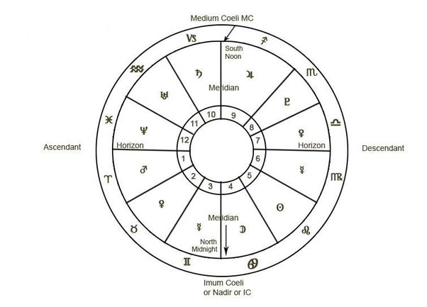
Houses – the 12 divisions

Slide 8
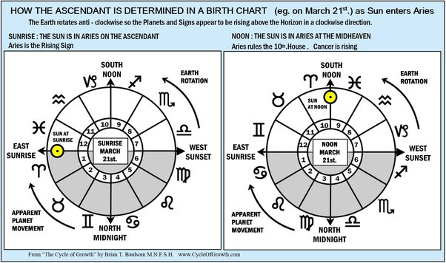
Houses – the rising signs

Slide 9
Casting the horoscope
Date of birth
Time of birth
Place of birth
They tell where the planets are in the zodiac
The houses – rising sign etc
Example casting using software

Slide 10
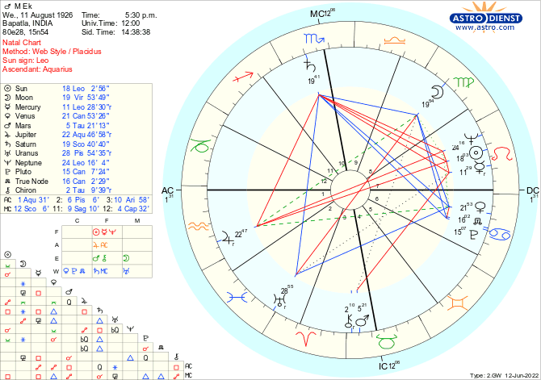
The Western Style Horoscope
(astro.com)

Slide 11
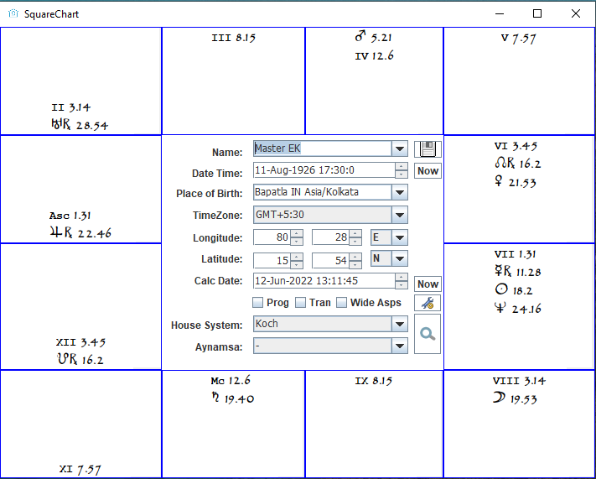
The South Indian Style Horoscope
(SquareChart - 9thhouse.org)

Slide 12
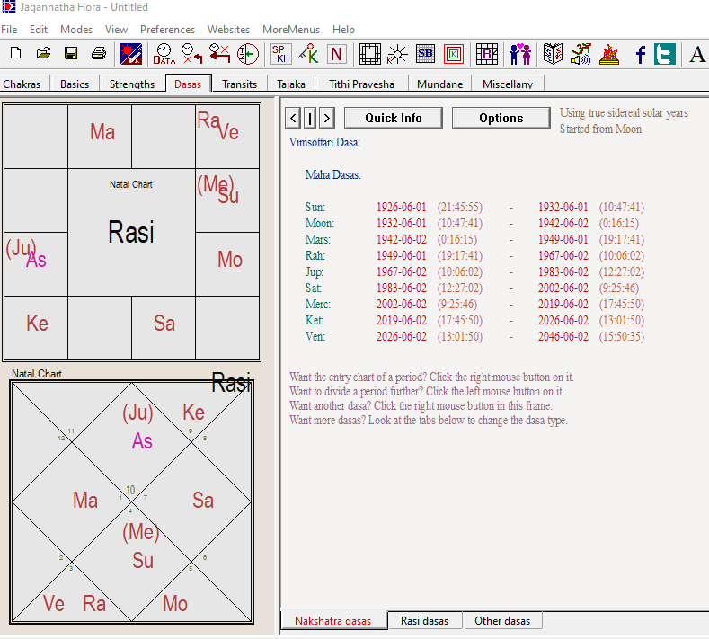
The Traditional Indian Style Horoscopes
(Jagannatha Hora - vedicastrologer.org)

Slide 13
House Divisions
Why houses are not 30 degrees in length?
Ecliptic systems: Equal, Porphyry
Space systems: Regiomontanus, Campanus
Time systems: Placidus, Koch
I use Koch: Demo using software
Ref:
https://www.uraniatrust.org/astrology/astronomy-of-houses

Slide 14
House Divisions
What exactly is a house in the horoscope?
Cusp vs space
1 sign = 1 house?
What is my understanding?
  Cusp = a degree = house
  Cusp has an orb – 6 degrees
  The sign containing the cusp = house
  Examples using horoscopes

Slide 15
Meanings of Houses
Lagna / Asc: Body, health, the environment you choose, your individuality, what defines you?
5th house: Children, people under your influence and protection, pets
9th house: Gurus, elders, people who influence you, spirituality, higher thoughts, research

Slide 16
Meanings of Houses
10th house / MC: Job, career, social status. What are you in the society?
2nd house: Finances, properties, businesses.
6th house: People who you have to serve, obligations, responsibilities, debts.

Slide 17
Meanings of Houses
7th house: Relationships, marriage, spouse, public relations, public image.
11th house: Social circle, friends, community strength.
3rd house: general knowledge, intellectual pursuits, communication, media (relatives – brothers)

Slide 18
Meanings of Houses
4th house: Family, your tribe, home-life, comforts (sukha-sthana)
8th house: Scandals, the forces operating against you, death, harms, enemies, obstacles.
12rd house: expenditure, giving-up, suffering, confinement, with-drawl, limitation.

Slide 19
Meanings of Houses
Traditional astrology has so many classifications and different ways of assigning meanings to houses.
1, 4, 7, 10 – our active life
6, 8, 12 – Bad-luck and dangers. Dusthanas.
2, 11 – houses of gains.
3, 9 – houses of intellect.

Slide 20
Exercise
Cast horoscopes
Study what planets are in what signs and houses
Try to derive meanings
The square chart software: 9thhouse.org

