Slide 1
Astrology Class 2
Murali Vadavalli
Sadguru Tapovana
06-Mar-2022

Slide 2
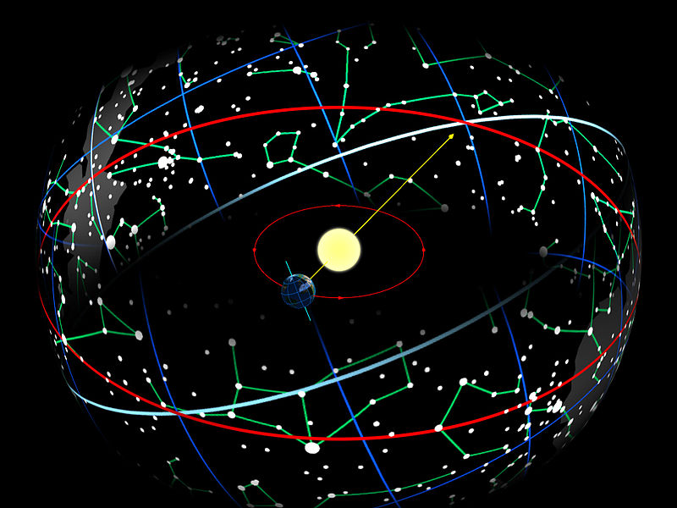
What is Zodiac?

Slide 3
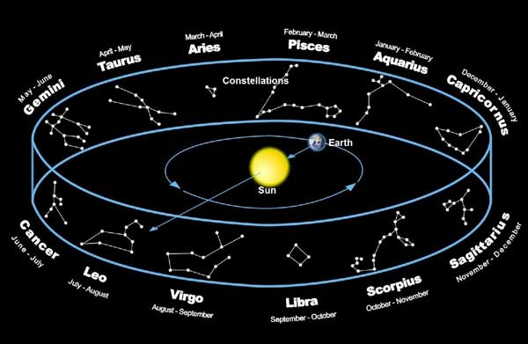
What is Zodiac?

Slide 4
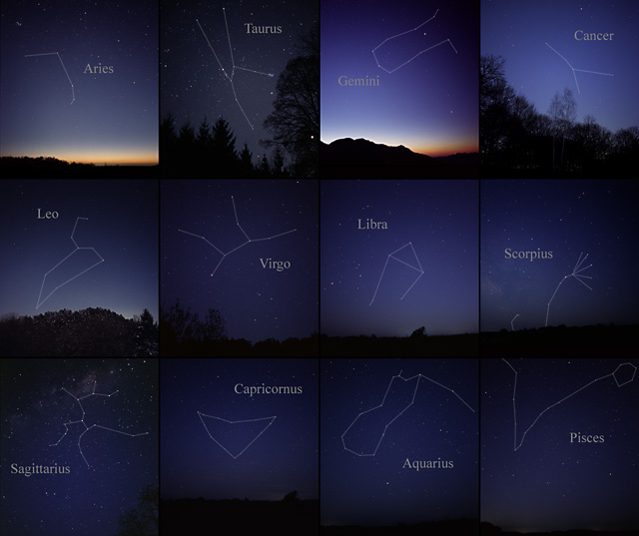
Zodiacal Division – 12 Signs

Slide 5
Zodiacal Signs
Aries, Taurus, Gemini, Cancer, Leo, Virgo
Libra, Scorpio, Sagittarius, Capricorn, Aquarius, Pisces
  What are the Sanskrit names?
  What are their symbols?
  What are Sun Signs?

Slide 6
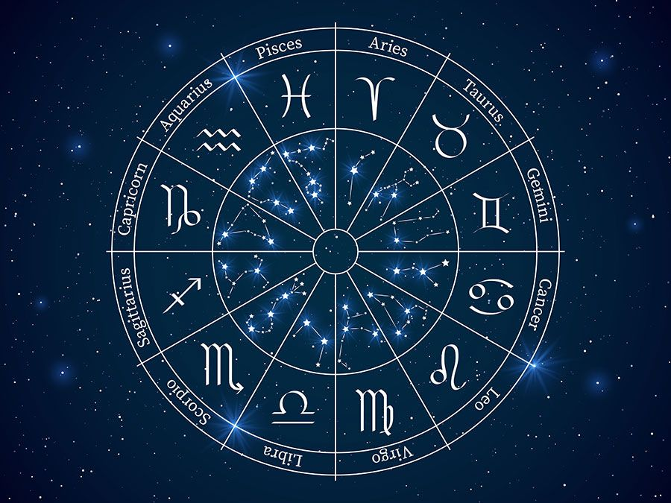
Zodiacal Signs

Slide 7
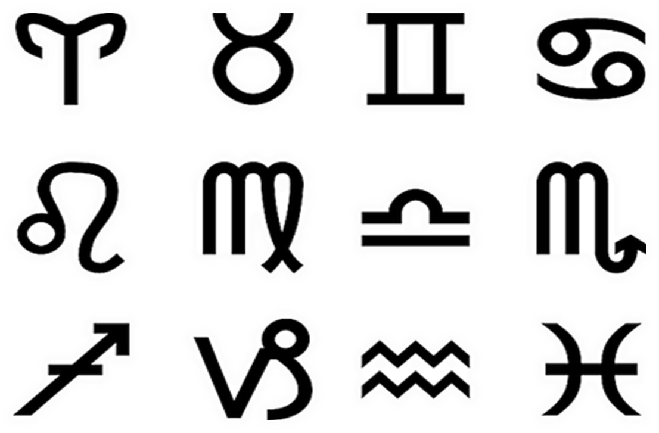
Symbols of the Signs

Slide 8
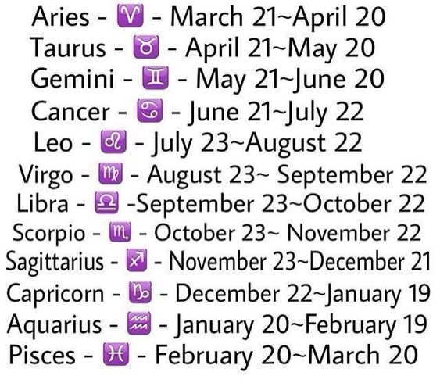
Sun Signs and Dates

Slide 9
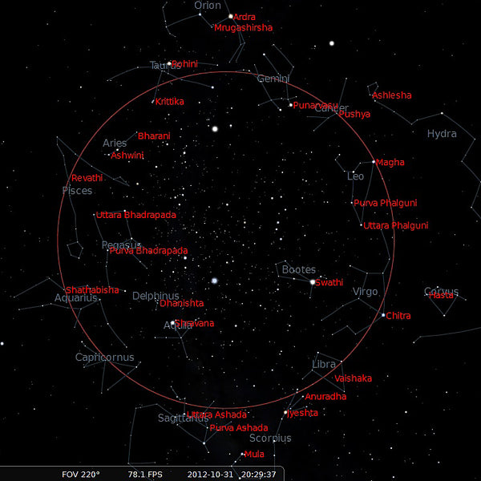
Zodiacal Division - 27 Nakshatras

Slide 10
Nakshatra Names
Aswini | Makha | Mula
Bharani | Purva Phalguni | Purva Ashadha
Kruttika | Uttara Phalguni | Uttara Ashadha
Rohini | Hasta | Sravana
Mrigasira | Chitra | Dhanishta
Ardra | Swati | Satabhisha
Punarvasu | Visakha | Purvabhadra
Pushyami | Jyeshtha | Uttarabhadra
Ashelsha | Anuradha | Revati

Slide 11
Constellations Vs Arcs
Signs are solar mansions, Nakshatras are lunar mansions
Signs as Constellations vs 30 degree divisions / arcs of the Zodiac
Nakshatras as constellations vs 13⁰20’ divisions of the Zodiac.

Slide 12
Fixed vs Tropical Zodiac
  Fixed Zodiac or the Nirayana or Indian System
    Starting from a fixed star – chitra
  Tropical or yearly zodiac or Sayana or Western system
    Starting from Vernal Equinox
  Ayanamsa

Slide 13
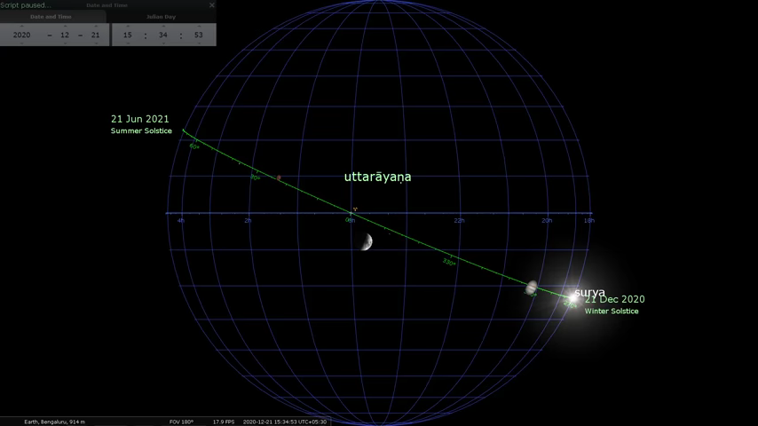
Uttara and Dakshina Ayanas

Slide 14
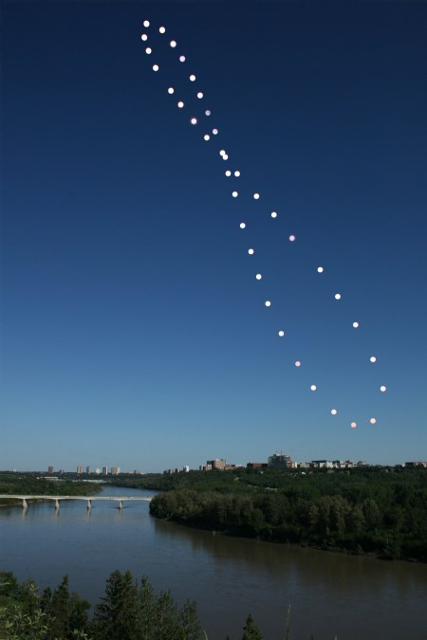
Ayanas and Equinoxes

Slide 15
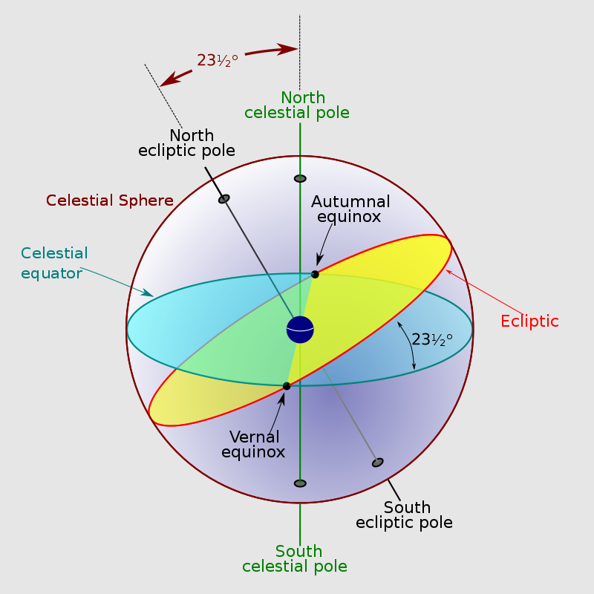
Equinoxes

Slide 16
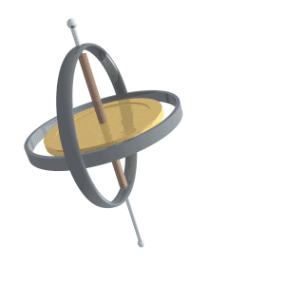
Precession of the equinoxes

Slide 17

Precession of the equinoxes

Slide 18
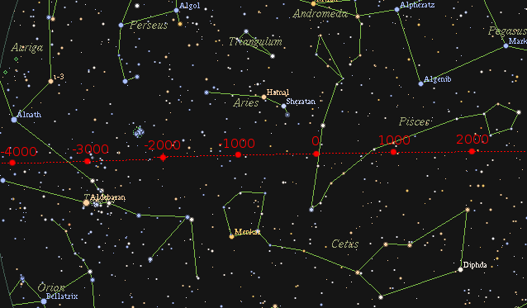
Precession of the equinoxes

Slide 19
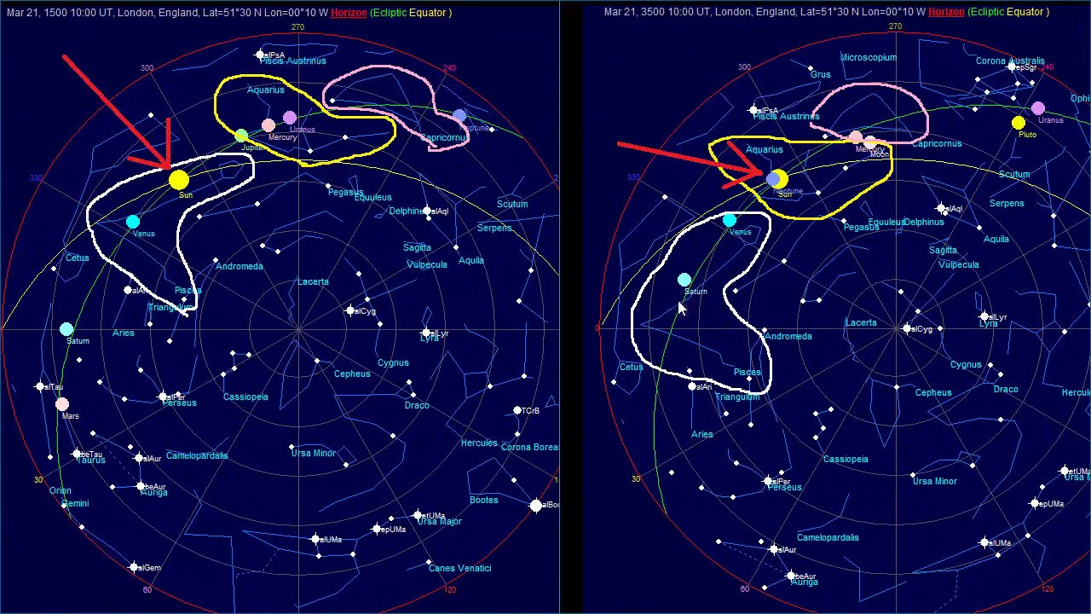
The Aquarian Age

Slide 20
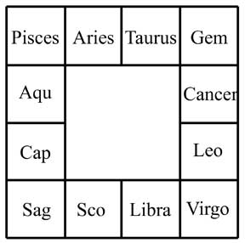
Zodiac as the Horoscope

Slide 21
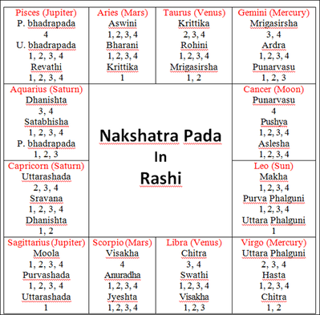
Nakshatras and the Signs

Slide 22

Identify the Signs

