Slide 1
Astrology Class 3
Murali Vadavalli
Sadguru Tapovana
13-Mar-2022

Slide 2
Classification of Zodiacal Signs
Many classifications exist. E.g. masculine - feminine, human - bestial, fruitful – barren etc.
Two classifications are important
  Triplicities
  Quadruplicities

Slide 3
Triplicities
The three energies of our being viz. Rajas, Tamas and Sattva
Action, Stability and Flexibility
Cardinal or Movable – chara
  Aries, Cancer, Libra, Capricorn
Fixed – sthira
  Taurus, Leo, Scorpio, Aquarius
Mutable – dwi-svabhava
  Gemini, Virgo, Sagittarius, Pisces

Slide 4
Quadruplicities
The four qualities of our being viz.
  Domain of the Self / Identity – Fire
    Individual freedom / authority, Environment, Interests, Children, Influence of elders
    Aries, Leo, Sagittarius
  Emotional life – Water
    Family bonds, desires, inner emotional life
    Cancer, Scorpio, Pisces
  Social life – Air
    Public image, partners, friends, social awareness
    Libra, Aquarius, Gemini
  Domain of the Resources – Earth
    Job / career, Finances, debts and responsibilities
    Capricorn, Taurus, Virgo

Slide 5
The Twelve Signs as 3 * 4
4 * 3 = 12
The twelve signs are a combination of triplicities and quadruplicities.
The whole idea is - How we operate with three energies in four areas
This concept is more important for Houses

Slide 6
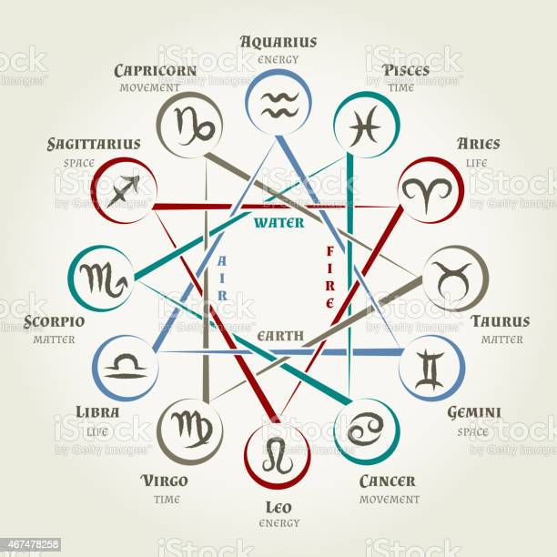
The Twelve Signs as 3 * 4

Slide 7
Signs Vs Houses
Signs are like the 12 departments in any organization – government or private.
  E.g. Administrative, marketing, production, media, accounts, etc.
Houses are similar departments or areas in an individual’s life.
  E.g. individual influence, marriage, children, job, responsibilities etc.

Slide 8
Sign Rulerships
Aries, Scorpio – Mars
Taurus, Libra – Venus
Gemini, Virgo – Mercury
Sagittarius, Pisces – Jupiter
Capricorn, Aquarius – Saturn
Aquarius – Uranus
Pisces – Neptune
Leo – Sun
Cancer - Moon
Opposite signs are called Detrimental
Sva-kshEtra and satru-kshEtra

Slide 9
Exaltations and Debilitations
Uccha / Neecha
Aries – Sun
Taurus – Moon
Cancer – Jupiter
Virgo – Mercury
Libra – Saturn
Capricorn – Mars
Pisces – Venus

Slide 10
Exaltations and Debilitations
Exaltation means the natures of the sign and the planet are in excellent harmony.
Opposite is the case for Debilitations.
These are very important in Traditional Astrology. Exaltation degrees etc.
  (My Scorpio Moon example; classification of horoscopes as class A, B, C etc)
Master EK’s analysis of King Raghu’s horoscope
Sri Rama’s horoscope

Slide 11
What does a sign actually mean?
The concept of Karakatva in traditional astrology.
A sign indicates a certain principle operating in the environment. Sometimes, a very specific area outside. Examples.
Your horoscope shows how you are connected to that principle.

Slide 12
Key words for signs
Develop an idea first. Be flexible to modify it later. Upanishadic story.
Aries – Power principle
Taurus – Comforts
Gemini – Intellect – language
Cancer – Family bond
Leo – leadership
Virgo – Intellect – numbers

Slide 13
Key words for signs
Libra – Art / public performance
Scorpio – The deeper layers, Sciences
Sagittarius – Religion, gurutva
Capricorn – concrete work e.g. civil engineering
Aquarius – Progress towards the modern
Pisces – The exotic and the spiritual

Slide 14
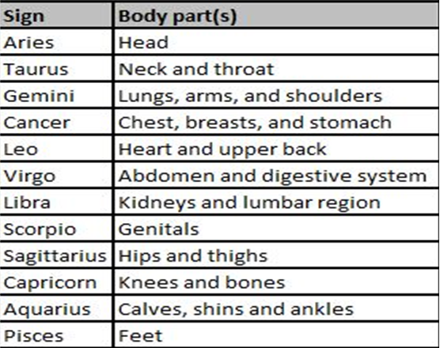
Signs and Body parts

Slide 15
Explore the signs
Lot of material. Read!
Linda Goodman, puTTina rOju for sun signs
Spiritual Astrology & Master KPK lectures
Medical astrology – Astro Diagnosis
In horoscope Analysis -
  Signs help establish the relation between planets and houses
  Difficult to identify the effect of signs themselves

Slide 16

Exercise
State the features of each sign we discussed

