Slide 1
Astrology Class 4
Murali Vadavalli
Sadguru Tapovana
27-Mar-2022

Slide 2
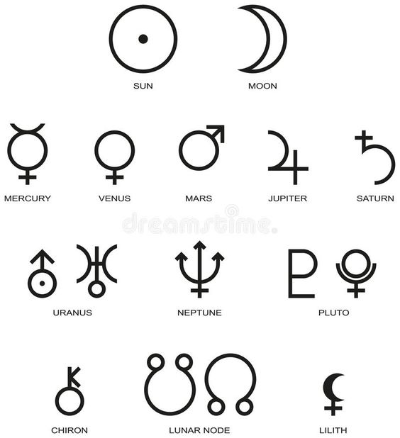
Planets and Symbols

Slide 3
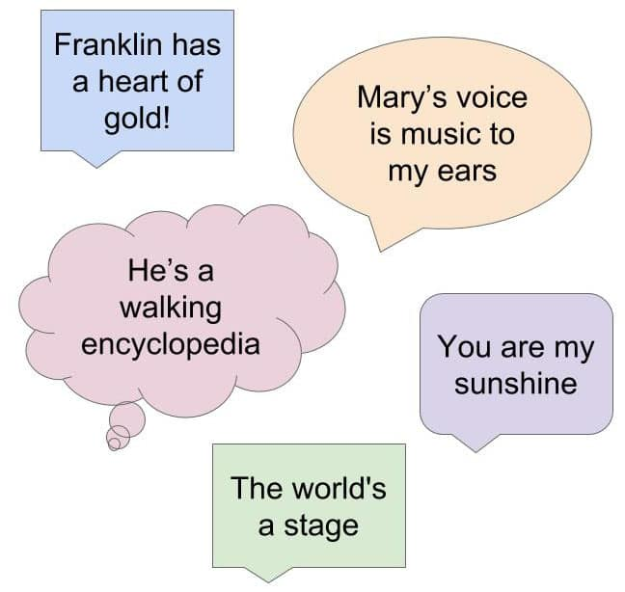
Planetary Characteristics
kArakatvas – things ruled by a planet
Planets are our fundamental life energies
One keyword / Metaphor for one planet
Metaphors

Slide 4
Mars
Metaphor: Engine
  Energy
  Drive
  Speed
  Hot
  Noisy emissions
Life situations you have to drive

Slide 5
Mars
The Animal Energy
  Self preservation
  Territorial (for the ego)
  Capacity for hard work
  Physical strength
  Aggression
  Arrogance, teenage behavior
  Cruel, rowdy, anti-social behavior

Slide 6
Mars
The drive as a positive trait
    Dealing with physical situations
    Driving any project or organization
    Facing tough situations
    Achieving goals
    Utsaaha and courage
    Risk taking
    Some Famous examples
      Napoleon, Elon Musk
    Sports, Military, Police, Doctors, Engineers

Slide 7
Mars
Negative traits and problems – Engine run by a bad a driver
    Fights, wars, murders, gangs
    Accidents, injuries, cuts
    Cruelty, brutality – give / take
    Surgeries
    Pain – physical and mental
  Miscellaneous
    Bad language, sarcasm
    Bad environment
    Low level work
  Remedy: External control and training

Slide 8
Judging a Planetary Energy
The Energy as a Spectrum
  Good - bad qualities
  Beneficial – malefic
  Strong – weak
  Activation of a planet
  Strength: Environment vs Individual energy

Slide 9
Exercise
Study the characteristics / kArakatvAs in standard texts
Study what body parts and health aspects ruled by these planets
Study the spiritual lectures on these planets

