Slide 1
Astrology Class 5
Murali Vadavalli
Sadguru Tapovana
03-Apr-2022

Slide 2
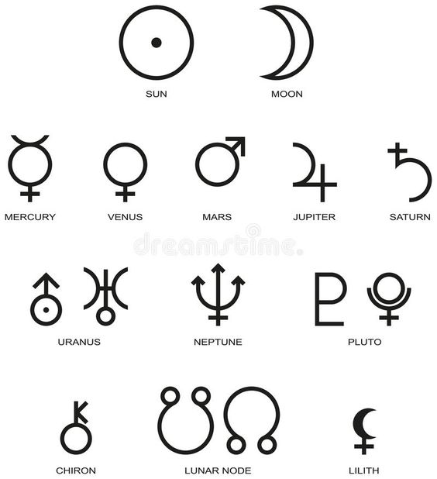
Planets and Symbols

Slide 3
Sanskrit Names of Planets
ravi, sUrya, Aditya
chandra, sOma, indu
kuja, mangala, bhauma
budha, saumya
Guru, bruhaspati
Sukra
Sani, SanaiSchara, manda
rAhu
kEtu

Slide 4
Saturn
Metaphor: Engineer
  Everything in life is a structure
  To build a structure, you need / learn
    Discipline
    Patience
    Failures
    Shortcomings
    Limitations
Saturn is the life situations you have to build

Slide 5
Saturn
Shows the life program to build new or handle broken structures
  Responsibilities in life
The positive traits
  Process, method
  Fundamentals, foundation
  Patient hard work
  No short-cuts
  Task master
  Diligence: minutest details (e.g. space travel)
  Set in a framework, unforgiving
    Sankara Sastry

Slide 6
Saturn
Negative traits and problems – Clueless engineer to fix a broken structure
  Program becomes training and suffering
  Misfortune, bad luck, limitation, loss, failure, getting exploited, servitude
  Structural collapses as fundamentals are lacking e.g. financial discipline
  Closed mind, Inflexible
  Overly critical. Impossible to please.
  Cannot accept or adjust to change

Slide 7
Saturn
Negative traits and problems contd..
  Lack of recognition or reward
  Choosing the hard path
  Chronic illnesses
  Putting the body to pain and torture
  Chronic illnesses
  Gullible / Loyal
  Early death or loss of parents

Slide 8
Saturn
Negative traits and problems contd..
  Pessimism, Depression, Withdrawal, Lethargy
  Ignorance, Frustration, Cynicism
  Fear, Worry, Tension, Hesitation
  Stuck in old structures
    Old customs
    Bosses vs subordinates
  Broken structures like chronic ill-health or handicaps
  Extreme bad-luck - examples

Slide 9
Saturn
Remedy
  Accept external help – requires trust
  Open mind
    try / learn new things
  Recognize the blessings in life
  Accept the program
    Why me vs Why not me?
  Let go of control
  Be kind, don’t ‘exact due service’

Slide 10
Exercise
Study the characteristics / kArakatvAs in standard texts
Study what body parts and health aspects ruled by these planets
Study the spiritual lectures on these planets

