Slide 1
Astrology Class 12
(9thhouse.org)
Murali Vadavalli
Sadguru Tapovana
10-Jul-2022

Slide 2
Aspects
Aspect – a flow of energy, a relation between planetary energies
  You want to do something, achieve a goal
  The journey begins, energies are focused, an event unfolds.
  It reaches a climax and something manifests.
  Examples: execution of a project, building a house, undergoing a surgery, marriage

Slide 3
Aspects
  Without an aspect, an energy is static. Example: Good Saturn, but what is it achieving in life?
  Natal aspects -
    Establish relations between various planets
    Indicate dynamic energies of the person
    Without strong aspects, the person has no ‘Rajas’ of Dynamism.
  Progressed Aspects -
    Specific manifestations at various times in life - Events

Slide 4
Aspects
Aspect – an angle between planets
  0 degrees: conjunction
  180 degrees: opposition
  120 degrees: trine
  90 degrees: square
  60 degrees: sextile
  These are called major aspects.
  Minor aspects: semi-sextile (30), Quincunx (150), Quintile (72), BiQuintile (144) etc

Slide 5
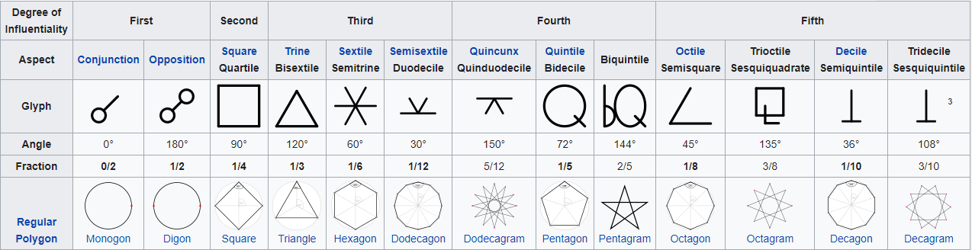

Aspects

Slide 6
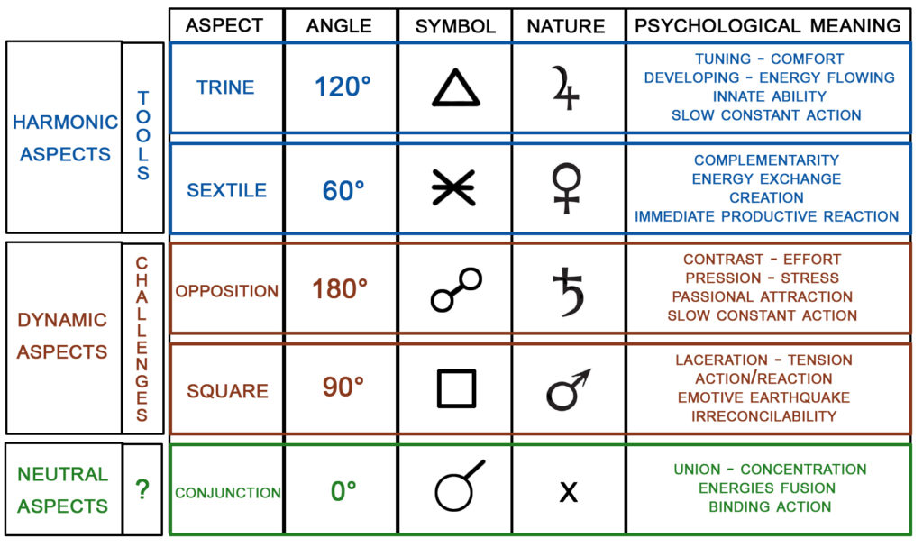
Aspects

Slide 7
Aspects
I consider only Major aspects
People give too much importance to harmonious (Trine, Sextile) vs discordant (Opposition, Square) aspects - I don’t.
An aspect in itself is important – it is energy in action – which is better than no aspect– i.e. not doing anything.
  Good or bad does not come from squares / oppositions or trines / sextiles.
  They come from the houses.

Slide 8
Aspects
Aspects have orb of influence
  Some people consider 8 to 12 degrees of orb. I take only 6.
Aspect can be Approaching, Partile or Exact, or Leaving.
Approaching – effort is on
Partile – climax
Leaving – dealing with after effects
Closer the aspect, stronger the effect
Definitions of aspects are completely different in Traditional astrology

Slide 9
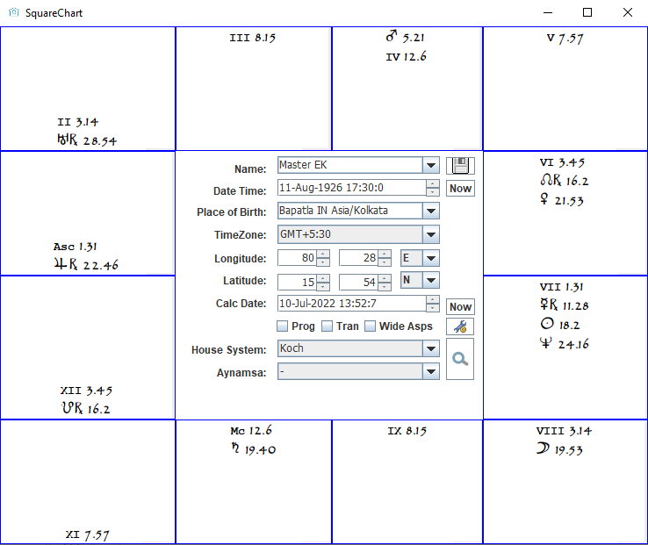
Identify Aspects

Slide 10
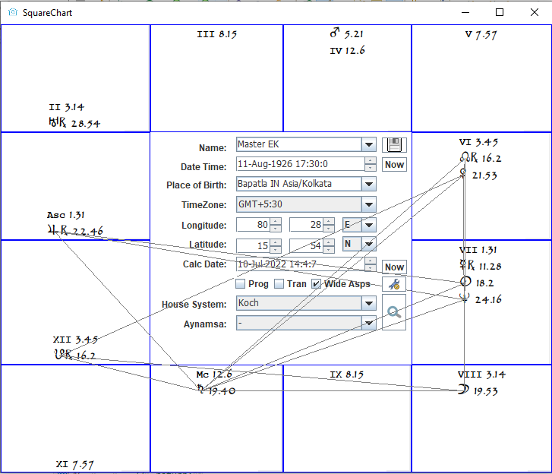
Identify Aspects

Slide 11
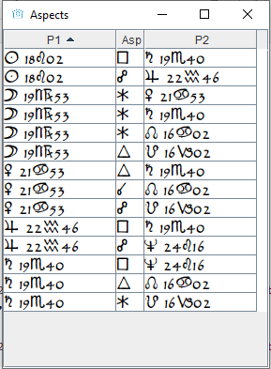
Identify Aspects

Slide 12
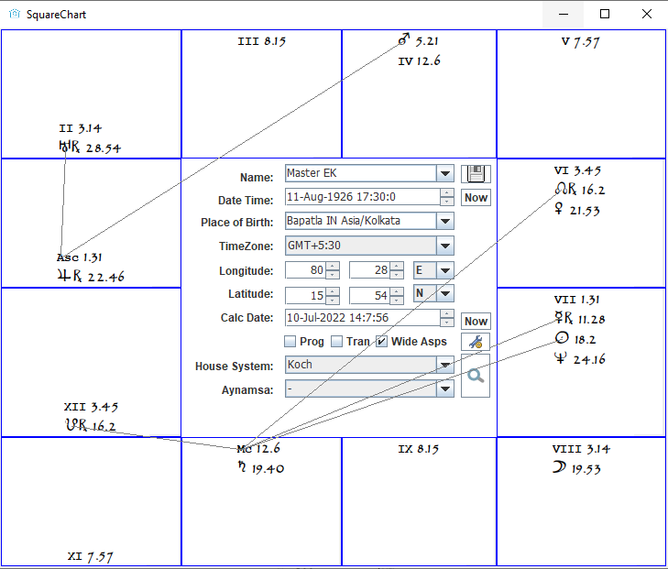
Identify Aspects
Some people consider aspects to house cusps – I do

Slide 13
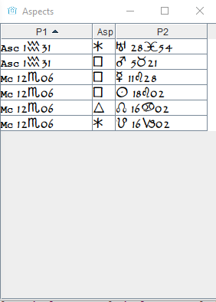
Identify Aspects
Some people consider aspects to house cusps – I do

Slide 14
Aspects – Some more
Mid points
  Mid way point between two planets
  Example: Sun 15 Aries, Moon 29 Virgo
  Difference between Sun and Moon Degrees = 164
  164 / 2 = 82
  Mid point = 15 Aries + 82 Degrees = 7 Cancer
  Therefore, Mid point of Sun and Moon = 7 Cancer
Aspects to Mid points
Parallel aspects – in traditional western astrology text books
Harmonics – big topic in Western Astrology

Slide 15
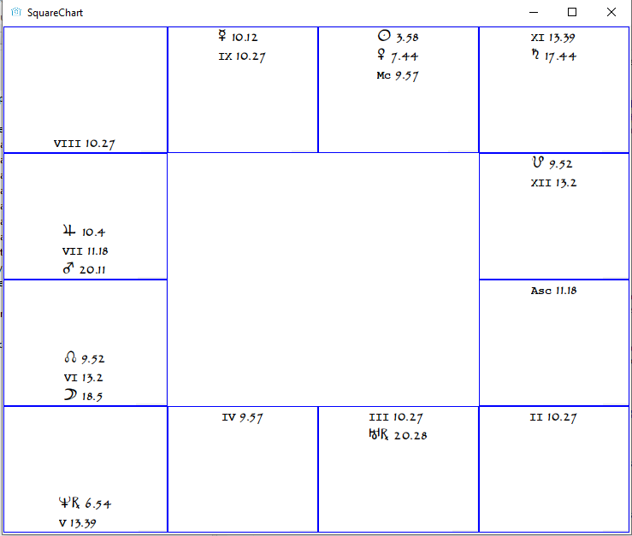
Example Horoscope 1

Slide 16
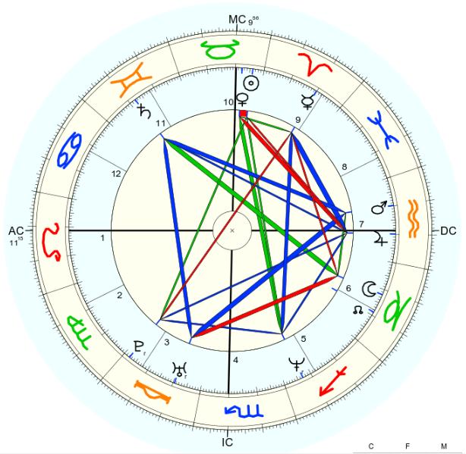
Example Horoscope 1

Slide 17
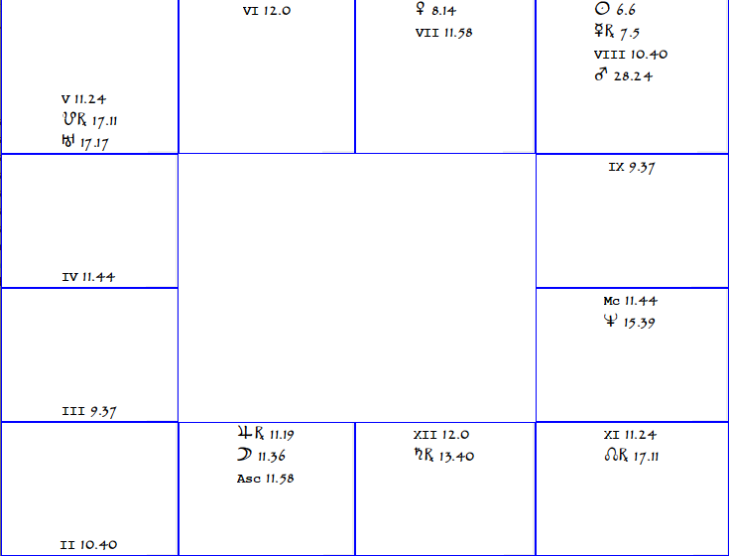
Example Horoscope 2

Slide 18
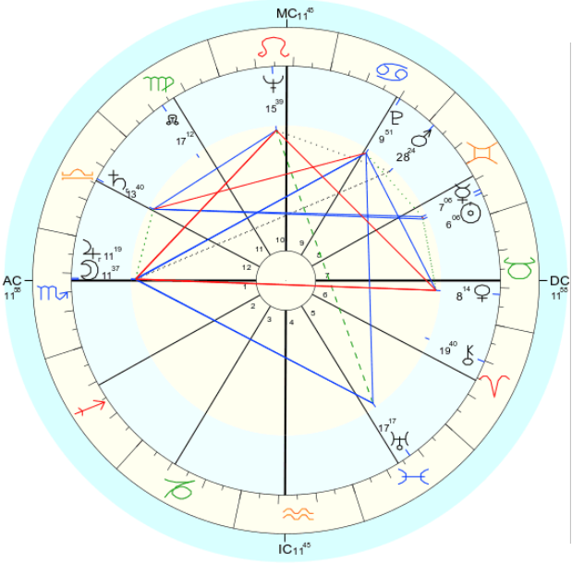
Example Horoscope 2

Slide 19
Exercise
Cast horoscopes
Study what planets are in what signs and houses
Identify aspects
Try to derive meanings

