Slide 1
Astrology Class 14
(9thhouse.org)
Murali Vadavalli
Sadguru Tapovana
7-Aug-2022

Slide 2
Life Trends
Life is not static; trends/waves
  School, College, Job, Promotions, etc
  Love, marriage, kids, building a house
  Problems, responsibilities, challenges
Natal horoscope shows the potentials
  Like a seed
Methods like Dasa systems, Progressions and Transits show the manifestation of the potentials in time
  Like the growth of a tree

Slide 3
Indian Dasa Systems
Each planet takes control of life for a certain period of time called Dasa
  Within each planetary period, sub-dasas of other planets will operate
  The trend of time in each dasa is determined by how the planet is disposed in the horoscope.
  Many Dasa systems exit. Primary one is called Vimosattari Dasa (120 years)
  KP system is largely based on this

Slide 4
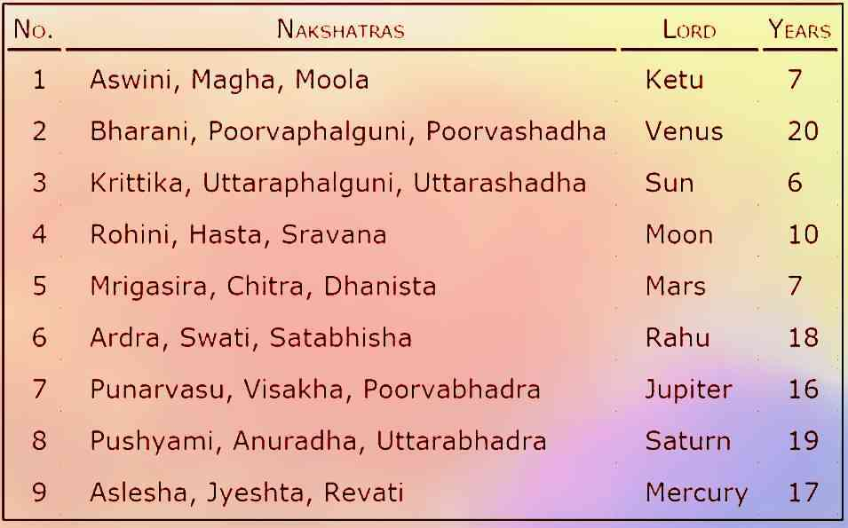
Vimsottari Dasa

Slide 5
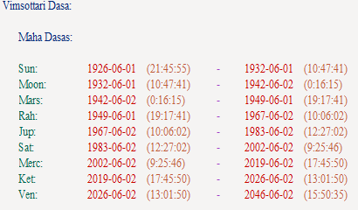
Vimsottari Dasa Example
Master EK: Nirayana Moon 27 Leo 05

Slide 6
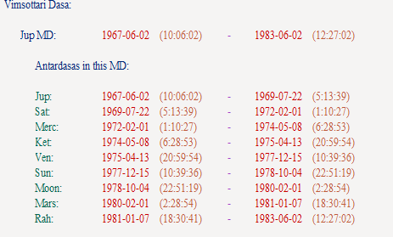
Vimsottari Dasa Example
Master EK: Nirayana Moon 27 Leo 05

Slide 7
Western Systems: Progression
Primary Directions (or Progression)
  Movement of the earth within 1st 6 hours of birth
  1 degree of movement = 1 year
Secondary Progression
  Movement of the planets each day after birth
    1 day = 1 year
Transit or gO-chAra
  Current movement of planets

Slide 8
So many varieties!
Progressions
  Secondary Progressed: 1 day = 1 year
  Tertiary Progressed: 1 day = 1 sidereal lunar month
  Minor Progressed: 1 sidereal lunar month = 1 tropical year
  Regressed: 1 day = -1 year
  Lunar Return Progressed: 1 sidereal lunar month = 1 year
  Embolismic Lunation Progressed: 1 synodic month = 1 year
  One degree of MC per year
  Solar Arc from MC

Slide 9
So many varieties!
Directions
  Primary Directed (natural): 1 degree of right ascension (RA) of the MC = 1 tropical year, or one sidereal day = 360 tropical years
  Primary Directed (classic) : uses oblique ascension to calculate angle between two planets1 year - describes a symbolic conformity between the daily rotation of the Earth
  Equatorial Directed
  Zodiacal Directed
  Solar Arc Directed – Equatorially or Zodically
  Solar Returns – Varsha phala
  Lunar Returns

Slide 10
So many varieties!
Directions
  Primary Directed (natural): 1 degree of right ascension (RA) of the MC = 1 tropical year, or one sidereal day = 360 tropical years
  Primary Directed (classic) : uses oblique ascension to calculate angle between two planets
  Equatorial Directed
  Zodiacal Directed
  Solar Arc Directed – Equatorially or Zodically
  Solar Returns – Varsha phala
  Lunar Returns

Slide 11
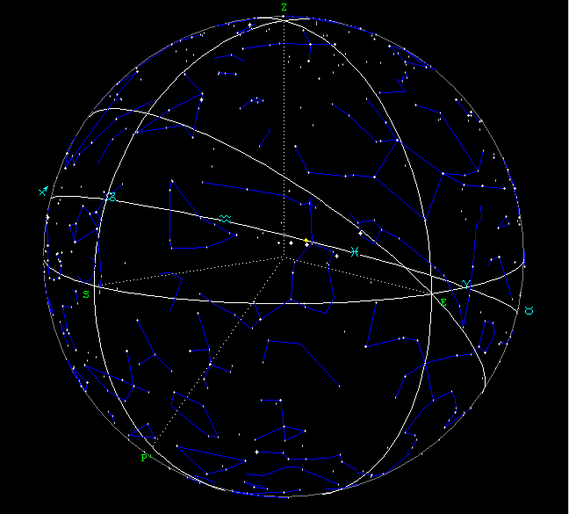
Primary Directions – A basic understanding

Slide 12
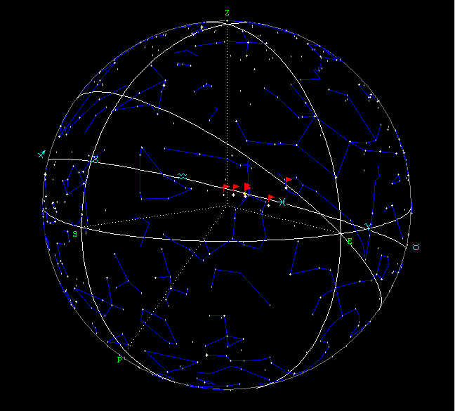
Primary Directions – A basic understanding

Slide 13
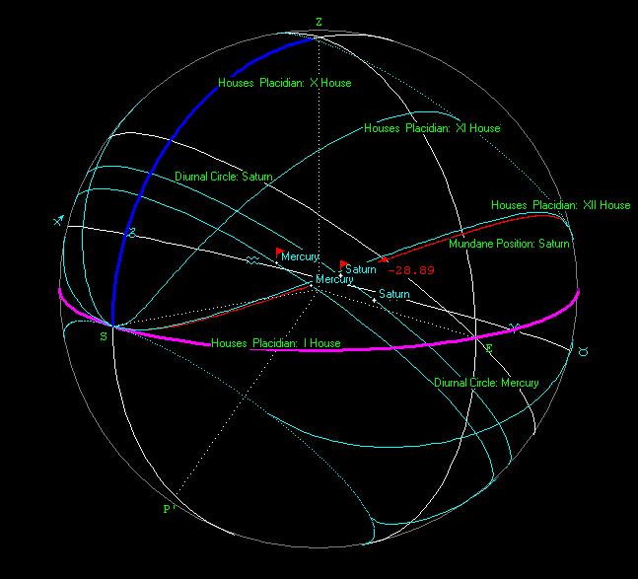
Primary Directions – A basic understanding

Slide 14
Primary Directions Vs Secondary Progression
Primary Directions
  Too technical. http://zaytsev.com/Manual/main.html
  I have experimented, but not very happy
Secondary Progressions
  Easier to calculate and observe
  Most popular
I use a combination of both – a technique taught by Rosicrucian Astrology Course.

Slide 15
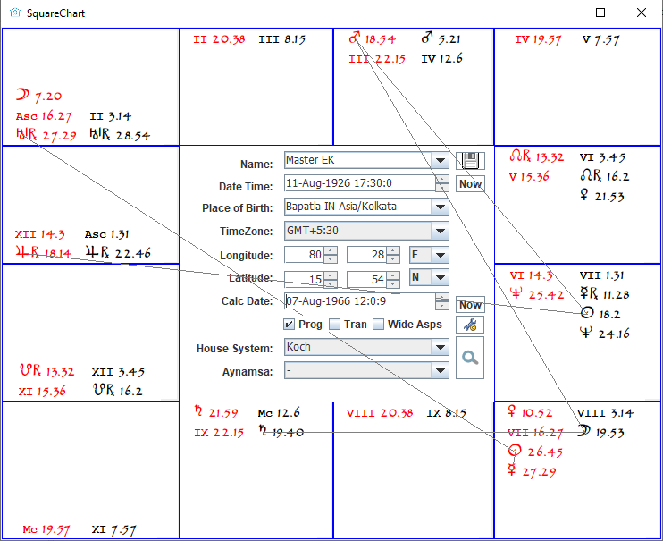
Secondary Progressions Demo

Slide 16
Secondary Progressions Demo
Walk through some of my life events
  Not that I am important – but because I can observe them from the closest point.
  All learners should do this. Identify major aspects in progression (planets and house cusps) and see if anything significant happened at that time

Slide 17
What to observe in Progression?
When a planet or house changes sign and joins other planets
  Indicates major changes
Aspects to natal planets and cusps
  Slower the planet, deeper the impact
Aspects between progressed planets and cusps – weaker
Progressed Moon acts as a trigger
House cusp coming to aspect with its ruler – V Imp

Slide 18
A million dollar question!
Sometimes progressed aspects show spectacular results, sometimes do not! Why?
  I don’t have an answer.
  Don’t rush to conclusions, observe.
No clear cut method or algorithm for predictions.
  We can sense a trend of time, but details cannot be inferred. Observe ground level realities.

Slide 19
Transits or gO-chAra
Progression: Planetary positions in the days after birth
Transit: Current planetary positions
  Famously dreaded Transit: Elinati Sani
  Transit of Saturn over Moon.
  7.5 years – Example.
Transits of Mars are also easily observable, when they make exact aspects
  Some aggression, travel or physical and mental stress
Transits are not as deep as progressions.
  I don’t give them too much importance compared to progressions
They act as triggers to progressions.

Slide 20
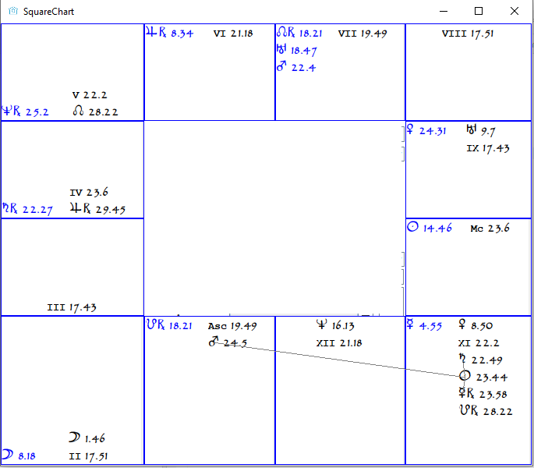
Transits Demo

Slide 21
What next?
Will create a forum for horoscope reading exercises in 9thhouse.org
Keep reading horoscopes from Astrodatabank.com

