Slide 1
Astrology Class 13
(9thhouse.org)
Murali Vadavalli
Sadguru Tapovana
24-Jul-2022

Slide 2
Horoscope Reading
Keep your expectations low
Divination vs Analysis
  Don’t get confused between the two
  Examples from Master EK (Mrigasira, dead man’s horoscope)
I chose the path of Analysis – Left brained approach
There is no clearly laid out method or algorithm for predictions that works 100% of the times
Claims are HIGH. Be cautious!

Slide 3
Horoscope Reading
The left brain approach
  Learn to identify the features of life first. Lot of introspection required.
    Exercise / example
  Try to match those features with the features of a horoscope.
    Lot of horoscopes to be studied.
  Prepare to be disappointed.
  Slow progress, but intellectually rewarding.
  You won’t fit into a typical astrologer stereotype

Slide 4
Horoscope Reading
NEVER JUDGE
JUST OBSERVE

Slide 5
Horoscope Reading
What to observe in a horoscope?
General Strength and Features
  Aspects to Sun and Moon
  Close Aspects to house cusps
  Aspects to planets joined with Sun and Moon
Any Particular house
  Aspects to cusp, ruler
  Planets joined with cusp or ruler
  Aspects to those planets

Slide 6
Horoscope Reading
What to observe in a horoscope?
General Strength and Features
  Aspects to Sun and Moon
  Close Aspects to house cusps
  Aspects to planets joined with Sun and Moon
Any Particular house
  Aspects to cusp, ruler
  Planets joined with cusp or ruler
  Aspects to those planets

Slide 7
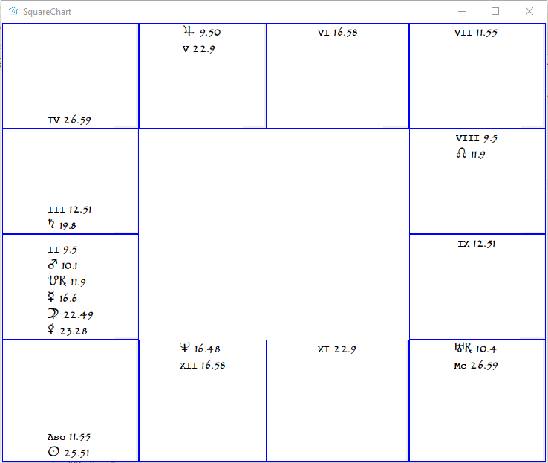
Example 1

Slide 8
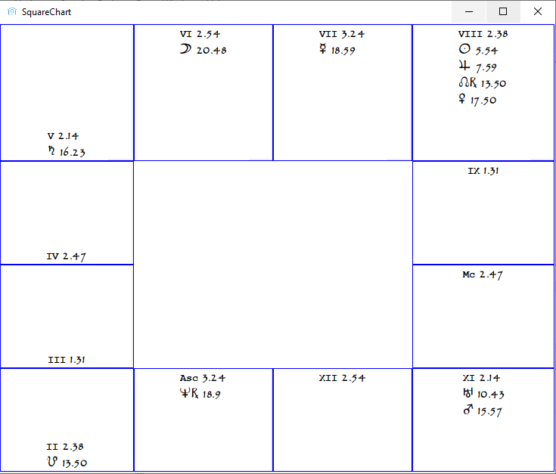
Example 2

Slide 9
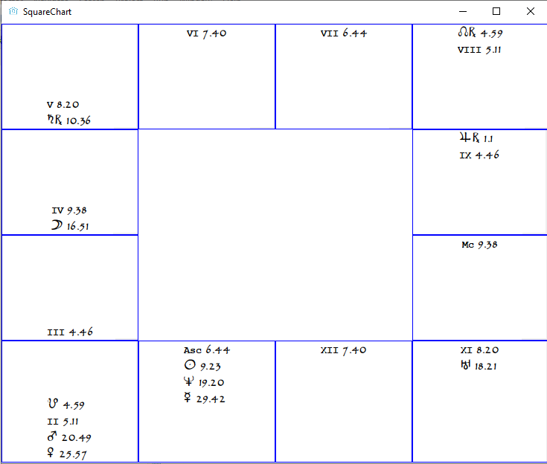
Example 3

Slide 10
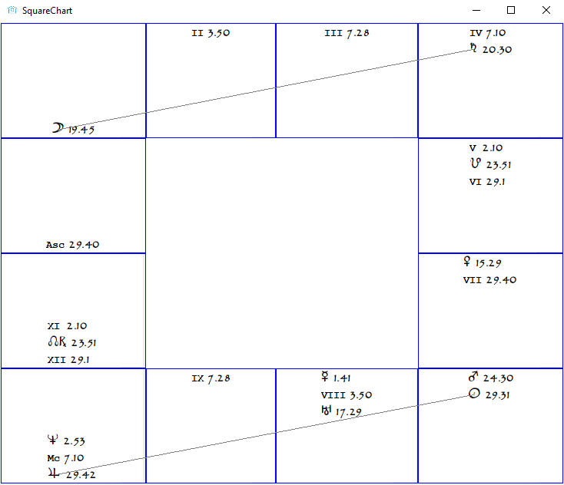
Example 4

Slide 11
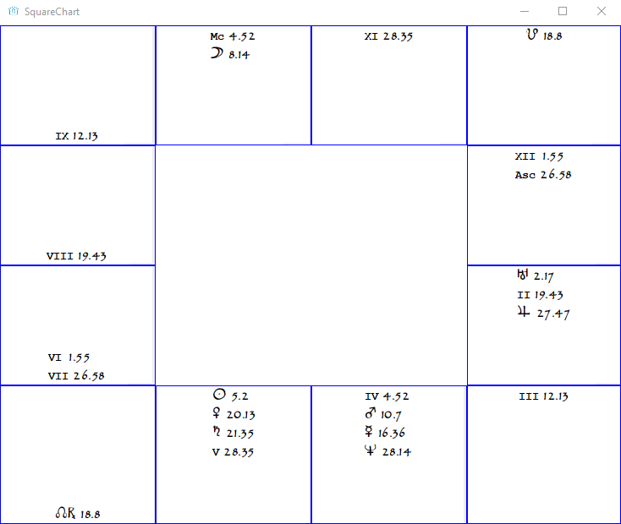
Example 5

Slide 12
Horoscope Reading
What are the conclusions?
  Analytical approach works only at an ABSTRACT level
    Impossible to know the particulars
    We get only a vague picture
  This is only as far as we can go in *any* analytical method
    Progressions will help us slightly more
  I am working for decades to develop an analytical algorithm
  Clients expect divination – I faced a million embarrassing situations
  For divination, a Guru’s guidance is required

Slide 13
What next?
Next class: Progressions
Do you want any specific topics?
Will create a forum for horoscope reading exercises
Astrodatabank.com

Slide 14
Exercise
Cast horoscopes
Study what planets are in what signs and houses
Identify aspects
Try to derive meanings

