Slide 1

Department of Electronics & Communication Engineering
25SC2107E - Machine Learning
Project Presentation
Presented by:
Baggu Lakshmi Sahithi - 2520040111
Vaddamani Pranathi - 2520040104
Vaddavalli Bhargavi – 2520040048
Guide: Mr. N Lava Prasad

Slide 2
Fidelity-Aware Safe Reinforcement Learning
for UAV Trajectory and Communication Control

Slide 3
INTRODUCTION
• UAVs are widely used in surveillance, delivery, disaster management and wireless communication.
• A UAV should reach its destination safely while maintaining reliable communication.
• Shortest-path navigation alone may cause collisions, poor communication or unnecessary energy use.
• Our project uses reinforcement learning to learn UAV movement and communication power control.

Slide 4
PROBLEM STATEMENT
The main problem is to control a UAV so that it can reach a target while balancing four requirements:
• Safe navigation — avoid obstacles and no-fly zones.
• Target reaching — reduce the distance to the destination.
• Reliable communication — maintain sufficient SINR and communication fidelity.
• Energy efficiency — avoid unnecessary movement and communication power consumption.
Therefore, the problem is treated as a multi-objective reinforcement learning task.

Slide 5
PROPOSED METHODOLOGY / ALGORITHM
PPO — Proximal Policy Optimization (Stable-Baselines3)
• Observation (12 values): goal/user direction, distances, power, communication fidelity, energy, trajectory fidelity, obstacle clearance and progress.
• Action (3 values): continuous X movement, Y movement and normalized transmit power.
• Reward: 12 × goal progress + 1.5 × communication fidelity + 0.8 × trajectory fidelity, minus energy, low-SINR, boundary and unsafe-move penalties, plus a 150 goal bonus.
• Safety shield: a move whose end point falls inside a no-fly zone (+1.5 margin) is rejected; positions are clamped to the map boundary.
• Note: safety handling is a simulation safeguard, not a guarantee of real-world UAV safety.

Slide 6
PROJECT WORKFLOW / IMPLEMENTATION
1
2
3
4
5
6
→
→
→
→
→
Create UAV
simulation
Define obstacles
and safe path
Calculate SINR
and fidelity
Train PPO
agent
Evaluate learned
trajectory
Compare with
Greedy baseline
Tools: Python • Gymnasium • Stable-Baselines3 • PPO • NumPy • Pandas • Matplotlib
Training: PPO for 300,000 time steps (147 iterations) • Evaluation: 20 episodes against a greedy baseline

Slide 7
SIMULATION / EXPERIMENTAL SETUP
• 2-D UAV simulation environment with a 100 × 100 map.
• Start: (10, 10); destination: (90, 90); ground user: (75, 65).
• Three circular no-fly zones and a 7-waypoint safe reference route.
• Episode limit: 160 steps; goal tolerance: 5 units; initial energy: 100.
• PPO: MlpPolicy (2 × 128 units), 300,000 time steps, seed 42.
• Evaluation: 20 episodes of the fixed scenario for PPO and a straight-line greedy baseline.
• The scenario is fixed, so repeated episodes are identical and do not test generalization.

Slide 8
SIMULATION / EXPERIMENTAL RESULTS
PPO VS GREEDY BASELINE (20 EVALUATION EPISODES, FIXED SCENARIO)
Metric | PPO | Greedy | Better
Average reward | 1518.20 | −4039.53 | PPO
Goal success rate | 100 % | 0 % | PPO
Final goal distance | 4.85 | 90.64 | PPO
Average SINR (dB) | 13.20 | 10.00 | PPO
Communication fidelity | 0.933 | 0.841 | PPO
Trajectory fidelity | 0.125 | 0.152 | Greedy
Final energy | 86.69 | 63.96 | PPO
Collision attempts (rejected moves) | 0 | 151 | PPO
PPO reached the goal in 46 steps in all 20 episodes; the greedy controller is blocked by the first no-fly zone (151 of 160 moves rejected).
Results hold for one fixed scenario (identical episodes): no generalization is claimed.

Slide 9
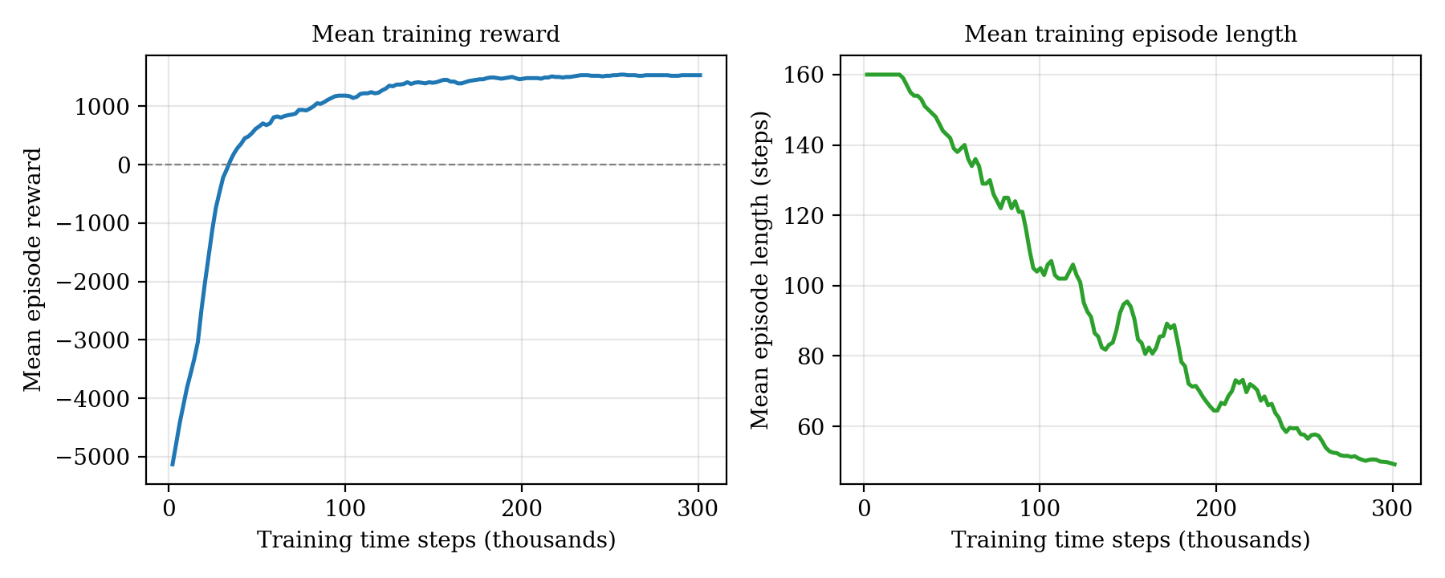
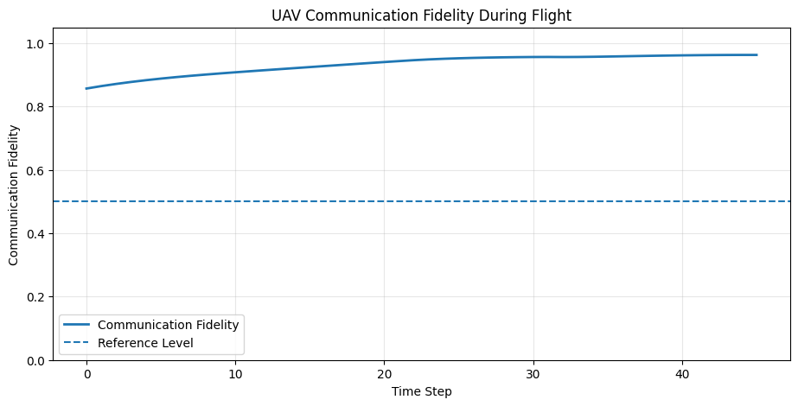
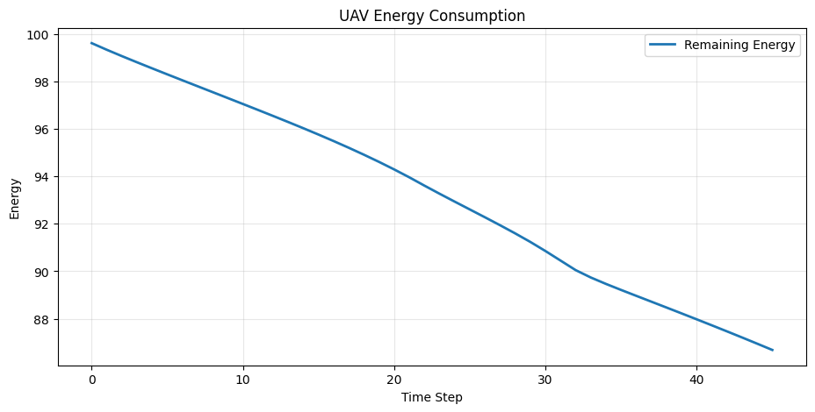
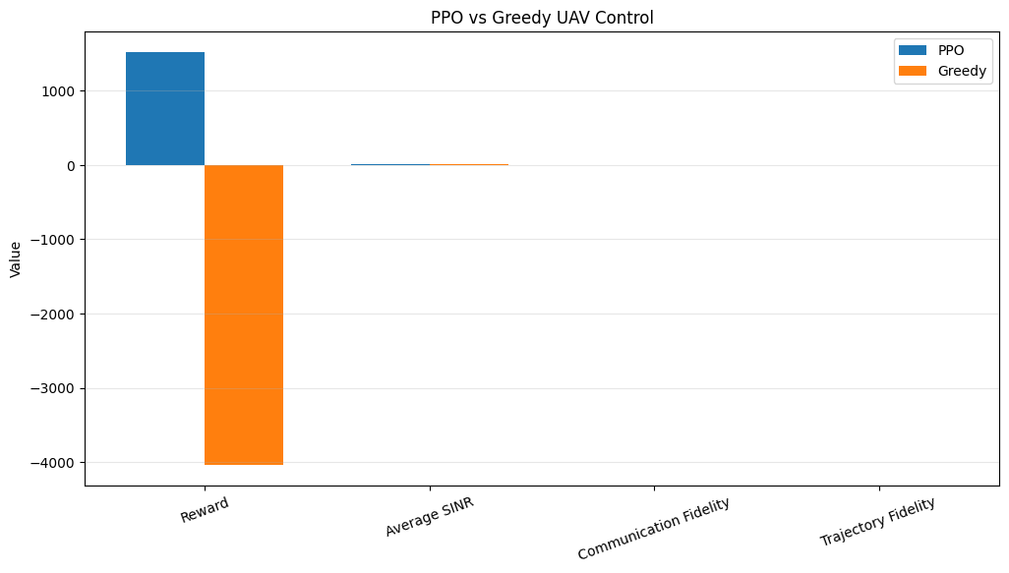
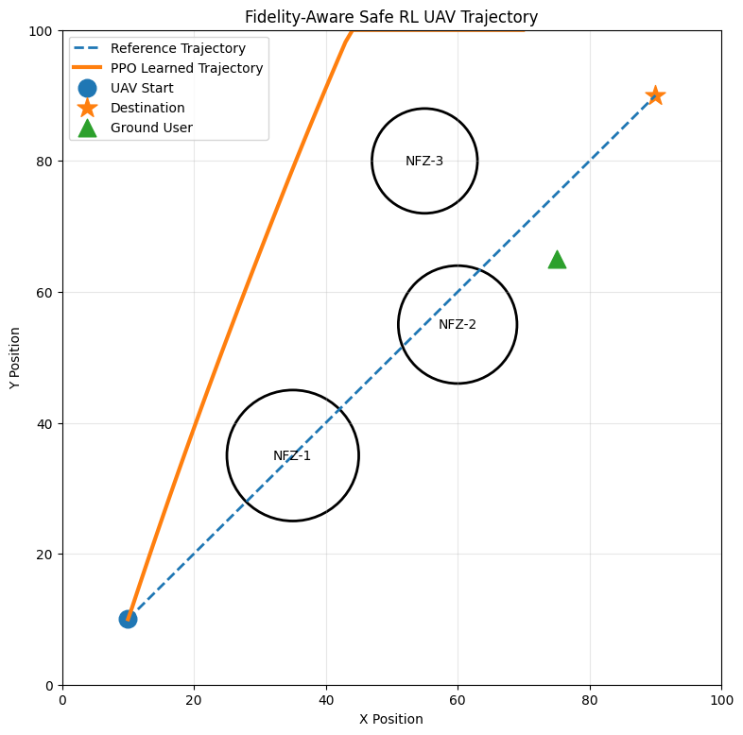
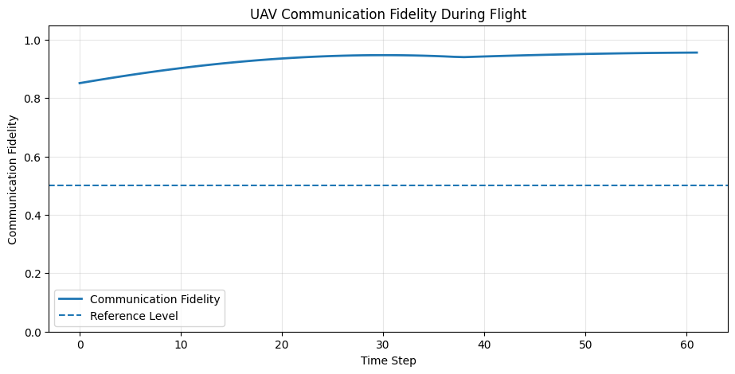
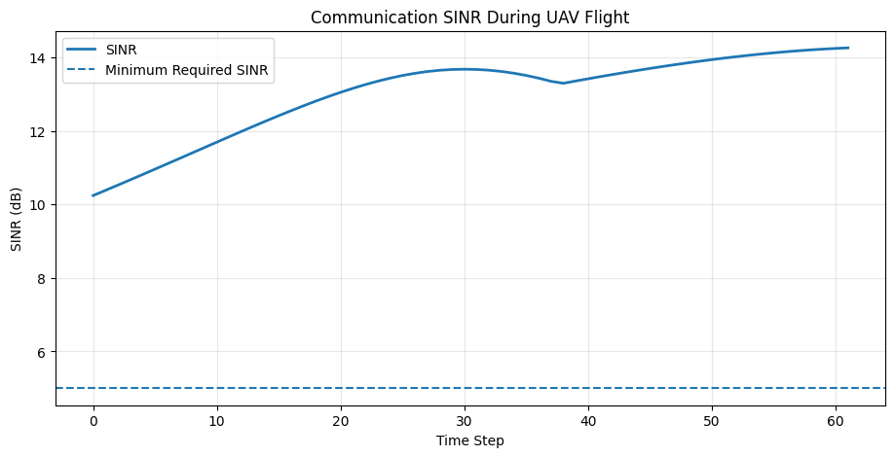
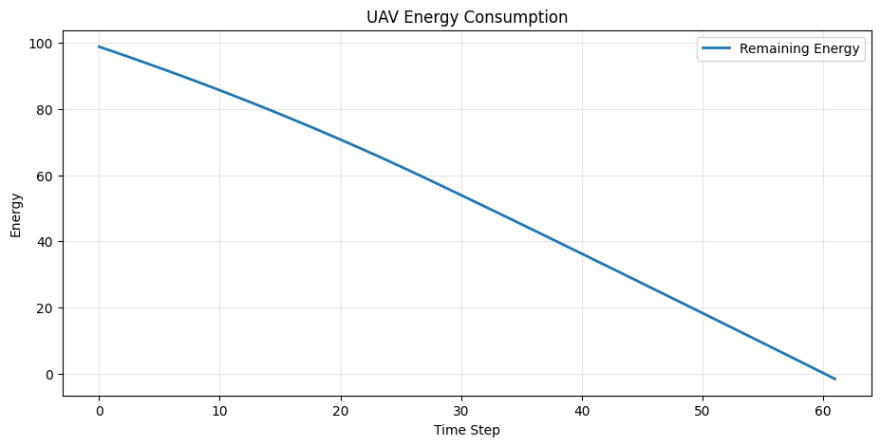
OUTPUT GRAPHS
Plots from the final notebook run: training progress, communication fidelity, energy use and the PPO vs greedy comparison.

Slide 10
PROJECT STATUS AND FUTURE WORK
COMPLETED IN THE PROJECT
• 100 × 100 2-D UAV simulation with three no-fly zones
• 12-element observation; continuous movement and power actions
• Safety filter (end-point check, 1.5 margin) and boundary handling
• SINR, communication-fidelity and trajectory-fidelity models
• PPO trained for 300,000 steps: goal reached in all 20 evaluation episodes
• Greedy baseline comparison, result plots and live simulation
FUTURE WORK
• Randomized start, goal, user and obstacle positions
• Several training seeds and a stronger baseline (waypoint following)
• Spatial trajectory-fidelity measure; power–energy trade-off
• Dynamic obstacles, multiple UAVs, fading and interference
• Hardware validation (this work is simulation only)

Slide 11
CONCLUSION AND FUTURE SCOPE
• A PPO-based simulation framework has been implemented for joint UAV trajectory and communication control.
• After 300,000 training steps, PPO reached the goal in all 20 evaluation episodes (46 steps, final distance 4.85) with 0 collision attempts, 13.20 dB average SINR and communication fidelity 0.933.
• The straight-line greedy baseline was blocked by the first no-fly zone (0 % success, 151 rejected moves).
• Limitations: one fixed scenario (no generalization claim), low trajectory fidelity (0.125) and constant full transmit power.
• Future extensions: randomized scenarios, dynamic obstacles, realistic wireless channels, multiple UAVs and hardware validation.

Slide 12
THANK YOU

