Slide 1




Slide 2
NETFLIX

Slide 3

vision
Becoming the best Global Entertainment distribution service licensing entertainment content around the world creating markets that are accessible to film makers helping content creators around the world to find a global audience.

Slide 4
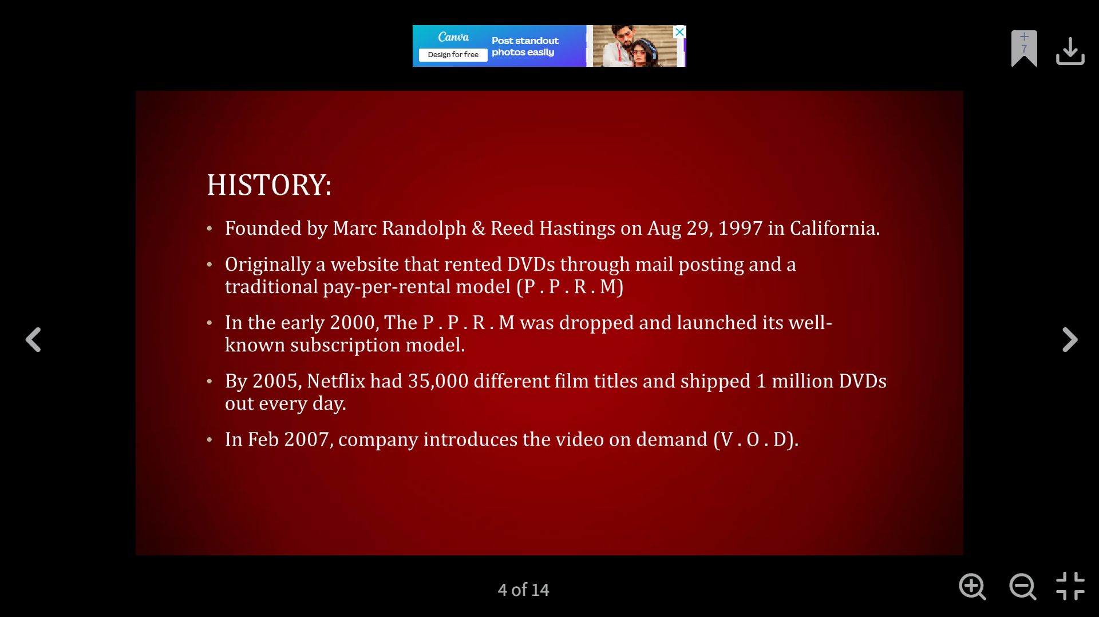

Slide 5
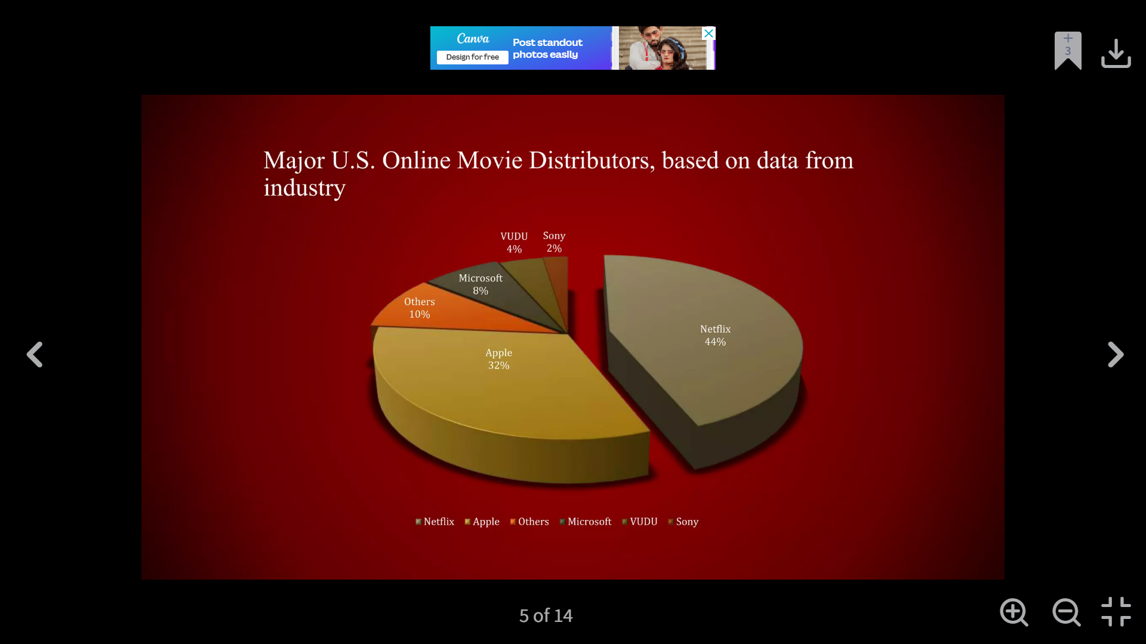

Slide 6
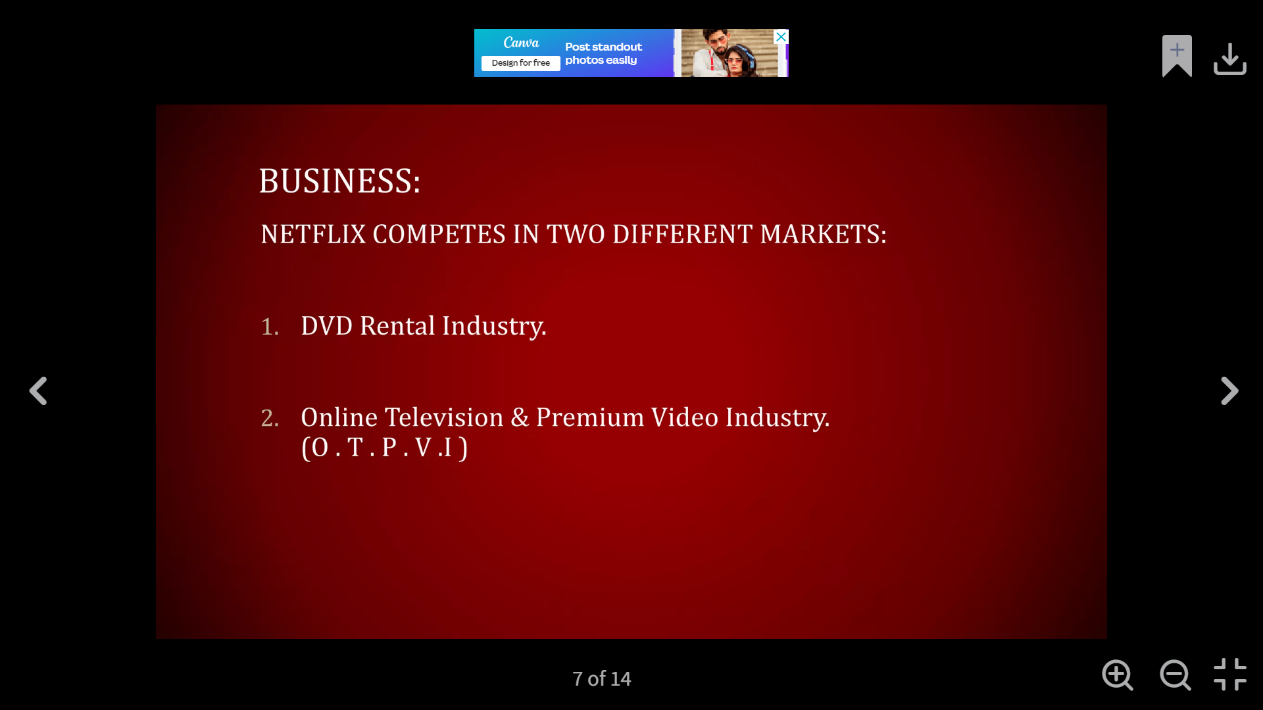

Slide 7
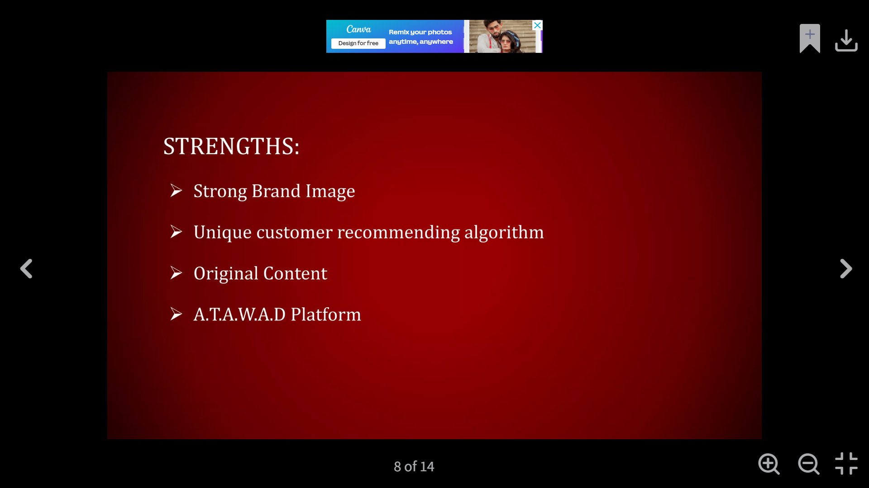


Slide 8
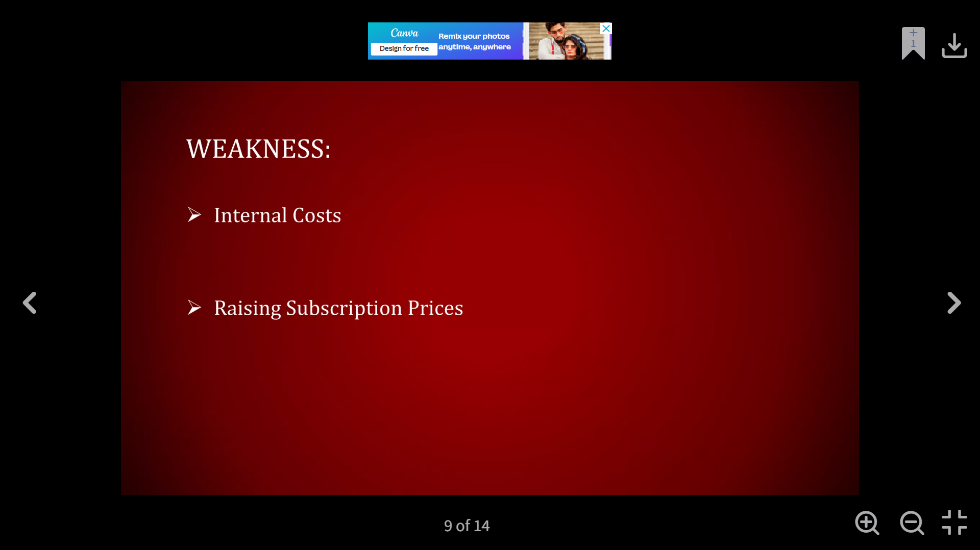


Slide 9
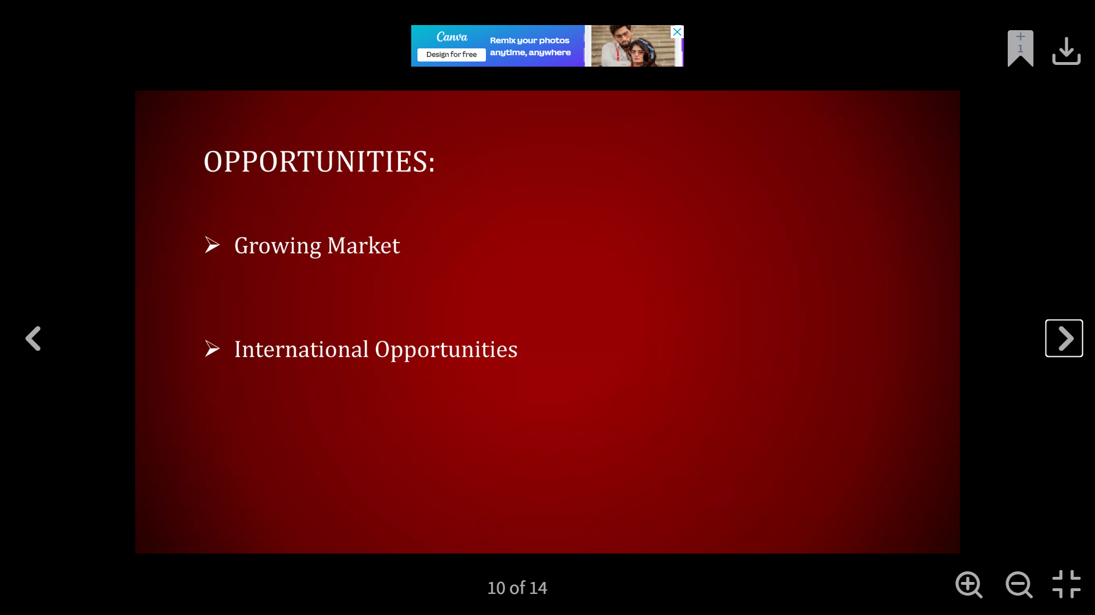


Slide 10
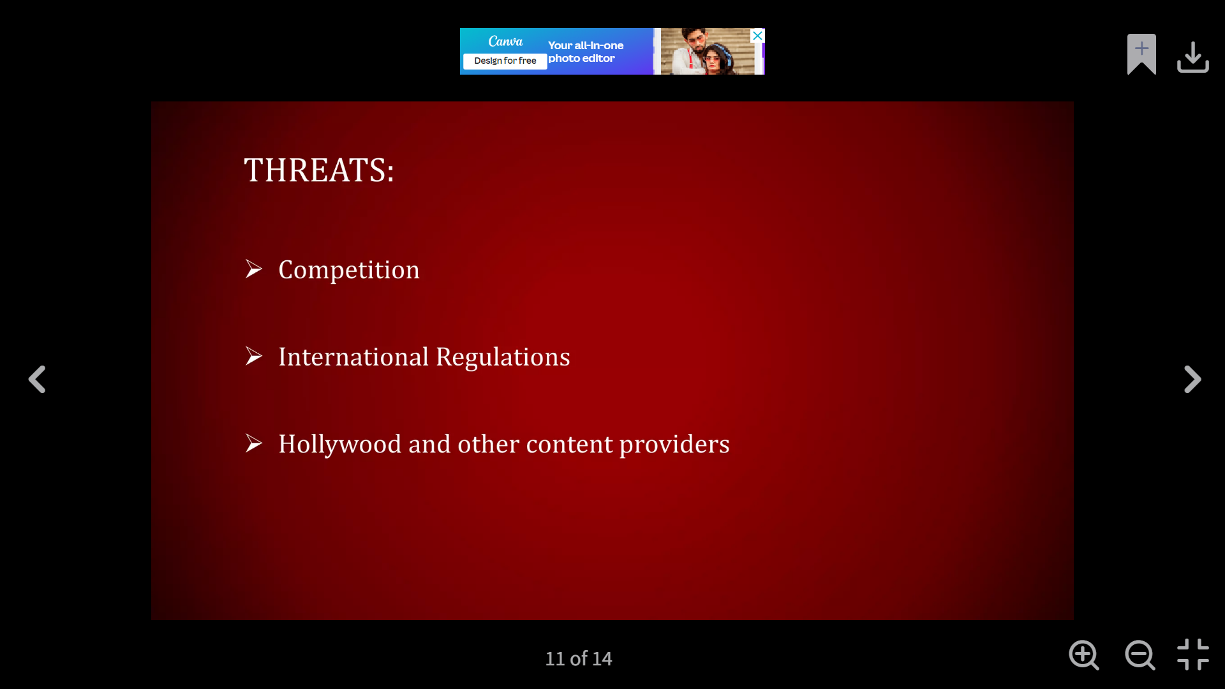


Slide 11
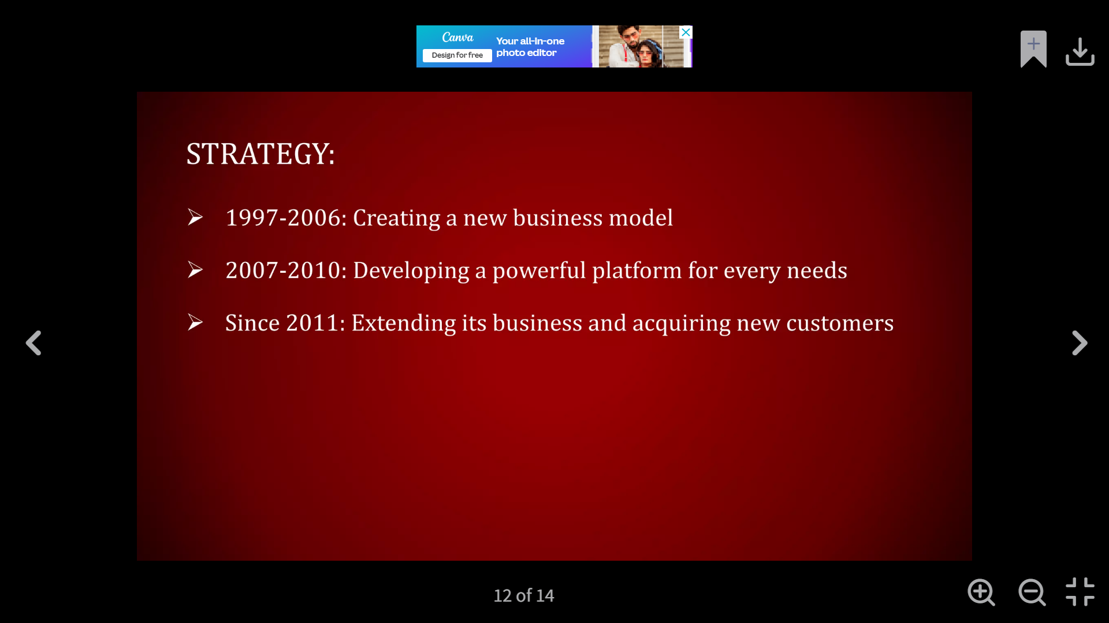


Slide 12
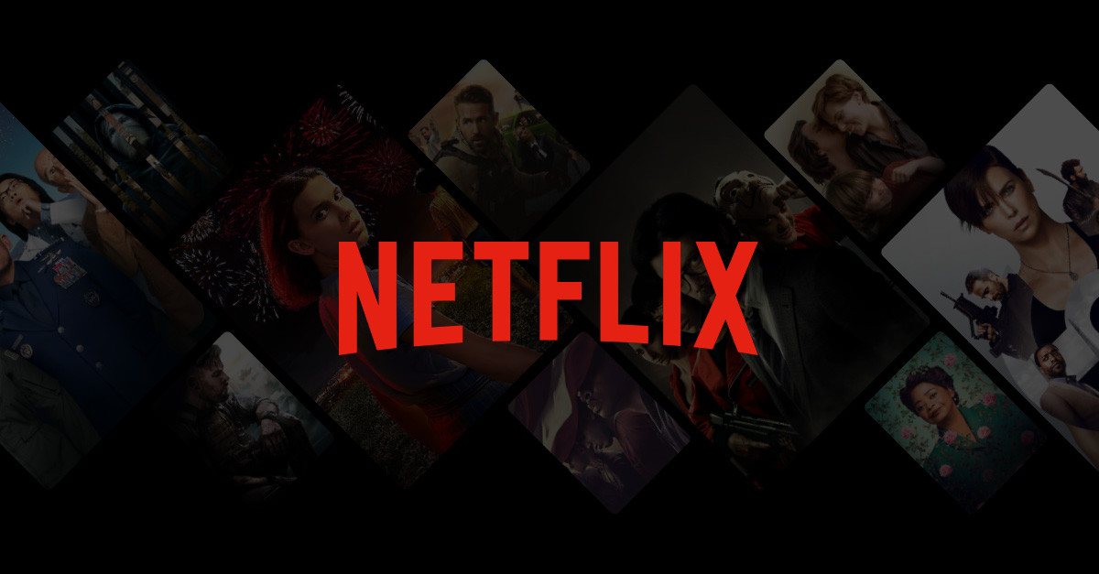
conclusion
It is important for Netflix to continue to grow their customer base within the online DVD rental market.
Be innovated as new technology is introduced into the home entertainment industry.

Slide 13
thankyou

