Slide 1

THEME: FILM MAKING

Slide 2

Welcome
To
CAPGEMINI

Slide 3
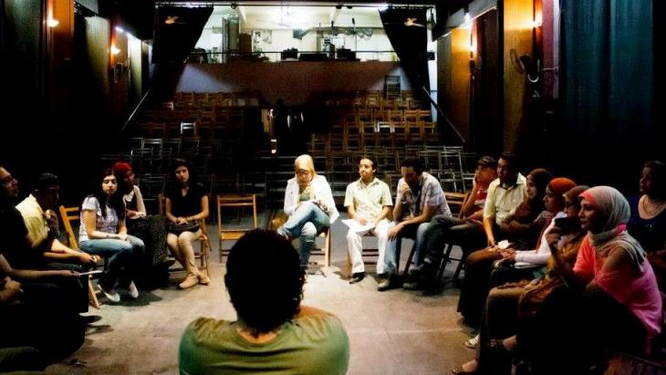
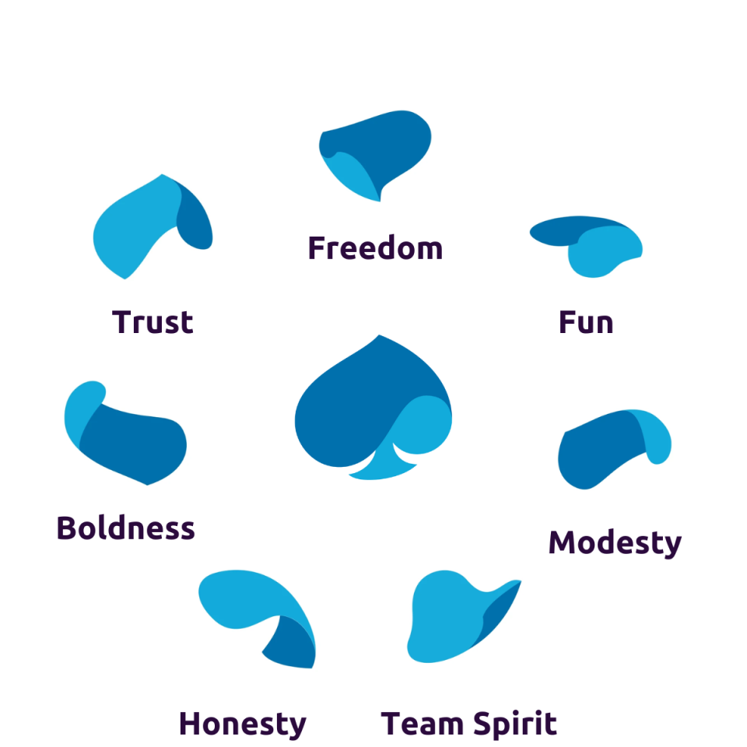
ORIENTATION SESSION
7 VALUES OF CAPGEMINI

Slide 4
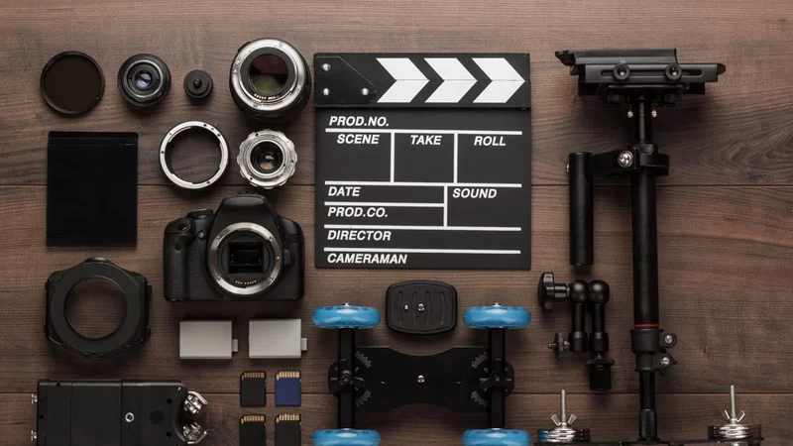
42
DOMAIN
01
15-12-22
MAINFRAME TECHNOLOGY

Slide 5


MOCHA SOFTWARE

Slide 6
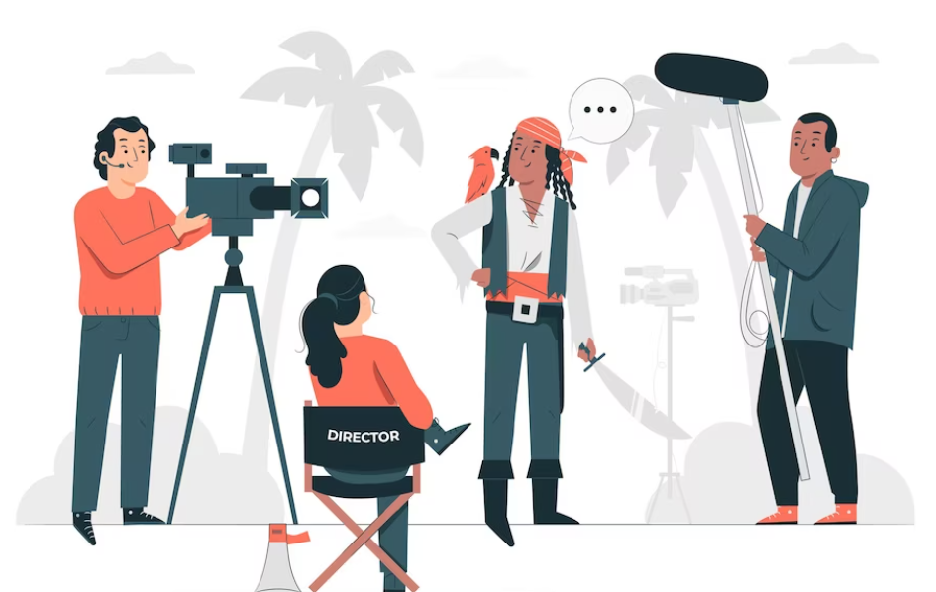
L&D TEAM
TRAINER
MENTOR

Slide 7
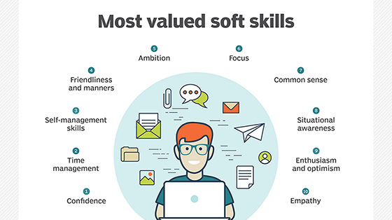

Slide 8
LIST OF MOVIES RELEASED IN 2022-23
S.NO | MOVIES
1 | MVS
2 | JCL
3 | VSAM
4 | COBOL
5 | CICS
6 | DB2

