Slide 1
Introduction to Supercomputing with Janus
Shelley Knuth Peter Ruprecht
shelley.knuth@colorado.edu peter.ruprecht@colorado.edu
www.rc.colorado.edu
Notes:
Introduce yourself and other RCers!
Ask about their backgrounds. This talk will be aimed mostly at beginners. Examples will use Janus but are analogous on other HPC sites.

Slide 2
Outline
Who is CU Research Computing?
What is a supercomputer?
Accessing resources
General supercomputing information
Job submission
Storage types
Keeping the system happy
Using and installing software
With examples!
Notes:
Please find any RC members during the conference if you’d like to chat.

Slide 3
What does Research Computing do?
We manage
Shared large scale compute resources
Large scale storage
High-speed network without firewalls – ScienceDMZ
Software and tools
We provide
Consulting support for building scientific workflows on the RC platform
Training
Data management support in collaboration with the Libraries
Notes:
“We support computing needs beyond the desktop”.
700 users across 30 institutes and departments on campus

Slide 4
Research Computing - Contact
rc-help@colorado.edu
Main contact email
Will go into our ticket system
http://www.rc.colorado.edu - main web site
http://data.colorado.edu - data management resource
Mailing Lists (announcements and collaboration)
https://lists.rc.colorado.edu/mailman/listinfo/rc-announce
Twitter @CUBoulderRC
Facebookhttps://www.facebook.com/CuBoulderResearchComputing
Meetuphttp://www.meetup.com/University-of-Colorado-Computational-Science-and-Engineering/
Notes:
How to contact us and receive info from us.

Slide 5
Janus Supercomputer and Other compute resources

Slide 6
What Is a Supercomputer?
CU’s supercomputer is one large computer made up of many smaller computers and processors
Each computer is called a node
Each node has processors/cores
Carry out the instructions of the computer
Within a supercomputer, all these different computers talk to each other through a communications network
On Janus – InfiniBand
Notes:
Supercomputing is approx equal to High Performance Computing
The interconnect makes the supercomputer more than just a bunch of individual nodes.
Supercomputer – one with capabilites well beyond those of consumer-grade or even department-sized servers. Moving target. Many processors, much RAM.

Slide 7
Why Use a Supercomputer?
Supercomputers give you the opportunity to solve problems that are too complex for the desktop
Might take hours, days, weeks, months, years
If you use a supercomputer, might only take minutes, hours, days, or weeks
Useful for problems that require large amounts of memory

Slide 8
World’s Fastest Supercomputers
www.top500.org
Rank | Site | Name | TeraFlops
1 | National Super Computer Center (Guangzhou, China) | Tianhe-2 | 54902.4
2 | Oak Ridge National Laboratory (United States) | Titan | 27112.5
3 | DOE/NNSA/LLNL (United States) | Sequoia | 20132.7
4 | RIKEN Advanced Institute for Computational Science (Japan) | K | 11280.4
5 | DOE/Argonne National Lab (United States) | Mira | 10066.3
6 | Swiss National Supercomputing Centre (Switzerland) | Piz Daint | 7788.9
7 | Texas Advanced Computing Center (United States) | Stampede | 8520.1
8 | Forschungszentrum Juelich (Germany) | JUQUEEN | 5872.0
9 | DOE/NNSA/LLNL (United States) | Vulcan | 5033.2
10 | Government (Undisclosed) (United States) | Undisclosed | 3143.5
Notes:
TeraFlops are an appropriate measure of speed for some applications, but not all!

Slide 9
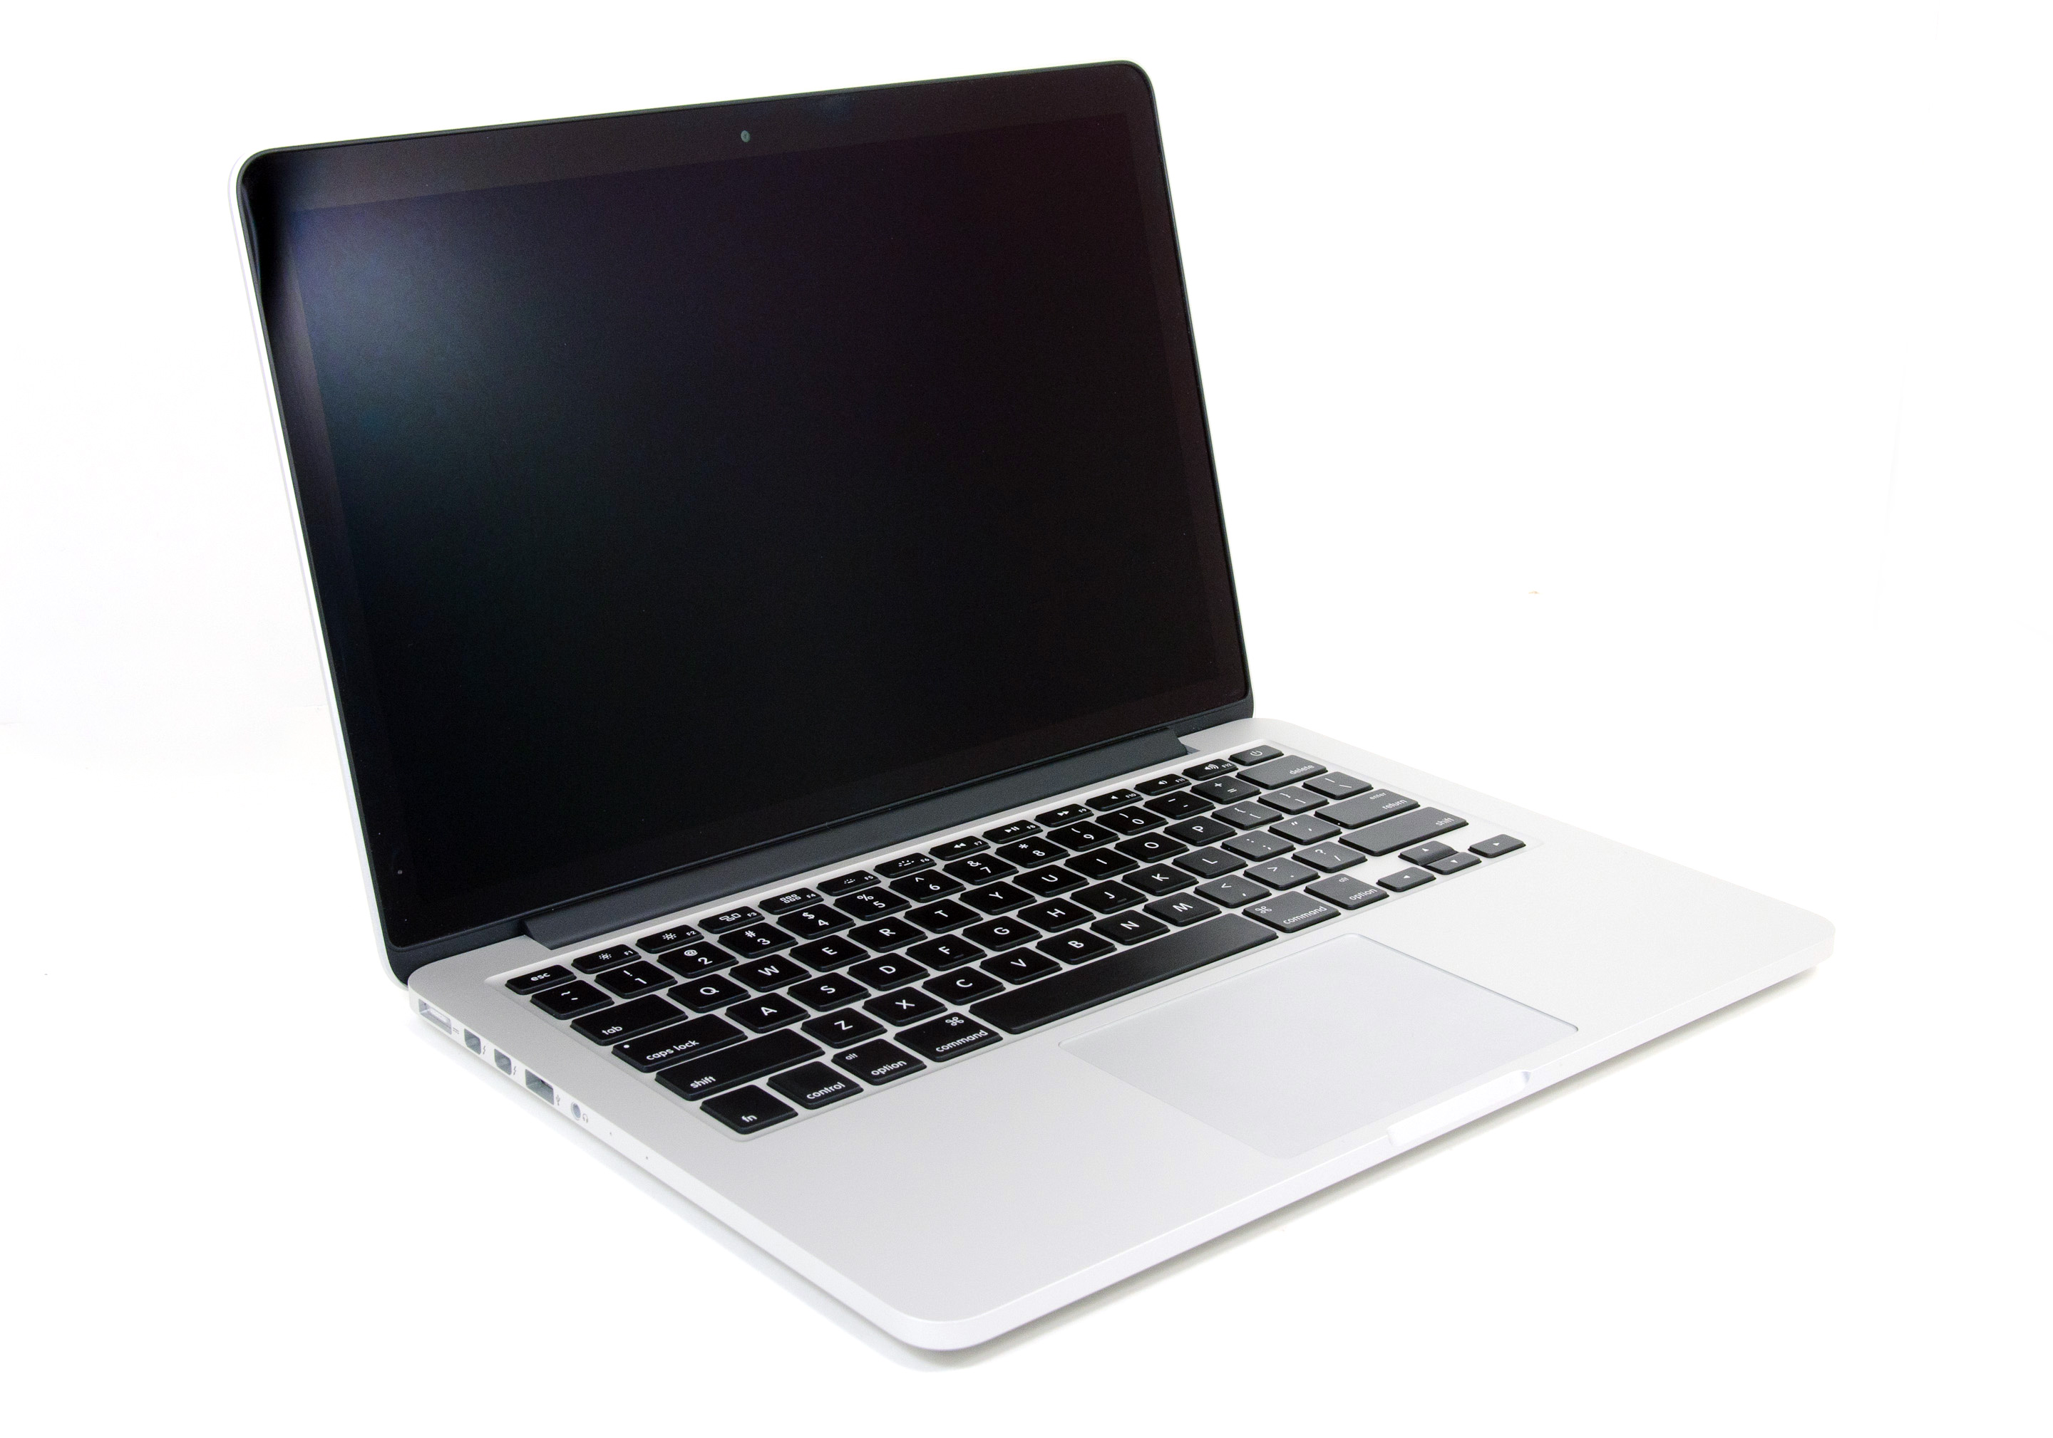
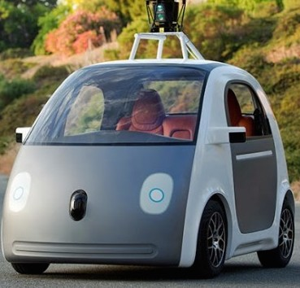
Computers and Cars - Analogy
≈
Notes:
Your personal computer is like a Google car – pretty much operates itself, quite reliable, but only goes 25mph.

Slide 10


Computers and Cars - Analogy
≈
Notes:
Supercomputer is like an Indy car - way faster but takes some special skills to operate, requires a dedicated maintenance crew, and can crash if not used properly.

Slide 11
Hardware - Janus Supercomputer
1368 compute nodes (Dell C6100)
16,428 total cores
No battery backup of the compute nodes
Fully non-blocking QDR Infiniband network
960 TB of usable Lustre based scratch storage
16-20 GB/s max throughput
Notes:
Main design consideration was running large parallel jobs really fast. Stability was a tradeoff.

Slide 12
Additional Compute Resources
2 Graphics Processing Unit (GPU) Nodes
Visualization of data
Exploring GPUs for computing
4 High Memory Nodes
1 TB of memory, 60-80 cores per node
16 Blades for long running jobs
2-week walltimes allowed
96 GB of memory (4 times more compared to a Janus node)
Notes:
Why use each?
There are many other HPC sites that offer computing time to US researchers.

Slide 13
Different Node Types
Login nodes
This is where you are when you log in to login.rc.colorado.edu
No heavy computation, interactive jobs, or long running processes
Script or code editing, minor compiling
Job submission
Compile nodes
Compiling code
Job submission
Compute/batch nodes
This is where jobs that are submitted through the scheduler run
Intended for heavy computation
Notes:
Other HPC sites will have a similar setup.
Compile nodes are same architecture as Janus nodes, so executables compiled on them run better on Janus.

Slide 14
ACCESSING and utilizing RC RESOURCES

Slide 15
Initial Steps to Use RC Systems
Apply for an RC account
https://portals.rc.colorado.edu/account/request
Get a One-Time Password device
Apply for a computing allocation
Startup allocation of 50K SU granted immediately
Additional SU require a proposal
You may be able to use an existing allocation
Notes:
OTP gives stronger “border” security so we can get away with fewer performance-stealing security measures within the RC environment.

Slide 16
Logging In
SSH to login.rc.colorado.edu
Use your RC username (same as IdentiKey) and One-Time Password
From a login node, can SSH to a compile node -
janus-compile1(2,3,4) - to build your programs
All RC nodes use RedHat Enterprise Linux 6
Notes:
SSH is “secure shell”

Slide 17
Job Scheduling
On supercomputer, jobs are scheduled rather than just run instantly at the command line
Several different scheduling software packages are in common use
Licensing, performance, and functionality issues have led us to choose Slurm
SLURM = Simple Linux Utility for Resource Management
Open source
Increasingly popular at other sites
More at https://www.rc.colorado.edu/support/examples/slurmtestjob

Slide 18
Running Jobs
Do NOT compute on login or compile nodes
Interactive jobs
Work interactively at the command line of a compute node
Command: salloc --qos=janus-debug
Batch jobs
Submit a job that will be executed when resources are available
Create a text file containing information about the job
Submit the job file to a queue
sbatch --qos=<queue> file

Slide 19
Slurm
Previous code
module load torque
module load moab
qsub –q janus-debug test.sh
qstat –u $USER
New code
module unload torque
module unload moab
module load slurm
sbatch –qos=janus-debug test.sh
squeue –u $USER
More at https://www.rc.colorado.edu/support/examples/slurmtestjob

Slide 20
Quality of Service = Queues
janus-debug
Only debugging – no production work
Maximum wall time 1 hour, 2 jobs per user
(The maximum amount of time your job is allowed to run)
normal
Default
Maximum wall time of 24 hours
janus-long
Maximum wall time of 168 hours; limited number of nodes
himem
serial
gpu

Slide 21
Parallel Computation
Special software is required to run a calculation across more than one processor core or more than one node
Sometimes the compiler can parallelize an algorithm, and frequently special libraries and functions can be used to abstract the parallelism
OpenMP
For multiprocessing across cores in a single node
Most compilers can auto-parallelize with OpenMP
MPI – Message Passing Interface
Can parallelize across multiple nodes
Libraries/functions compiled into executable
Several implementations (OpenMPI, mvapich, mpich, …)
Usually requires a fast interconnect (like InfiniBand)

Slide 22
No More PBS Directives!
Previous code
#PBS –l nodes=1:ppn=1, walltime=00:10:00
#PBS -q janus-debug
#PBS –o testjob.out
#PBS -N matlab_test_serial
#PBS -m be
#PBS –M ralphie@colorado.edu
New code
#SBATCH –N 1
#SBATCH --time=0:10:00
#SBATCH --qos=janus-debug
#SBATCH -o testjob.out
#SBATCH –J matlab_test_serial
#SBATCH --mail-type begin, end
#SBATCH --mail-user ralphie@colorado.edu
More at https://www.rc.colorado.edu/support/examples/slurmtestjob
Notes:
We provide “wrappers” so that basic torque-style commands and directives will still work, but we recommend you use the Slurm style whenever possible.

Slide 23
Software
Common software is available to everyone on the systems
To find out what software is available, you can type module avail
To set up your environment to use a software package, type module load <package>/<version>
Can install your own software
But you are responsible for support
We are happy to assist

Slide 24
EXAMPLES

Slide 25
Login and Modules example
Log in:
ssh username@login.rc.colorado.edu
ssh janus-compile2
List and load modules
module list
module avail
module load openmpi/openmpi-1.8.0_intel-13.0.0
module load slurm
Compile parallel program
mpicc -o hello hello.c

Slide 26
Submit Batch Job example
Batch Script:
#!/bin/bash
#SBATCH –N 2 # Number of requested nodes
#SBATCH --ntasks-per-node=12 # number of cores per node
#SBATCH --time=1:00:00 # Max walltime
#SBATCH --job-name=SLURMDemo # Job submission name
#SBATCH --output=SLURMDemo.out # Output file name
###SBATCH -A <account> # Allocation
###SBATCH --mail-type=end # Send Email on completion
###SBATCH --mail-user=<your@email> # Email address
module load openmpi/openmpi-1.8.0_intel-13.0.0
mpirun ./hello
Submit the job:
sbatch --qos janus-debug slurmSub.sh
Check job status:
squeue –q janus-debug
cat SLURMDemo.out
Notes:
You DO NOT run the batch script yourself – you submit it to the queue.

Slide 27
Data STORAGE and TRANSFER

Slide 28
Storage Spaces
Home Directories
Not high performance; not for direct computational output
2 GB quota
/home/user1234
Project Spaces
Not high performance; can be used to store or share programs, input files, maybe small data files
250 GB quota
/projects/user1234
Lustre Parallel Scratch Filesystem
No hard quotas
Files created more than 180 days in the past may be purged at any time
/lustre/janus_scratch/user1234
Notes:
Different spaces are appropriate for different kinds of data and I/O

Slide 29
Keeping Lustre Happy
Janus Lustre is tuned for large parallel I/O operations.
Creating, reading, writing, or removing many small files simultaneously can cause performance problems.
Don’t put more than 10,000 files in a single directory.
Avoid “ls –l” in a large directory.
Avoid shell wildcard expansions ( * ) in large directories.
Notes:
Have seen 10x speedups by improving I/O patterns! We have a usage guide that you should peruse.
Remember, storage is a shared resource.

Slide 30
Research Data Storage: PetaLibrary
NSF Major Research Instrumentation grant
Long term storage option
Keep data on spinning disk or tape
Provide expertise and services around this storage
Data management
Consulting
No HIPAA, FERPA data
Infrastructure guaranteed for 5 years

Slide 31
Data Sharing and Transfers
Globus tools: Globus Online and gridftp
https://www.globus.org
Easier external access without CU-RC account, especially for external collaborators
Endpoint: colorado#gridftp
SSH: scp, sftp, rsync
Adequate for smaller transfers
Notes:
EMPHASIZE sharing! Drop-box like access for your collaborators to your PL storage!

Slide 32
Training, Consulting and Partnerships

Slide 33
Training
Weekly tutorials on computational science and engineering topics
Meetup group
http://www.meetup.com/University-of-Colorado-Computational-Science-and-Engineering
All materials are online
http://researchcomputing.github.io
Various boot camps/tutorials
Notes:
Open to anyone, not just CU members.

Slide 34
Consulting
Support in building software
Workflow efficiency
Parallel performance debugging and profiling
Data management in collaboration with the Libraries
Getting started with XSEDE

Slide 35
Best Data Management Plans and Practices Competition
Internal grant this summer offered by the Vice Chancellor’s Office
August 15 close
Winners announced at Research Fair on 9/17
Grad students, postdocs, and faculty
Five people $2000 each
Arts and Humanities, Engineering, Life Sciences, Physical Sciences, and Social Sciences
General funds

Slide 36
Best Data Management Plans and Practices Competition
Awards for data plans that describe best practices for their current data or a plan for the future
http://data.colorado.edu
Please don’t hesitate to ask questions
Contact Shelley.Knuth@colorado.edu

Slide 37
Upcoming Conferences/Tutorials
RMACC
Data Management Boot camps
“How to Use a Supercomputer”
Others…?

Slide 38
Thank you! Questions?
www.rc.colorado.edu

