Slide 1
Best Practices for Data Management
September 24, 2014

Slide 2
Presenters
Andrew Johnson
Research Data Librarian
University Libraries
Shelley Knuth
Research Data Specialist
Research Computing

Slide 3
Outline
What is research data?
What are the important aspects of data management?
How can I use data management to improve my research status?
How do I write a data management plan to meet funding agency requirements?

Slide 4
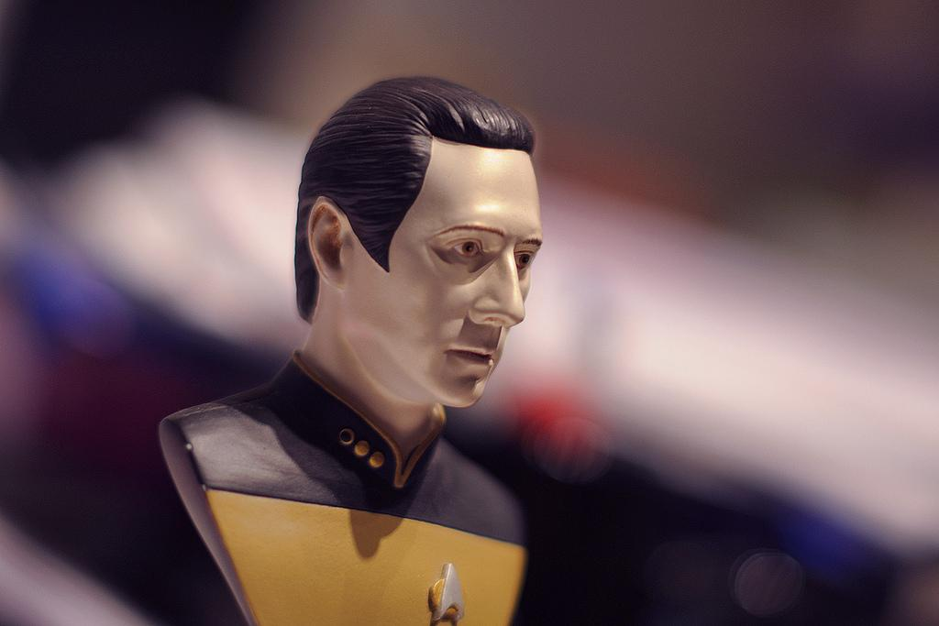
What do we mean when we talk about “data”?

Slide 5
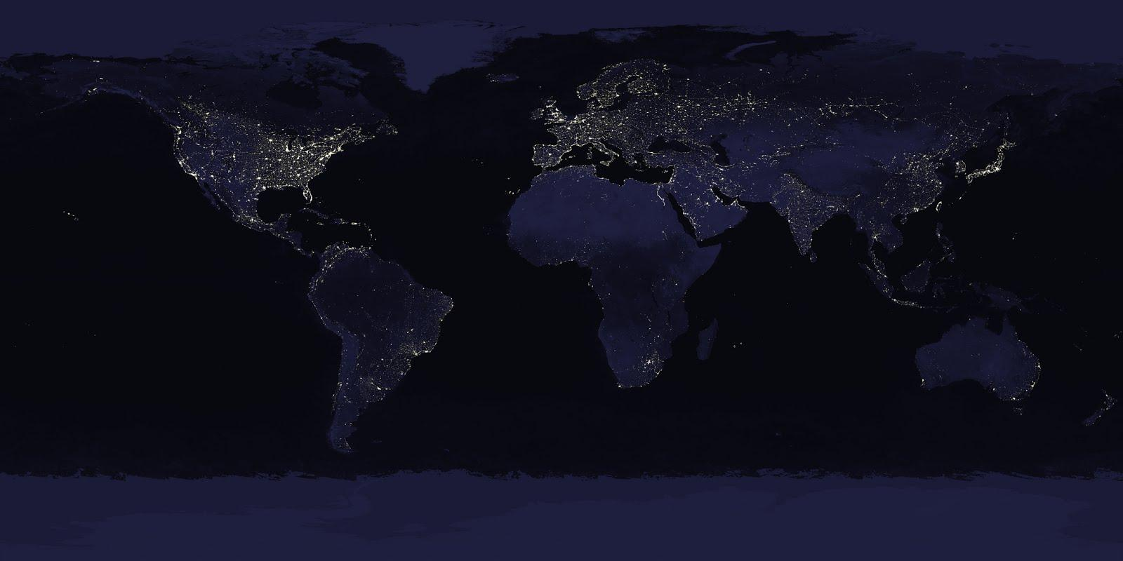
Some research data definitions
White House Office of Management and Budget:
“the recorded factual material commonly accepted in the scientific community as necessary to validate research findings."
CU-Boulder Data Management Task Force:
“the digital representation of information generated at any stage of the research process in a formalized manner suitable for communication, interpretation, or processing.”
CU-Boulder Research Data Advisory Committee:
“digital outputs, which include content in structured forms including but not limited to: text files, word processing documents, spreadsheets, websites, calibration information, or simulation outputs; digital information artifacts, such as images, vector-based map products, audio and video products; digital outputs may also include the code used to decode those products, the metadata describing such information artifacts, and required source code that runs computer instructions.”

Slide 6
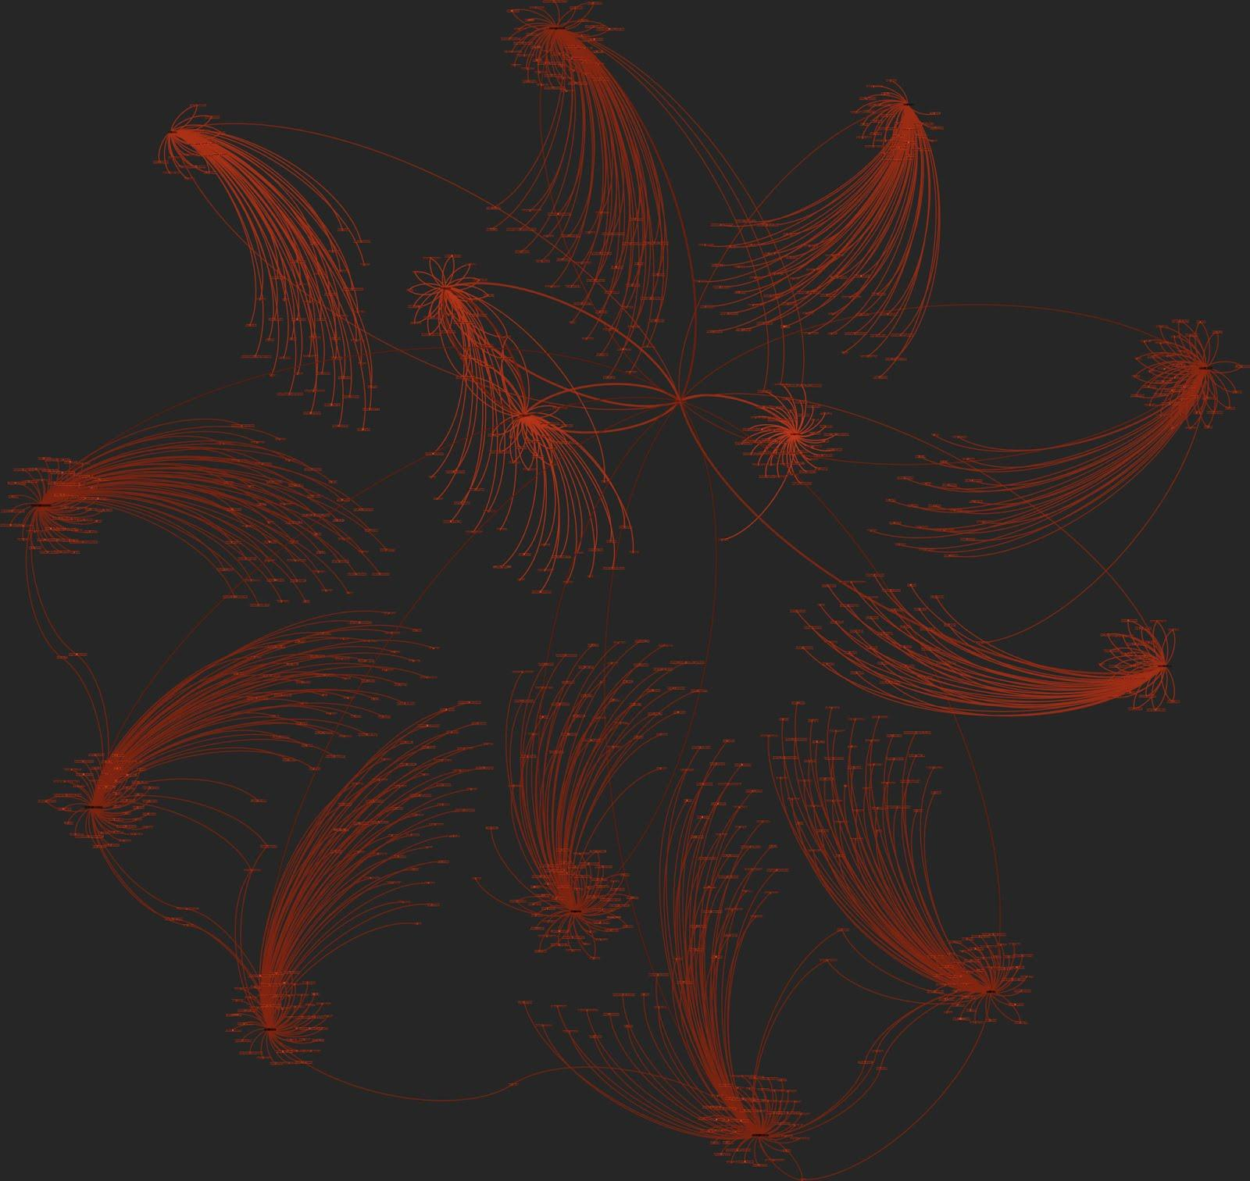
How do we get started with research data management?
What are the most important aspects in managing data?
Plan for archival and curation
Appropriate metadata
Standardizing data
Data accessibility for the long term
Put a plan into place before you collect data if possible

Slide 7
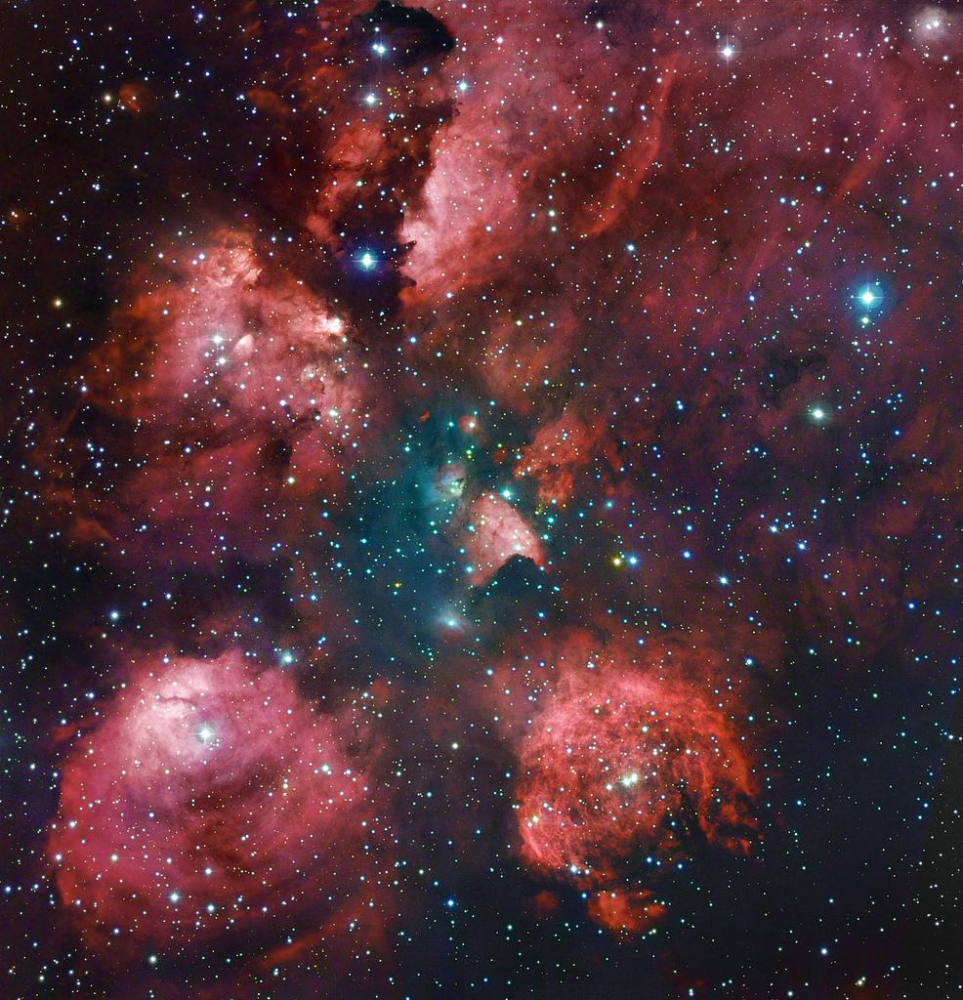
Data Collection
Make a plan!
Data formats
File names
Where will I put my data?
How large will my files be?
What can I expect for growth rates?

Slide 8
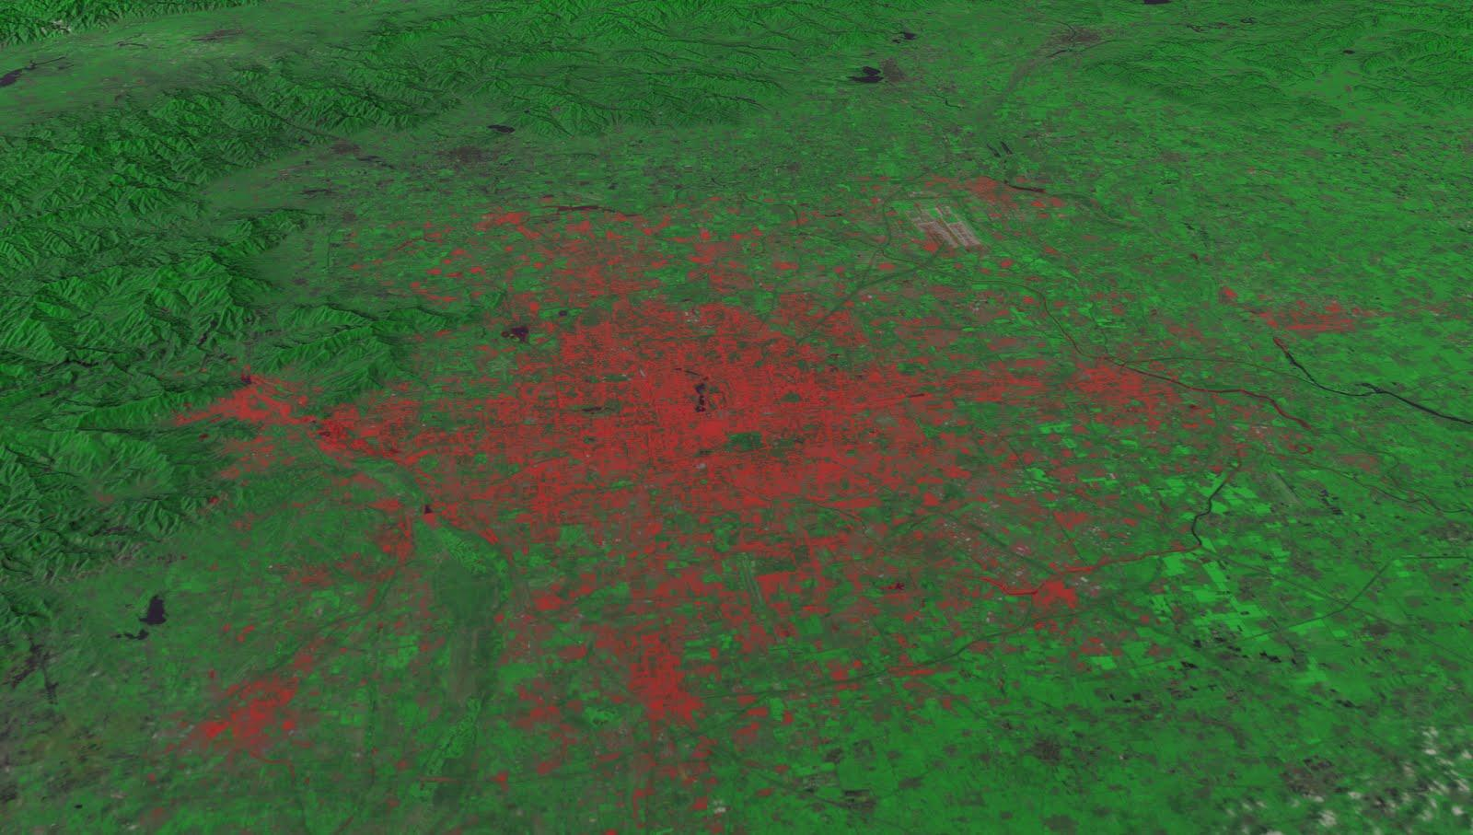
Data Archiving and Preservation
Proper archiving for long-term preservation of data critical
What should be archived?
Data
Metadata
Research products
Scripts
Anything required to reproduce the results of research

Slide 9
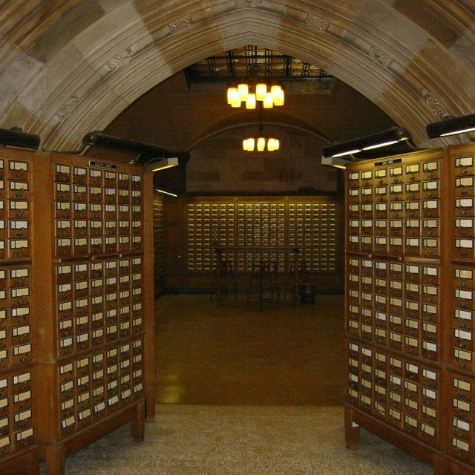
Good Practices for Data Archiving and Preservation
Trusted repository is best!
Only storing data on thumb drives – bad
Store multiple copies!
Active management
Backups!
Security?
Review schedule for preservation
Ten years?

Slide 10
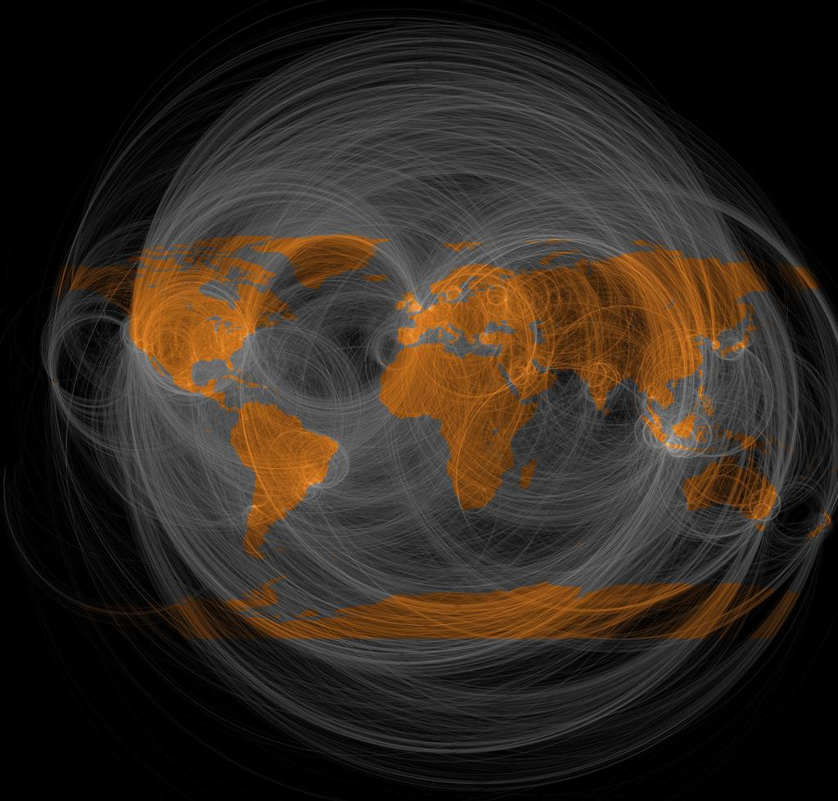
CU Data Storage: PetaLibrary
NSF Major Research Instrumentation grant
Data collections from faculty and students
Deposition and archival of data
Researchers pay for the medium (disk or tape)
No HIPAA, FERPA, ITAR data
Infrastructure guaranteed for 5 years

Slide 11
PetaLibrary Storage Options
Active: for data that is written or read frequently
Always stored on spinning disk
Mounted on CU-RC compute resources (NFS, GPFS)
Accessible via certain protocols from outside CU-RC
Option for second copy on tape or on disk in a different building
Archive: for data that is accessed infrequently
Stored on a combination of disk and tape
Not mounted on compute resources
Accessible via certain protocols from outside CU-RC
Option for additional copy on tape

Slide 12
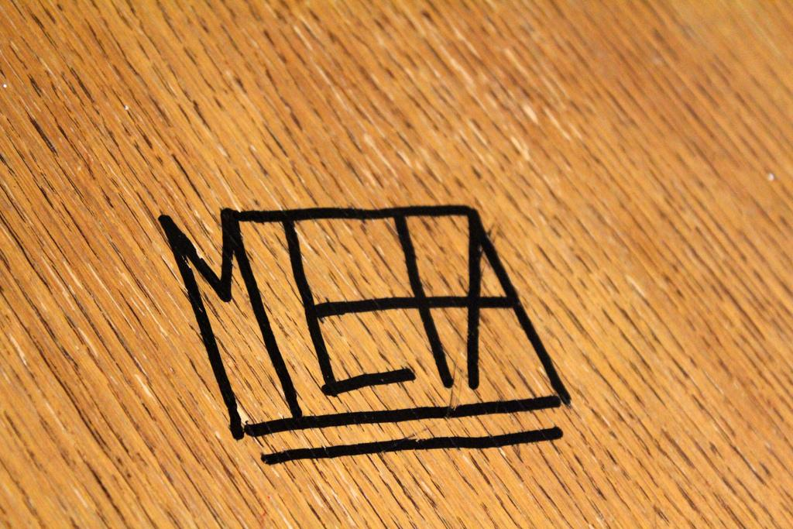
What is metadata?

Slide 13
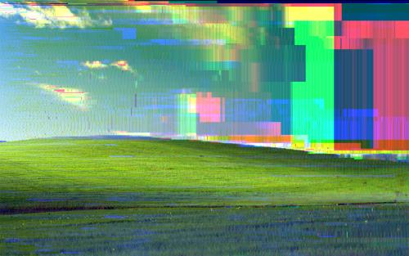
Basic metadata should include:
Title
Creators
Date(s)
Version
Identifiers (for published data)
Location (online and/or physical)
Archive/Distributor (for archived data)
It’s data about data!

Slide 14
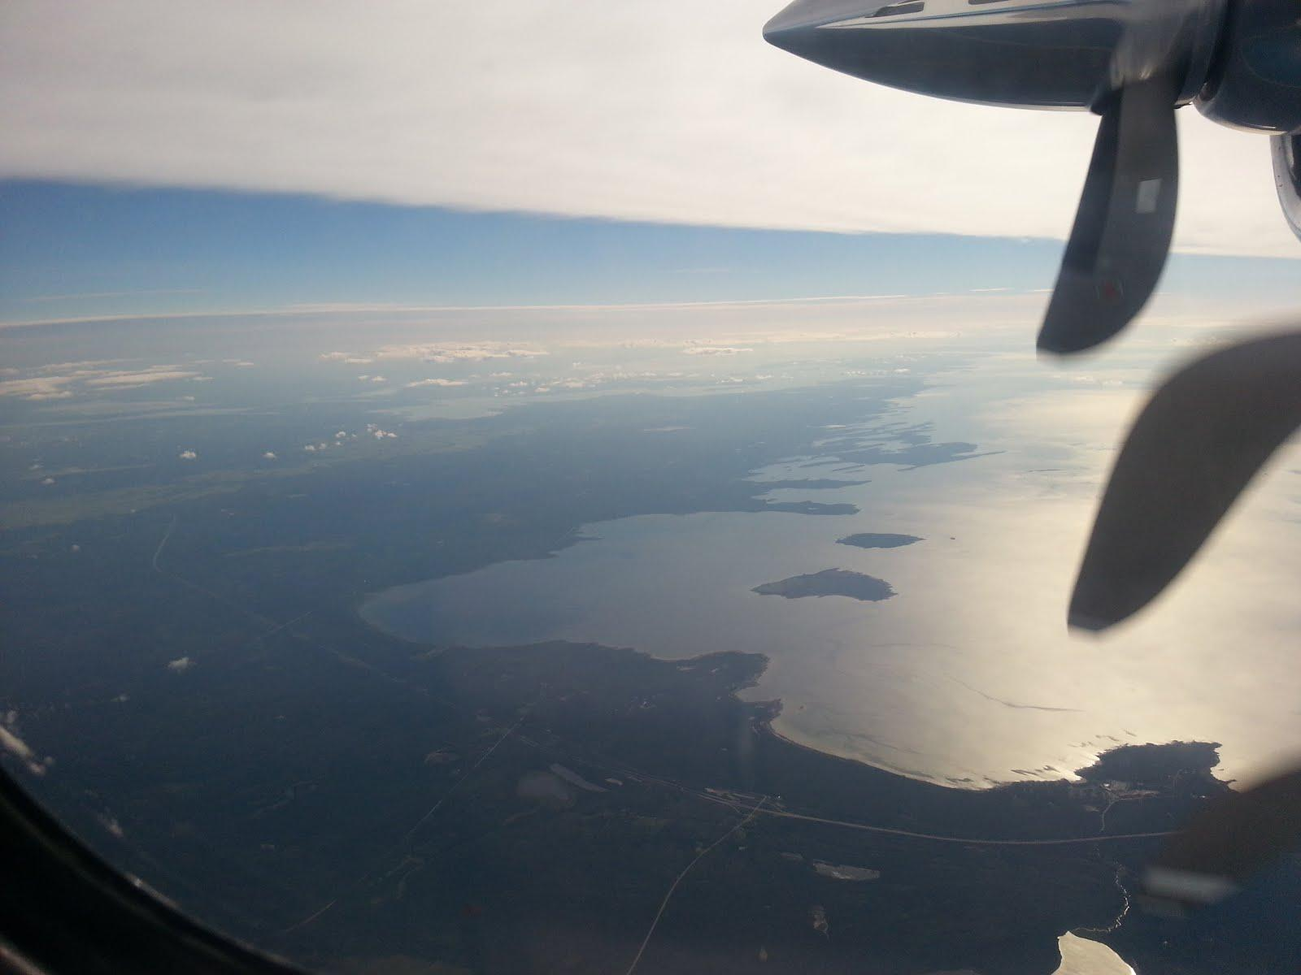
How do I create metadata?
As simple as a text file!
Example:
http://www.usap-data.org/entry/NSF-ANT07-39464/2013-01-22_09-39-50/
Other options:
Standardized XML code

Slide 15
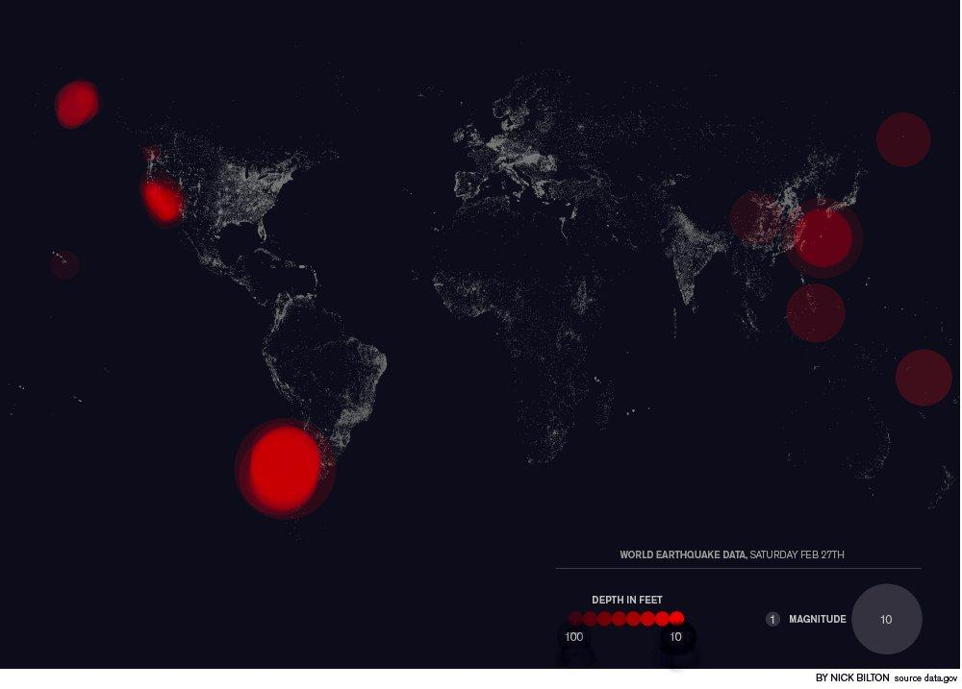
Good metadata should:
Follow community- or discipline-based standards
http://www.dcc.ac.uk/resources/metadata-standards
Use consistent and documented conventions in the absence of standards
Allow intended users to:
Discover data
Understand data
Reuse data

Slide 16
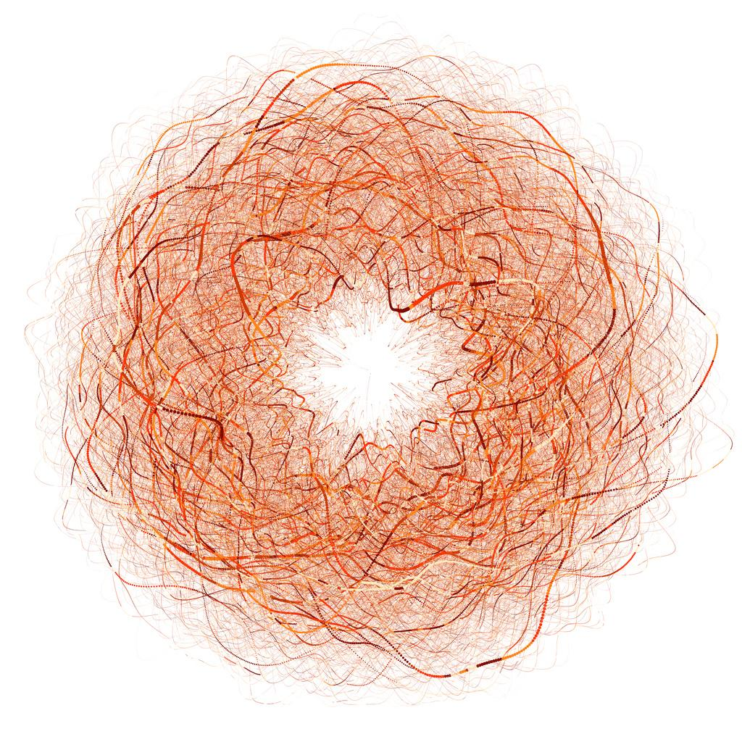
Why do we care about research data management?

Slide 17

Good for science
Reproducibility
Efficiency
Innovation
Good for you
More usage (including citations)
More exposure to potential collaborators
More competitive grant applications

Slide 18

Increased Visibility
By:
Archiving data in a disciplinary repository
Example: Dryad
Publishing data
Publishing data sets
Example: Figshare
Publishing peer-reviewed data papers
Example: http://www.earth-syst-sci-data.net/5/57/2013/essd-5-57-2013.pdf

Slide 19
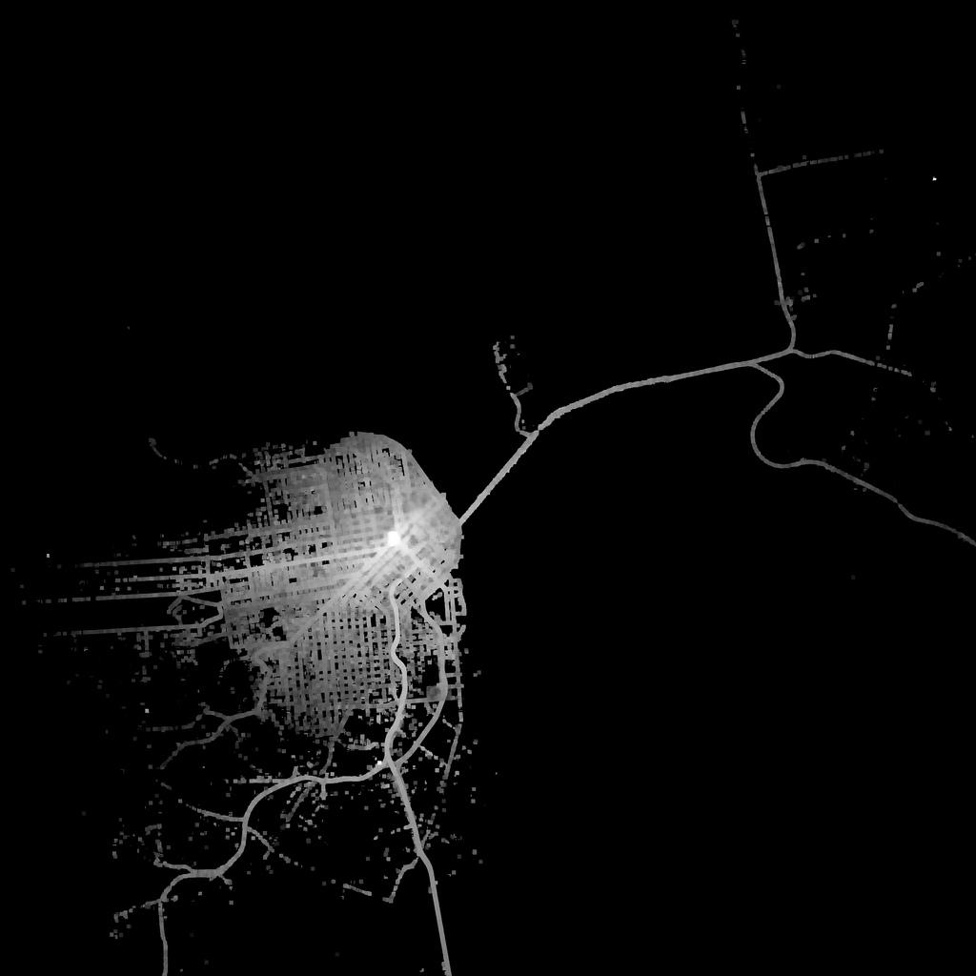
Data Management Plans for Grants
1. Go to DMPTool (http://dmptool.org)
2. Log in with institutional credentials (or create an account)
3. Find appropriate funding agency template
4. Fill out each section of the DMP
5. Export file for grant application or other use

Slide 20
Internal Competitions
Innovative Seed Grants
Best Digital Data Management Plans and Practices
2014 Winners:
L. Erin Baxter (Anthropology)
Joanna Boehnert (CIRES)
Lindsay Skog (Geography)
Yuko Munakata (Psychology and Neuroscience)
2014 Honorable Mention:
Julie Lundquist (ATOC)

Slide 21
Campus Resources
Research Data Services
Website: http://data.colorado.edu
Email: data-help@colorado.edu

Slide 22
Thank you!
Copyright 2014 by Andrew Johnson and Shelley Knuth
This work is licensed under a Creative Commons Attribution 3.0 Unported License.

Slide 23
Image credits
Slide 4: “Data”, https://flic.kr/p/bJDnpB
Slide 5: “Earth's City Lights 1994”, https://flic.kr/p/dywxTR
Slide 6: “Social graph”, https://flic.kr/p/fnzLPk
Slide 7: “The Cat's Paw Remastered”, https://flic.kr/p/ctRpEw
Slide 8: “Landsat data of Beijing in 2010”, https://flic.kr/p/cE8fns
Slide 9: “Card catalogs at Sterling Memorial Library, kept only for appearances”, https://flic.kr/p/cKHzQ
Slides 10-11: “Geography of Twitter @replies”, https://flic.kr/p/avgZqq
Slide 12: “Metadata”, https://flic.kr/p/9BZ7rG
Slide 13: “Pure Data File Killer - Bliss (sgi)”, https://flic.kr/p/h4RV3y
Slide 14: “Collecting Data from the Air”, https://flic.kr/p/jRk9Fp
Slide 15: “Earthquake Data, Feb 27th”, https://flic.kr/p/7GaoYw
Slide 16: “Wired UK - NDNAD Infographic”, https://flic.kr/p/6tV5SZ
Slide 17: “Milky Way”, https://flic.kr/p/9q6g4U
Slide 18: “Government and library open data using Creative Commons tools”, https://flic.kr/p/9rnTdL
Slide 19: “20 minutes from 4th and Market by car”, https://flic.kr/p/8FDzna

