Slide 1
ARIA Productivity Agent
By :- Vadher Dhruvil Roll no: 2302106060

Slide 2
Introduction
ARIA stands for Advanced Responsive Intelligence Agent
It is a Python-based productivity application
Helps users manage:
Tasks
Time
Habits
Focus
Includes an AI chatbot for guidance
Designed to improve daily productivity and efficiency

Slide 3
Task performed
*Developed modules:
Task Manager
Pomodoro Timer
Habit Tracker
AI Chatbot
Designed UI using CustomTkinter
* Implemented:
CRUD operations
Real-time updates

Slide 4
Project Overview
A multi-functional productivity system combining:
Task Manager with Pomodoro
Productivity Scoring System
AI-based Coaching Assistant
local Chatbot for user interaction
Location-based relaxation suggestions
Focused on improving both efficiency and user well-being

Slide 5
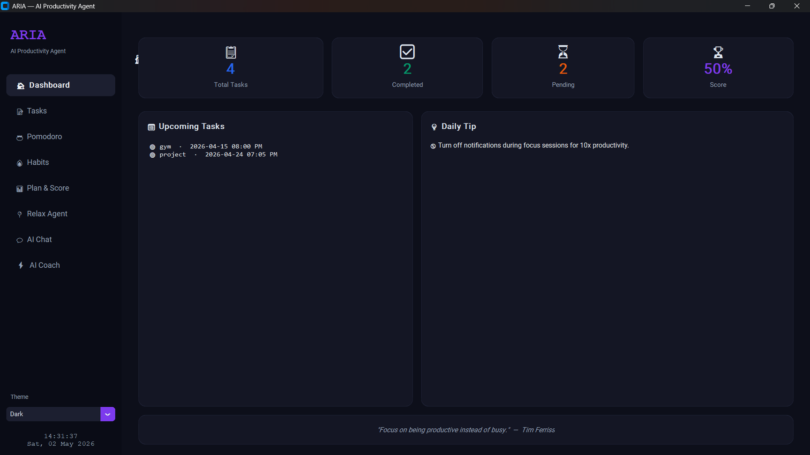
Screenshots

Slide 6
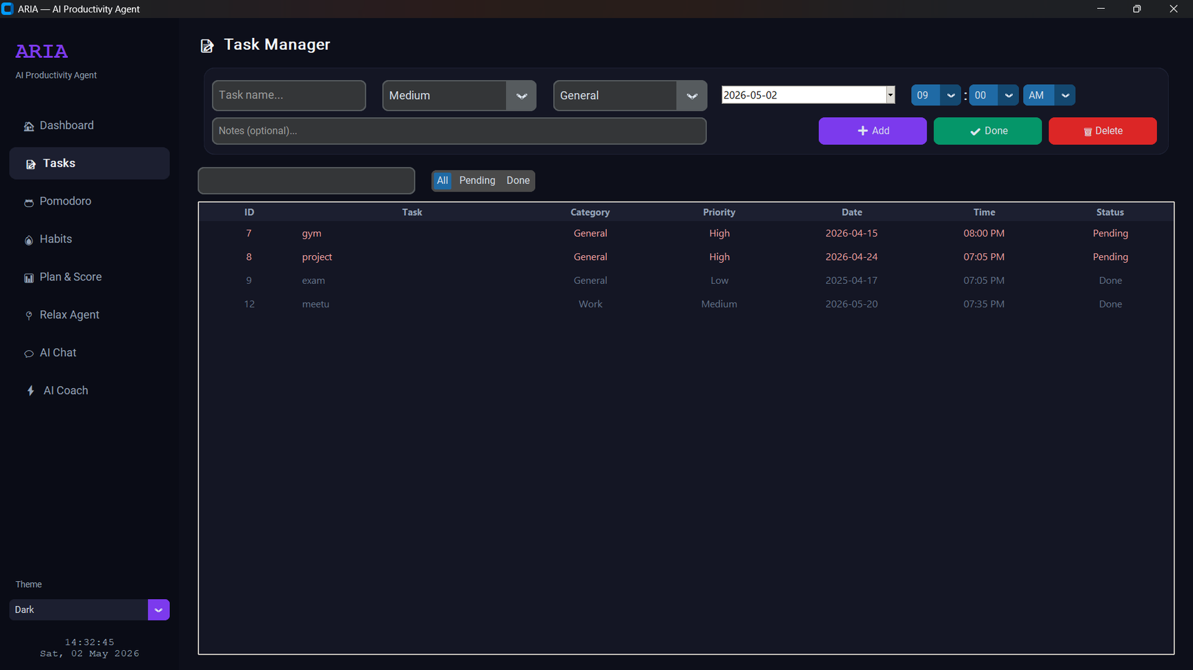
Screenshots

Slide 7
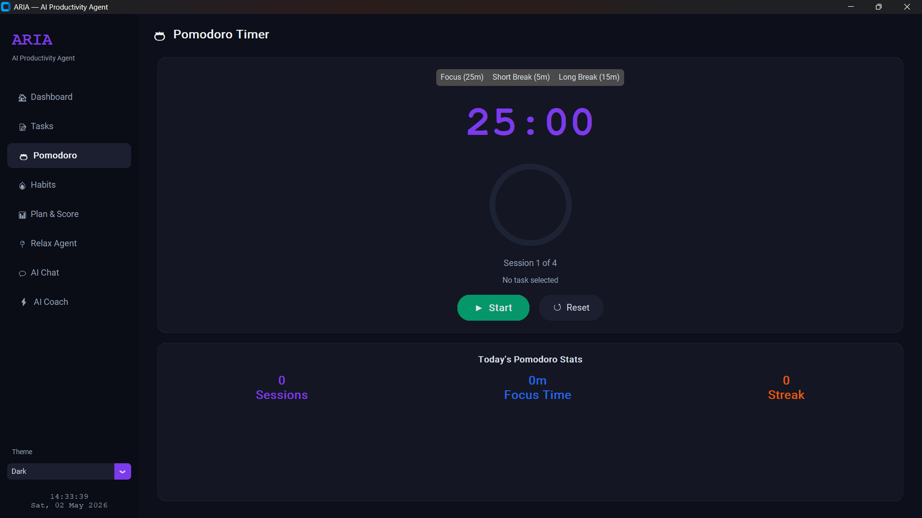
Screenshots

Slide 8
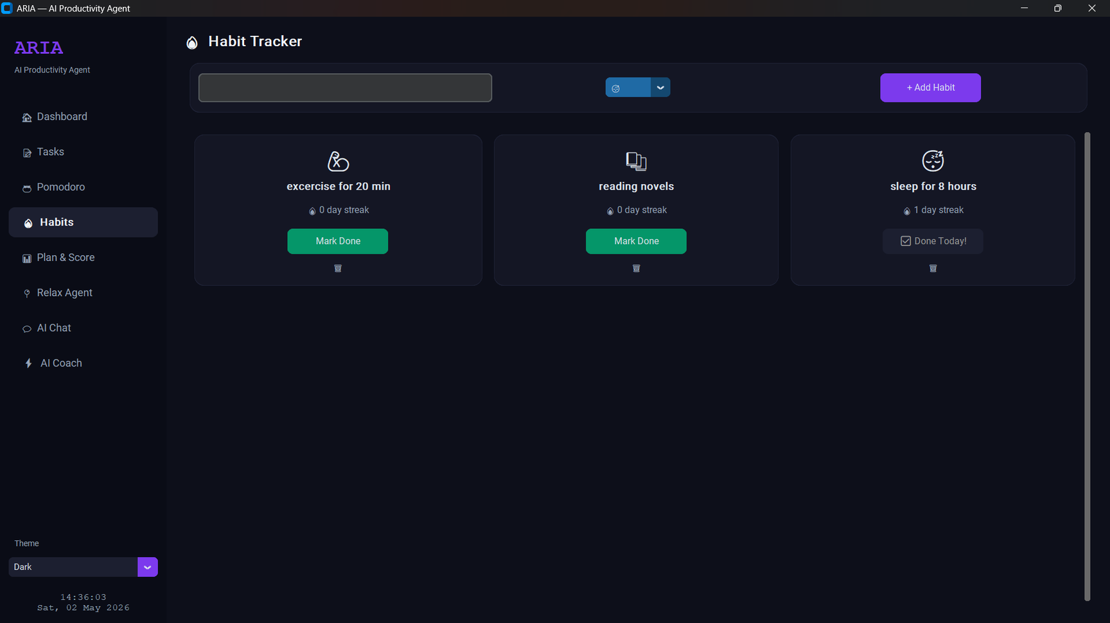
Screenshots

Slide 9
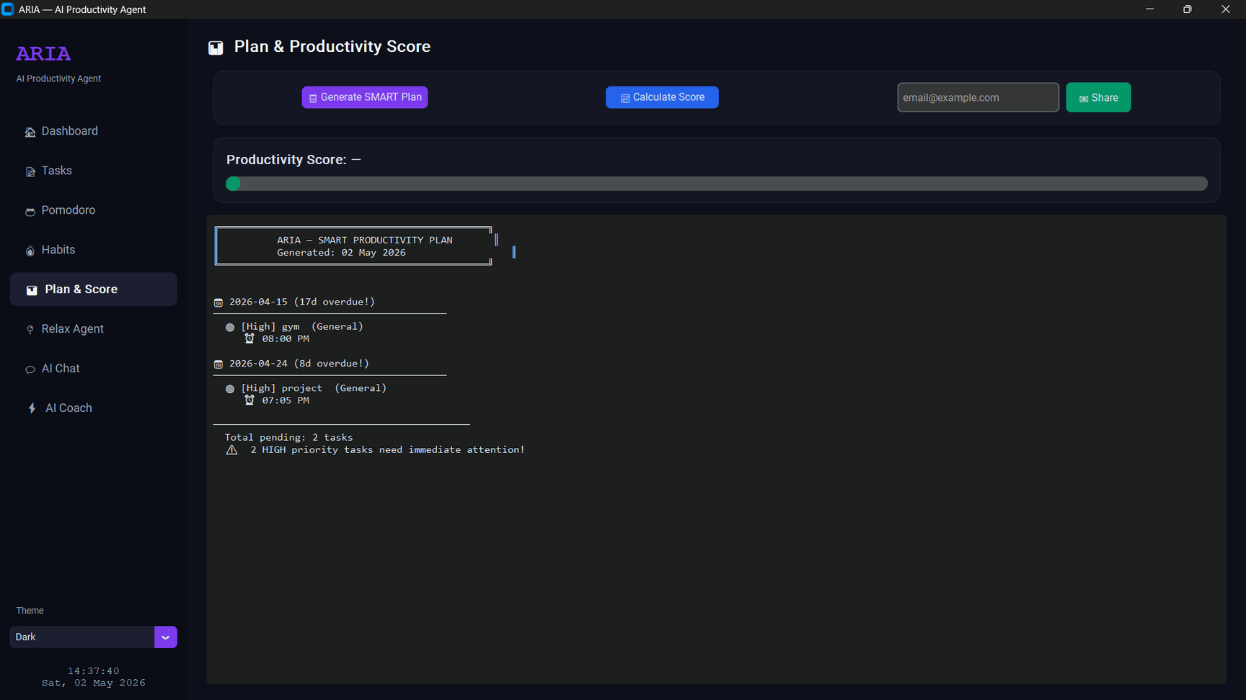
Screenshots

Slide 10
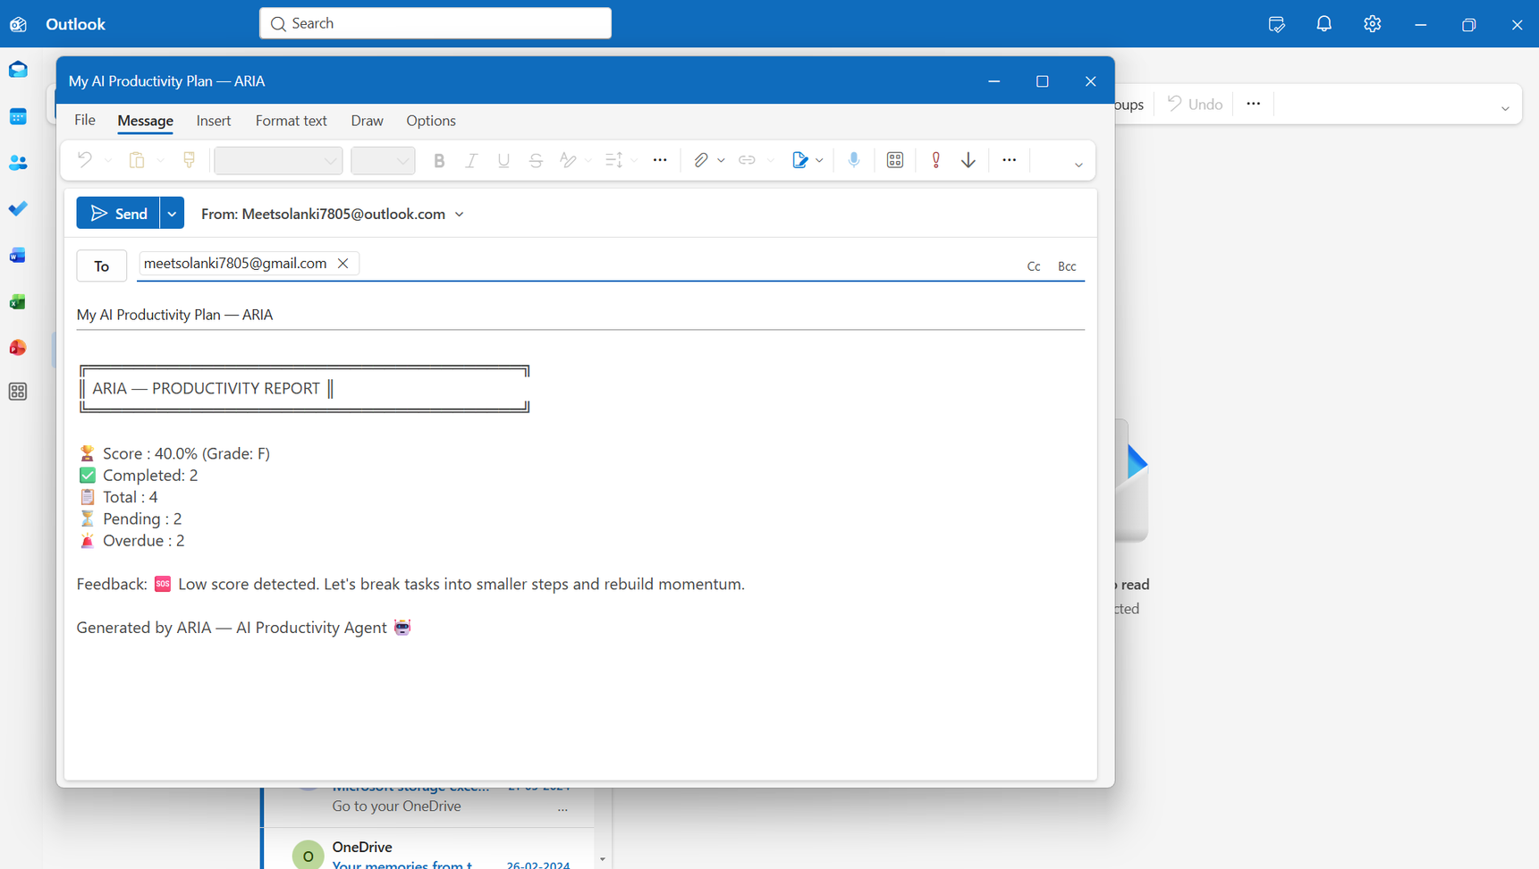
Screenshots

Slide 11
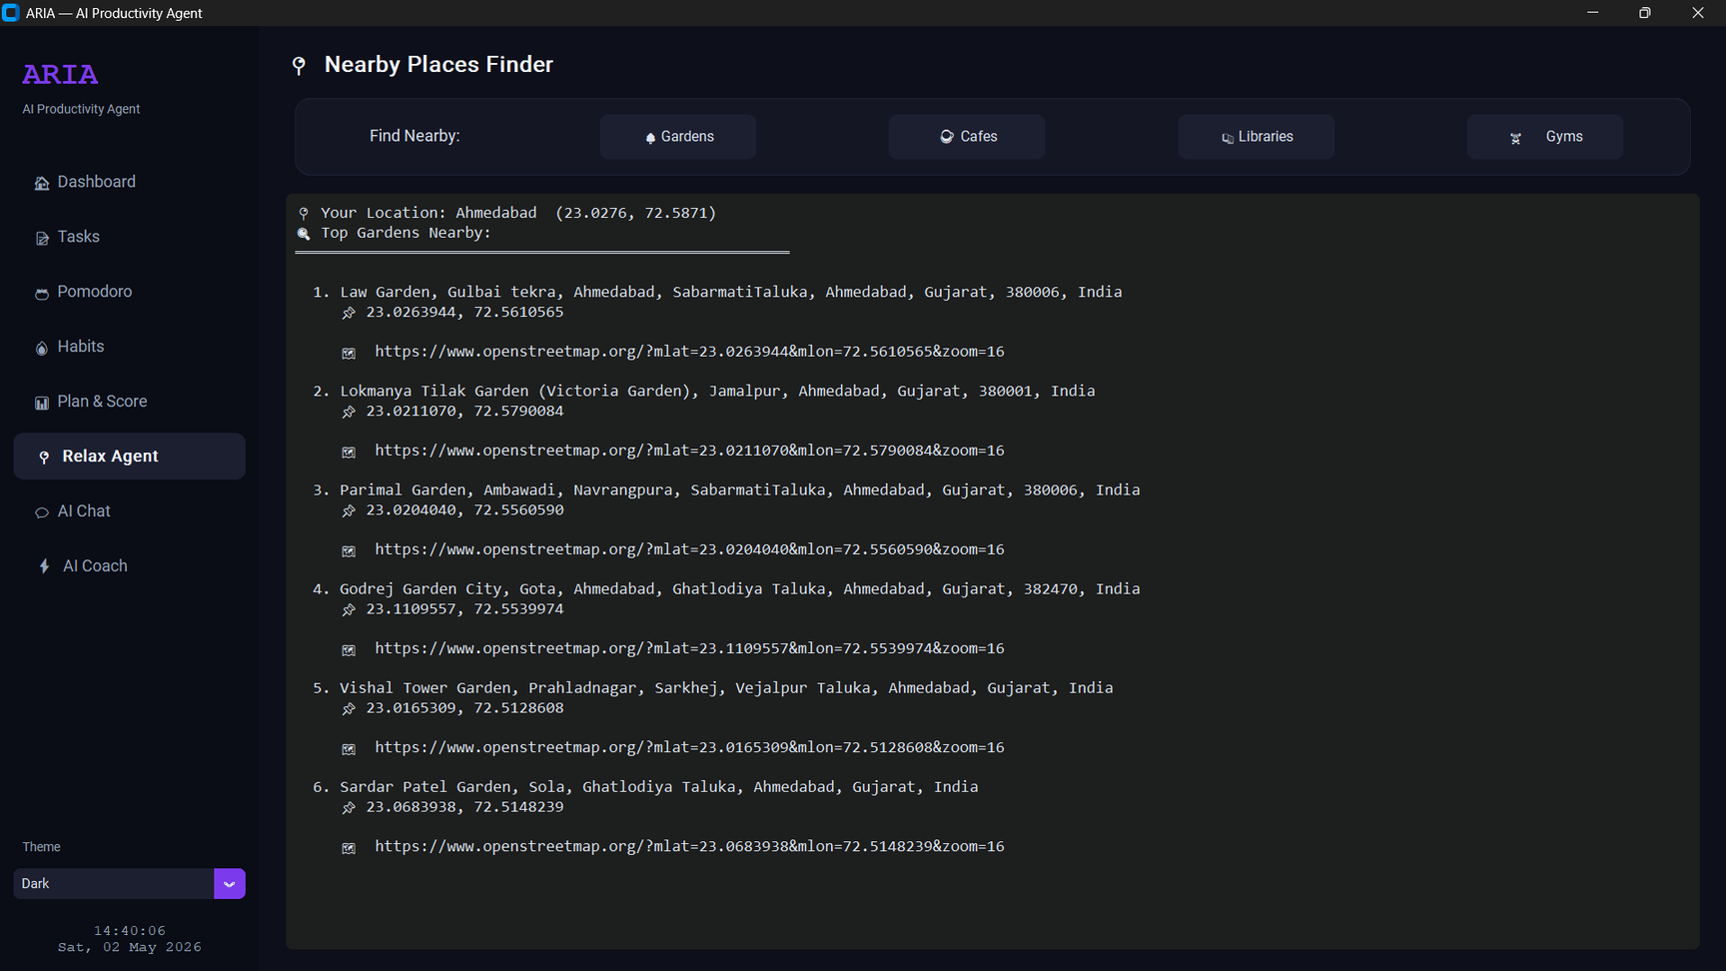
Screenshots

Slide 12
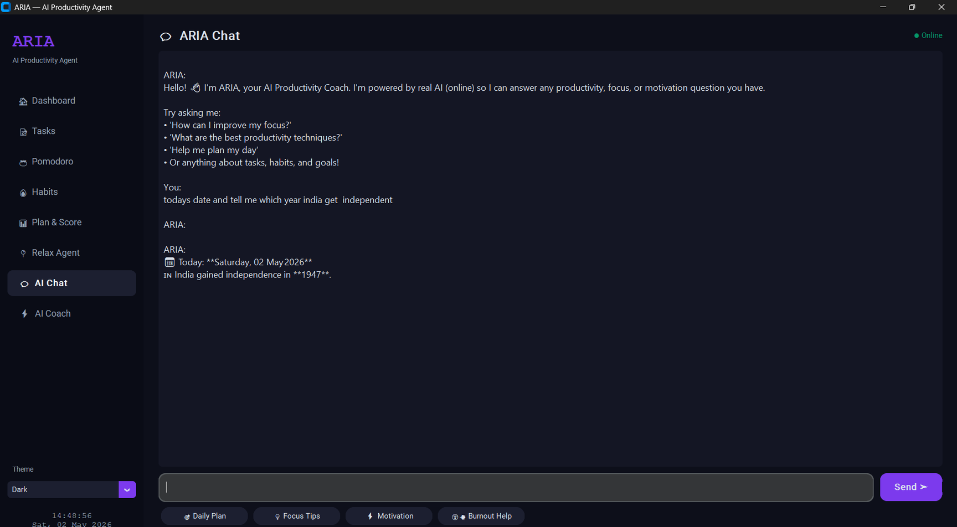
Screenshots

Slide 13
Learning Outcomes
Learning Outcomes
Gained practical experience in development using Python
Understood UI and Color logic
Understood Python Library for better performance
Improved problem-solving and debugging skills

Slide 14
Conclusion
Successfully combined Task Management, Pomodoro Timer, Habit Tracker, SMART Planning, and AI Coaching into one cohesive desktop application.
Provides a user-friendly and efficient productivity solution
Demonstrated practical AI integration using free Pollinations AI — no paid API key — with an offline fallback system for reliability.

Slide 15
Thank you!

