Slide 1
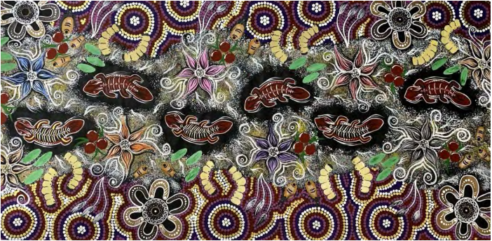
Barngarla Songs

