Slide 1
Using intel C/C++ compiler for Integrated graphics
Intel Software Professionals Conference
COLLABORATE. INNOVATE. ENRICH.
DPD / MCC / Gen compiler
August 12, 2015
Konstantin Bobrovsky
Sergey Dmitriev

Slide 2
Legal Notice
This presentation is for informational purposes only. INTEL MAKES NO WARRANTIES, EXPRESS OR IMPLIED, IN THIS SUMMARY.
[BunnyPeople, Celeron, Celeron Inside, Centrino, Centrino Inside, Core Inside, i960, Intel, the Intel logo, Intel Atom, Intel Atom Inside, Intel Core, Intel Inside, the Intel Inside logo, Intel NetBurst, Intel NetMerge, Intel NetStructure, Intel SingleDriver, Intel SpeedStep, Intel Sponsors of Tomorrow., the Intel Sponsors of Tomorrow. logo, Intel StrataFlash, Intel Viiv, Intel vPro, Intel XScale, InTru, the InTru logo, InTru soundmark, Itanium, Itanium Inside, MCS, MMX, Pentium, Pentium Inside, skoool, the skoool logo, Sound Mark, The Journey Inside, vPro Inside, VTune, Xeon, and Xeon Inside] are trademarks of Intel Corporation in the U.S. and other countries.
*Other names and brands may be claimed as the property of others.
Microsoft, Windows, and the Windows logo are trademarks, or registered trademarks of Microsoft Corporation in the United States and/or other countries.
Java and all Java based trademarks and logos are trademarks or registered trademarks of Sun Microsystems, Inc. in the U.S. and other countries.
Bluetooth is a trademark owned by its proprietor and used by Intel Corporation under license.
Intel Corporation uses the Palm OS® Ready mark under license from Palm, Inc.
Copyright © 2015, Intel Corporation. All rights reserved.

Slide 3
Executive Summary
Intel Integrated Graphics (aka Gen) brings compute power on-chip
Would be nice to harness it in new apps or boost the old ones
... and do this the easy way
... The easy way is using the Intel C/C++ compiler for the integrated graphics
This tutorial will show how

Slide 4
Agenda
Introduction
What is Intel Integrated Graphics (aka Gen)
How people program it w/o Intel compiler?
Why use Intel compiler?
Tutorial exercises
Key Results
Q&A

Slide 5
Introduction
What is Gen, how to program it

Slide 6
Gen architecture

Slide 7
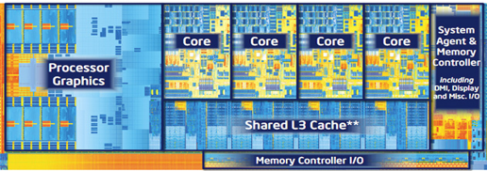
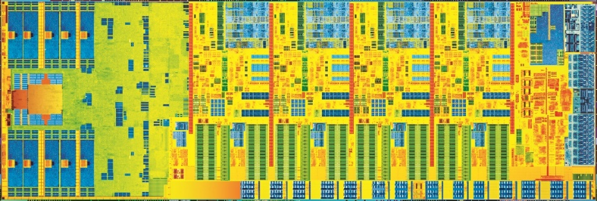
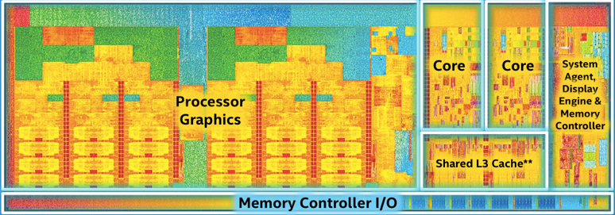
What is Intel Integrated Graphics?
3rd Generation Intel® Processors
4th Generation Intel® Processors
5th Generation Intel® Processors
Lots of compute power for data-parallel apps
Notes:
*** INSTRUCTIONS ***
Recommend focus on specific compelling goal or key objectives, such as a specific strategic goal, business need, specific process improvement, fulfill primary use case or key-use cases. For example, describe primary use case or key-use cases to be provided, performance improvement, quality improvement, competitive analysis, security threat addressed, business/development efficiency or TTM improvement, etc. Include what is in scope and not within scope, if applicable. If possible, use visual aids to clearly illustrated the problem or challenge.
State why is it important for Intel to address the challenge or problem and key groups or organizations that are affected. Include key impacts, such as expected MSS, TTM, development cost, quality, etc.
************

Slide 8
Gen architecture
Half-slice
Interface to the LLC
To LLC
Data cluster – talks to L3$ and render caches
Filtering / interpolation
Commands from the driver, including kernel code for EUs
GTI
Blitter
L1 Inst $
EU
EU
3D sampler
Tex $
“Slice common”
Display
...
2D sampler
EU
EU
Data cluster
Command streamer
3D pipeline
Rasterizer / depth
L3 $
2D/3D Pixel ops
Render$ Depth$
Formatted surfaces I/O goes thru these
Media / GPGPU pipeline
Thread spawner
Thread dispatcher
L1 Inst $
EU
EU
3D sampler
Tex $
Also URB (IVB+), SLM, constants
Video Front End (VFE)
...
2D sampler
EU
EU
Data cluster

Slide 9
Gen architecture building blocks
Gen building block hierarchy: Slice/Half slice/EU/thread/vector lane
GT (aka Gen)
MEMORY
Fixed Functions, 3D & Media pipelines
Sampler, Math,
Data port, I$…
Execution Unit
Half-slice
CPU L3 Cache =
GT Last Level Cache
CPU Core
H a l f - s l i c e
CPU Core
L3$
GT L3 Cache (Slice1)
Hardware thread
16 vector
lanes
CPU Core
Half-slice
H a l f - s l i c e
CPU Core
IVB GT2: 1 slice, 2 ½slices, 8 EUs/½slice, 8 threads/EU
Slice2
Slice1

Slide 10
Gen architecture highlights
GT is basically Fixed Functions + Shared Functions + EUs + Caches
EU is a general purpose highly parallel processor:
6/8/? H/W threads per EU
each thread has 4K register space
32 vector lanes
Share Dataport, Math, Message gateway, other shared functions
Misc peculiarities
no L1/L2$ => stack is slow
L3$ - 128K/EU
part is configurable for SLM
highly banked => efficient gathers/scatters

Slide 11
Gen architecture highlights (cont’d 1)
EU execution engine – 4 pipes, shared between threads:
FPU pipe - FP and int instructions
EM pipe - extended math instructions (message ‘send’s to EM unit)
Messaging pipe - ‘send’ instructions
Branch pipe – branch instructions
IVB: Instruction co-issue from different threads supported
4 op/cycle (FPU) + 4 op/cycle (EM) = 8 ops/cycle/EU, 128 ops/cycle per GT2
With MAD (multiply-add) – 256 ops/cycle per GT2 (256 Gflops @ 1GHz)
Integer only (no MAD, no EM): 4 ops/cycle/EU, 64 GFLops @ 1GHz
IVB Instruction latency: 14 cycles FPU, 16 cycles EM

Slide 12
Gen architecture highlights (cont’d 2)
GPGPU mode
thread groups with fast barriers and SLM
automatic thread creation
2D/3D memory layout: memory page encloses 2D/3D image tiles entirely
ISA is an ISA of general-purpose CPU (indirect branches, exceptions, calls) - efficient not only on data-parallel code
rectangular GRF regions (with strides) as operands
(nested) simd control flow
per-lane predication
Physically shared memory between CPU and GPU – different memory model until BDW though
1024 bit reads/writes in a single memory access
BDW: Shared Virtual Memory (SVM) – can share pointers between CPU and GPU, need OS cooperation

Slide 13
Architecture summary
Arch | CPU code name / Soc code name | Year | EU count | Thr / EU | Freq, GHz | Peak GFLOPs (MAD) |  | FP performance details
 |  |  |  |  |  | Single | Double | 32bit /EU /clk | 64bit /EU /clk | 16bit /EU /clk | Transcend 32bit /EU /clk
Gen5 | ILK Ironlake | 2010 |  |  | 0.77 | 74 | N/A
Gen6 | SNB SandyBridge | 2011 | 6/12 | 4-GT1 5-GT2 | 1.3 | 125 | N/A | 4 |  |  | 4
Gen7 | IVB Ivybridge | 2012 | 8/16, 8 T/EU | 6-GT1 8-GT2 | 0.975 | 250 | 62 | 8 | 2 | 8 | 4
Gen7.5 | HSW Haswell / VLV ValleyView | 2013 | 10/12/20/40 | 7 | 0.9 | 640 | 160 | 8 | 2 | 8 | 4
Gen8 | BDW Broadwell / CHV Cherryview | 2014 | 24-96 | 7 | 0.9 | 1382 | 346 | 8 | 2 | 16 | 2
Gen9 | SKL Skylake / BXT Broxton | 2015

Slide 14
Programming models

Slide 15
Programming models for Gen - OpenCL
Target code
Host code
void BlackScholesBody(
__global float *call, __global float *put,
float S, float X, float T, float R, float V)
{
float sqrtT = SQRT(T);
float d1 = (LOG(DIV(S,X)) + (R + 0.5f*V*V) * T) / (V*sqrtT);
float d2 = d1 - V * sqrtT;
float CNDD1 = CND(d1);
float CNDD2 = CND(d2);
//Calculate Call and Put simultaneously
float expRT = EXP(- R * T);
*call = (S * CNDD1 - X * expRT * CNDD2);
*put = (X * expRT * (1.0f - CNDD2) - S * (1.0f - CNDD1));
}
__kernel void BlackScholes(
__global float *d_Call, //Call option price
__global float *d_Put, //Put option price
__global float *d_S, //Current stock price
__global float *d_X, //Option strike price
__global float *d_T, //Option years
float R, //Riskless rate of return
float V, //Stock volatility
unsigned int optN)
{
unsigned int opt = get_global_id(0);
BlackScholesBody(&d_Call[opt], &d_Put[opt],
d_S[opt], d_X[opt], d_T[opt], R, V );
}
const cl_mem_flags f_ro = CL_MEM_READ_ONLY | CL_MEM_USE_HOST_PTR;
const cl_mem_flags f_wo = CL_MEM_WRITE_ONLY | CL_MEM_USE_HOST_PTR;
size_t size = sizeof(cl_float) * optionCount;
if (!(&SBuf = clCreateBuffer(m_cxt, f_ro, size,h_S, &err))
|| !(&TBuf = clCreateBuffer(m_cxt, f_ro, size,h_T, &err))
|| !(&XBuf = clCreateBuffer(m_cxt, f_ro, size,h_X, &err))
|| !(&callPriceBuf = clCreateBuffer(m_cxt, f_wo, size, callPrice, &err))
|| !(&putPriceBuf = clCreateBuffer(m_cxt, f_wo, size, putPrice, &err))
|| err != CL_SUCCESS)
{ return false; }
if ((clSetKernelArg(m_krn,0,sizeof(cl_mem),&callPriceBuf) != CL_SUCCESS)
||(clSetKernelArg(m_krn,1,sizeof(cl_mem), &putPriceBuf) != CL_SUCCESS)
||(clSetKernelArg(m_krn,2,sizeof(cl_mem), &SBuf) != CL_SUCCESS)
||(clSetKernelArg(m_krn,3,sizeof(cl_mem), &XBuf) != CL_SUCCESS)
||(clSetKernelArg(m_krn,4,sizeof(cl_mem), &TBuf) != CL_SUCCESS)
||(clSetKernelArg(m_krn,5,sizeof(cl_float), &R) != CL_SUCCESS)
||(clSetKernelArg(m_krn,6,sizeof(cl_float), &V) != CL_SUCCESS)
||(clSetKernelArg(m_krn,7,sizeof(cl_uint),&optionCount) != CL_SUCCESS))
{ false; }
size_t globalWorkSize = optionCount;
size_t localWorkSize = 512;
if (clEnqueueNDRangeKernel(
m_queue, m_kernel, (cl_uint)sz_dimensions, NULL,
globalWorkSize, localWorkSize, 0, NULL, e) != CL_SUCCESS)
{ return false; }
if (clFinish(m_queue) != CL_SUCCESS) { return false; }
if ((clReleaseMemObject(SBuf) != CL_SUCCESS)
||(clReleaseMemObject(TBuf) != CL_SUCCESS)
||(clReleaseMemObject(XBuf) != CL_SUCCESS)
|| (clReleaseMemObject(callPriceBuf) != CL_SUCCESS)
|| (clReleaseMemObject(putPriceBuf) != CL_SUCCESS))
{ return false; }
return true;
Parallelization is manual
and can be much more complex. Algorithm is per 1 “vector lane” (work item) and is split between host and device.

Slide 16
Programming models – Microsoft AMP
void blackscholes::execute()
{
const array<float, 1> a_stock_price(data_size, stock_price.begin());
const array<float, 1> a_option_strike(data_size, option_strike.begin());
const array<float, 1> a_option_years(data_size, option_years.begin());
array<float, 1> a_call_result(data_size);
array<float, 1> a_put_result(data_size);
float R = riskfreerate;
float V = volatility;
assert((data_size%BSCHOLES_TILE_SIZE) == 0);
parallel_for_each(extent<1>(data_size).tile<BSCHOLES_TILE_SIZE>(),
[=, &a_stock_price, &a_option_strike, &a_option_years, &a_call_result, &a_put_result](tiled_index<BSCHOLES_TILE_SIZE> tidx) restrict(amp)
{
float S = a_stock_price(tidx.global[0]);
float X = a_option_strike(tidx.global[0]);
float T = a_option_years(tidx.global[0]);
float sqrtT = fast_math::sqrtf(T);
float d1 = (fast_math::logf(S / X) + (R + 0.5f * V * V) * T) / (V * sqrtT);
float d2 = d1 - V * sqrtT;
float cndd1 = cnd_calc(d1);
float cndd2 = cnd_calc(d2);
float exp_RT = fast_math::expf(-R * T);
a_call_result[tidx.global[0]] = S * cndd1 - X * exp_RT * cndd2;
a_put_result[tidx.global[0]] = X * exp_RT * (1.0f - cndd2) - S * (1.0f - cndd1);
});
copy(a_call_result, call_result_amp.begin());
copy(a_put_result, put_result_amp.begin());
}
Source:
http://blogs.msdn.com/b/nativeconcurrency/archive/2012/03/16/black-scholes-using-c-amp.aspx
Pro
Standard C++ syntax (with tiny exceptions)
Host and target code in one place
Con
Porting from older parallel code requires re-writing
Semi-automatic parallelization

Slide 17
Programming models for Gen – CilkPlus
__declspec(target(gfx)) __declspec(vector(linear(call:1, put:1)))
void BlackScholesBody(float* call, float* put, float S, float X, float T, float R, float V)
{
float sqrtT = sqrtf(T);
float d1 = (logf(S / X) + (R + 0.5f * V*V) * T) / (V*sqrtT);
float d2 = d1 - V * sqrtT;
float CNDD1 = CND(d1);
float CNDD2 = CND(d2);
//Calculate Call and Put simultaneously
float expRT = expf(- R * T);
*call = (float)(S * CNDD1 - X * expRT * CNDD2);
*put = (float)(X * expRT * (1.0f - CNDD2) - S * (1.0f - CNDD1));
}
void BlackScholes(
float *Call, //Call option price
float *Put, //Put option price
float *S, //Current stock price
float *X, //Option strike price
float *T, //Option years
float R, //Riskless rate of return
float V, //Stock volatility
unsigned int optCnt) //Option count
{
#pragma offload target(gfx) pin(Call, Put, S, X, T : length(optCnt))
_Cilk_for (int i = 0; i < optN; i++) {
BlackScholesBody(&Call[i], &Put[i], S[i], X[i], T[i], R, V);
}
}
Pro
Standard C/C++ syntax (with tiny exceptions)
Host and target code in one place
Little efforts to port older parallel code
Fully automatic parallelization

Slide 18
Why use Intel compiler?
void vecadd(int n, float *a, float *b, float *c)
{
}
Usual C/C++ with small extensions => easy learning and porting
Industry standards (CilkPlus® and OpenMP) support for parallel programming
True separate linkage of the target code
#pragma offload target(gfx) pin(a, b, c : length(n))
_Cilk_for (int i=0; i < n; i++) {
a[i] = b[i] + c[i];
}
#pragma offload target(gfx) pin(a, b, c : length(n))
a[0:n] = b[0:n] + c[0:n];
#pragma omp target map(tofrom: a[0:n], b[0:n], c[0:n]) \
map(to: n)
#pragma omp parallel for
for (int i=0; i < n; i++) {
a[i] = b[i] + c[i];
}
Three syntax alternatives

Slide 19
Gen C/C++ Compiler and Runtime workflow intro

Slide 20
Compilation process flow
a.cpp and b.cpp
Compile time:
icc –c a.cpp b.cpp
a.o and b.o
a.o and b.o has target object code as .gfxobj section
Temp target objects deleted
icc a.o b.o –o app
Executable has target executable embedded
The target executable can be extracted from fat executable using offload_extract tool (shipped with the compiler)
icc
Host compiler
Target compiler
a.o and b.o
tmpa.o and tmpb.o
a.o and b.o (with .gfxobj)
Host and target linker
app (ELF)
appGFX.gfx (ELF)

Slide 21
Linking flow
Obj1.o
1
2
3
Binutils ld
tmp1.o
vISA linker
tmp2.o
Binutils ld
vISA
a.out
Lib1.a
4
Jitter
3-4 steps of GFX image linking
Intermediate linking performed by GNU binutils linker.
GFX objects and static libraries produces relocatable ELF object file with all vISA(s) concatenated in .text section
vISA linking + link-time optimizations.
Links vISA(s) contained in .text section and performs link-time optimizations on final vISA
Final linking converts relocatable object file into executable image
Optional offline Jitting produces native executable image
ISA
a.out

Slide 22
Software Stack for Gen offload
This is the target code
Heterogeneous application
COFF/ELF
thread space partitioning
arguments setup
surface creation
task creation and enqueue
GFX .elf
vISA
GFX offload runtime
JITs vISA bytecode to native code
Intel HD graphics driver
Media Development Framework
vISA JIT
User mode
Kernel mode
Intel® HD graphics driver
GT hardware

Slide 23
System and compiler setup
This section tells how to setup your system for Gen offload and how to build and run the application using the compiler.

Slide 24
System Requirements
Hardware
3rd Generation Intel® Core Processor or later with HD Graphic
OS
Windows* 7, Windows* 8, Windows* 8.1, Windows* 10
Linux – limited distributions
Drivers
Windows:
http://downloadcenter.intel.com for Windows 7, 8, 8.1
Windows update for Windows 10
Linux*:
Proprietary Intel drivers made available with compiler license
Open Source drivers are available at https://github.com/01org/cmrt.git

Slide 25

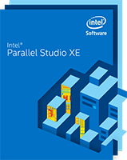
System Requirements
Compilers
Intel® System Studio 2015
Intel® System Studio 2016
Intel® Parallel Studio XE 2015
Intel® Parallel Studio XE 2016
Note: binutils required for Windows*

Slide 26
System Setup
Complete Compiler Installation
Check/Install Driver
Check for offload support
Diagnostics tool provided with compiler
gfx_sys_check
Processor (cpuid)
Processor graphics
Proper installation of drivers
Sample offloads for different driver versions
Diagnostics to help identify issues for offload
Install Binutils for Windows*

Slide 27
System Setup
Binutils
Target objects are always ELF
Target linker depends on ld
On Windows* access to a binutils package is provided
binutils version 2.24.51.20131210 for Windows
available at https://software.intel.com/en-us/articles/open-source-downloads)
Set PATH to include directory containing ld
On Linux the existing binutils is used

Slide 28
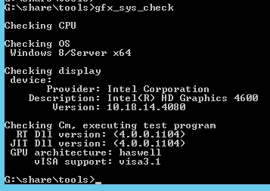
System setup: verify
Run gfx_sys_check utility supplied with the compiler
If the utility does not report errors, then your C/C++ hetero apps should work on the system

Slide 29
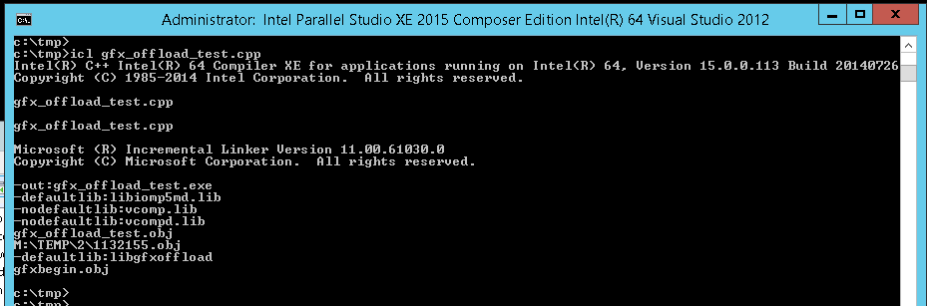
Compilation
If compiler and binutils is installed correctly, gfx hetero apps can be built. This can be done from Parallel Studio’s Visual Studio mode console:
Target compiler invocation

Slide 30
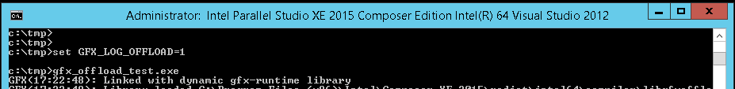
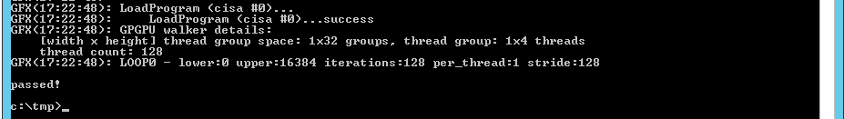
Running Gen hetero application
Prerequisites:
Proper driver and system setup – use gfx_sys_check to confirm
GFX C/C++ redistributable package
It comes with the compiler product - e.g. Parallel Studio XE
Must be in the PATH when running a hetero app
Turns on GFX runtime logging (minimal level)
Runs the hetero app
Appears only when actual offload happens

Slide 31
Examples: basics
This section tells how to do offload using different programming models supported by the Intel compiler.

Slide 32
Example1a: basic #pragma offload
// a vector function
__declspec(target(gfx)) /*executes on GPU*/ \
__declspec(vector(uniform(arr_in1,arr_in2,arr_in3), linear(i:1)))
int vec_func(int *arr_in1, int *arr_in2, int *arr_in3, int i)
{
return arr_in1[i]*arr_in2[i] + arr_in3[i];
}
static void do_test(
int *arr_out, int *arr_in1, int *arr_in2, int *arr_in3, int N, bool do_offload)
{
#pragma offload target(gfx) \
out (arr_out:length(N)) /*array copied GPU -> CPU after offload */ \
in (arr_in1:length(N)) /*array copied CPU -> GPU before offload*/ \
inout(arr_in2:length(N)) /*array copied back and forth */ \
pin (arr_in3:length(N)) /*no copying, array is physically shared*/ \
if(do_offload) /*offload happens only if c do_offload to true*/
_Cilk_for _Simd (int i = 0; i < N; i++) { // a parallel loop
arr_out[i] = vec_func(arr_in1, arr_in2, arr_in3, i); // a vector function call
}
}
Notes:
*** INSTRUCTIONS ***
Describe each of the alternatives considered and reasons for choosing this solution. Include your selection strategy and approach: what are the key attributes of each of the alternatives considered and what are the expected results of each alternative. If possible, use visual aids (pros/cons table, comparative graphs, etc.) that are easy to read.
***

Slide 33
Example1b: basic #pragma offload with AN
// a vector function
__declspec(target(gfx)) /*executes on GPU*/ \
__declspec(vector)
int vec_func(int in1, int in2, int in3)
{
return in1*in2 + in3;
}
static void do_test(
int *arr_out, int *arr_in1, int *arr_in2, int *arr_in3, int N, bool do_offload)
{
#pragma offload target(gfx) \
out (arr_out:length(N)) /*array copied GPU -> CPU after offload */ \
in (arr_in1:length(N)) /*array copied CPU -> GPU before offload*/ \
inout(arr_in2:length(N)) /*array copied back and forth */ \
pin (arr_in3:length(N)) /*no copying, array is physically shared*/ \
if(do_offload) /*offload happens only if c do_offload to true*/
arr_out[0:N] = vec_func(arr_in1[0:N], arr_in2[0:N], arr_in3[0:N]);
}

Slide 34
Example1c: basic OpenMP synatax for offload
#pragma omp declare target
// a vector function executes on GPU
#pragma omp declare simd \
uniform(arr_in1,arr_in2,arr_in3), linear(i:1)
int vec_func(int *arr_in1, int *arr_in2, int *arr_in3, int i)
{
return arr_in1[i]*arr_in2[i] + arr_in3[i];
}
#pragma omp end declare target
static void do_test(
int *arr_out, int *arr_in1, int *arr_in2, int *arr_in3, int N, bool do_offload)
{
#pragma omp target \
map(from: arr_out[0:N]) /*array copied GPU -> CPU after offload */ \
map(to: arr_in1[0:N]) /*array copied CPU -> GPU before offload*/ \
map(tofrom: arr_in2[0:N], /*tofrom is replaced with 'pin' by the compiler */ \
arr_in3[0:N]) \
if(do_offload) /*offload happens only if c do_offload to true*/
#pragma omp parallel for
for (int i = 0; i < N; i++) { // a parallel loop
arr_out[i] = vec_func(arr_in1, arr_in2, arr_in3, i); // a vector function call
}
}

Slide 35
Example1d: basic async offload
Target code:
Host calling sequence:
// a vector function
__declspec(target(gfx)) /*executes on GPU*/ \
__declspec(vector(uniform(arr_in1,arr_in2,arr_in3), linear(i:1)))
int vec_func(int *arr_in1, int *arr_in2, int *arr_in3, int i)
{
return arr_in1[i]*arr_in2[i] + arr_in3[i];
}
__declspec(target(gfx_kernel)) // gfx function callable from CPU
void do_test(
int *arr_out, int *arr_in1, int *arr_in2, int *arr_in3, int N)
{
_Cilk_for _Simd (int i = 0; i < N; i++) { // a parallel loop
// a vector function call:
arr_out[i] = vec_func(arr_in1, arr_in2, arr_in3, i);
}
}
int n = N*sizeof(int);
_GFX_share(arr_gpu, n);
_GFX_share(arr_in1, n);
_GFX_share(arr_in2, n);
_GFX_share(arr_in3, n);
GfxTaskId id = _GFX_offload(
do_test,
arr_gpu,
arr_in1,
arr_in2,
arr_in3,
N);
_GFX_wait(id);
_GFX_unshare(arr_gpu);
_GFX_unshare(arr_in1);
_GFX_unshare(arr_in2);
_GFX_unshare(arr_in3);

Slide 36
Key language and semantic restrictions
Only parallel loops can be offloaded
#pragma offload target(gfx), #pragma omp target can be put only before a parallel loop, a direct kernel body must be a parallel loop
Some of the advanced C/C++ features not supported:
Variable length arrays, indirect control flow (like virtual calls, function pointers), exceptions, RTTI, varargs, long double, longjump/setjump
Pointer use restrictions (not applicable in Shared Virtual Memory mode)
Not allowed: pointer sharing between CPU and GPU, double+ indirection pointers, dereferencing pointer-typed fields of classes and structs, &ptr

Slide 37
Conclusion
Intel C/C++ compiler for Integrated Graphics supports a number of programming models.
#pragma offload – based is most convenient
#pragma omp – based is (will be) most portable
more support is expected
Asynchronous model based on API – most flexible currently, decouples data sharing from offload execution, also allows to wait for offload completion at the desired place using _GFX_wait
#pragma offload and #pragma omp are expected to catch up

Slide 38
Examples: advanced features
This section provides usage examples for more advanced compiler features: Shared Virtual Memory and Shared Local Memory support, static variables, recursive calls.

Slide 39
Advanced features: static data
Static data is always allocated in memory
Better avoid where performance is critical
17.0 will no longer require enumerating used static data in data sharing clauses
Static data; must be declared as target(gfx)
...
__declspec(target(gfx)) int arr[N];
__declspec(target(gfx)) const int const_arr[N] =
{1,2,3,4,5,6,7,8,9,1,2,3,4,5,6,7};
static void do_test()
{
#pragma offload target(gfx) inout(arr)
_Cilk_for (int i = 0; i < N; i++) {
arr[i] = const_arr[i];
}
}
...
Constant static data
Non-constant static data must be enumerated in data sharing clauses; constant – does not need to

Slide 40
Advanced features: recursive calls & separate compilation
recurse.cpp:
recurse_func_def.cpp:
...
// Recursively calculates the factorial of the
// argument. Defined in a separate source file
__declspec(target(gfx)) extern int fact(int i);
// replaces elements of given array with their
// factorials
static void do_test(int *arr, int N, bool do_offload)
{
#pragma offload target(gfx) \
pin(arr:length(N)) if(do_offload)
_Cilk_for (int i = 0; i < N; i++) {
arr[i] = fact(arr[i]);
}
}
...
Function is defined and called in separate source files
// recursively calculates the factorial
// function of the argument
__declspec(target(gfx)) int fact(int i)
{
if (i <= 1) {
return 1;
}
return i*fact(i - 1);
}
Function is recursive

Slide 41
Advanced features: Shared Virtual Memory
...
Node** nodes = (Node**)svm_mmgr.allocate(N * sizeof(Node*));
for (int i = 0; i < N; i++) {
const char* key = svm_strdup(svm_mmgr, (i % 2) ? "one" : "zero");
void* arena = svm_mmgr.allocate(sizeof(Node));
nodes[i] = new(arena) Node(key);
}
char* key_one = svm_strdup(svm_mmgr, "one");
__pragma(offload target(gfx))
_Cilk_for(int i = 0; i < N; i++) {
if (gfx_strcmp(key_one, nodes[i]->get_key()) == 0) {
nodes[i]->set_value(1);
}
}
...
Shared SVM memory must be specially allocated – this boils down to _GFX_svm_alloc API call
Limitations:
SVM works only on BDW+ Windows 10+
no Linux support currently
Usage:
Compile with -Qoffload-svm
In future it will be possible to share usual malloc-ed memory w/o the need in _GFX_svm_alloc
note that there is no a 'pin' or other data sharing clause - it is not needed with SVM!
in SVM mode a pointer read from memory can be dereferenced:

Slide 42
Advanced features: Shared Local Memory
// SLM-based algorithm - cache B's vertical stripes in SLM
__declspec(target(gfx_kernel)) void matmult3(
int SIZE_K, int SIZE_X, int SIZE_Y, DTYPE *AA, DTYPE *BB, DTYPE *CC) {
_Cilk_for _Thread_group (int tg_x = 0; tg_x < SIZE_X; tg_x += TILE_X) {
...
// declare "supertiles" of B matrix to be allocated in SLM
__thread_group_local DTYPE slm_btile[SIZE_K_C][TILE_X];
// initialize the B's supertile (in parallel)
_Cilk_for (int i0 = 0; i0 < SIZE_K_C; i0++) {
slm_btile[i0][:] = B[i0][tg_x:TILE_X];
}
_gfx_gpgpu_thread_barrier();
// calculate the tg_x's column of tiles in the result matrix
_Cilk_for (int super_y = 0; super_y < SIZE_Y; super_y += TILE_Y) {
// each thread calculates its own tile in the column - which is
// a dot product of A's tile row and the cached column
// allocate tiles in registers
DTYPE atile[TILE_Y][TILE_K], btile[TILE_X], ctile[TILE_Y][TILE_X];
// ... and initialize ctile to zero
ctile[:][:] = (DTYPE)0;
...
Key concepts:
Two-level nested parallelism
_Cilk_for Thread_group is a 1st- level parallel loop. Iterations are distributed among thread groups (or teams in OpenMP terms)
Nested _Cilk_fors are 2nd-level parallel loops. Iterations are distributed among threads in a group.
__thread_group_local - data local to and shared by threads in a group – 1 copy per group.
_gfx_gpgpu_thread_barrier - intra-group thread barrier
SLM resembles OpenCL’s _local space
Supported on HSW+

Slide 43
Examples: heterogeneous execution
This section demonstrates dividing the work between CPU and GPU using Nbody gravity simulation as the example.

Slide 44
N-Body simulation
N particles
Each has its own mass, position and velocity in 3D space
Particles are moving by influence of mutual gravitational forces
Classic simulation has O(N²) computational complexity

Slide 45
N-Body simulation: main loop
_Cilk_for (int i = start; i < end; ++i) {
Vector3<float> acc = 0.0f;
for (int j = 0; j < body_count; ++j) {
Vector3<float> dist = old_pos[j] - old_pos[i];
float len = sqrtf(dot(dist, dist) + epsilon);
acc += dist * masses[j] / (len * len * len);
}
new_vel[i] = old_vel[i] + acc * time;
new_pos[i] = old_pos[i] + old_vel[i] * time + acc * time * time / 2;
}
Straightforward approach is to add #pragma offload to the main loop

Slide 46
N-Body simulation: #pragma offload
#pragma offload target(gfx) pin(old_pos, old_vel, new_pos, new_vel: length(body_count))
_Cilk_for (int i = start; i < end; ++i) {
Vector3<float> acc = 0.0f;
for (int j = 0; j < body_count; ++j) {
Vector3<float> dist = old_pos[j] - old_pos[i];
float len = sqrtf(dot(dist, dist) + epsilon);
acc += dist * masses[j] / (len * len * len);
}
new_vel[i] = old_vel[i] + acc * time;
new_pos[i] = old_pos[i] + old_vel[i] * time + acc * time * time / 2.0f;
}
May eliminate pining/unpining overhead by moving loop body to an asynchronous kernel
Pinning/unpinning should be done in initialization and cleanup code

Slide 47
N-Body simulation: asynchronous kernel
__declspec(target(gfx_kernel))
void nbody_kernel(int start, int end, int body_count, float *masses, ...) {
_Cilk_for (int i = start; i < end; ++i) {
Vector3<float> acc = 0.0f;
for (int j = 0; j < body_count; ++j) {
Vector3<float> dist = old_pos[j] - old_pos[i];
float len = sqrtf(dot(dist, dist) + epsilon);
acc += dist * masses[j] / (len * len * len);
}
new_vel[i] = old_vel[i] + acc * time;
new_pos[i] = old_pos[i] + old_vel[i] * time + acc * time * time / 2.0f;
}
}
// Run kernel asynchronously followed by the wait
_GFX_offload(nbody_kernel, start, end, masses, old_pos, old_vel,
new_pos, new_vel, epsilon, time);
_GFX_wait();

Slide 48
N-Body simulation: blocking
_Cilk_for (int i = start; i < end; i += TILE) {
GFXVector3<float> pos[TILE];
GFXVector3<float> acc[TILE];
pos[0:TILE] = old_pos[i:TILE];
acc[0:TILE] = 0.0f;
for (int j = 0; j < body_count; j += TILE) {
GFXVector3<float> tpos[TILE];
GFXVector3<float> tmass[TILE];
tpos[0:TILE] = old_pos[j:TILE];
tmass[0:TILE] = masses[j:TILE];
for (int t = 0; t < TILE; t++) {
for (int k = 0; k < TILE; k++) {
GFXVector3<float> dist = tpos[t] - pos[k];
float inv_len = 1.0f / sqrtf(dot(dist, dist) + epsilon);
acc[k] += dist * tmass[t] * inv_len * inv_len * inv_len;
}
}
}
new_vel[i:TILE] = old_vel[i:TILE] + acc[0:TILE] * time;
new_pos[i:TILE] = pos[0:TILE] + old_vel[i:TIME] * time + acc[0:TILE] * time * time / 2.0f;
}

Slide 49
N-Body simulation: heterogeneous execution
int cpu_part = body_count * cpu_share;
int gpu_part = body_count - cpu_part;
if (gpu_part > 0) {
// Run kernel asynchronously
_GFX_offload(nbody_kernel, 0, gpu_part, body_count, masses, old_pos, old_vel,
new_pos, new_vel, epsilon, time);
}
if (cpu_part > 0) {
// CPU part is calculated synchronously
nbody_kernel(gpu_part, body_count, body_count, masses, old_pos, old_vel,
new_pos, new_vel, epsilon, time);
}
if (gpu_part > 0) {
// Wait for the async kernel to complete
_GFX_wait();
}

Slide 50
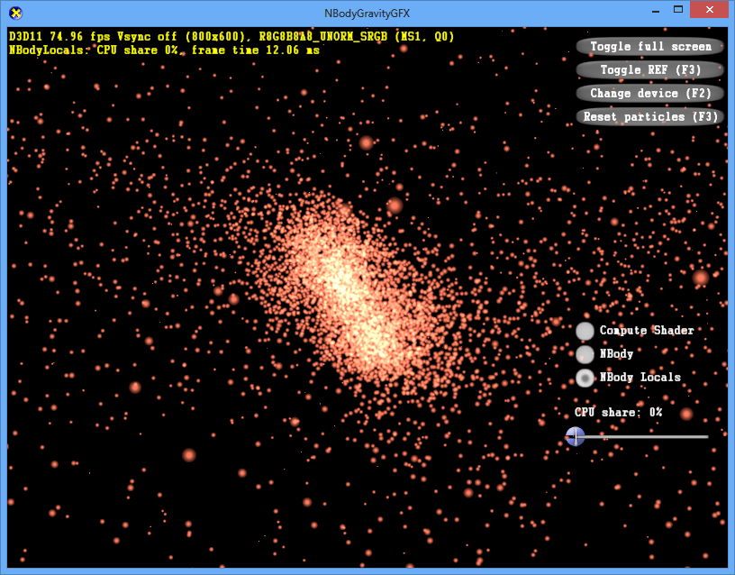
N-Body simulation

Slide 51
Performance tuning
This section shows how to program effectively using matrix multiplication as an example. It also provides a set of tips of high-performance programming for Gen and tells how to control code effectiveness using optimization report. In conclusion, execution profile is collected using VTune and analyzed. Also GTPin usage is shown.

Slide 52
Performance tuning tips: engage all hardware
Make sure all hardware threads are busy
There must be enough iterations in the offloaded parallel loop nest for each hardware thread
140 on HSW GT2, 384 on BDW GT3 etc.
Convert inner for into Cilk_for if needed
Make sure all vector lanes are busy - help vectorization
Use #pragma simd or array notation
Use __restrict to tell compilers arrays don’t overlap
Use __assume_aligned
These also help avoid multiple code paths and reduce code size

Slide 53
Performance tuning tips: use registers
Use local arrays under 3K to cache portions of big data
Compiler tries to allocate locals on registers
A local must be <= 3K and its address not escaping
Usually requires algorithm change based on loop blocking:
extract an iteration space tile explicitly as a loop:
cache a portion of a big array accessed in the tile in a local array
change big array access to local array access
update the big one from local if needed
Total size of locals must be < 4K, costly spills otherwise
for (int i = 0; i < M; i++) {
... arr[i]...arr[i]...
arr[i] = ...
}
for (int i0 = 0; i0 < M; i0 += TILE) {
int buf[TILE];
buf[:] = arr[i0:TILE];
for (int i1 = 0; i1 < TILE; i1++) {
int i = i0 + i1;
... buf[i1] ... buf[i1]...
buf[i1] = ...
}
arr[i0:TILE] = buf[:];
}

Slide 54
Performance tuning tips: miscellaneous
Fully unroll small loops over register-allocated local arrays
If not unrolled, slower indirect register addressing is used
... But avoid excessive unrolling – code bloat may hurt and lead to extra register pressure (spills)
Avoid strided access to char and short arrays
Strided access becomes gather/scatter, which is slow for 1- and 2-byte elements
Aim at contiguous access in the vectorized loop
Gen can access 1024 bits at a time via aligned block access – the fastest

Slide 55
Matrix multiplication example.
Demonstrates:
optimization techniques
Shared Local Memory usage
Performance gains at each step

Slide 56
Matrix multiplication - naive
Matrix B
N
Naïve version:
Each element of matrix A is read N times from memory (for each column of B)
M*K*N elements read from A
C = A x B
K
K
M
Matrix A
Matrix C (result)

Slide 57
Matrix multiplication - tiled
Matrix B
Tiled version:
Each thread calculates a tile in the result matrix, tiles are allocated on the register file (GRF)
A result tile is a dot product of corresponding tile row in A and column in B
tile * tile is a normal matrix multiplication
Each element of A is read from RAM this number of times: (M/TILE_M*K/TILE_K)*(N/TILE_N) = (M*K*N)/(TILE_M*TILE_K*TILE_N)
Times less than in naïve version
=> Larger tiles are better
But: may not fit into GRF
SLM – L3$-speed memory - can help
N
C = A x B
K
K
TILE_N
M
Matrix A
Matrix C (result)

Slide 58
Matrix multiplication - SLM
Reads from memory can be as fast as reads from SLM, when there are no L3$ misses, but SLM allows to forcibly “lock” frequently used data in the L3$ and protect from misses on critical data
Matrix B
SLM version:
Each thread still calculates a tile of the same size in the result matrix as before
But it reads an A and B tiles from SLM, not RAM
Before reading a tile from SLM, threads in a group collectively read a ‘super’ tile from RAM to SLM (green cell)
Need a thread barrier after super tile is read to SLM (and before C supertile is written from SLM to memory)
Each tile in A’s supertile is accessed by SUPER_TILE_N / TILE_N threads
Again, each A element is read fewer times from memory
Actual performance depends on SLM size available, tile/supertitle sizes, barrier overhead, etc. – tuning needed
SLM is (well, should be) good because it allows even larger tiles
N
C = A x B
K
K
TILE_N
SUPER_TILE_N
M
Matrix A
Matrix C (result)

Slide 59
Matrix multiplication: naïve

Slide 60
Matrix multiplication: naïve (code)
__declspec(target(gfx_kernel))
void matmult_naive(float A[][SIZE_K], float B[][SIZE_X], float C[][SIZE_X]) {
_Cilk_for (int y = 0; y < SIZE_Y; y++) {
_Cilk_for (int x = 0; x < SIZE_X; x++) {
C[y][x] = (float)0;
for (int k = 0; k < SIZE_K; k++) {
C[y][x] += A[y][k] * B[k][x];
}
}
}
}
Best offload time 512x512, BDW GT3 - 19.339 ms

Slide 61
Matrix multiplication: tiled

Slide 62
Matrix multiplication: tiled (code)
__declspec(target(gfx_kernel)) void matmult_tiled(
float A[][SIZE_K], float B[][SIZE_X], float C[][SIZE_X])
{
_Cilk_for (int y = 0; y < SIZE_Y; y += TILE_Y) {
_Cilk_for (int x = 0; x < SIZE_X; x += TILE_X) {
// allocate tiles in registers
float atile[TILE_Y][TILE_K], btile[TILE_X];
float ctile[TILE_Y][TILE_X];
// ... and initialize ctile to zero
ctile[:][:] = (float)0;
// calculate the dot product of the tiles
...
// flush the in-register ctile into the memory
C[y:TILE_Y][x:TILE_X] = ctile[:][:];
}
}
}

Slide 63
Matrix multiplication: tiled (code) – cont’d
...
for (int k = 0; k < SIZE_K; k += TILE_K) {
atile[:][:] = A[y:TILE_Y][k:TILE_K];
for (int k_ind = 0; k_ind < TILE_K; k_ind++) {
btile[:] = B[k+k_ind][x:TILE_X];
// multiply current btile row by atile's cur element
// and add up to corresponding ctile row
for (int y_ind = 0; y_ind < TILE_Y; y_ind++) {
ctile[y_ind][:] += atile[y_ind][k_ind] * btile[:];
}
}
}
...
Best offload time 512x512, BDW GT3 - 5.982 ms

Slide 64
Matrix multiplication: tiled optimized

Slide 65
Matrix multiplication: tiled optimized
__declspec(target(gfx_kernel)) void matmult_tiled(float A[][SIZE_K], float B[][SIZE_X], float C[][SIZE_X]) {
_Cilk_for (int y = 0; y < SIZE_Y; y += TILE_Y) {
_Cilk_for (int x = 0; x < SIZE_X; x += TILE_X) {
// allocate tiles in registers
float atile[TILE_Y][TILE_K], btile[TILE_X];
float ctile[TILE_Y][TILE_X];
// ... and initialize ctile to zero
#pragma unroll(TILE_X)
ctile[:][:] = (float)0;
// calculate the dot product of the tiles
...
// flush the in-register ctile into the memory
#pragma unroll(TILE_X)
C[y:TILE_Y][x:TILE_X] = ctile[:][:];
}
}
}

Slide 66
Matrix multiplication: tiled optimized – cont’d
...
for (int k = 0; k < SIZE_K; k += TILE_K) {
#pragma unroll(TILE_K)
atile[:][:] = A[y:TILE_Y][k:TILE_K];
#pragma unroll(TILE_K)
for (int k_ind = 0; k_ind < TILE_K; k_ind++) {
btile[:] = B[k+k_ind][x:TILE_X];
// multiply current btile row by atile's cur element
// and add up to corresponding ctile row
#pragma unroll(TILE_Y)
for (int y_ind = 0; y_ind < TILE_Y; y_ind++) {
ctile[y_ind][:] += atile[y_ind][k_ind] * btile[:];
}
}
}
...
Best offload time 512x512, BDW GT3 - 4.433 ms

Slide 67
Matrix multiplication: SLM version

Slide 68
Matrix multiplication: SLM version (code)
// SLM-based algorithm - cache B's vertical stripes in SLM
__declspec(target(gfx_kernel)) void matmult3(
int SIZE_K, int SIZE_X, int SIZE_Y, DTYPE *AA, DTYPE *BB, DTYPE *CC) {
_Cilk_for _Thread_group (int tg_x = 0; tg_x < SIZE_X; tg_x += TILE_X) {
...
// declare "supertiles" of B matrix to be allocated in SLM
__thread_group_local DTYPE slm_btile[SIZE_K_C][TILE_X];
// initialize the B's supertile (in parallel)
_Cilk_for (int i0 = 0; i0 < SIZE_K_C; i0++) {
slm_btile[i0][:] = B[i0][tg_x:TILE_X];
}
_gfx_gpgpu_thread_barrier();
// calculate the tg_x's column of tiles in the result matrix
_Cilk_for (int super_y = 0; super_y < SIZE_Y; super_y += TILE_Y) {
// each thread calculates its own tile in the column - which is
// a dot product of A's tile row and the cached column
// allocate tiles in registers
DTYPE atile[TILE_Y][TILE_K], btile[TILE_X], ctile[TILE_Y][TILE_X];
// ... and initialize ctile to zero
ctile[:][:] = (DTYPE)0;
...
Best offload time 512x512, BDW GT3 - 5.459 ms

Slide 69
Matrix multiplication: VTune analysis

Slide 70
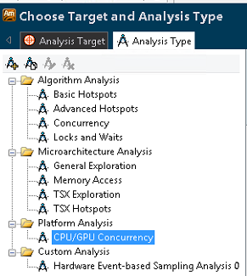
VTune setup
Install latest graphics drivers
Run in administrator mode
May require using VNC (depending on driver)
Prefer BDW+ - more accurate information

Slide 71
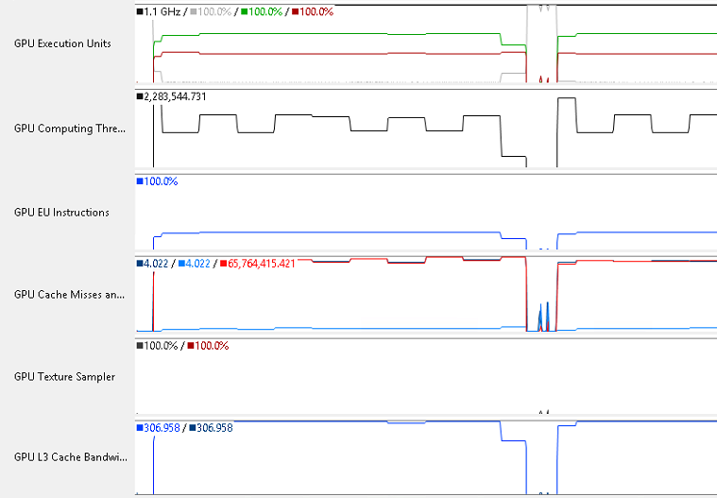
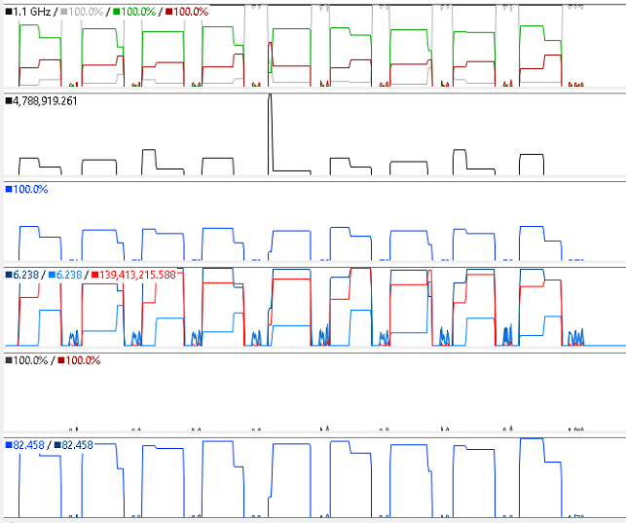
VTune results
Naïve (10ms interval):
Optimized (10ms interval):
Less stalled EU share
L3$ miss is 2x higher, kernel duration is ~6x shorter => 3X less L3$ misses per unit of work
Much lower memory I/O – GRF caching at work

Slide 72
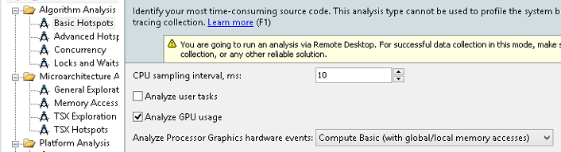
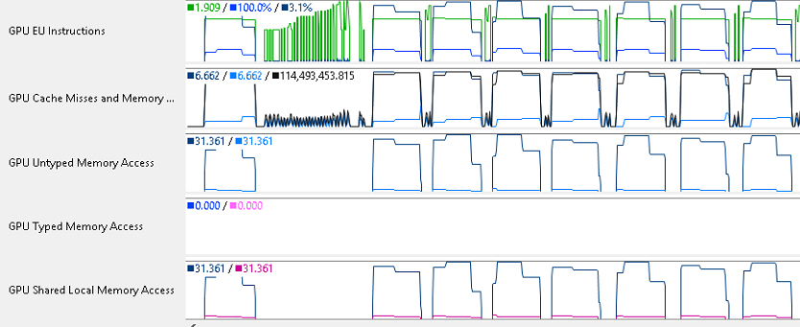
More VTune GPU options

Slide 73
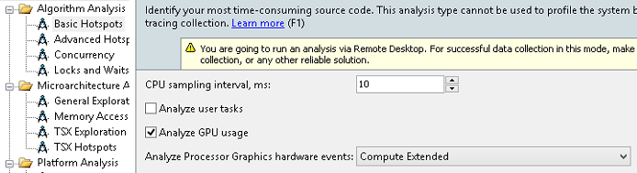
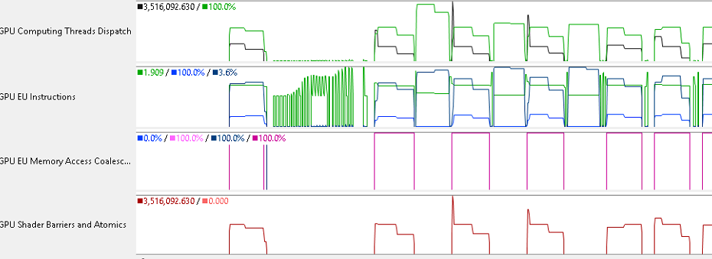
More Vtune GPU options (cont’d)

Slide 74
Matrix multiplication: GTPin analysis

Slide 75
GTPin intro (http://goto/gtpin)
GT-Pin is a software system that instruments programs running on the programmable cores called Execution Units (EUs) of Intel GPUs.
GTPin-based tools:
Funtime: Kernel and function execution time profiler
Latency: an instruction-latency profiler using hardware performance
Srcprof: a source-level execution-count profiler
Opcodeprof: reporting the static and dynamic distributions of Gen machine opcodes
Cacheprof2: analyzing cache behavior and memory bandwidth requirements. It can also generate memory address traces for other tools.
Simdprof: Simd channel utilization
DebugPrint: a tool which prints all Gen instructions that were successfully executed and hence can pinpoint where the crash happened in the shader/kernel
CountMe: a tool for OpenCL tracing that can separate statistics into different enqueue instances.

Slide 76
GTPin opcodeprof sub-tool
bash-3.2$ c:/Users/kbobrovs/GTPin/Bin/gtpinrun.exe opcodeprof -- ./Swpc2015GfxSamples.exe -a slm
Executing slm version, X=512 Y=512 K=512...
SLM_TILE_X=16, SLM_TILE_Y=512, SLM_TILE_K=16
GROUP_WIDTH=1 GROUP_HEIGHT=32 SUBS_NUM_GROUPS=2 SLM_PER_GROUP=8192
TILE_X=16, TILE_Y=16, TILE_K=16
Validating...
CPU...
GFX...
Successfully generated the debug-info file (C:\Users\kbobrovs\work\swpc2015\GTPIN_PROFILE_OPCODEPROF\Tmp\slm_matmult_3.dbg) from the kernel
asm file (slm_matmult_3.asm)

Slide 77
GTPin opcodeprof sub-tool results
.asm files in current directory for each kernel
GTPIN_PROFILE_OPCODEPROF/.../opcode_prof.out:
*** Kernel_0: "matmult3"
Opcode Simd-width Type Static-Count Dynamic-Count
-----------------------------------------------------------------------
mad 16 f 256 8388608
add 1 d 122 1250304
send 16 w 33 1064960
add 16 ud 33 557056
asr 1 ud 21 544768
shl 1 ud 20 543744
shl 16 ud 17 540672
shr 1 ud 17 540672
mov 16 d 32 540672
shl 1 d 16 95232
add 1 ud 12 74752
asr 16 ud 18 65536
OPCODE Report:
add 1680 (23.9%) 18831360 (12.9%)
and 50 ( 0.7%) 51200 ( 0.0%)
asr 400 ( 5.7%) 6113280 ( 4.2%)
cmp 70 ( 1.0%) 542720 ( 0.4%)
jmpi 70 ( 1.0%) 542720 ( 0.4%)
mad 2560 (36.4%) 83886080 (57.7%)
mov 590 ( 8.4%) 6307840 ( 4.3%)
mul 300 ( 4.3%) 460800 ( 0.3%)
sel 30 ( 0.4%) 30720 ( 0.0%)
send 530 ( 7.5%) 11008000 ( 7.6%)
shl 560 ( 8.0%) 12298240 ( 8.5%)
shr 190 ( 2.7%) 5427200 ( 3.7%)
Good
Not so good

Slide 78
Key results & Conclusion
This section shows performance data, provides a summary of new compiler features

Slide 79
CPU + GPU cooperative execution speed-up
Driver | Intel(R) HD Graphics 4600
Driver version | 10.18.10.3960
MDF version | 4.0.0.1072
CPU | i7-4770 3.5 GHz 16GB
GPU | HSW GT2 1300 MHz
OS | Windows 8/Server
Up to 3X speedup with Gen offload compared to pure-CPU

Slide 80
Key 16.0 compiler features summary
Supports OpenMP 4.0 syntax for offload, expect more in 17.0
Shared Local Memory (aka local in OpenCL) for better performance
Shared Virtual Memory wipes out the offload boundary. OS and H/W is not fully ready yet to run SVM apps efficiently, but they can be developed now.
Improved performance (vectorization, runtime scheduling)
Improved usability (opt reports, fewer language restrictions)
16.0: lots of programming model extensions, better performance
Notes:
*** INSTRUCTIONS ***
Show compelling key benefits or results realized, if available; include objectives achieved (e.g. design wins, work product delivered, development or quality objectives achieved, benchmarks reached, etc.) and supporting data (e.g. approved road maps, data tables or graphs, etc.).
Show any limitations and refer to any future work to address.
****

Slide 81
Acknowledgements
Vyacheslav Shakin
Sergey Dmitriev
Knud Kirkegaard
Anoop Madhusoodhanan
Novosibirsk Gen C/C++ compiler team

Slide 82
Q&A

