Slide 1
Homework 1
ES 603
Vadim Egorov

Slide 2
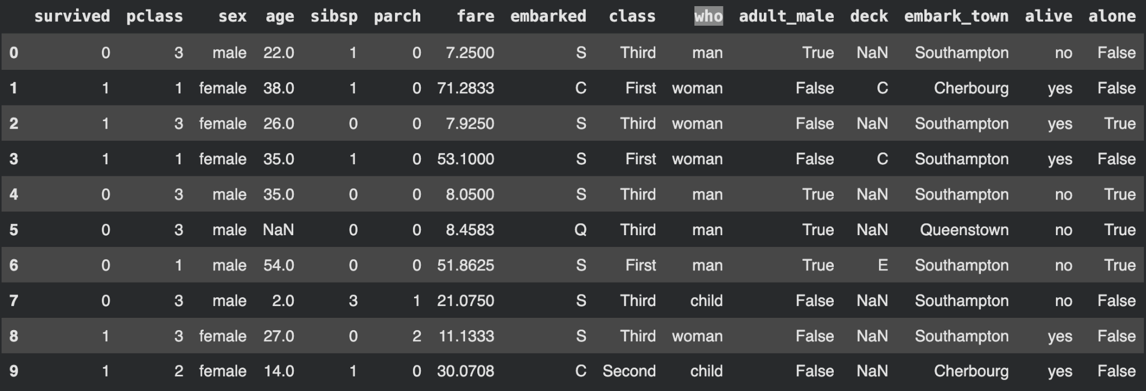
Data & Quality
Dataset
Missing values
891 rows × 15 columns
age: 177
deck: 688
embarked: 2
embark_town: 2
all other columns: 0
Handling
• For age-based plots, rows with missing age were removed using dropna().
• No missing ages were imputed.
Code
url = "https://raw.githubusercontent.com/mwaskom/seaborn-data/master/titanic.csv"
df = pd.read_csv(url)
df.head(10)
df.shape
df.isnull().sum()

Slide 3
Questions
Question & result
Code used
What was the average age of the passengers?
29.70 years
df['age'].mean()
What was the average age of male passengers compared with female passengers?
Female: 27.92 years | Male: 30.73 years
df.groupby('sex')['age'].mean()
What percentage of passengers survived?
38.38%
df['survived'].mean() * 100
Which passenger class had the highest survival rate?
1st class: 62.96% | 2nd: 47.28% | 3rd: 24.24%
df.groupby('pclass')['survived'].mean()

Slide 4
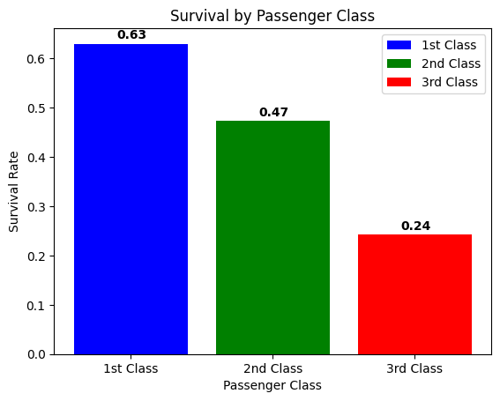
Survival by Passenger Class (Bar Chart)
Why
Compare survival rates across the three passenger classes.
Steps
• Group passengers by pclass.
• Calculate the mean of survived for each class.
• Plot the three rates as bars.
What it tells us
• 1st class had the highest survival rate at about 63%.
• 2nd class was about 47%, while 3rd class was only about 24%.
• Survival decreased as passenger class decreased.

Slide 5
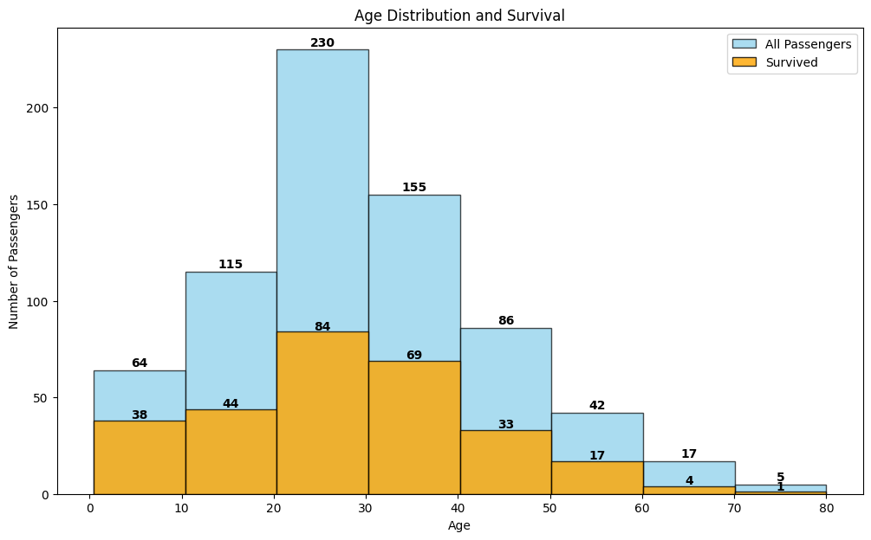
Age Distribution and Survival (Histogram)
Why
Compare the age distribution of all passengers with the ages of survivors.
Steps
• Drop missing ages with dropna().
• Create a survivor-only age series.
• Use the same 8 age bins for both groups.
• Overlay the histograms and label the counts.
What it tells us
• Most passengers were between about 20 and 40 years old.
• Under age 10, 38 of 64 passengers survived (~59%).
• Older groups had lower rates, but their sample sizes were small.

Slide 6
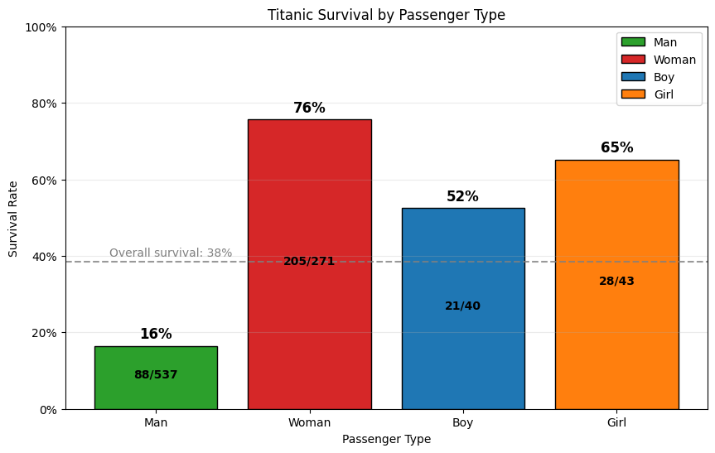
Survival by Passenger Type (Bar Chart)
Why
Compare adult men and women with children.
Steps
• Create person_type from who and sex.
• Assign Boy, Girl, Man, and Woman.
• Remove Unknown values.
• Calculate mean, survivors, and total by group.
• Add overall survival as a reference.
What it tells us
• Women: 76% survived (205/271).
• Girls: 65% (28/43); boys: 52% (21/40).
• Men: 16% (88/537), well below the overall 38%.

Slide 7
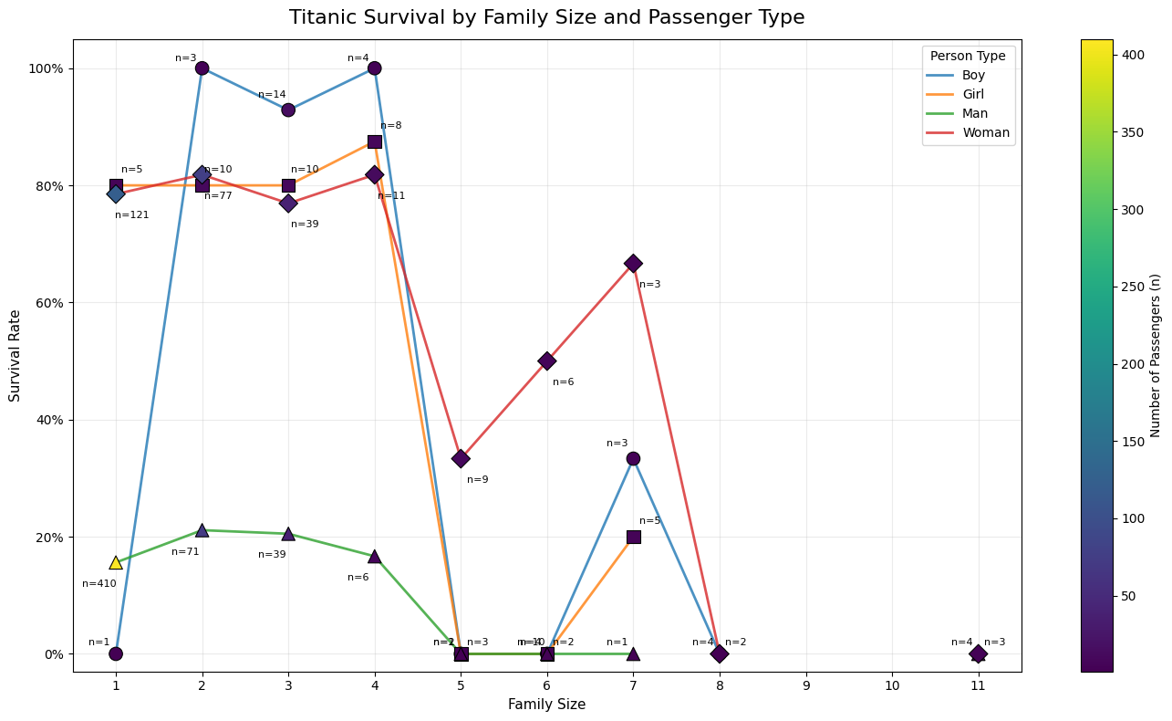
Survival by Family Size and Passenger Type
Why
See whether family size changes the survival pattern for each passenger type.
Steps
• family_size = sibsp + parch + 1.
• Group by family_size and person_type.
• Calculate survival rate and sample size n.
• Add missing combinations so gaps mean no data.
• Use line/marker for type and color for n.
What it tells us
• Family sizes 1–4: women stayed near 77–82%, while men were about 16–21%.
• Boys and girls were often high in small families, but some n values were tiny.
Family size is calculated as sibsp + parch + 1, so it is based on each passenger’s immediate relationships. This can produce different values within the same broader family—for example, a woman may have a calculated family size of 7 while a child in that family has a calculated family size of 4.

Slide 8
Key Takeaways
Overall survival was 38.4%.
Passenger class mattered: about 63% of 1st-class passengers survived versus 24% of 3rd-class passengers.
Passenger type showed an even larger gap: women 76%, girls 65%, boys 52%, and men 16%.
Family size changed the pattern, but results for very large families were based on small samples.
Age had 177 missing values, so age-based plots used the 714 passengers with known ages.

