Slide 1
Steam Games: Popularity vs. Reception
An Exploratory Data Analysis of the Steam Games Dataset V2
ES 603 — Homework 2
Vadim Egorov

Slide 2
Dataset & Research Questions
Steam Games Dataset V2 (Kaggle) — 22,611 games x 16 columns after cleaning
Group comparison
Do genres differ in player engagement (concurrent players)?
Predicted: Action & RPG higher than casual genres
Numerical relationship
Does review sentiment relate to how much a game is actually played?
Predicted: more positive reviews -> more engagement
Creative question
Do free-to-play and paid games differ in engagement and reception?
Predicted: free games more engaging (no cost barrier)
Note: original questions were built around average playtime, but that variable turned out to be unusable — see next slide.

Slide 3
Data Quality
Cleaning
Key issues found
- 23,100 -> 22,611 rows (489 duplicates removed)
- 28 -> 16 columns (12 unusable columns dropped)
- Dropped for: zero variance, mostly missing, free text, or unreliable data
- average_forever & median_forever = 0 for every game (dead SteamSpy field since 2018)
- recommendations also unreliable - shows 0 for hundreds of clearly popular games (e.g. SCP: Secret Laboratory, Dota Underlords)
- -> engagement questions reworked around ccu (concurrent players)

Slide 4
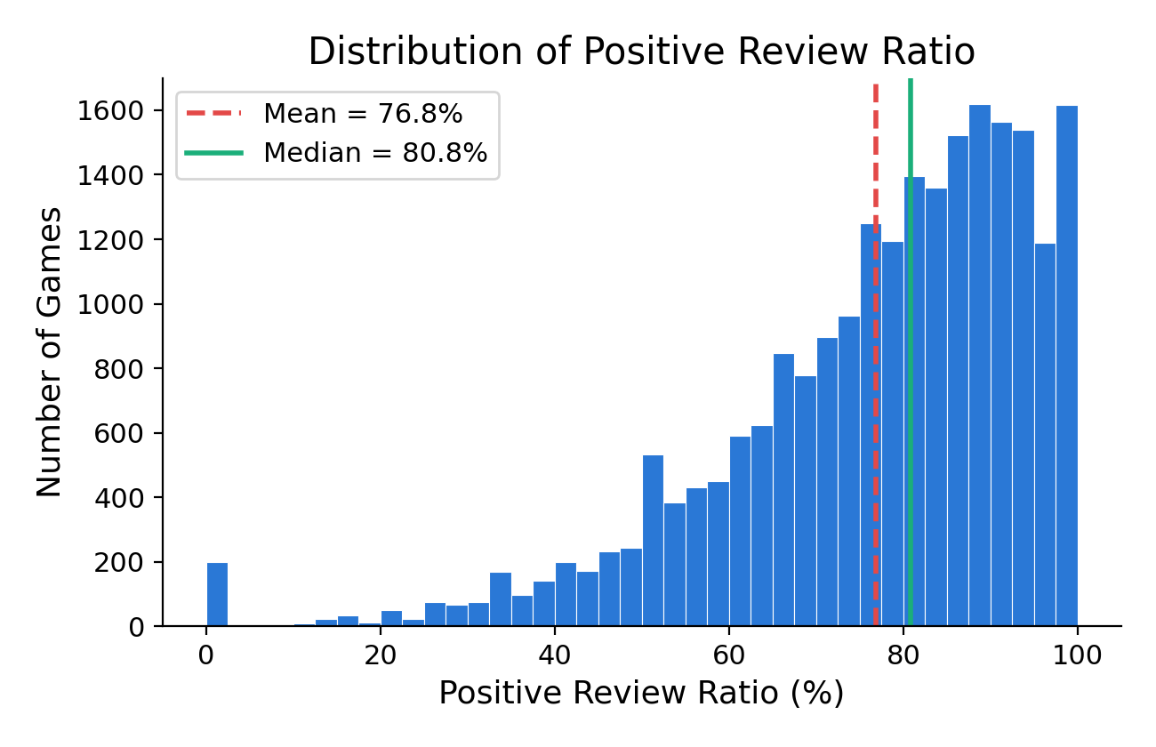
Distribution of Review Ratio (Histogram)
Why
I wanted to understand the shape of positive_review_ratio, my key outcome variable, before comparing groups or checking correlations - is it symmetric, skewed, or affected by outliers?
Results
- Mean 76.8%, median 80.8% -> left-skewed (mean below median)
- Skew statistic: -1.32
- Most games cluster between the 25th-75th percentile (67-90%)
- A pileup right at 100% comes from games with very few total reviews

Slide 5
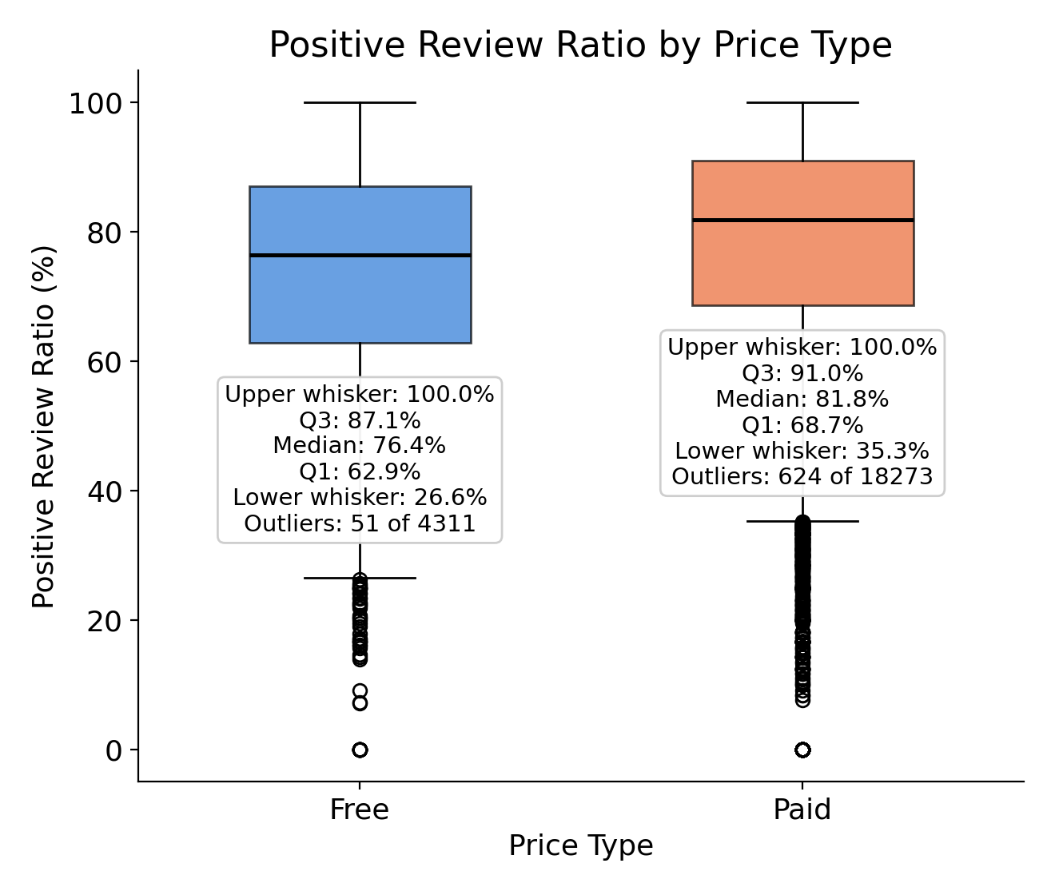
Free vs. Paid Reviews (Boxplot)
Why
A boxplot shows the full spread of a variable across two groups - median, quartiles, and outliers - not just one average number. I needed this for Q3 (free vs. paid).
Results
- Paid median 81.8% vs. Free median 76.4%
- Both groups have a tail of badly-reviewed outliers (51 for Free, 624 for Paid)
- Sets up the formal hypothesis test later in this deck

Slide 6
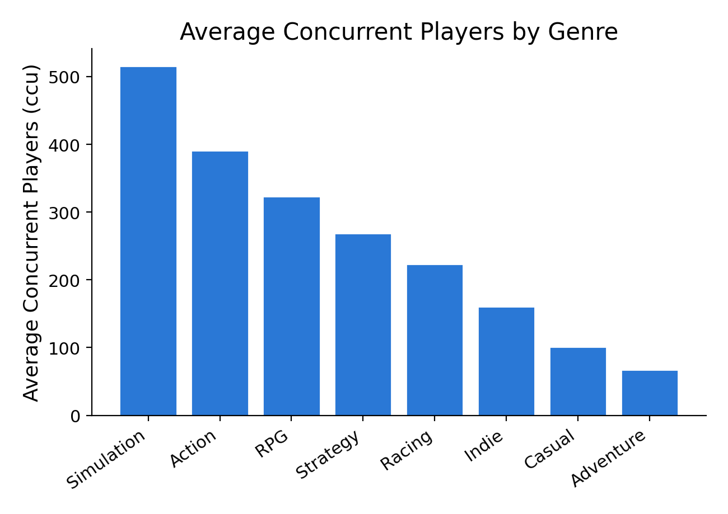
Engagement by Genre (Bar Chart)
Why
Testing Q1 - do genres differ in player engagement? Using ccu (concurrent players) since average_forever and recommendations both turned out unusable.
Results
- Simulation (516) and Action (391) average the most concurrent players
- Casual (101) and Adventure (68) average the least
- But averages alone can be misleading - see the Group Comparison slide

Slide 7
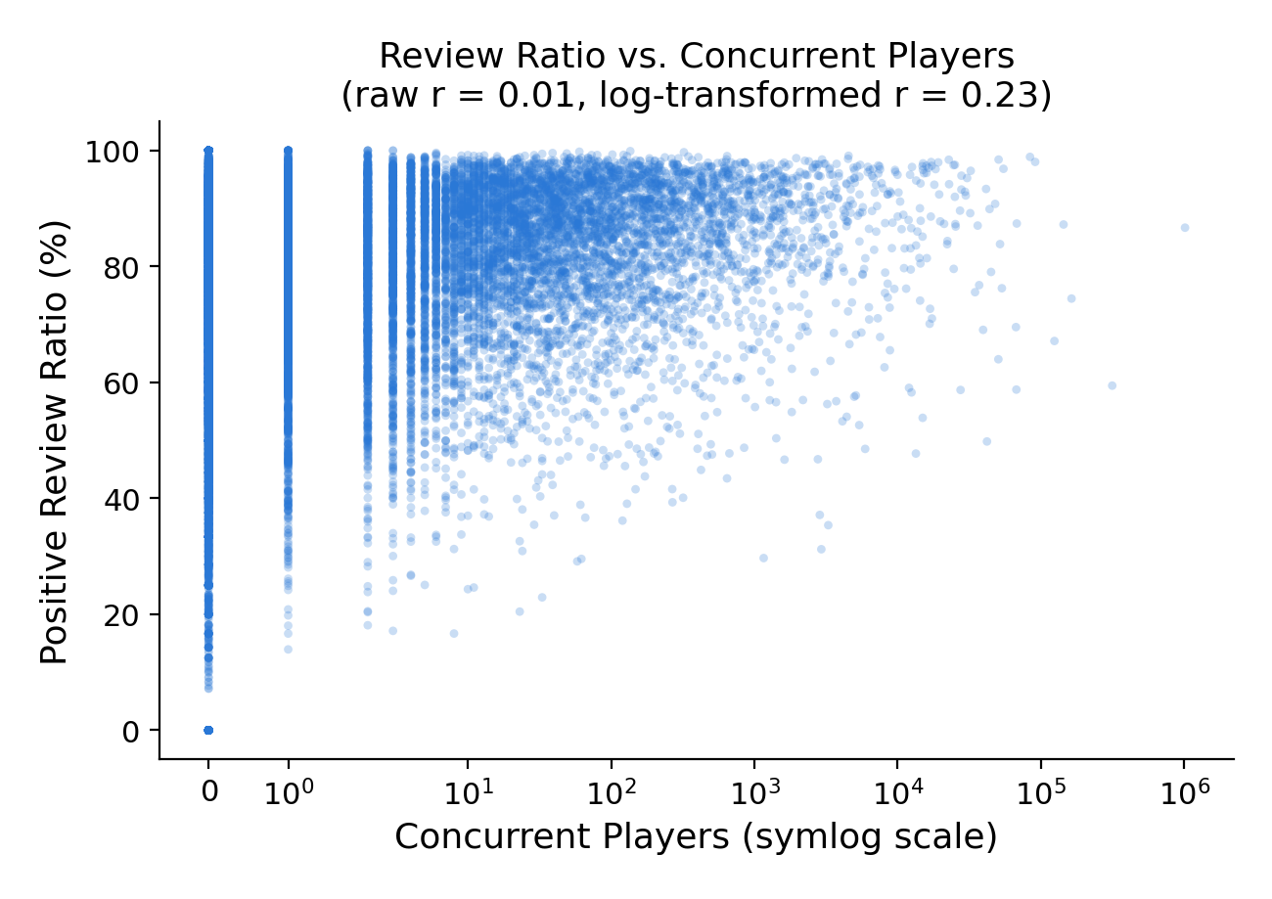
Review Ratio vs. Engagement (Scatter Plot)
Why
Testing Q2 - does a better-reviewed game actually get played more?
Results
- Raw correlation looks like nothing: r = 0.01
- ccu is extremely skewed (skew stat 113) - a raw correlation misses the real pattern
- Log-transformed correlation: r = 0.23 - weak to moderate, but real

Slide 8
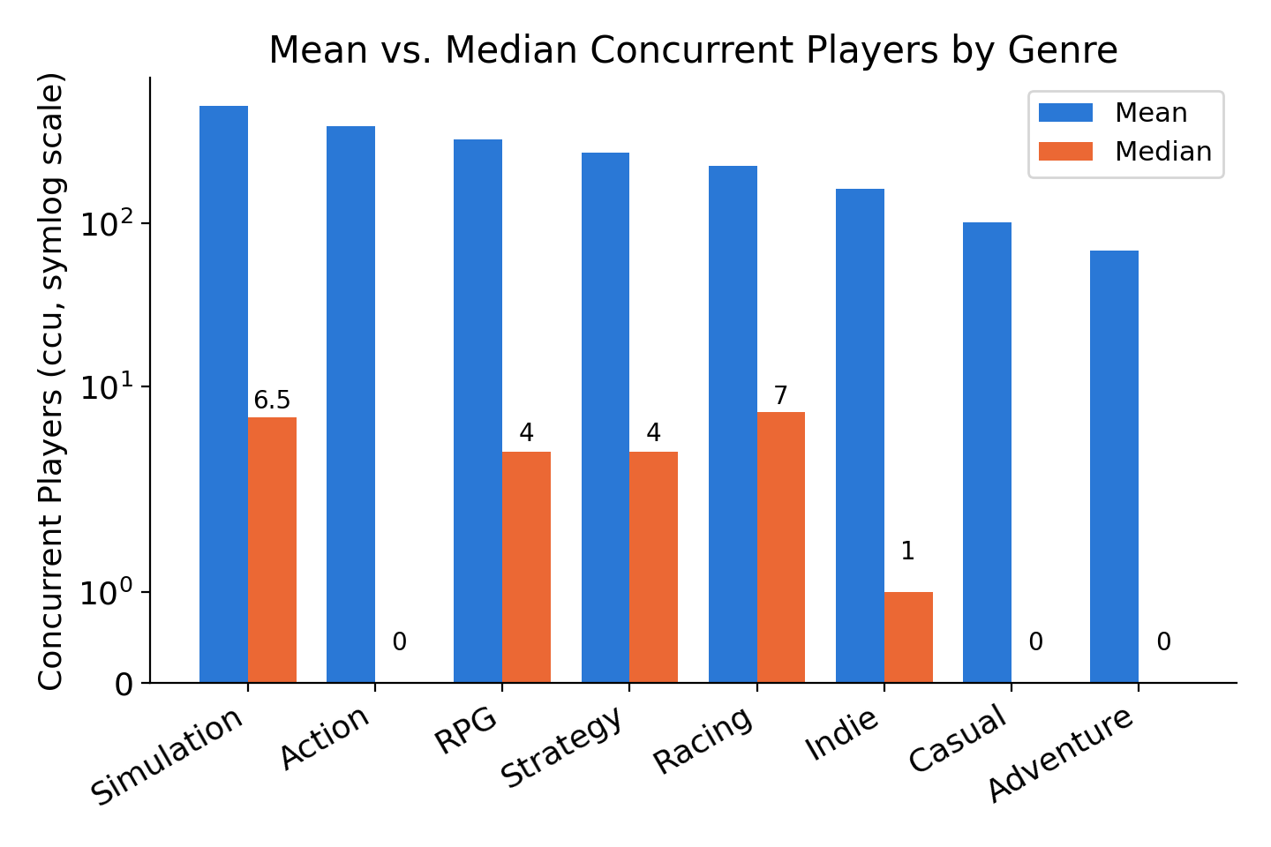
Group Comparison: Engagement by Genre
Why
Comparing mean AND median ccu per genre reveals something the bar chart alone can't: how concentrated each genre's popularity actually is.
Results
- Casual: mean 101, median 0 -> 54.9% of Casual games have nobody currently playing
- Action: mean 391, median 0 -> 51.5% of Action games have nobody currently playing
- Racing: mean 223, median 7 -> the most evenly-spread genre here
- High averages often mean a few blockbusters carry the genre, not that a typical game does well

Slide 9
Hypothesis Test: Free vs. Paid Reviews
Why
The boxplot showed a gap between free and paid review ratios - is it real, or could it be random noise from how games happened to split into groups?
H0: mean review ratio is equal for Free and Paid games
H1: mean review ratio differs between groups
Test: Welch's two-sample t-test
(unequal variances, unequal group sizes)
Results
- Free: n = 4,311, mean = 73.5%
- Paid: n = 18,273, mean = 77.6%
- t = 13.44, p ~ 1.17 x 10^-40
- alpha = 0.05 -> REJECT H0 (real, but modest, ~4-pt gap)

Slide 10
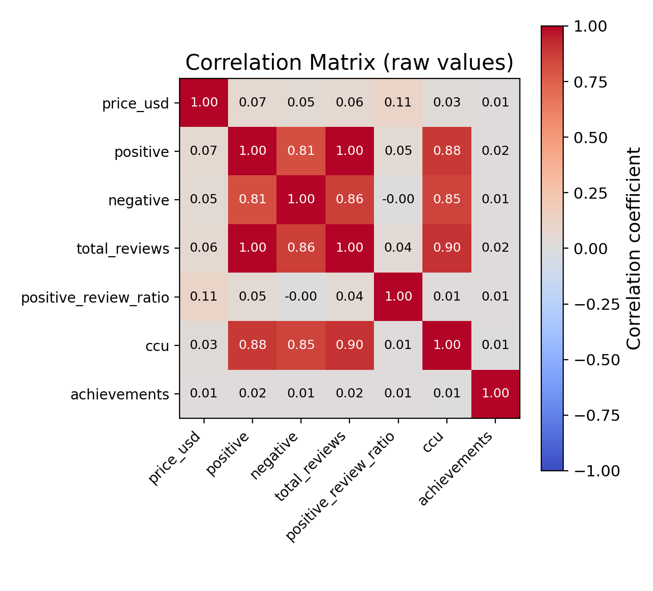
Most Surprising Finding
Why
I predicted (Q2) that better-reviewed games would also be more engaging - more people currently playing them.
Results
- Raw correlation: r = 0.01 - looks like no relationship at all
- But ccu is extremely skewed (skew stat 113) - a raw correlation misses the real pattern
- Log-transformed: r = 0.23 - a real, modest, positive relationship
- Popularity measures (reviews, ccu) correlate strongly with EACH OTHER (0.81-0.90), but only weakly with review ratio
- Lesson: a skewed variable can hide a real relationship unless you check for it

Slide 11
Final Takeaway
- Popularity and reception have a real but weak relationship (r = 0.23) — easy to miss without handling skew
- Paid games review significantly better than free games (p < 0.001)
- Genre-level engagement is often driven by a handful of blockbusters, not a typical game
- Two of three planned variables were dead or unreliable — real EDA means verifying data before building on it

