Slide 1
Predicting Critical Temperature
Comparing four regression models on the UCI Superconductivity dataset
ES 603 — Homework 4
Vadim Egorov

Slide 2
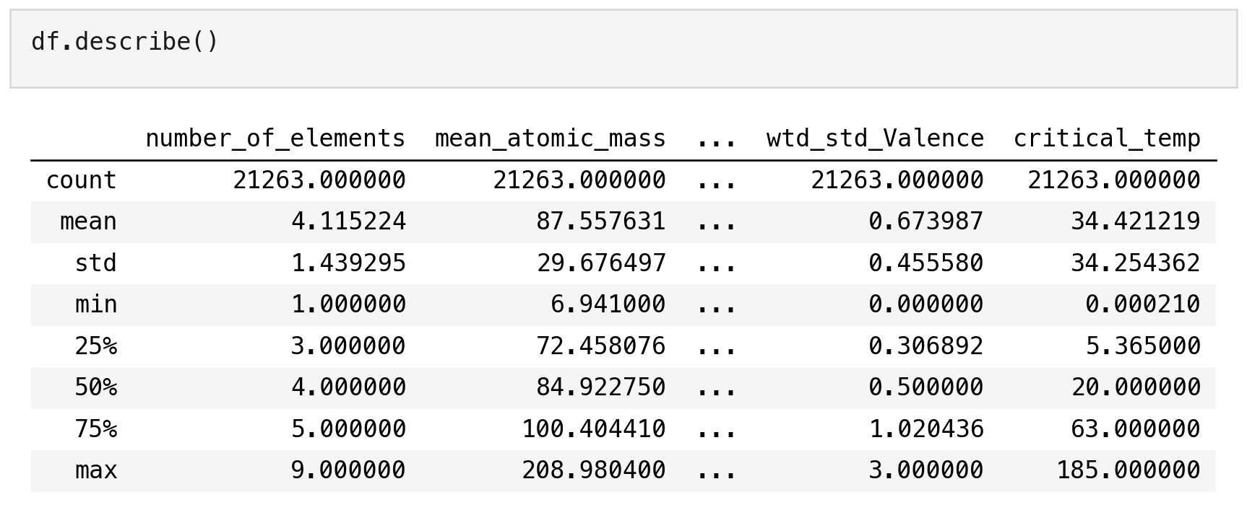
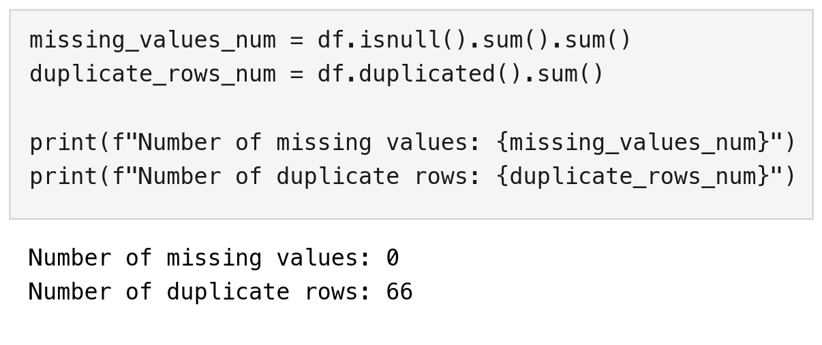
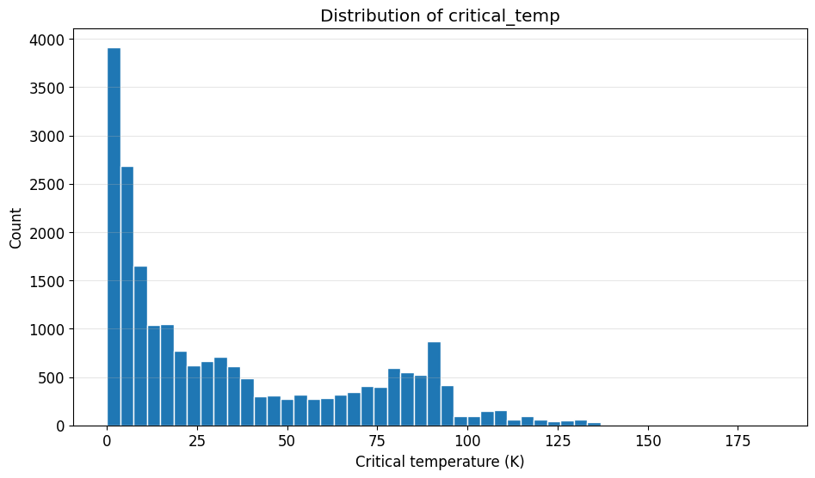
Dataset, Research Question & Preparation
Research question
Can a material's chemical properties predict the temperature at which it becomes superconductive?
Dataset
- Superconductivity Data (UCI): 21,263 materials x 81 features
- Features: 8 element properties x 10 statistics, all calculated from the chemical formula
- Target: critical_temp, measured in the lab (0 to 185 K, median 20 K)
Preparation
Notebook output: summary statistics, missing values and duplicates. Right: distribution of critical_temp.
- No missing values, no categorical columns
- 66 duplicate rows removed -> 21,197 materials
- 80/20 train/test split, random_state = 42

Slide 3
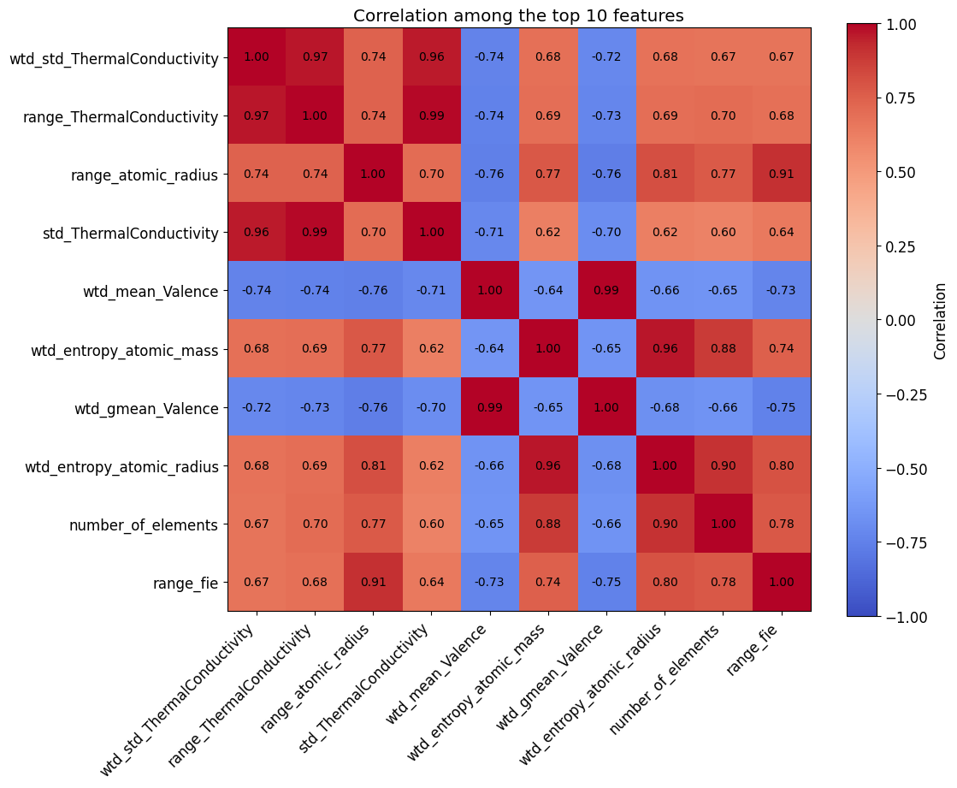
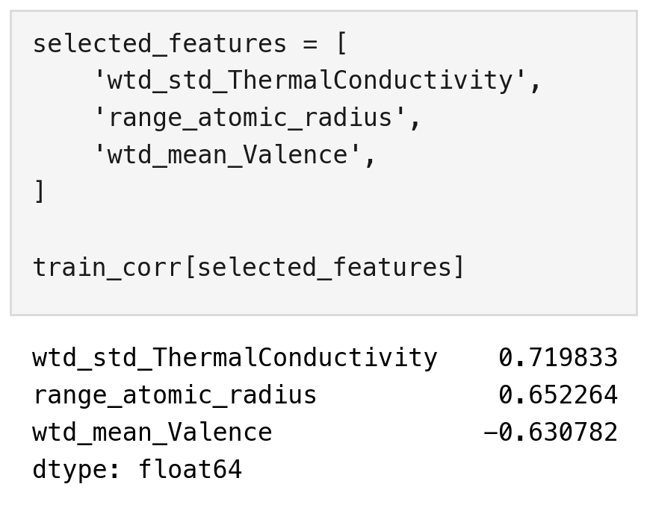
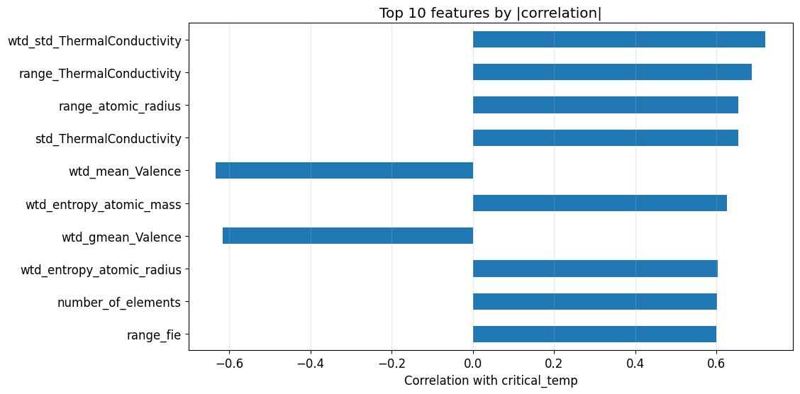
How I Chose the 3 Features
1. Rank all 81 by correlation
2. The top features overlap
3. Take the best one per property
Thermal conductivity features are the strongest predictors of critical_temp (r = 0.72, 0.69).
Three of the top four are thermal conductivity statistics (r > 0.95 with each other): the same information three times.
One feature each from the three most predictive properties: thermal, atomic size and valence.
Why only 3 features?
A degree-10 polynomial creates 285 columns from 3 features, but about 6.4 trillion from all 81. All four models use the same 3 features, so they can be compared directly.

Slide 4
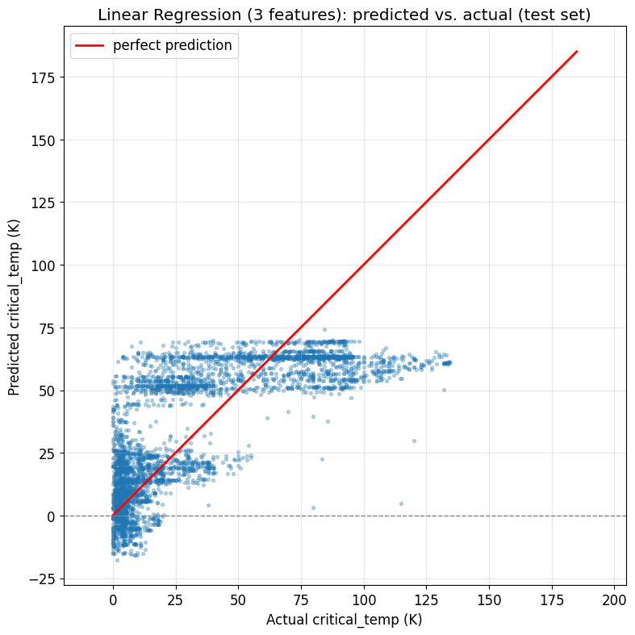
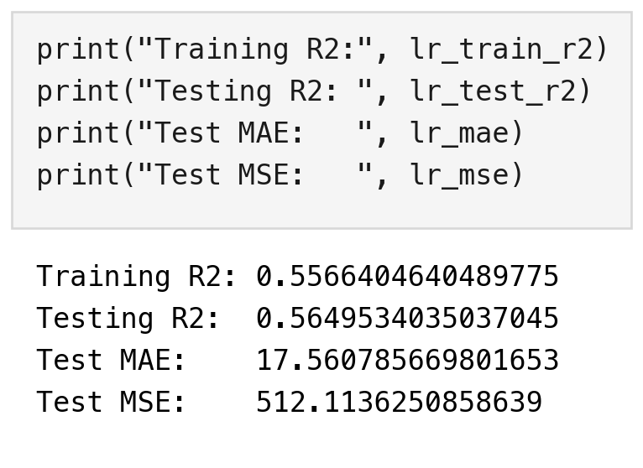
Model 1: Linear Regression
The simplest model, as a baseline: multiple linear regression on the 3 selected features.
Results
Notebook output: test metrics
- Train R² = 0.557, Test R² = 0.565: no overfitting, but the model underfits
- Test MAE = 17.6 K, large when the median is 20 K
- Predictions top out at about 70 K, so every hotter material is underestimated
- Some predictions are below 0 K, which is physically impossible
Predicted vs. actual on the test set. Points on the red line are perfect predictions. The model forms two flat bands and does not follow the line.

Slide 5
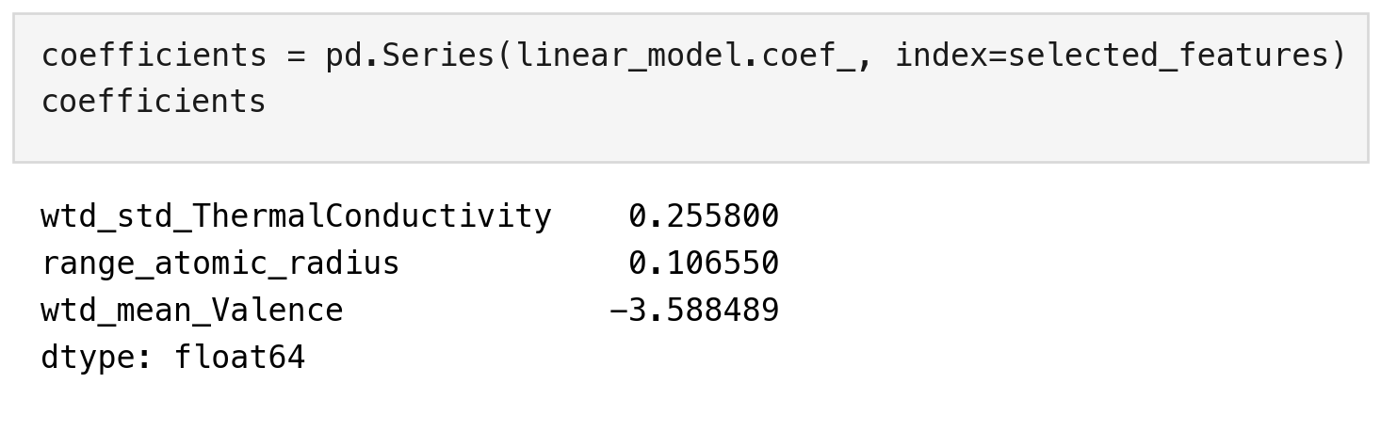
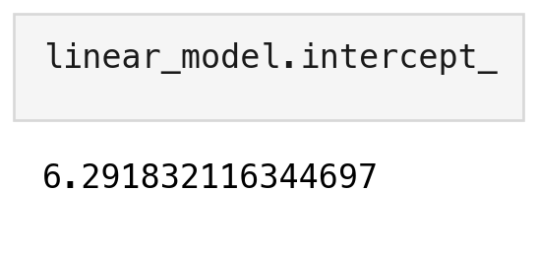
Linear Regression: Coefficients
What they tell us
- Thermal conductivity spread: +0.256 K per unit
- Atomic radius range: +0.107 K per unit
- Average valence: -3.59 K per extra bonding electron
- Signs match the correlations found in the EDA
- Intercept = 6.29 K: the prediction when all features are 0, with no physical meaning
Notebook output: coefficients and intercept

Slide 6
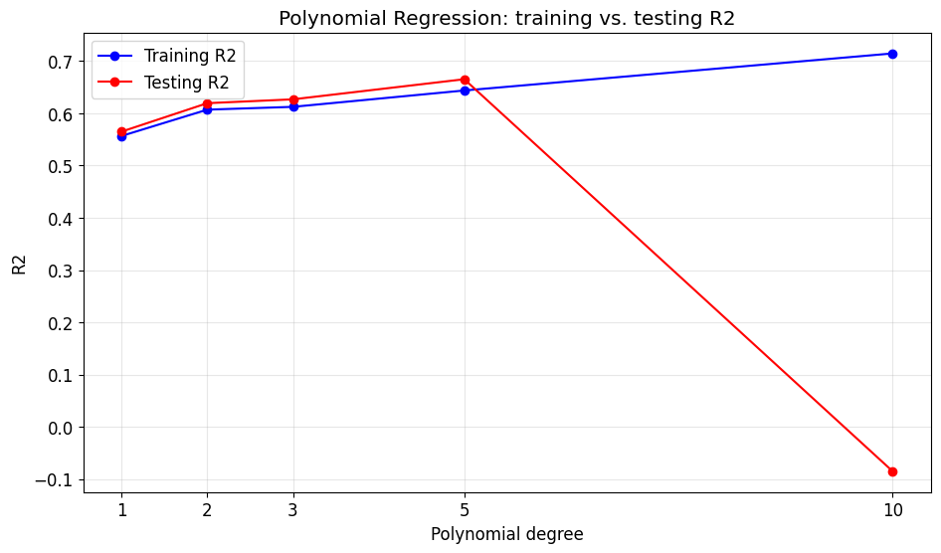
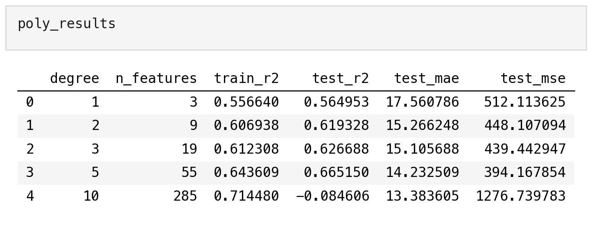
Model 2: Polynomial Regression
Testing whether curved terms and interactions between the 3 features improve on the straight-line model. Degrees 1, 2, 3, 5 and 10.
Results
- Degree 1: test R² = 0.565 (underfitting)
- Degrees 2 to 5: train and test rise together, up to test R² = 0.665 at degree 5 (best)
- Degree 10: train R² rises to 0.714, but test R² drops to -0.085 (overfitting)
- A higher degree did not always improve testing performance

Slide 7
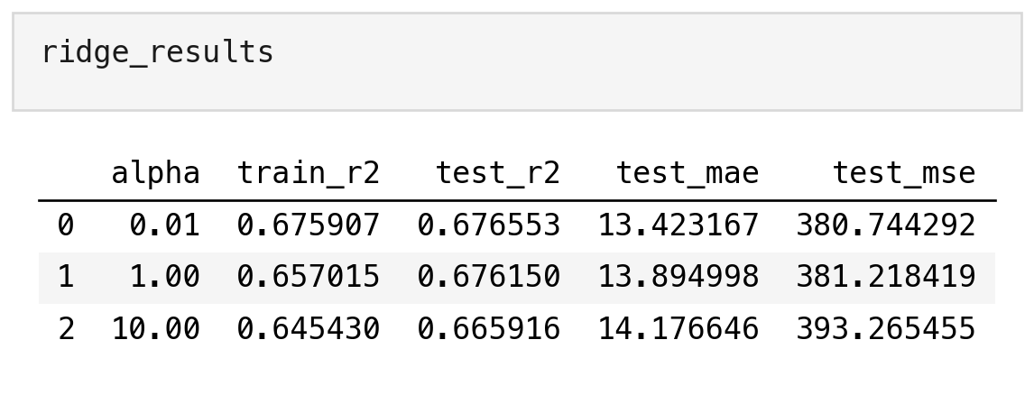
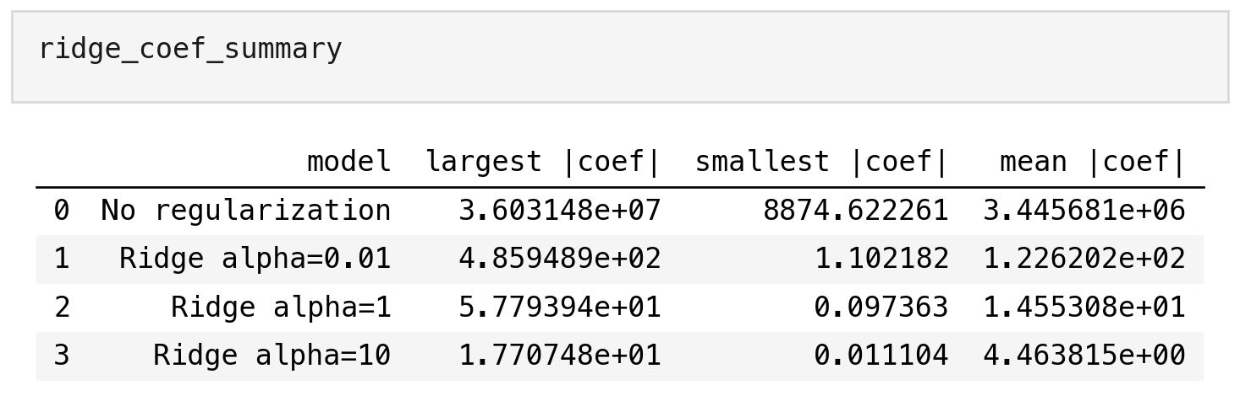
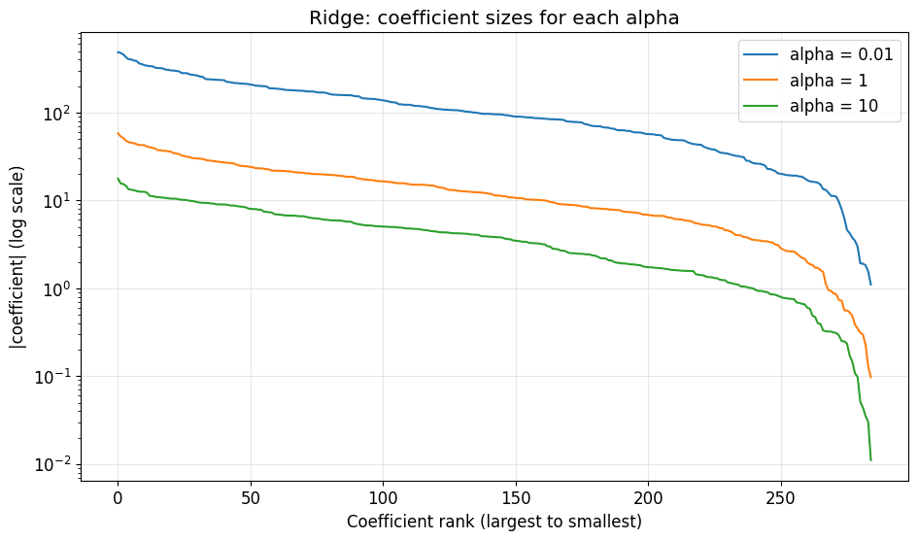
Model 3: Ridge Regression
The degree-10 model overfit, so that is the one to regularize. Ridge penalizes large coefficients. The polynomial features were scaled first.
Results
- alpha = 0.01: test R² = 0.677 (it was -0.085 without Ridge)
- alpha = 1: test R² = 0.676. alpha = 10: test R² = 0.666
- Largest coefficient: 36 million with no penalty, then 486 -> 58 -> 18 as alpha grows
- No coefficient becomes exactly zero
Coefficient sizes for each alpha: every increase in alpha shifts the whole curve down.

Slide 8
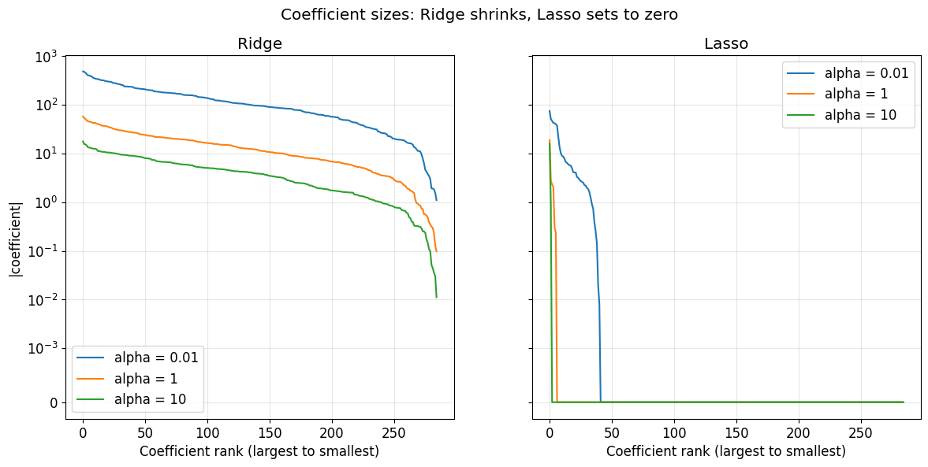
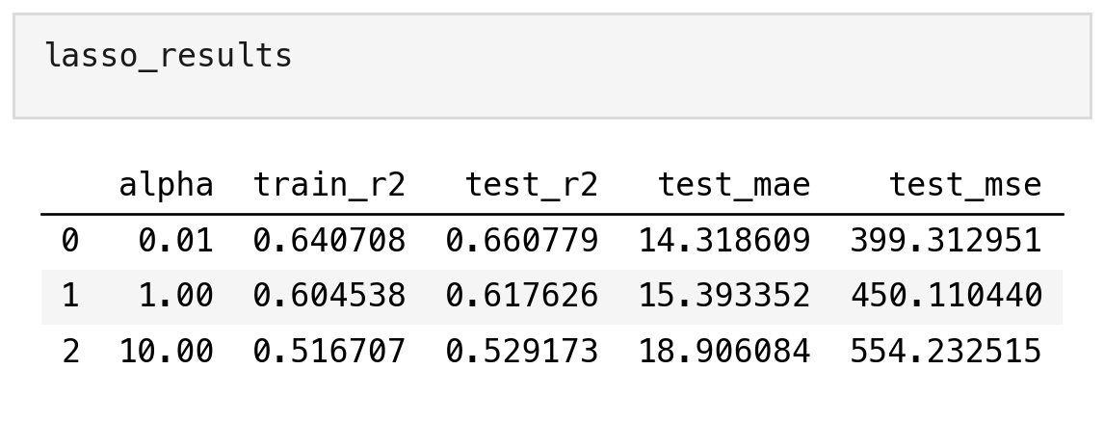
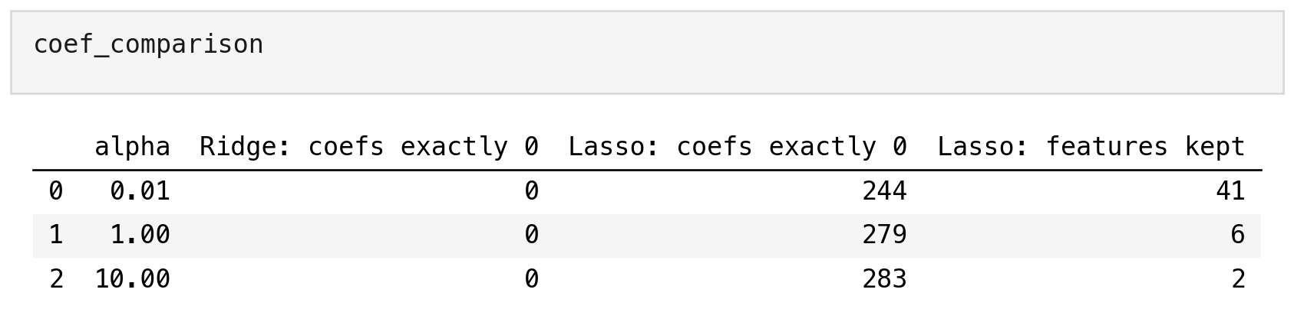
Model 4: Lasso Regression
Same polynomial features and same alphas as Ridge, to compare how the two penalties treat the coefficients.
Results
- alpha = 0.01: test R² = 0.661, with 244 of 285 coefficients at exactly zero
- alpha = 1: test R² = 0.618, 279 at zero (6 terms kept)
- alpha = 10: test R² = 0.529, 283 at zero (2 terms kept): underfitting
- Ridge shrinks the coefficients. Lasso removes them
Notebook output: Lasso scores and the number of coefficients at zero

Slide 9
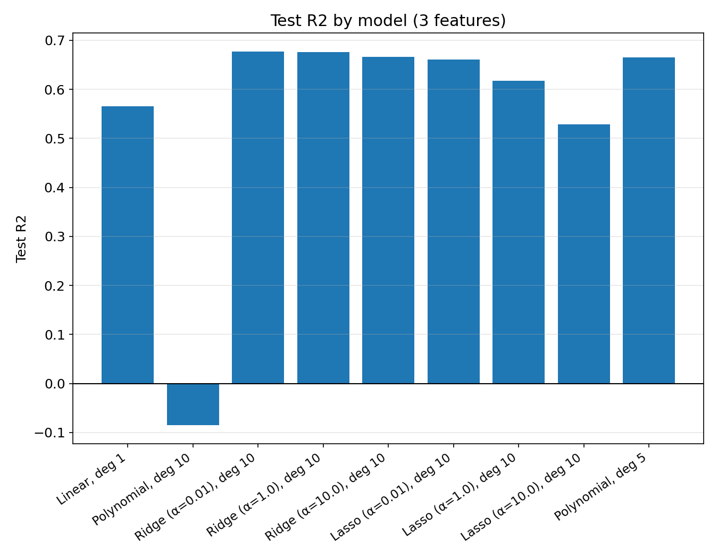
Model Comparison
Model | Degree | Alpha | Train R² | Test R² | MAE (K)
Linear | 1 | - | 0.557 | 0.565 | 17.6
Polynomial | 1 | - | 0.557 | 0.565 | 17.6
Polynomial | 2 | - | 0.607 | 0.619 | 15.3
Polynomial | 3 | - | 0.612 | 0.627 | 15.1
Polynomial | 5 | - | 0.643 | 0.665 | 14.23
Polynomial | 10 | - | 0.714 | -0.085 | 13.4
Ridge | 10 | 0.01 | 0.676 | 0.677 | 13.4
Ridge | 10 | 1 | 0.657 | 0.676 | 13.9
Ridge | 10 | 10 | 0.645 | 0.666 | 14.2
Lasso | 10 | 0.01 | 0.641 | 0.661 | 14.3
Lasso | 10 | 1 | 0.605 | 0.618 | 15.4
Lasso | 10 | 10 | 0.517 | 0.529 | 18.9
The last bar is the degree-5 polynomial (test R² = 0.665), the best unregularized degree, shown for reference.
- All models use the same 3 features and the same train/test split
- Linear underfits, Polynomial (degree 10) overfits
- Best on unseen data: Ridge, alpha = 0.01 - explains about 68% of the variation in critical temperature.
- Lasso is close behind using only 41 of 285 features

Slide 10
Most Surprising Finding
Degree 10, 3 features | MAE (K) | MSE | Test R²
Polynomial | 13.4 | 1,277 | -0.085
Ridge, alpha = 0.01 | 13.4 | 381 | 0.677
Overfitting sounds like a model that is wrong everywhere on new data. The degree-10 polynomial showed something different.
Results
- Its MAE (13.4 K) matches Ridge's, so a typical prediction is just as good
- Its MSE is about 4x higher (1,277 vs. 381)
- The damage comes from a few extremely wrong predictions
- Those few are enough to push test R² below zero
- Lesson: one metric alone can hide what is going wrong
Notebook output: test MAE keeps improving up to degree 10 while test MSE triples.

Slide 11
Final Takeaway
- Best model on unseen data: Ridge Regression (degree 10, alpha = 0.01), test R² = 0.677
- A more complex model was not better by itself: degree 10 without a penalty scored worst (test R² = -0.085)
- Ridge and Lasso both fixed that overfitting (test R² = 0.677 and 0.661)
- Raising alpha shrinks Ridge coefficients, and sets most Lasso coefficients to exactly zero

