Slide 1
Identifying Gases from Sensor Readings
Can XGBoost beat Logistic Regression and a Decision Tree on the UCI Gas Sensor Array dataset?
ES 603 — Homework 5
Vadim Egorov
Notes:
Hi, I'm Vadim Egorov, and this is my Homework 5 for ES 603.
The assignment was to learn a new classification algorithm and try to beat the baseline. My algorithm is XGBoost.
First I'll explain what XGBoost is and how it learns, including the math, and work through a small example by hand. Then I'll apply it to a real dataset, where electronic gas sensors have to identify which of six gases they are smelling. I'll compare it with Logistic Regression and a Decision Tree.

Slide 2
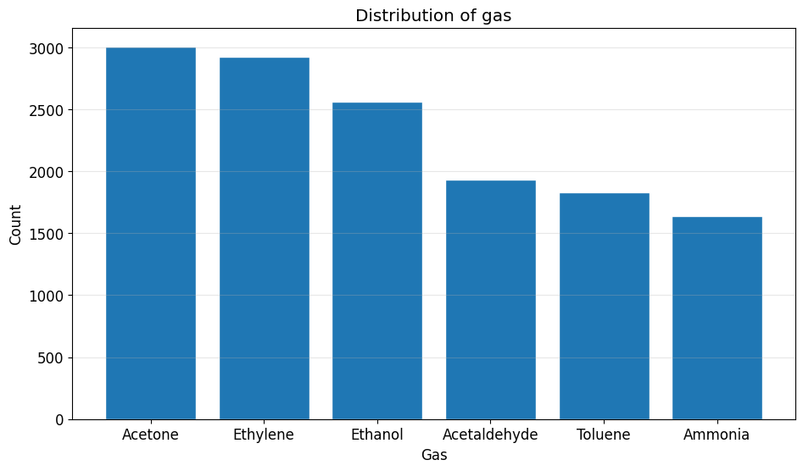
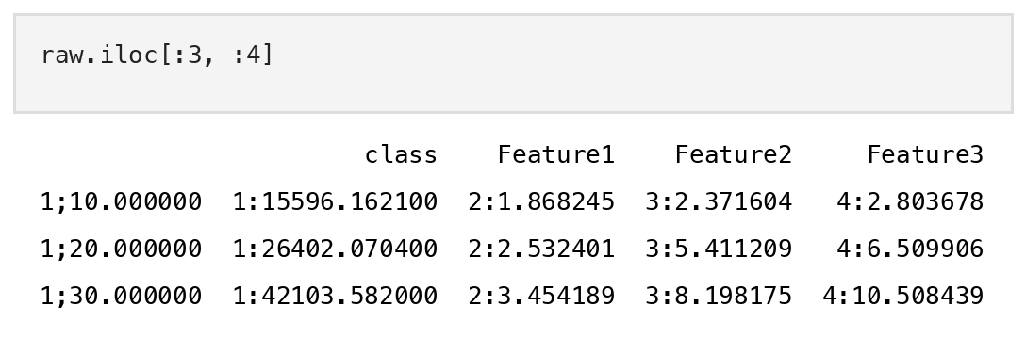
Dataset, Research Question & Preparation
Research question
Can XGBoost classify gases more accurately than Logistic Regression and a Decision Tree, using only the sensor readings?
Dataset
Gas Sensor Array Drift at Different Concentrations (UCI)
13,910 measurements × 128 features (16 sensors × 8)
Target: gas, 6 classes (Acetone, Ethylene, Ethanol, Acetaldehyde, Toluene, Ammonia)
Preparation
Fixed the parsing: values loaded as "2:1.868" strings
No missing values, no duplicates
80/20 stratified train/test split, random_state = 42
Top: measurements per gas (largest / smallest = 1.83, mildly imbalanced). Bottom: raw data before the parsing fix.
Notes:
My research question is: can XGBoost classify gases more accurately than Logistic Regression and a Decision Tree, using only the sensor readings?
The dataset is the Gas Sensor Array Drift dataset from UCI. It has 13,910 measurements. Each one comes from an array of 16 metal-oxide sensors, and each sensor gives 8 features, so there are 128 features in total. The target is which gas was in the chamber, one of six: Acetone, Ethylene, Ethanol, Acetaldehyde, Toluene and Ammonia.
On the right you can see the class counts. Acetone is the largest class and Ammonia the smallest, with a ratio of 1.83, so the data is only mildly imbalanced. I still report balanced accuracy and macro F1, so the small classes count as much as the big ones.
For preparation, the main problem was that the loader didn't parse the files correctly. As you can see at the bottom right, every value came in as a string like "2:1.868", with the feature number in front. I stripped those prefixes and converted everything to numbers. There were no missing values and no duplicates. Then I did an 80/20 stratified train/test split with random state 42.

Slide 3
What Is XGBoost?
eXtreme Gradient Boosting (Chen & Guestrin, 2016): an ensemble of small decision trees, built one after another.
Start
ŷ = mean
+ Tree 1
+ Tree 2
+ Tree 3
+ Tree 4
Main idea
Toy example: training loss after each tree
Start with a simple guess (for example, the mean)
Each new tree learns the errors the model still makes
Its output is scaled by the learning rate η and added
A penalty on tree size keeps every tree small
20
13.52
9.37
Prediction
ŷ = ŷ⁽⁰⁾ + η · [ f₁(x) + f₂(x) + … + f_{K}(x) ]
6.72
5.02
Boosting vs. Random Forest
A Random Forest averages deep trees built independently. XGBoost adds shallow trees in sequence, each one correcting the last.
Each tree removes part of the remaining error. Toy data from slide 5, η = 0.3, one split per tree.
Notes:
So what is XGBoost? It stands for eXtreme Gradient Boosting, and it was introduced by Chen and Guestrin in 2016. It is an ensemble of small decision trees that are built one after another.
The main idea is boosting. We start with a very simple guess, for example the average of the target. Then we build a small tree, and that tree doesn't try to predict the target directly. It tries to predict the errors our current model is still making. We scale its output down by the learning rate, eta, and add it to the model. Then the next tree looks at the errors that are left, and so on.
So the final prediction, in the gray box, is the starting guess plus eta times the sum of all the trees' outputs. To predict, you just drop a sample down every tree and add up the values in the leaves it lands in.
On the right you can see this with the small example I'll do by hand in a moment. The training loss starts at 20, and every tree removes part of what's left: 13.5, 9.4, 6.7, 5.
This is different from a Random Forest. A Random Forest builds deep trees independently and averages them, which mainly reduces variance. XGBoost builds shallow trees in sequence, each one correcting the last, which mainly reduces bias. The "extreme" part is the extra regularization and engineering on top, which I'll show on the next slide.

Slide 4
How XGBoost Learns: The Math
1. Objective: error + complexity penalty
2. Gradient and Hessian of the loss
Obj = Σ_{i} l(y_{i}, ŷ_{i}) + Σ_{k} Ω(f_{k})
Ω(f) = γT + ½ λ Σ_{j} w_{j}²
g_{i} = ∂l / ∂ŷ_{i} h_{i} = ∂²l / ∂ŷ_{i}²
T = number of leaves, w = leaf values. γ penalizes extra leaves and λ penalizes large leaf values.
From a 2nd-order Taylor expansion of the loss. Squared error: g = ŷ − y, h = 1. Log-loss: g = p − y, h = p(1 − p).
3. Best value for each leaf
4. Gain of a split
w* = − G / (H + λ)
Gain = ½ [ G_{L}²/(H_{L}+λ) + G_{R}²/(H_{R}+λ) − G²/(H+λ) ] − γ
G and H are the sums of g and h over the samples in the leaf. λ pulls the value toward 0.
Left score + right score − parent score. Split only if Gain > 0, and pick the split with the largest gain.
Notes:
Now the math. It comes down to four formulas.
One: the objective. XGBoost minimizes the training loss, plus a penalty for each tree. The penalty is gamma times the number of leaves, plus one half lambda times the sum of the squared leaf values. So it pays to have fewer leaves and smaller leaf values, and that's what makes it harder to overfit than plain gradient boosting.
Two: at each round we already have predictions, and we want to add one more tree. XGBoost approximates the loss with a second-order Taylor expansion around the current prediction. So every sample is summarized by two numbers: the gradient g, the first derivative of the loss, and the Hessian h, the second derivative. For squared error, g is just prediction minus target, and h is 1. For classification with log-loss, g is p minus y, and h is p times one minus p. Because the tree only ever sees g and h, you can use any loss you can differentiate twice.
Three: once we fix which samples go into which leaf, the best value for each leaf has a closed form: minus G over H plus lambda, where G and H are the sums of g and h in that leaf. You can see lambda in the denominator, pulling the value toward zero.
Four: to decide where to split, XGBoost computes the gain: the score of the left child plus the right child, minus the parent, minus gamma. It tries every feature and threshold, picks the largest gain, and only splits if the gain is positive.
Let's see these four formulas in action on a small example.

Slide 5
Toy Example: Finding the Best Split
4 students: hours studied (x) and quiz score (y). Squared error, λ = 1, γ = 0, η = 0.3.
Drawing area: residuals and the best split
score (y)
Step 1: start and gradients
10
x | y | ŷ(0) | g = ŷ − y | h
1 | 1 | 5 | 4 | 1
2 | 3 | 5 | 2 | 1
3 | 7 | 5 | −2 | 1
4 | 9 | 5 | −4 | 1
(4, 9)
(3, 7)
ŷ(0) = mean(y) = 5. Root: G = 0, H = 4
ŷ(0) = 5
5
Step 2: gain of each split
Split | Left: G, H | Right: G, H | Gain
x < 1.5 | 4, 1 | −4, 3 | 6
x < 2.5 | 6, 2 | −6, 2 | 12
x < 3.5 | 4, 3 | −4, 1 | 6
(2, 3)
(1, 1)
x < 2.5: ½ [ 6²/3 + (−6)²/3 − 0²/5 ] = ½ (12 + 12) = 12
0
1
2
3
4
hours studied (x)
Notes:
Here is the toy example. Four students: hours studied, x, and quiz score, y. I use squared error, lambda equal to 1, gamma equal to 0, and a learning rate of 0.3.
Step 1. The starting prediction is the mean of y, which is 5. You can see it as the dashed line.
[DRAW: from each point, draw a short vertical arrow to the dashed line at 5. Label them: +4, +2, −2, −4.]
These are the residuals. Since g is the prediction minus the target, the gradients are 4, 2, minus 2 and minus 4, as in the table. For squared error, h is 1 for every point. So at the root, G is 0 and H is 4.
Step 2. The candidate splits are the midpoints between the x values: 1.5, 2.5 and 3.5. For each one I compute the gain. For x less than 2.5, the left side has G = 6 and H = 2, so its score is 6 squared over 2 plus 1, which is 12. The right side is the same, 12. The parent score is 0. So the gain is one half of 12 plus 12, which is 12.
The other two splits only give 6, so the tree splits at x less than 2.5.
[DRAW: a vertical line at x = 2.5, between the second and third points. Circle the two points on each side.]
That makes sense: it separates the low scorers from the high scorers. Next, the leaf values.

Slide 6
Toy Example: Leaf Values and the Update
Step 3: leaf values
Drawing area: the tree
w_{L} = −6 / (2 + 1) = −2 w_{R} = 6 / (2 + 1) = +2
Without λ these would be the mean residuals, −3 and +3.
Step 4: update predictions (η = 0.3)
x | y | ŷ(0) | leaf w | ŷ(1) = 5 + 0.3w
1 | 1 | 5 | −2 | 4.4
2 | 3 | 5 | −2 | 4.4
3 | 7 | 5 | +2 | 5.6
4 | 9 | 5 | +2 | 5.6
Drawing area: new predictions
score (y)
Training loss ½Σ(y − ŷ)²: 20 → 13.52 after one tree
10
(4, 9)
Step 5: should a leaf split again?
(3, 7)
ŷ(0) = 5
5
Left leaf (x = 1, 2): Gain = ½ (8 + 2 − 12) = −1. It is negative, so no split. λ alone stops the tree from fitting single points.
(2, 3)
(1, 1)
0
1
2
3
4
hours studied (x)
Notes:
Step 3: the leaf values. With the formula minus G over H plus lambda, the left leaf gets minus 6 over 2 plus 1, which is minus 2. The right leaf gets plus 2. Without lambda these would just be the average residuals, minus 3 and plus 3, so lambda shrinks them.
[DRAW in the top box: the tree. A root node labeled "x < 2.5?", a "yes" branch to a leaf with "w = −2", and a "no" branch to a leaf with "w = +2".]
This is the first tree.
Step 4: we update the predictions. The new prediction is the old one, 5, plus the learning rate 0.3 times the leaf value. So the first two students go down to 4.4, and the other two go up to 5.6.
[DRAW in the bottom chart: a step line at 4.4 from x = 1 to x = 2.5, then at 5.6 from 2.5 to 4. Show with arrows that every point is now a bit closer to the line than to the dashed line.]
The training loss drops from 20 to 13.52 with just one small tree. The next round would start again from step 1, with the new residuals.
Step 5. The tree could go one level deeper, so should the left leaf split again? Its gain is one half of 8 plus 2 minus 12, which is minus 1. It's negative, so no, even though gamma is 0. Lambda alone stops the tree from growing leaves for single points. That is the regularization doing its job.

Slide 7
Key Parameters, Advantages and Limitations
Most important parameters
Advantages
Parameter | What it controls | My value
learning_rate (η) | How much each tree adds | 0.1
n_estimators | Number of trees | 300
max_depth | Depth of each tree | 3
subsample | Share of rows per tree | 0.7
colsample_bytree | Share of features per tree | 0.5
reg_lambda (λ) | L2 penalty on leaf values | 1 (default)
gamma (γ) | Minimum gain to split | 0 (default)
min_child_weight | Minimum sum of h in a leaf | 1 (default)
Often the most accurate model on tabular data
Built-in regularization: λ, γ, η, sampling
No feature scaling needed; handles missing values
Fast: parallel split search, histograms, GPU
Limitations
Many interacting hyperparameters to tune
Trees are built one at a time
Can overfit small or noisy data
Harder to interpret than one tree
Tuned values come from cross-validation (slide 11). The rest are defaults.
Notes:
These are the most important parameters. The learning rate controls how much each tree adds. A smaller value needs more trees but usually generalizes better. n_estimators is the number of trees. max_depth limits each tree. subsample and colsample_bytree give every tree a random share of the rows and the features, which makes the trees less alike and helps against overfitting. Then there are the regularization parameters from the math slide: lambda, gamma, and min_child_weight, which is the minimum sum of Hessians in a leaf.
The right column shows the values I ended up with. I'll show how I chose them on slide 11.
Advantages: XGBoost is often the most accurate model on tabular data. Regularization is built in. It doesn't need feature scaling, because trees only compare a feature to a threshold, and it handles missing values itself. And it's fast.
Limitations: there are many hyperparameters, and they interact. The trees have to be built one at a time, so it can't be parallelized across trees like a Random Forest. It can overfit small or noisy data. And it's harder to interpret than a single tree. Also, its predictions are piecewise constant, so it can't extrapolate beyond the range it was trained on.

Slide 8
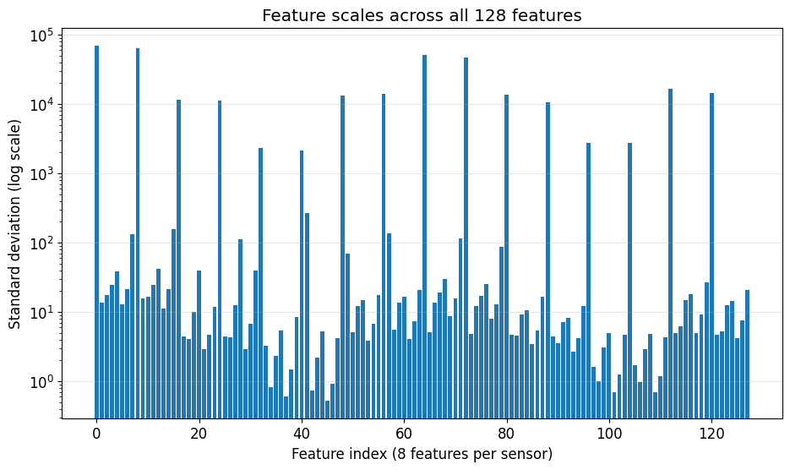
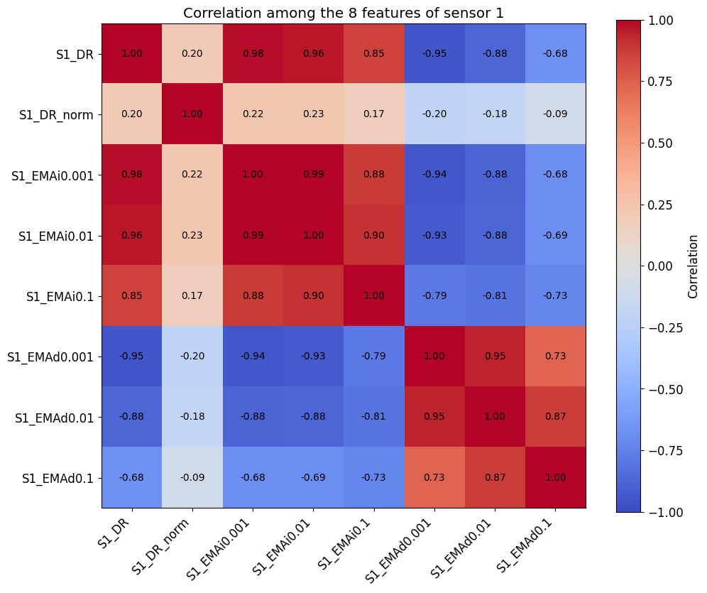
EDA: Feature Scales and Correlation
Feature scales
Standard deviations range from below 1 to about 10⁴
Logistic Regression needs scaling: StandardScaler in a pipeline, fit on training data only
Tree models split on thresholds, so XGBoost and the Decision Tree use raw values
Correlation
Features of one sensor are strongly correlated (|r| up to 0.95)
Only DR_norm carries different information
Redundant, but harmless for prediction
Top: spread of all 128 features (log scale). The tall spikes are the DR features.
Left: correlation among the 8 features of sensor 1.
Notes:
Two things from the exploratory analysis affected the modeling.
First, the feature scales. The top chart shows the standard deviation of all 128 features on a log scale. The tall spikes are the DR features, the raw resistance change, with standard deviations around ten thousand, while some others are below 1. Logistic Regression is sensitive to that, so I scaled the features for it, inside a pipeline, so the scaler only ever sees training data. The tree-based models only compare a feature to a threshold, so scaling doesn't change them, and I left their features raw.
Second, correlation. The heatmap shows the 8 features of sensor 1. Most of them are strongly correlated, up to 0.95. Only the normalized DR feature carries different information. So the 128 features are quite redundant. That's not a problem for prediction: Logistic Regression's regularization handles it, and a tree just picks whichever of the correlated features splits best.

Slide 9
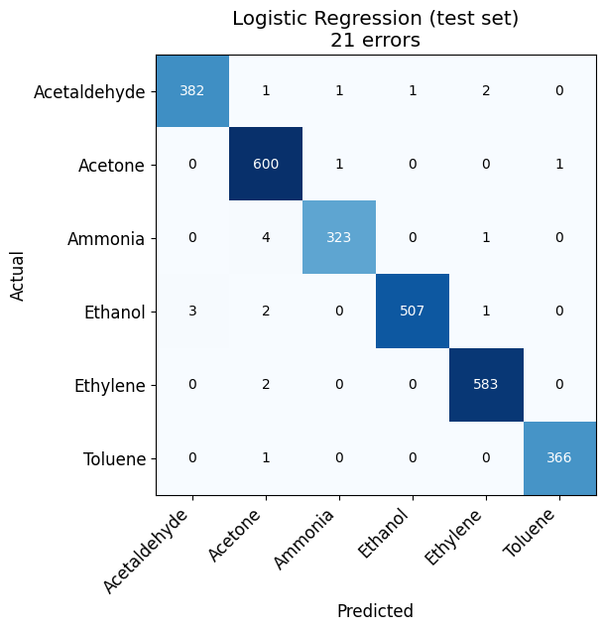
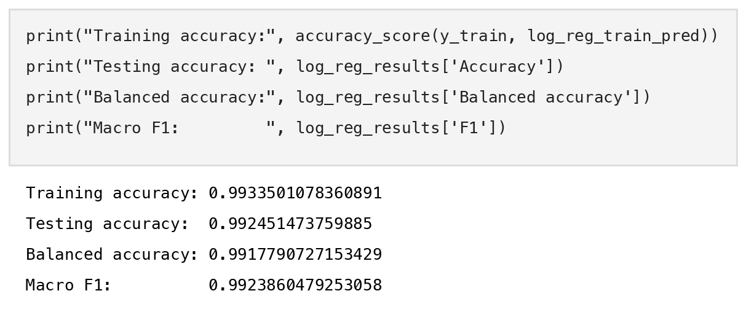
Model 1: Logistic Regression
The baseline: multinomial Logistic Regression on all 128 scaled features (max_iter = 5000).
Results
Test accuracy = 99.25% (21 of 2,782 wrong)
Train 99.34% vs. test 99.25%: no overfitting
Balanced accuracy 99.18%: small classes are not neglected
The gases are nearly linearly separable: a high bar for XGBoost
Confusion matrix on the test set. Most errors involve Ammonia and Acetone.
Notes:
Model 1 is the baseline, Logistic Regression, on all 128 scaled features. I raised the maximum number of iterations so the solver converges.
It does very well: 99.25 percent test accuracy, so only 21 of the 2,782 test measurements are wrong. Training accuracy is almost the same, 99.34, so there's no overfitting. Balanced accuracy is 99.18, so the smaller classes aren't being neglected.
In the confusion matrix, almost everything is on the diagonal. The biggest mistake is 4 Ammonia measurements predicted as Acetone.
A linear model doing this well tells us the six gases are almost linearly separable in this 128-dimensional space. So this is a high bar for XGBoost to beat.

Slide 10
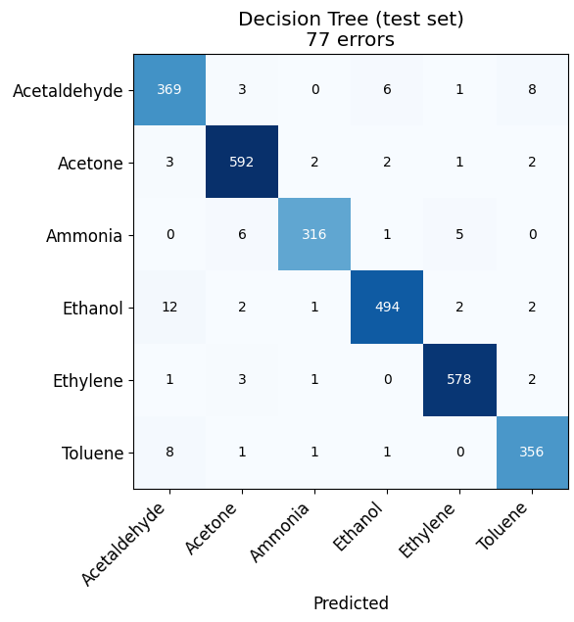
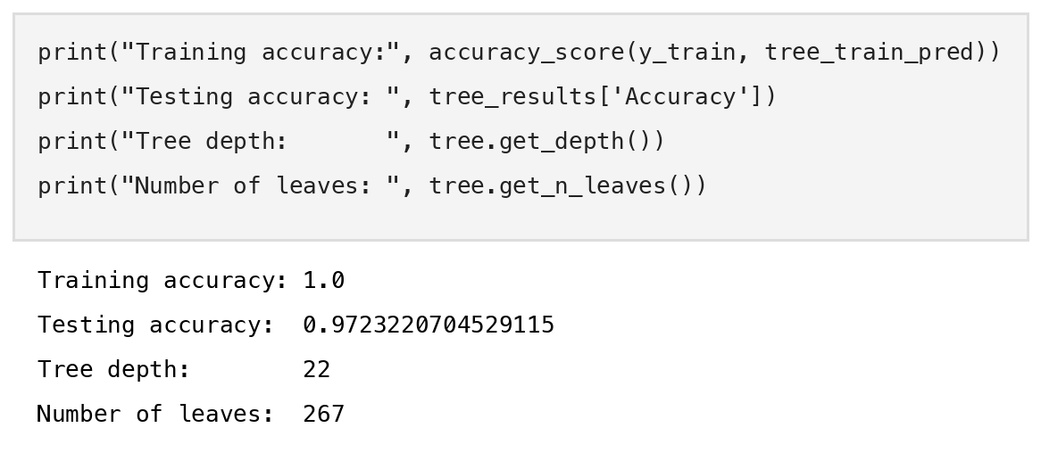
Model 2: Decision Tree
A single tree with default settings: it grows until every leaf is pure. Unscaled features.
Results
Test accuracy = 97.23% (77 errors): the weakest model
Train 100% vs. test 97.23%: the tree overfits
Depth 22 with 267 leaves: many leaves fit only a few points
Confuses Acetaldehyde with Ethanol and Toluene
Confusion matrix on the test set: errors are spread across many classes.
Notes:
Model 2 is a single Decision Tree with the default settings, so it keeps growing until every leaf is pure.
It's clearly the weakest model: 97.23 percent test accuracy, 77 errors. Training accuracy is 100 percent, so the gap of almost 3 points means the tree overfits. It grew to depth 22 with 267 leaves, so many leaves describe just a handful of training measurements.
In the confusion matrix, the errors are spread out. The worst is Acetaldehyde, which gets mixed up with Ethanol in both directions, 12 and 6 times, and with Toluene, 8 and 8 times.
This is the problem XGBoost is supposed to fix: instead of one deep tree, it uses many shallow ones.

Slide 11
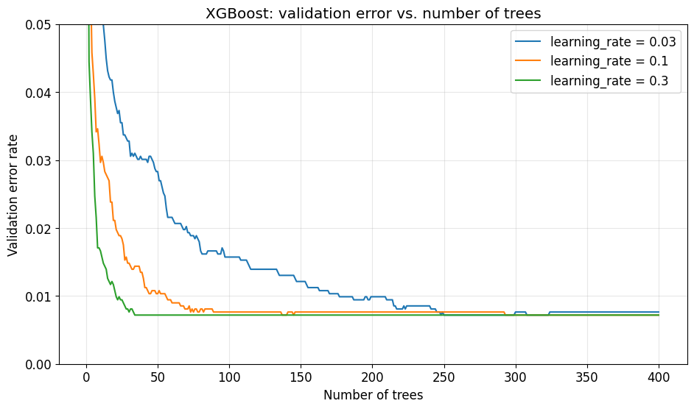
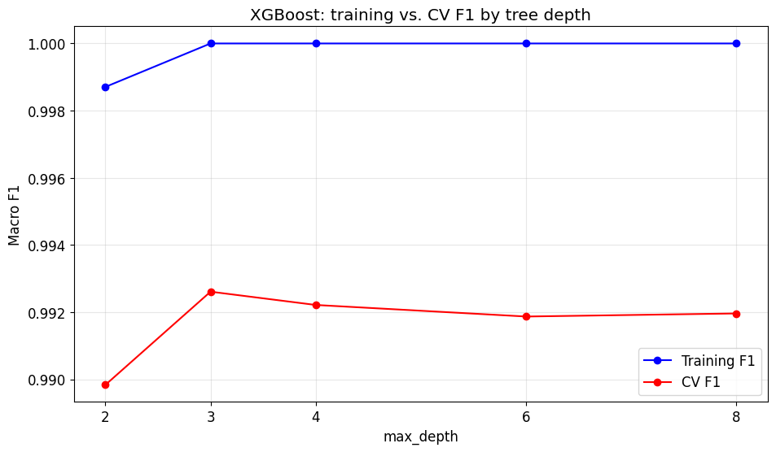
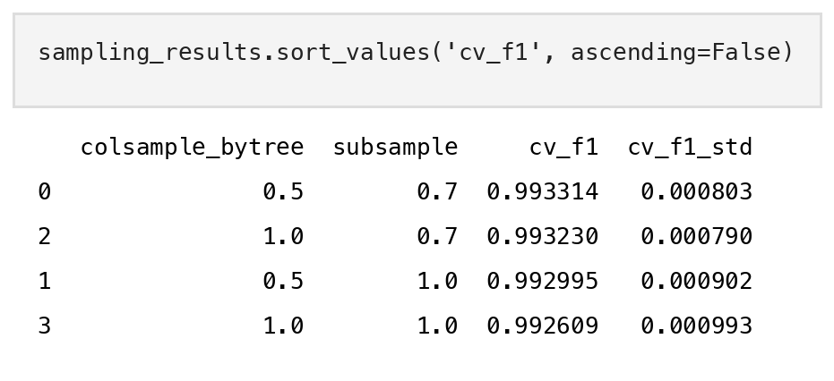
Model 3: XGBoost, Tuning
1. Trees and learning rate
2. Tree depth
3. Row and feature sampling
All 3 learning rates reach 0.72% validation error. 0.1 needs about 137 trees. Chosen: 0.1 with 300 trees.
Best CV F1 at depth 3 (0.9926). Depth 2 underfits; deeper trees don't help.
70% of rows and 50% of features per tree: CV F1 0.9933, a gain within the fold-to-fold noise.
How it was tuned
Cross-validation on the training set only (3-fold, stratified), one parameter group at a time. The test set was used once, for the final model.
Notes:
Model 3 is XGBoost. I tuned its main parameters, using only the training data, with 3-fold stratified cross-validation. I tuned them in three steps.
Step 1: the number of trees and the learning rate. These go together, since a smaller learning rate needs more trees. I tracked the validation error after every tree for three learning rates. All three reach the same lowest error, 0.72 percent. They just get there at different speeds: 34 trees at 0.3, about 137 at 0.1, and 248 at 0.03. After that the curves stay flat, so extra trees don't cause overfitting here. I chose 0.1 with 300 trees.
Step 2: tree depth. The training score is perfect for every depth from 3 up, so only the cross-validation score is useful. It's best at depth 3. Depth 2 underfits, and deeper trees don't help, because each tree only has to correct the errors left by the trees before it.
Step 3: row and feature sampling. Giving each tree 70 percent of the rows and 50 percent of the features was slightly best. That fits the correlation we saw: a tree that sees only half the features still finds near-copies of the missing ones.
Honestly, all of these differences are smaller than the variation between folds, so the defaults were already close to optimal on this data.

Slide 12

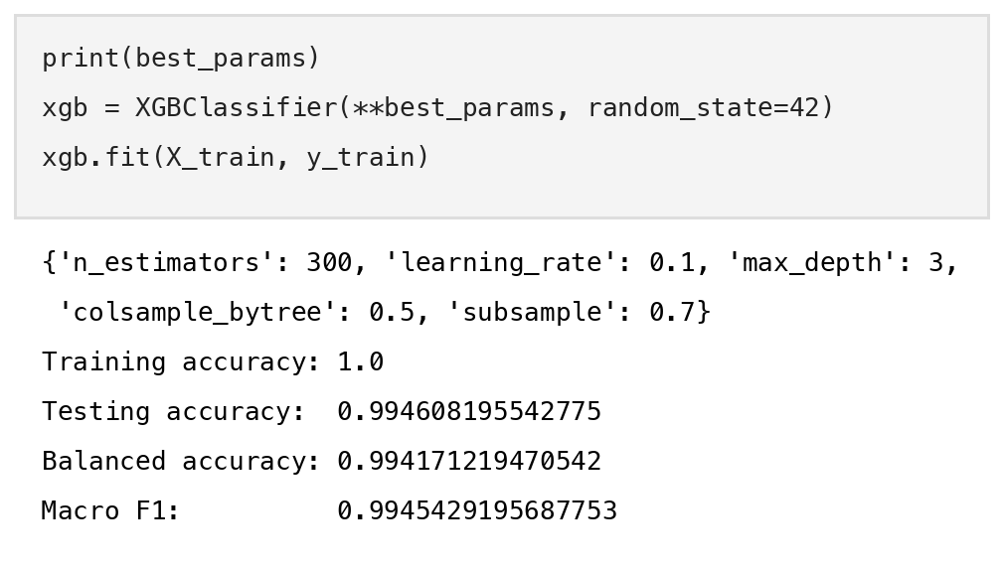
Model 3: XGBoost, Final Model
Retrained on the full training set: 300 trees, learning rate 0.1, depth 3, subsample 0.7, colsample_bytree 0.5.
Results
Test accuracy = 99.46% (15 errors): the best model
Train 100%, but the test score stays high: many shallow trees generalize better than one deep tree
Balanced accuracy 99.42%, macro F1 99.45%
Misses only 4 Ammonia measurements
Confusion matrix on the test set: no gas has more than 4 errors.
Notes:
With those parameters I retrained XGBoost on the full training set and evaluated it on the test set once.
Test accuracy is 99.46 percent, 15 errors, the best of the three models. Balanced accuracy is 99.42 and macro F1 is 99.45.
Training accuracy is 100 percent, just like the Decision Tree. But here the test score stays very high. The difference is that every tree is shallow, depth 3, and its contribution is scaled down by the learning rate. So no single tree can memorize the training data the way one deep tree does.
In the confusion matrix, no gas has more than 4 errors. The smallest class, Ammonia, loses only 4 measurements.

Slide 13
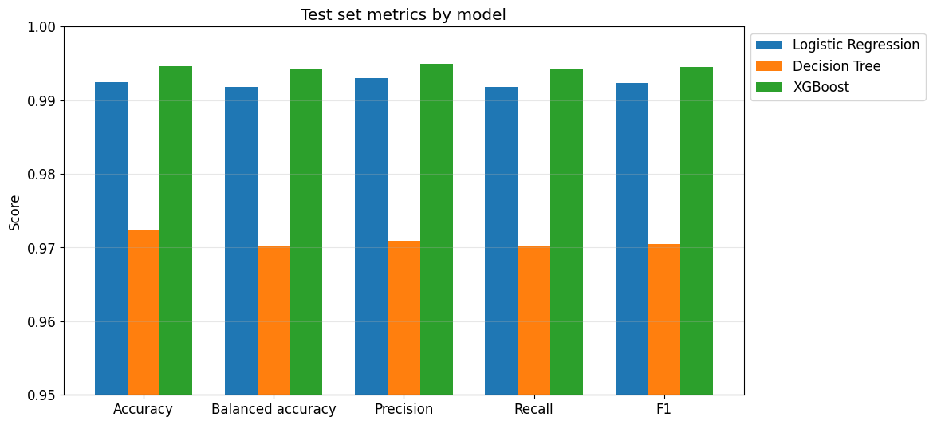
Model Comparison
Model | Accuracy | Bal. acc. | Macro F1 | Errors
Logistic Regression | 0.9925 | 0.9918 | 0.9924 | 21
Decision Tree | 0.9723 | 0.9702 | 0.9705 | 77
XGBoost | 0.9946 | 0.9942 | 0.9945 | 15
XGBoost is the best model on every metric
vs. Decision Tree: 15 errors instead of 77, about 80% fewer
vs. Logistic Regression: 15 instead of 21, about 30% fewer
Precision ≈ recall for every model: no class is over-predicted
Test set metrics by model (y-axis starts at 0.95).
Is a 6-error gap meaningful?
The test set has 2,782 measurements, so 6 errors is only 0.2 points of accuracy. Slide 15 checks whether the gap is real.
Notes:
Here are the three models side by side, all trained on the same training data and evaluated on the same test set.
XGBoost is the best on every metric.
Compared with the Decision Tree, the improvement is big: 15 errors instead of 77, about 80 percent fewer. Boosting many shallow trees fixes the overfitting of one deep tree.
Compared with Logistic Regression, the improvement is small: 15 errors instead of 21, about 30 percent fewer, or 0.2 points of accuracy.
Precision and recall are almost equal for every model, so none of them is systematically over-predicting one gas.
But with only 2,782 test measurements, a gap of 6 errors could be luck. I check that on slide 15. First, the individual gases.

Slide 14
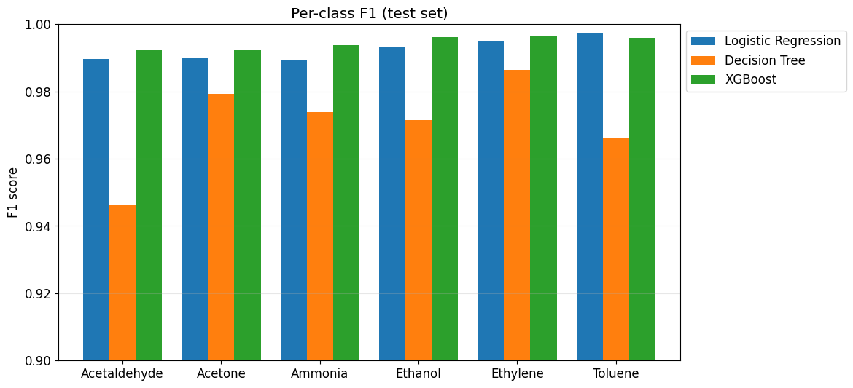
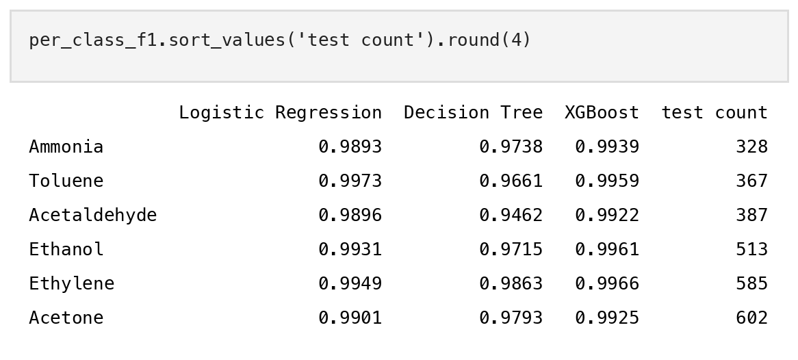
Per-Class Performance
Ammonia is the smallest class (328 test measurements), so it gets a separate check.
Results
Ammonia: XGBoost F1 0.9939 vs. 0.9893 (Logistic Regression) and 0.9738 (Decision Tree)
XGBoost has the highest F1 on 5 of 6 gases
Toluene: Logistic Regression is ahead by 1 measurement
The tree's worst class: Acetaldehyde (F1 0.946)
Notes:
Now the individual gases, sorted from the smallest class to the largest.
Ammonia is the smallest class, so I checked it separately. XGBoost has the best F1 on it, 0.994, compared with 0.989 for Logistic Regression and 0.974 for the Decision Tree. For Logistic Regression, Ammonia is actually its weakest class, so being the smallest class costs it a little. XGBoost doesn't show that problem.
Overall, XGBoost has the highest F1 on 5 of the 6 gases. The one exception is Toluene, where Logistic Regression is ahead by a single measurement.
The Decision Tree's worst class is Acetaldehyde, with an F1 of 0.946, because of the confusion with Ethanol and Toluene we saw earlier.

Slide 15
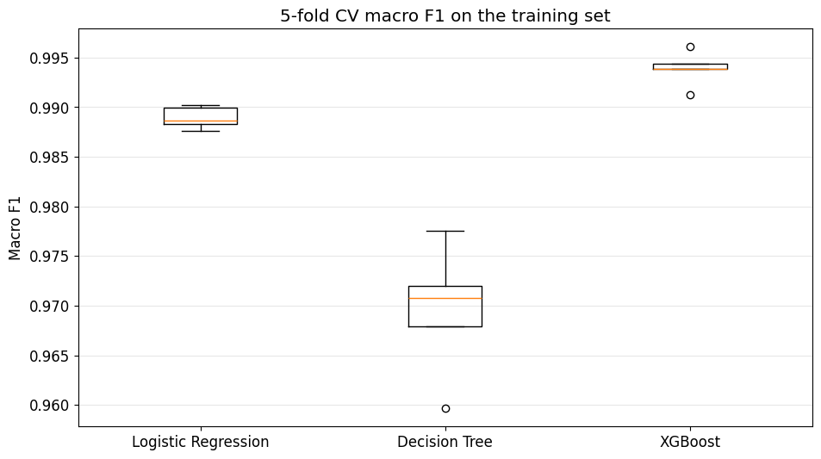
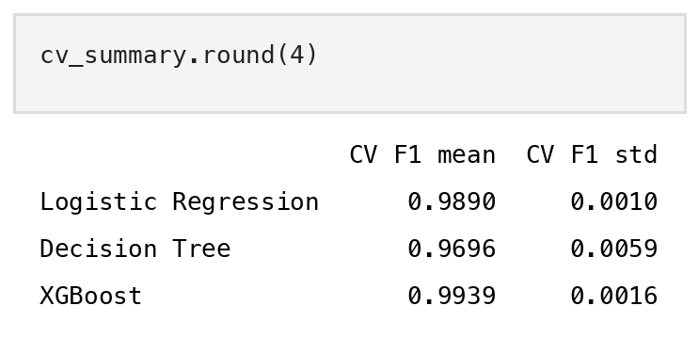
Most Surprising Finding
A simple linear model reached 99.25%, only 6 test errors behind XGBoost. With so few errors, is XGBoost's lead real or luck?
Results
5-fold CV on the training set; the test set is not used
XGBoost beats Logistic Regression in every fold: mean F1 0.9939 vs. 0.9890
The gap is 3 to 5 times the fold-to-fold spread: consistent, not luck
The Decision Tree is far behind (0.9696) and the least stable
5-fold cross-validated macro F1 for each model. The XGBoost box sits above the Logistic Regression box.
Notes:
The most surprising finding for me was how good the simple baseline was. A linear model reached 99.25 percent, only 6 test errors behind XGBoost. With so few errors, I wanted to know if XGBoost's lead is real, or just luck with this particular test set.
So I scored all three models with 5-fold cross-validation on the training set, without touching the test set.
XGBoost beats Logistic Regression in every single fold. Its lowest fold is above Logistic Regression's highest fold. The means are 0.9939 versus 0.9890, and that gap is 3 to 5 times the fold-to-fold standard deviation. So the improvement is small, but it's consistent, not luck.
The Decision Tree is far behind, at 0.97, and it's also the least stable model: its spread is about four times bigger than the others'.

Slide 16
Final Takeaway
Best model: XGBoost (300 trees, depth 3), test accuracy 99.46%, macro F1 0.9945
vs. Decision Tree: about 80% fewer errors; boosting fixes the single tree's overfitting
vs. Logistic Regression: a small but consistent gain, ahead in every CV fold
Shallow trees were enough: depth 3 was best, and tuning changed CV F1 by less than the fold noise
Limitation: sensor drift
The data covers 36 months and the sensors drift over time. A random split mixes all months, so these scores are optimistic. Training on early batches and testing on later ones would be a harder, more realistic test.
Notes:
To wrap up.
The best model is XGBoost, with 300 trees of depth 3: 99.46 percent test accuracy and a macro F1 of 0.9945.
Compared with the Decision Tree, it makes about 80 percent fewer errors. Boosting many small trees fixes the overfitting of a single deep tree.
Compared with Logistic Regression, the gain is small but consistent: XGBoost is ahead in every cross-validation fold.
Shallow trees were enough. Depth 3 was the best, and the tuning moved the score by less than the noise between folds, so XGBoost's defaults were already very good.
One important limitation: this dataset was collected over 36 months, and the sensors drift over time. My random split mixes measurements from every month into both the training and the test set, so these scores are optimistic. A harder and more realistic test would be to train on the early batches and test on the later ones.
Thank you for watching.

