Slide 1
Treating multiple detections with Hough transform
By Wojciech Zaremba and Vadim Kantorov

Slide 2
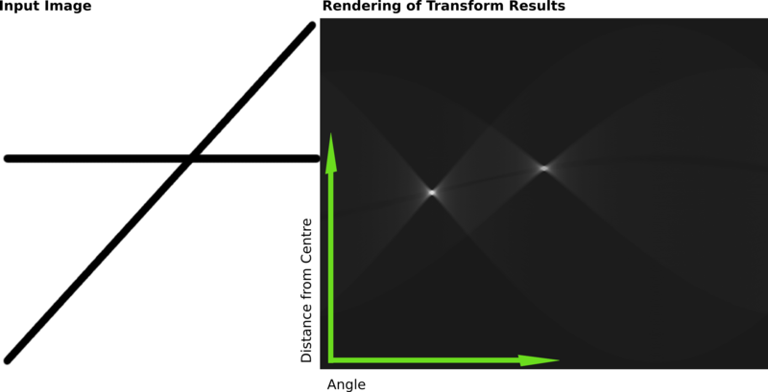
Classical Hough transform - recall

Slide 3
Enhanced Hough transform - Assumptions
Classical Hough assumes votes independence – enhanced not
Allow to detect objects close to each other without many false positives
Model differently joint probability than classical Hough transform

Slide 4
Enhanced Hough transform - algorithm
Hypothesis space H
Many voters – N of them
Count likelihood for every hypothesis h in H
Take hypothesis with maximum likelihood
Update voters preferences
Repeat

Slide 5
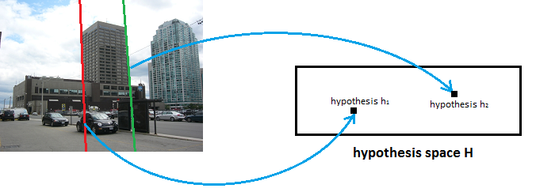
Caching
Allow to avoid to recomputing many likelihood values in hypothesis space in consecutive iterations

Slide 6
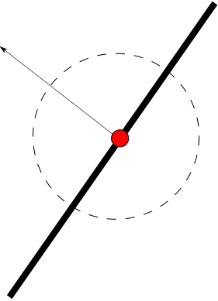
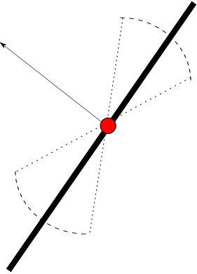
Examined angles reduction

Slide 7
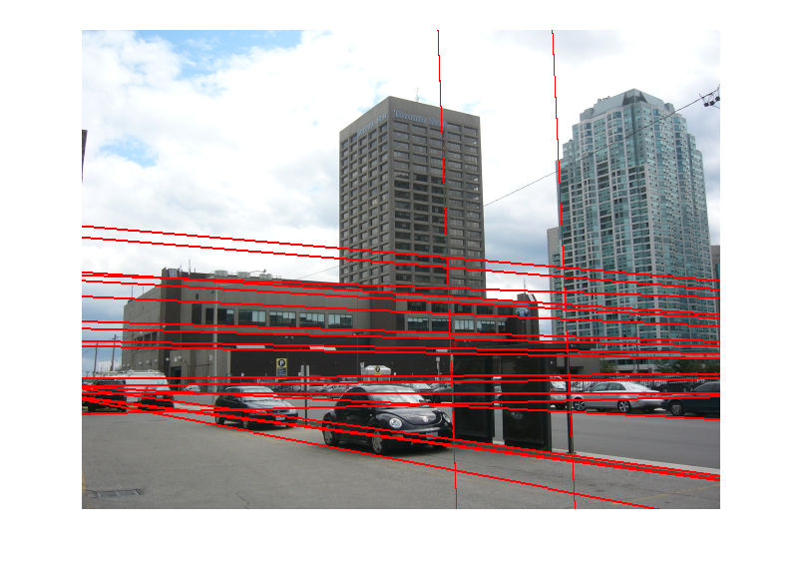
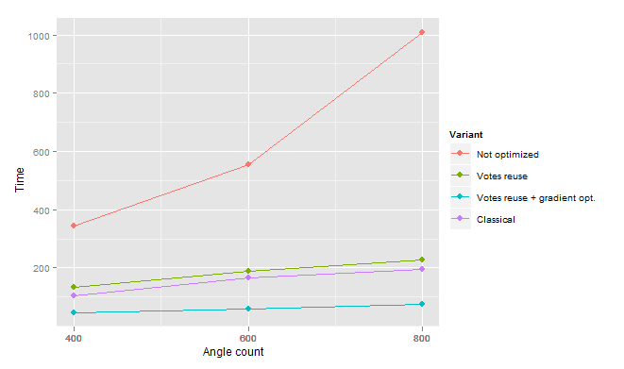
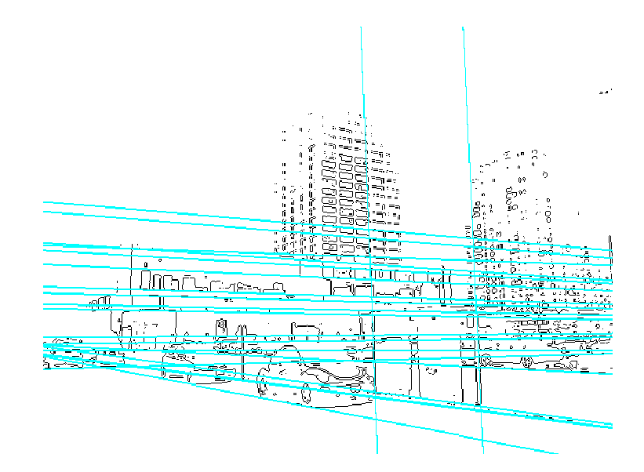
Evaluation

Slide 8
Conclusion and questions
We have been talking today about:
Multiple object detection using enhanced Hough transform
Beneficial when objects of interest tend to be closely located
Optimizations
Angle reduction by considering gradient direction
Caching
Evaluation
We are more than happy to take any question
Code available on the github https://github.com/vadimkantorov/advancedcv-hough/

