Slide 1







Emerging Technology Trends – Key Findings
Vadim Savenkov
2023-02-05

Slide 2



OUTLINE
Executive Summary
Introduction
Methodology
Results
Visualization – Charts
Dashboard
Discussion
Findings & Implications
Conclusion
Appendix

Slide 3

EXECUTIVE SUMMARY
Current Technology Trends By:
Language
Database
Platform
Web Frameworks
Future Technology Trends By:
Language
Database
Platform
Web Frameworks
Demographic Trends By:
Age
Gender
Education
Key Findings

Slide 4

INTRODUCTION
Identifying technology trends for future skill requirements.
Collecting data from various sources and identifying trends for this year's report on emerging skills from:
Job postings
Training portals
Surveys
Analyzing the data and identifying insights and trends including:
The top programming languages in demand
The top database skills in demand
The popular IDEs
Building dashboards to visualize insights and trends to bring findings for developers, recruiters, educators, and policymakers

Slide 5

METHODOLOGY
Data Sourcing and Collection
Data Wrangling and Cleaning
Exploratory Data Analysis
Data Visualization and Comparison
Dashboards by IBM Cognos Analytics

Slide 6
RESULTS OVERVIEW
Programming Language Trends
Database Management Systems Trends
Software Platform Technology Trends
Software Framework Technology Trends
Demographic Trends

Slide 7
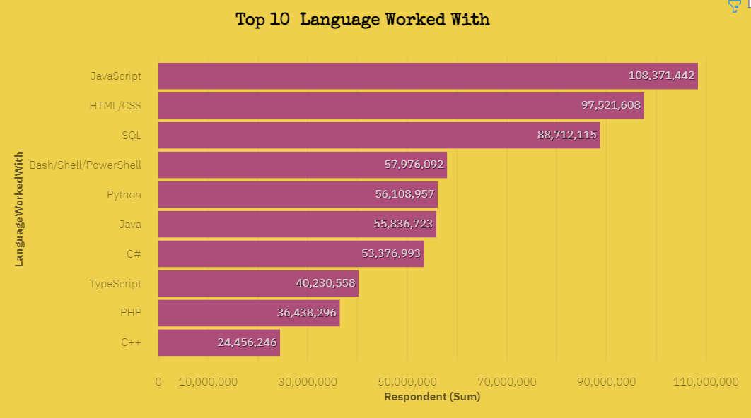
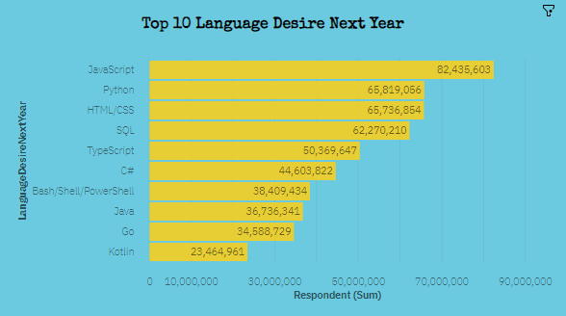
PROGRAMMING LANGUAGE TRENDS
Current Year
Next Year

Slide 8
PROGRAMMING LANGUAGE TRENDS - FINDINGS & IMPLICATIONS
Findings:
JavaScript is the most popular language for software development today.
HTML/CSS remains one of the top front-end languages
SQL stays popular as a main language to manage relational databases.
PowerShell/Bash is among the top 5 languages used for system administration.
Python keeps climbing to the top.
Implications:
JavaScript and HTML/CSS will continue to dominate in web development.
The interest in open-source TypeScript has increased as larger applications are required to be developed and maintained.
SQL will remain the main relational DB querying language for the time being.
Python’s popularity keeps growing with the recent extensive development of AI, ML, and neural network applications.

Slide 9
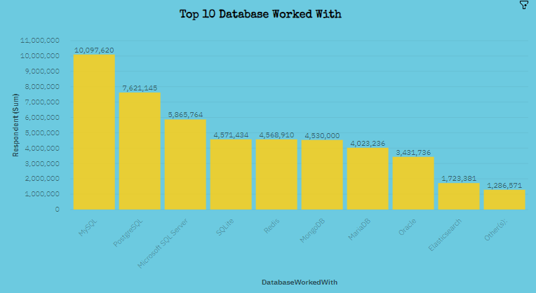
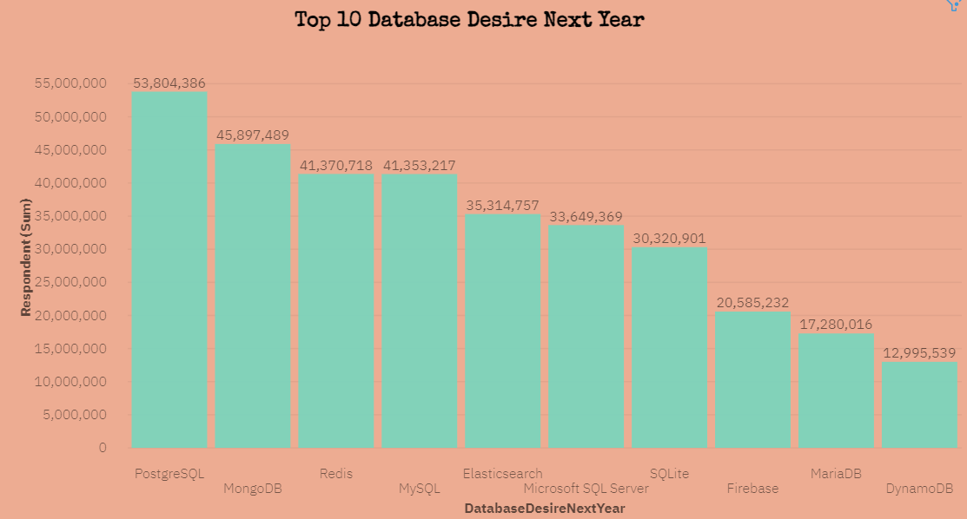
DATABASE TRENDS
Current Year
Next Year

Slide 10
DATABASE TRENDS - FINDINGS & IMPLICATIONS
Findings:
MySQL, PostgreSQL, and MS SQL Server are the top 3 programming languages to store and process information in a relational database.
MongoDB is among 5 database management programs. It stays popular as an alternative to traditional relational databases.
SQLite stays popular as a C-language library that implements a small, fast, high-reliability SQL database engine.
Implications:
PostgreSQL has become the most popular database management program as an object-relational database to manage more complex data types.
MongoDB has gained more popularity, as a non-relational document database that provides support for JSON-like storage.
There is a growing demand to manage unstructured data and document-oriented databases like Elasticsearch get more popular.

Slide 11

DASHBOARDS LINKS
Current Technology Trends Dashboard:
https://dataplatform.cloud.ibm.com/dashboards/4757e074-977b-42e6-812c-875bc1be35dd/view/4169f01c2cea3e914be2dce407cd7d027e37245cb0bb840589877b490f367797f06e1597c8264d0bda165732fbbf4458c1
Future Technology Trends Dashboard:
https://dataplatform.cloud.ibm.com/dashboards/3151b53b-40ec-4529-98b1-8fa1d17e1123/view/610ac2031f9d2ec80db6f6e407cd7d027e37245cb0bb840589877b490f367797f06e1597c8264d0bda165732fbbf4458c1
Demographics Dashboard:
https://dataplatform.cloud.ibm.com/dashboards/ba8e311d-ef43-41a6-9d2f-4857a15e5636/view/4761ca2615ed62e563b5c4e407cd7d027e37245cb0bb840589877b490f367797f06e1597c8264d0bda165732fbbf4458c1

Slide 12
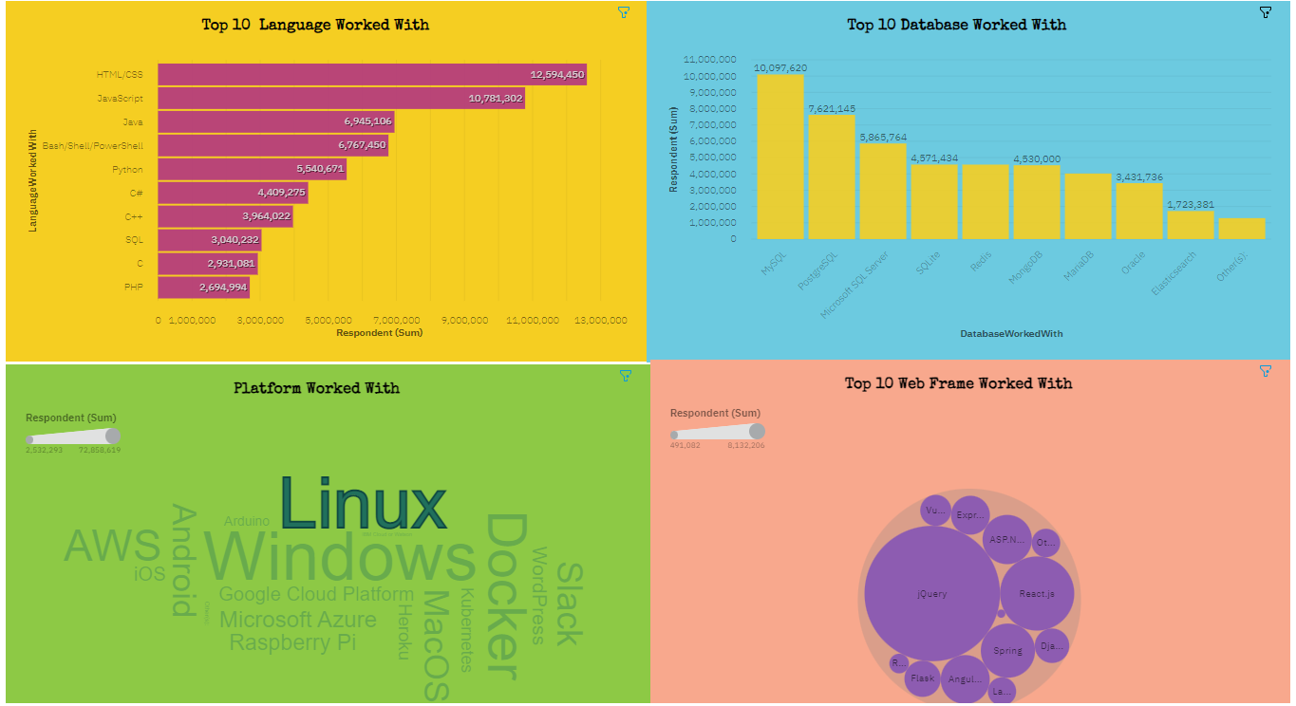
DASHBOARD 1 – CURRENT TECHNOLOGY TRENDS

Slide 13
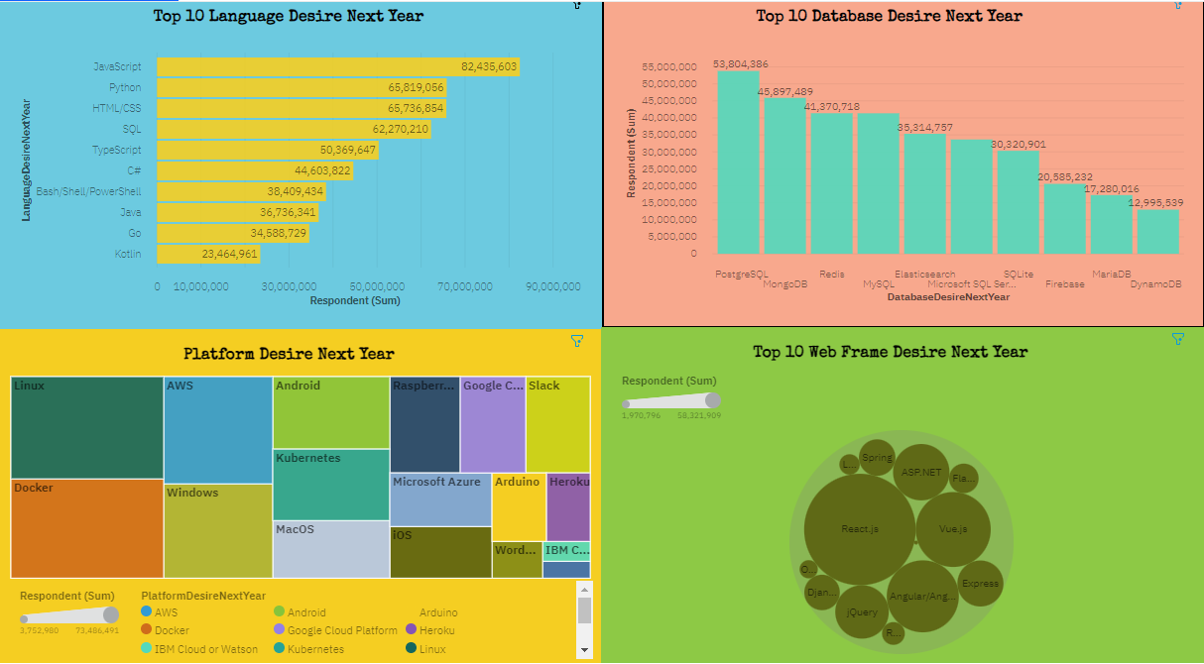
DASHBOARD 2 – FUTURE TECHNOLOGY TRENDS

Slide 14
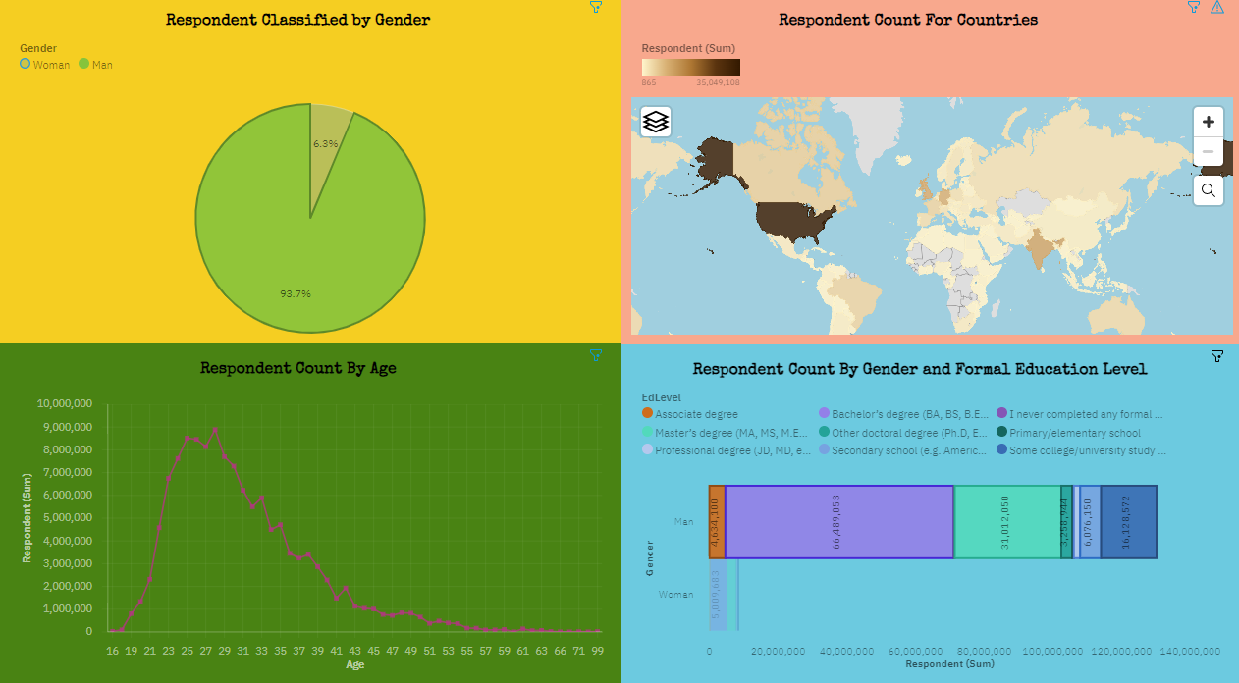
DASHBOARD 3 – DEMOGRAPHICS TRENDS

Slide 15
DISCUSSION
Current software development technologies in high demand.
The growing popularity of some modern programming languages and frameworks for web development.
New technologies skills to learn in the nearest future for software developers and database administrators.
Software developer’s demographic in terms of age, gender, and education.
Today’s expectations of compensation for full-stack software developers.

Slide 16
OVERALL FINDINGS & IMPLICATIONS
Findings:
High demand for JavaScript and HTML/CSS programming languages.
Growing popularity in Python and Typescript.
High interest in SQL database management programs with MySQL at the top.
MongoDB stays a great alternative to traditional relational databases.
Linux and Docker are the most popular platforms
Implications:
Prospective software developers will have to learn new skills such as Typescript, MongoDB, and React.js.
Data analysts should become more proficient in Python programing language to handle a larger amount of data for business needs.
SQL, as well as No SQL competence, is a must for business analysts.
To adapt to changing technologies and reduce gender and education gaps.

Slide 17

CONCLUSION
This data analysis allowed us to get valuable insights from the software development technologies.
It helped to discover trends for future development of critical skills to stay competitive in the volatility of today’s market for software developers.
It provided more clear insights that could help businesses to target new talents, to solve educational complications, and to address gender issues.

Slide 18

APPENDIX 1 - 3
Platform Technology Trends
Framework Technology Trends
Demographics Trends

Slide 19
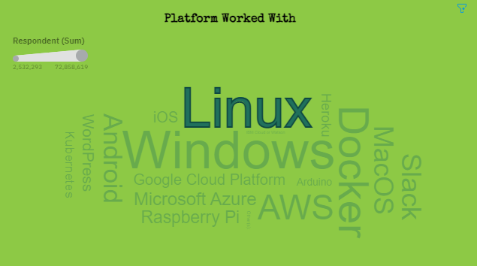
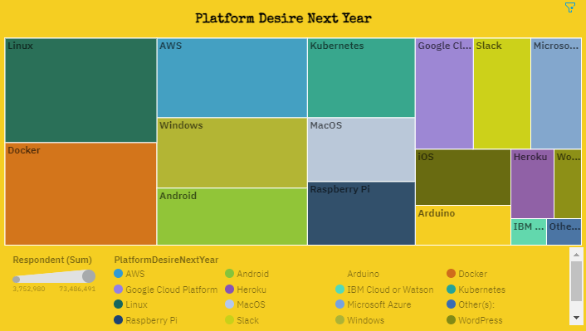
APPENDIX 1 - PLATFORM TRENDS
Current Year
Next Year

Slide 20
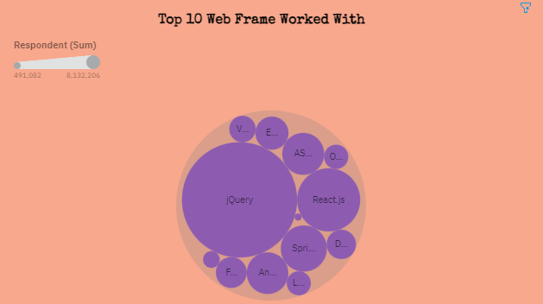
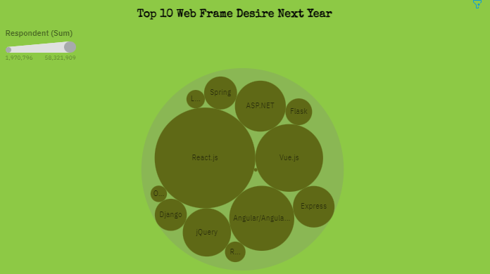
APPENDIX 2 - FRAMEWORK TRENDS
Current Year
Next Year

Slide 21
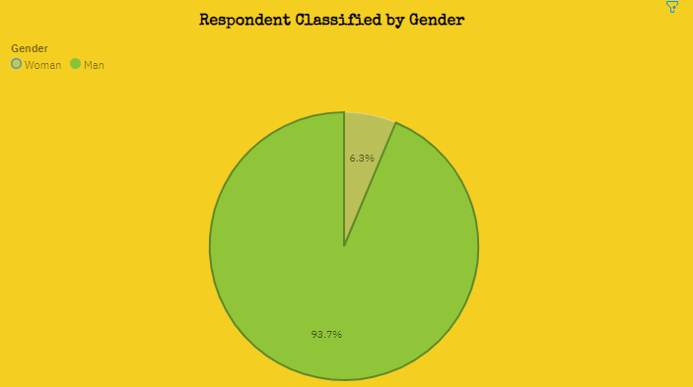
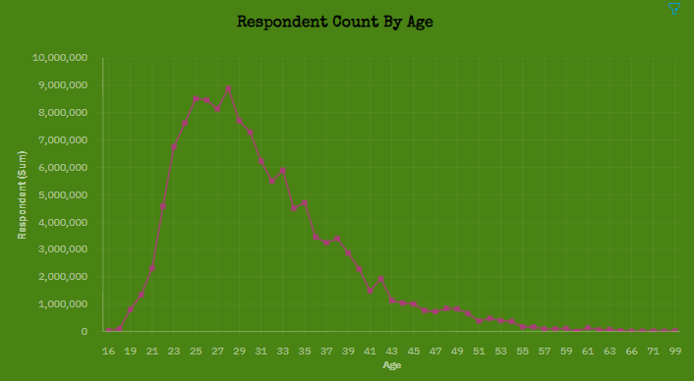
APPENDIX 3 - DEMOGRAPHICS TRENDS
By Gender
By Age

Slide 22
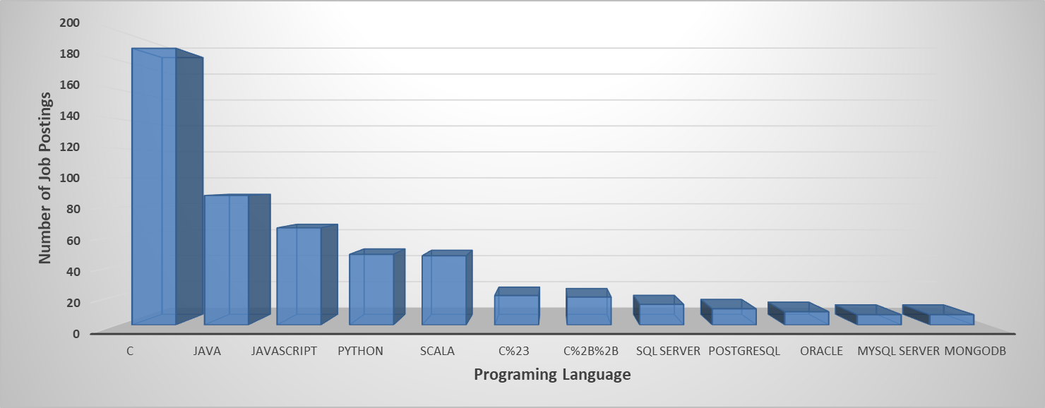
JOB POSTINGS

Slide 23
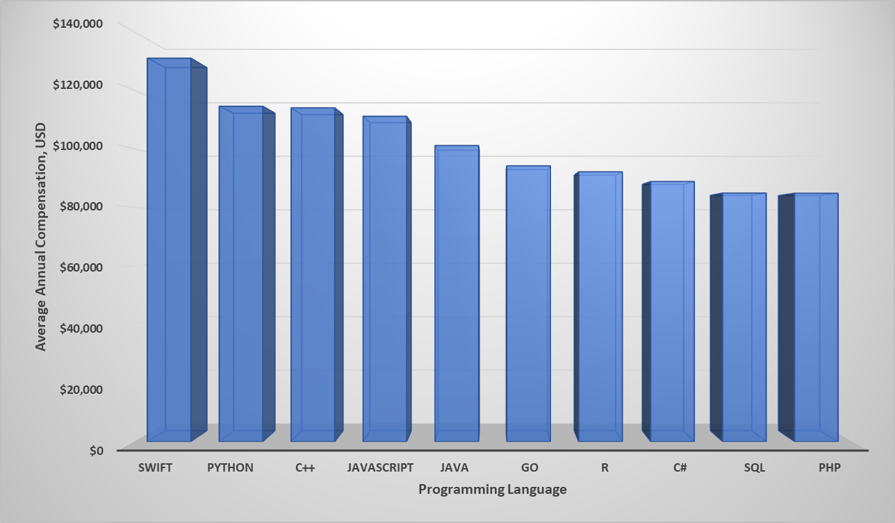
POPULAR LANGUAGES

