Slide 1
FRAUD DETECTION ANALYTICS · COURSE PROJECT
Card Transaction Fraud Detection
1.85M
card transactions (2019–2020)
Customer & Merchant Behaviour Analysis using Machine Learning
9,651
fraud cases (0.52%)
V Adithya
PRN 25030242063
Symbiosis Centre for Information Technology, Pune
0.92
PR-AUC on unseen test data
Notes:
Introduce yourself and the project: detecting fraudulent card transactions and explaining the behaviour behind them. Dataset: Sparkov simulated credit card transactions from Kaggle.

Slide 2
PROBLEM
Why card fraud is hard to catch
Fraud is rare: about 1 in every 172 transactions.
Missing fraud costs money; flagging genuine customers costs trust and analyst time.
Simple rules (e.g. "flag large amounts") catch fraud but drown teams in false alarms.
Goal: catch most fraud while keeping false alarms low, and explain what fraud looks like.
Understand fraud behaviour
1
EDA by amount, category, time, customer and card usage
2
Engineer behavioural features
Spend vs usual, time since last use, recent activity
3
Segment without labels
K-Means clustering and Isolation Forest anomaly detection
4
Compare sampling & ML models
7 sampling strategies, 5 models, 100–1000 iterations, tuning
Notes:
Frame the business problem: rare events, two kinds of cost (missed fraud vs false alarms). Then the four objectives that map to the four notebooks.

Slide 3
DATASET
Sparkov credit card transactions
1.85M
983
693
Why this dataset
Readable features (amount, category, time, age, location), so every finding becomes a business insight
Unlike anonymised datasets (V1–V28 PCA columns) that cannot be interpreted
Already split by date: train Jan 2019–Jun 2020, test Jun–Dec 2020
Public domain (CC0) on Kaggle
transactions
(1.30M train · 0.56M test)
cards / customers
merchants
14
51
0.58%
merchant categories
US states
fraud rate (train)
Note: the data is synthetic (generated by the Sparkov simulator to resemble real card activity). Patterns reflect the simulator's fraud profiles.
Notes:
Explain dataset choice and differentiation: readable columns allow behaviour analysis. Be upfront that the data is simulated.

Slide 4
APPROACH
Project pipeline and honest evaluation
01
02
03
04
05
EDA
Feature
engineering
Clustering &
anomalies
Sampling &
models
Final test
›
›
›
›
Patterns by amount,
category, time, card
Behaviour features
(past data only)
K-Means, Isolation
Forest
7 strategies, 5 models,
iterations, tuning
Scored once on
unseen data
Data period | Dates | Transactions | Frauds | Used for
Fit | Jan 2019 – Mar 2020 | 1,076,870 | 6,272 | Training during experiments
Validation | Mar 2020 – Jun 2020 | 219,805 | 1,234 | All choices: sampling, trees, settings, thresholds
Test | Jun 2020 – Dec 2020 | 555,719 | 2,145 | Final evaluation only — never used for any choice
Time-based split: models always learn from the past and are tested on the future, like a bank would use them.
Notes:
Walk through the notebooks. Stress that the test file was never used to make any decision; all choices were made on the validation period.

Slide 5
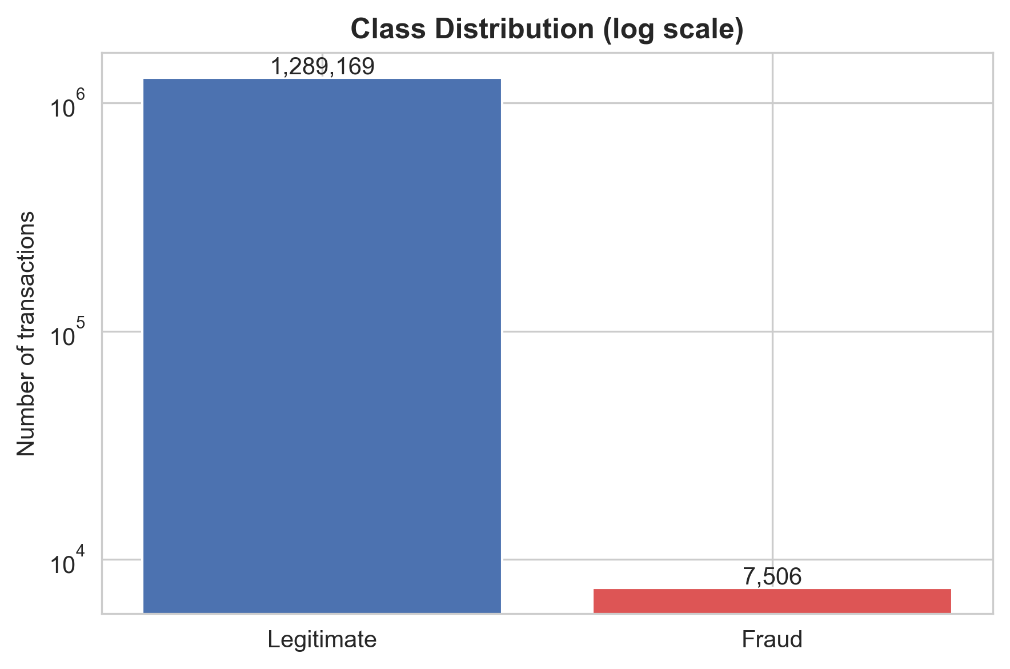
EDA · 1
Fraud is rare: accuracy is the wrong metric
1 in 172
transactions is fraud (7,506 of 1.30M in training)
99.42%
accuracy from predicting "legitimate" for everything, while catching zero fraud
PR-AUC
main metric, plus precision, recall and F1, which focus on the fraud class
Notes:
Log scale is used so the fraud bar is visible. The accuracy trap motivates PR-AUC, precision and recall.

Slide 6
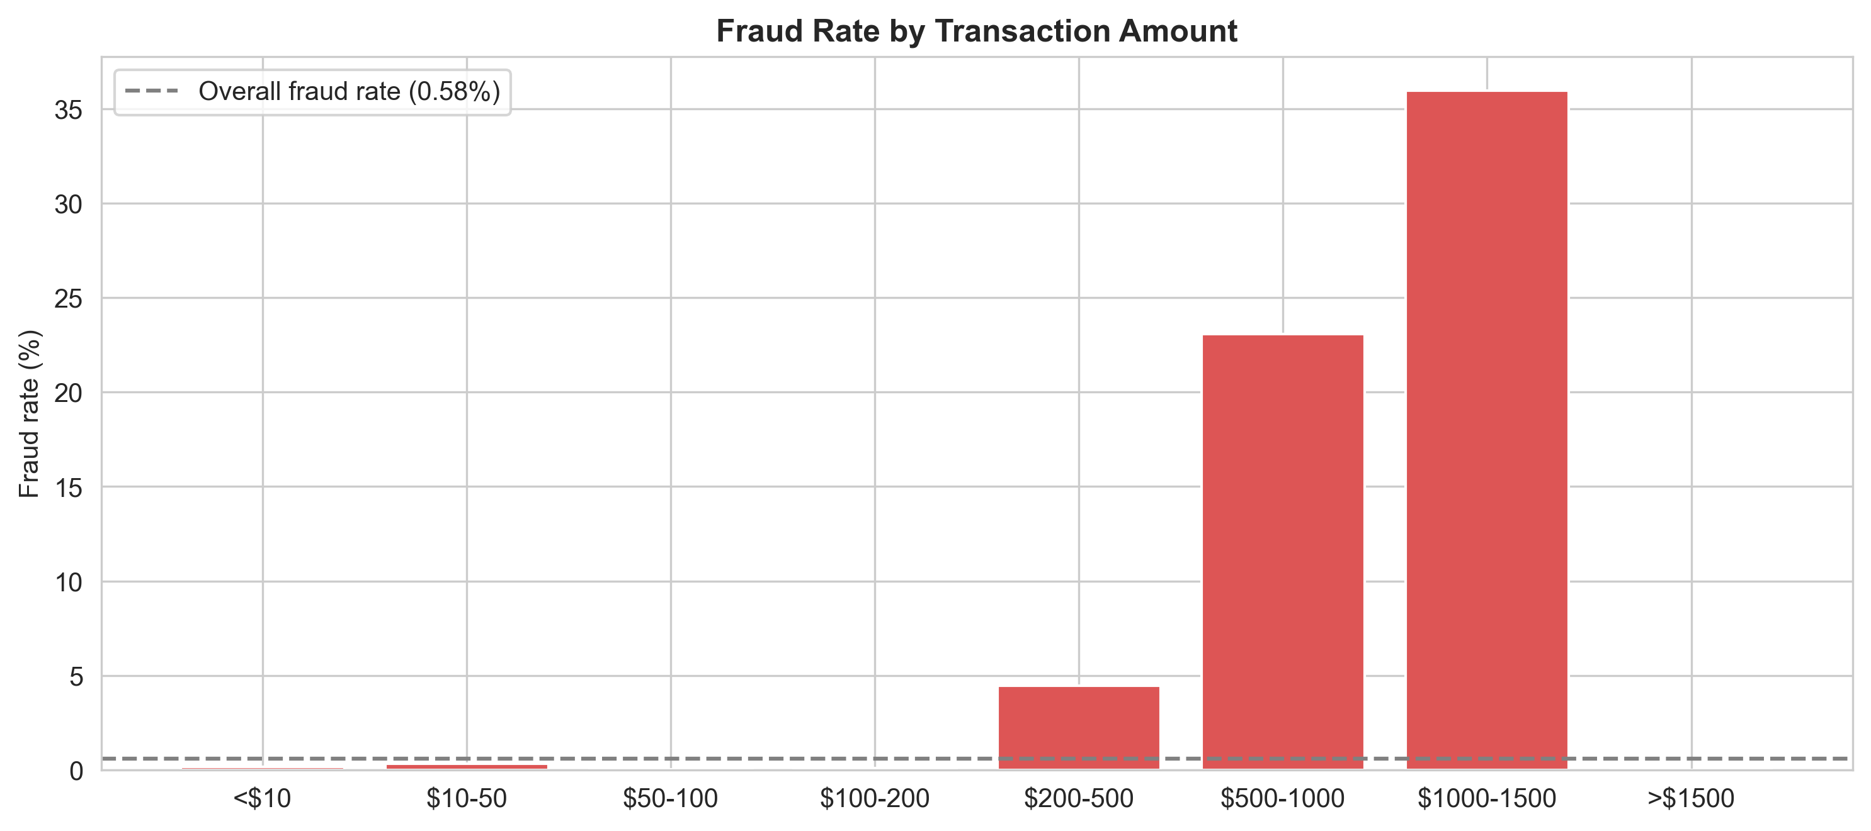
EDA · 2
Fraud concentrates in high-value transactions
$397 vs $47
median fraud vs median legitimate amount
76%
of fraud sits in the ~5% of transactions between $200 and $1,500
36%
A smaller group of low-value fraud ($10–50, ~21% of cases) also exists. No fraud above $1,500 is a quirk of the simulated data.
fraud rate in the $1,000–1,500 band (62x the average)
Notes:
Two fraud groups: mostly high-value, plus a smaller low-value group. The >$1,500 zero-fraud band is a data limitation.

Slide 7
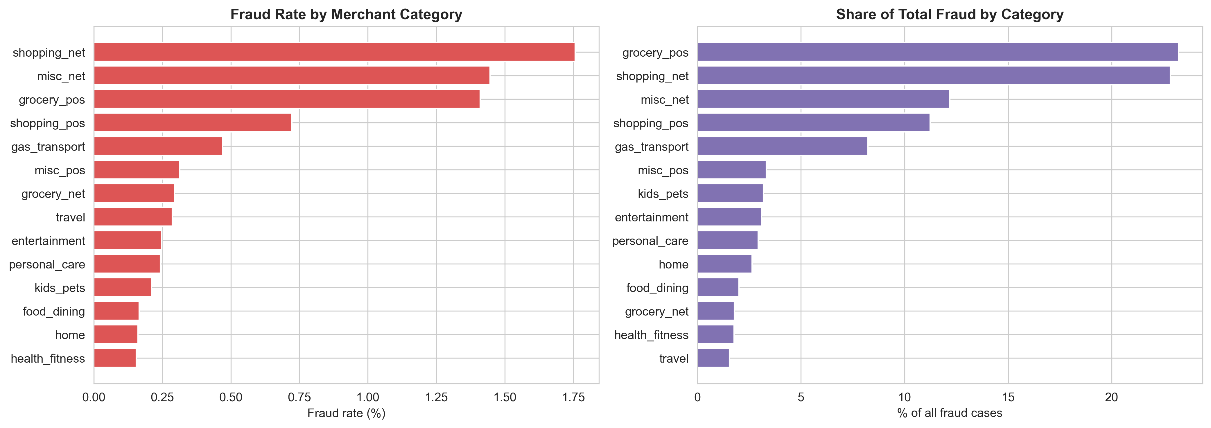
EDA · 3
Online shopping is riskiest; grocery stores see the most cases
2.4x
69%
Rate ≠ volume
online vs in-store shopping fraud rate (1.76% vs 0.72%)
of all fraud in 4 categories: grocery_pos, shopping_net, misc_net, shopping_pos
shopping_net has the highest rate; grocery_pos the most cases (1,743)
Notes:
Left chart answers how risky a purchase is; right chart answers where losses pile up. A bank needs both views.

Slide 8
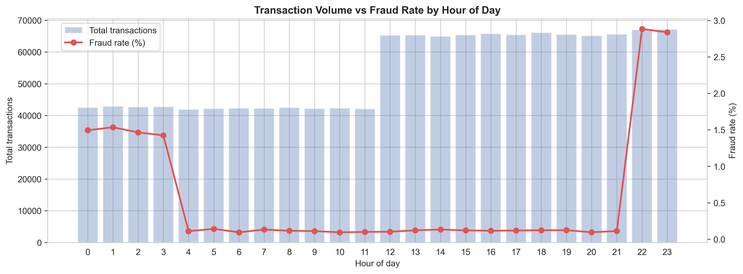
EDA · 4
85% of fraud happens between 10 pm and 4 am
85%
~28x
Every day
of all fraud falls in 6 night hours (10 pm–4 am)
higher fraud rate at 10–11 pm than during the day (~2.9% vs ~0.1%)
the night pattern holds on all 7 days of the week
Notes:
Night volume is not low in this data, so the high night rate is real concentration of fraud. The sharp 10 pm / 4 am edges are a simulator artefact.

Slide 9
FEATURE ENGINEERING
Behaviour features separate fraud best
Feature (median) | Legitimate | Fraud | Signal
Amount vs card's usual spend | 0.66x | 5.16x | Very strong
Transaction amount | $47 | $397 | Very strong
Hour of day | 14:00 | 22:00 | Strong
Hours since card's previous use | 4.6 h | 1.4 h | Strong
Transactions on card in last 24 h | 3 | 4 | Moderate
Customer age | 43 | 47 | Weak
Distance from home | 78.2 km | 77.9 km | None
10 frauds in 1.9 days
median burst on a compromised card: fraud comes fast and repeatedly
No leakage
behaviour features use only transactions before the current one, as a bank would see them
Distance ≠ fraud
a common assumption that does not hold in this data
Notes:
Spend vs usual is the key engineered feature: fraud is about 5x the card's normal spend. Distance shows no difference, which is itself a finding.

Slide 10
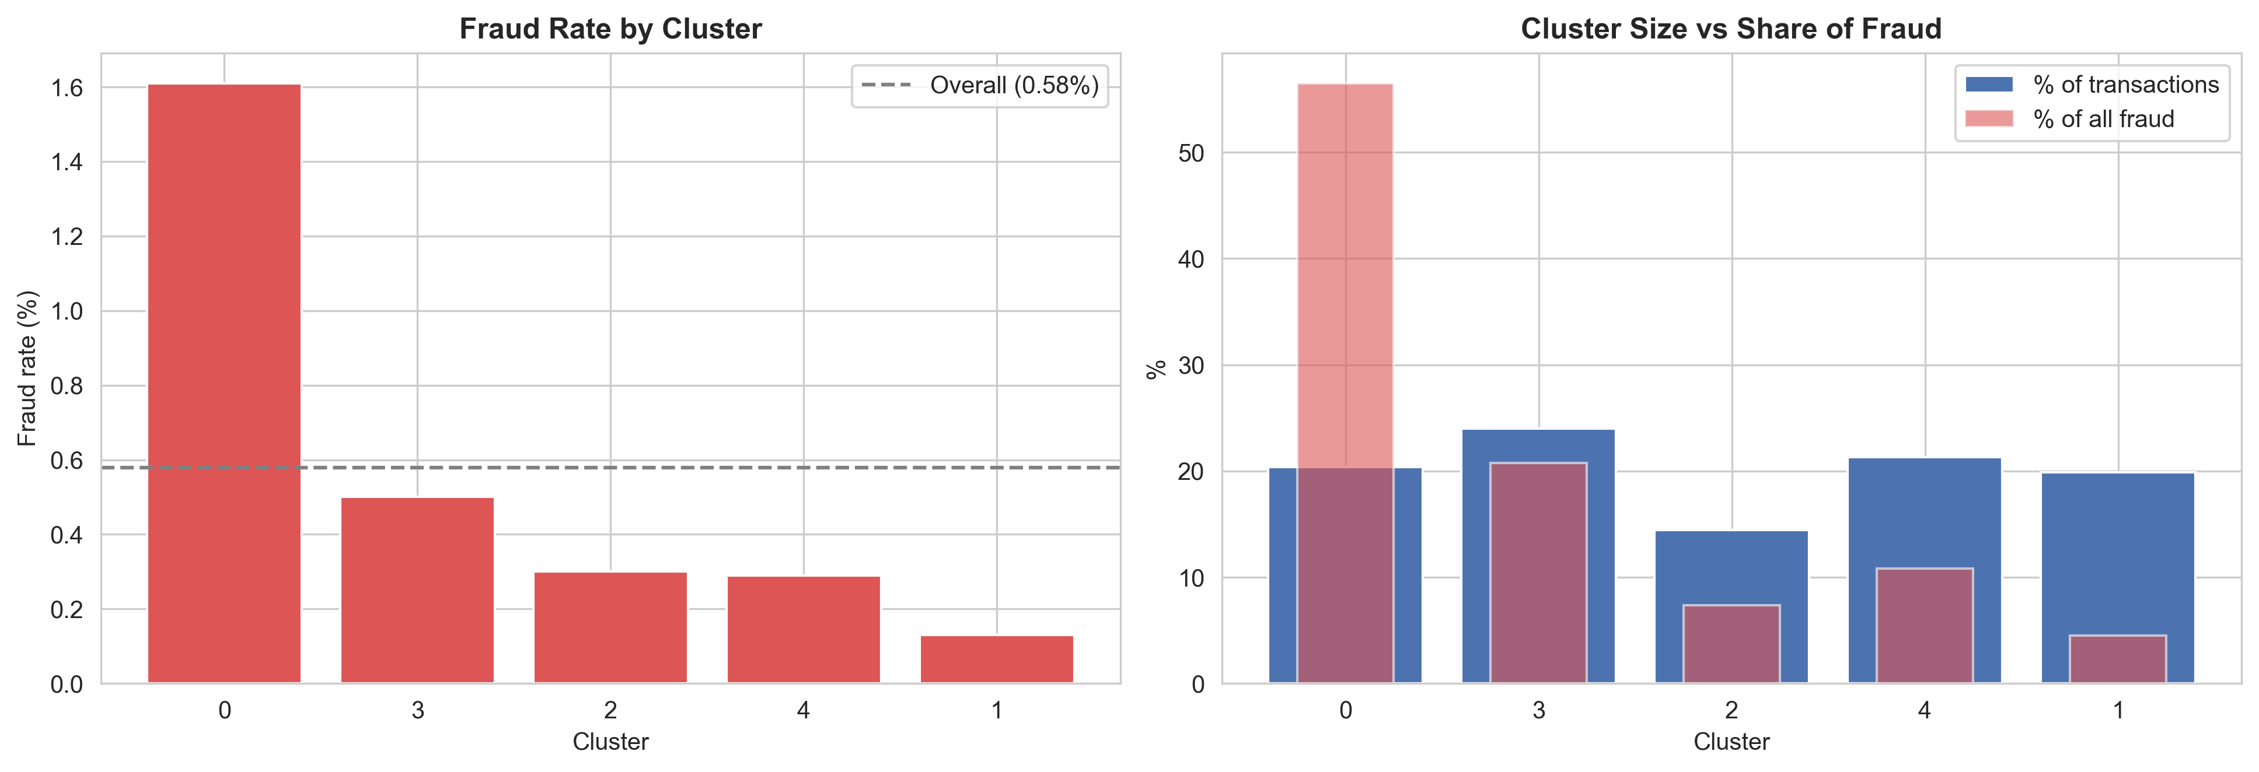
CLUSTERING
One behaviour segment holds most of the fraud
K-Means (k = 5) on 7 behaviour features, with no fraud labels used. Silhouette 0.14–0.18: behaviour forms a continuum, not sharp groups.
Cluster 0 "high-velocity users": 20% of transactions but 56.5% of fraud (1.61% rate), about 6 transactions a day, 1.6 h apart.
Notes:
Clustering found the fraud-heavy segment without seeing labels. Still, 98% of cluster 0 is legitimate, so segments show where to look, not which transaction is fraud.

Slide 11
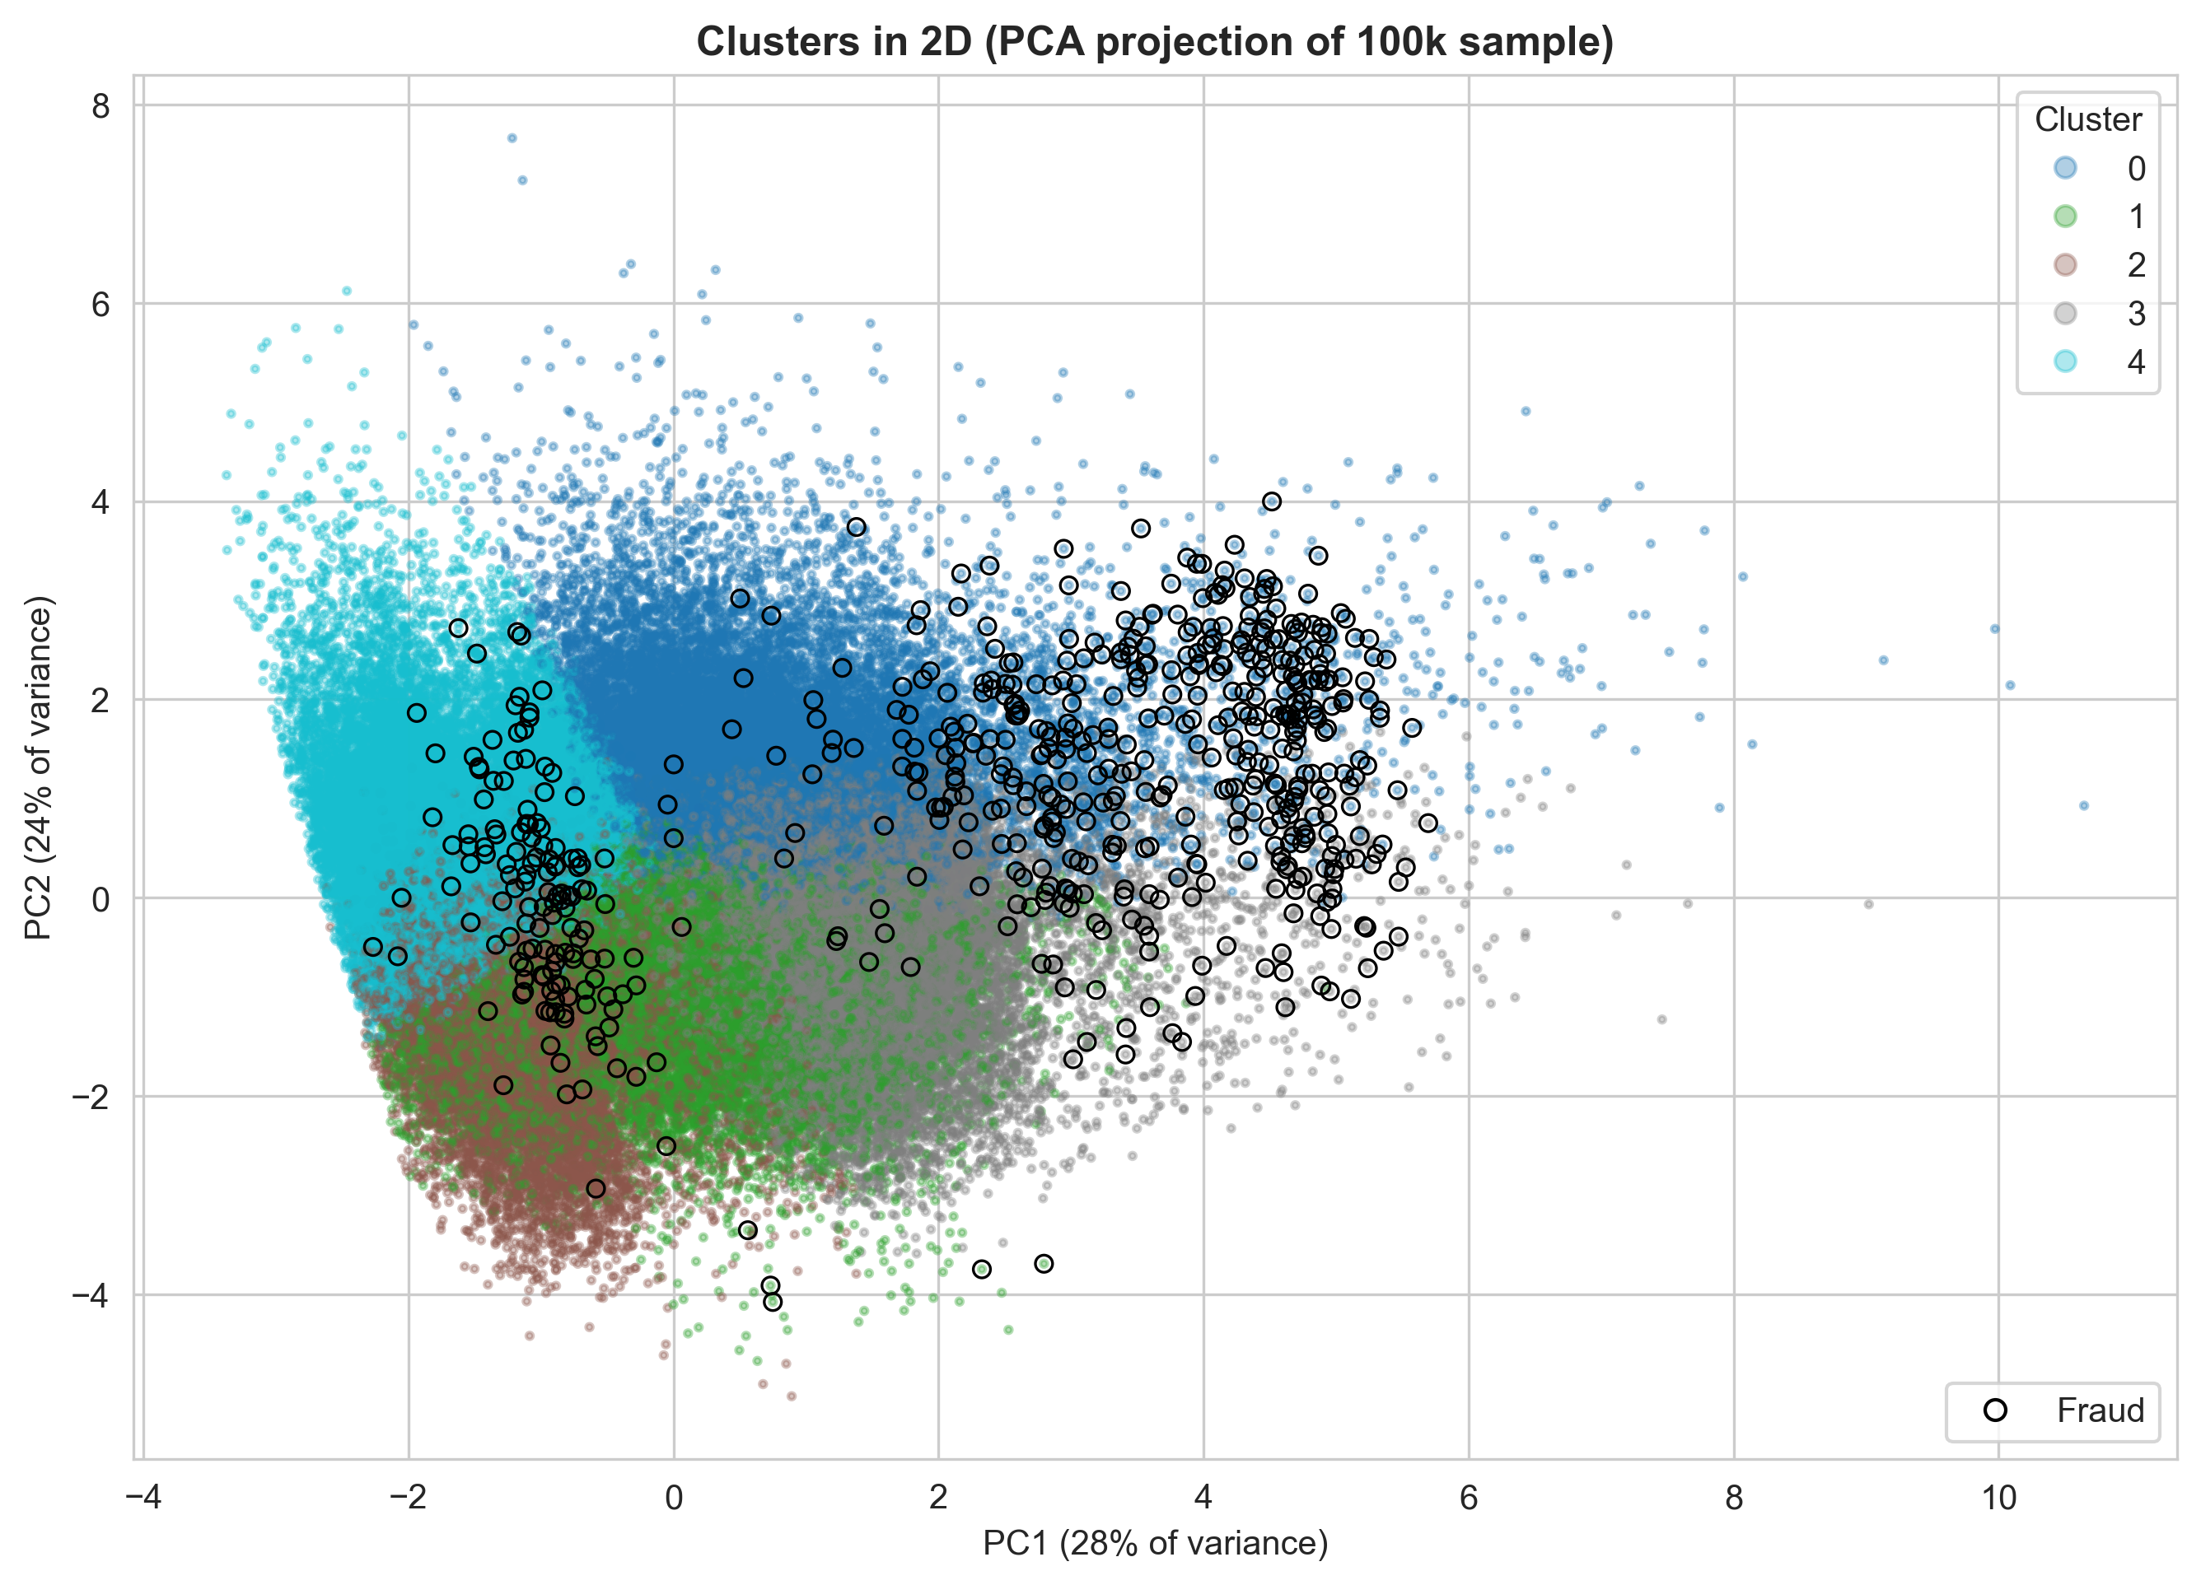
UNSUPERVISED VIEW
Fraud forms two groups, even without labels
Black circles (fraud) gather in two places:
a large high-value group (right)
a smaller low-value group (left)
This matches the two amount peaks from the EDA.
Isolation Forest (anomaly detection, test set)
43%
0.869
of fraud caught in the top 1% most unusual
ROC-AUC with no labels at all
But 5 of every 6 alerts are false, so labels make a big difference.
Notes:
Unsupervised detection is useful for new fraud types without labels, but supervised models are far more precise.

Slide 12
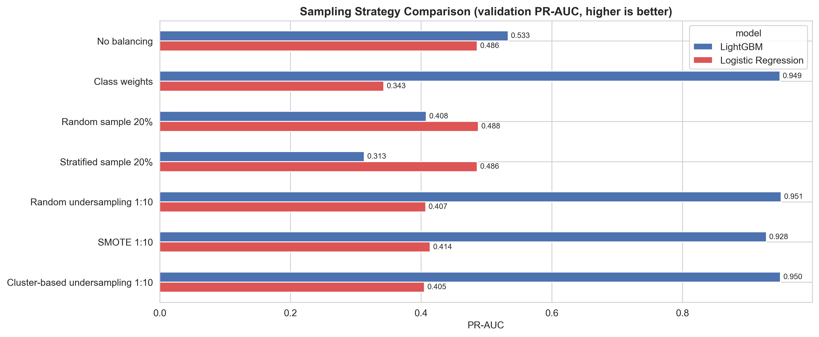
SAMPLING STRATEGIES
Balancing the training data nearly doubled performance
0.53 → 0.95
LightGBM PR-AUC without vs with rebalancing
3-way tie
undersampling, class weights, cluster-based (~0.95); undersampling chosen: 10x faster
Validation PR-AUC. Each strategy changes only the training data; validation and test keep the real fraud rate.
≤ 0.49
Logistic Regression under every strategy: the model, not the data, is the limit
Notes:
Seven strategies tested with Logistic Regression and LightGBM. SMOTE slightly lower (0.928). Cluster-based sampling did not beat random undersampling, consistent with overlapping clusters.

Slide 13
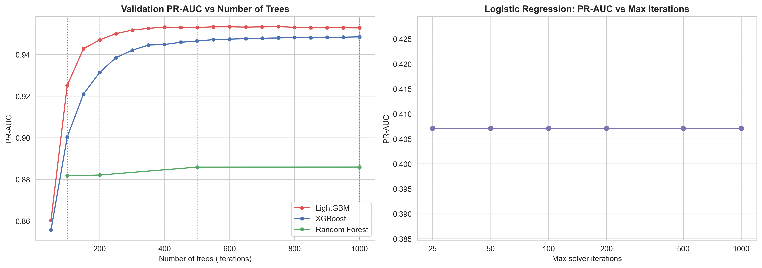
ITERATIONS & TUNING
More training helps, up to a point
500 ≈ 1000
Flat
+0.002
LightGBM: 0.925 (100 trees) → 0.953 (500); no gain at 1000, no overfitting
Random Forest after 100 trees (0.882 → 0.886); Logistic Regression same at every iteration
from tuning 8 LightGBM settings (0.951 → 0.953): defaults were near-optimal
Notes:
Boosting improves quickly then plateaus. XGBoost learns more slowly than LightGBM. Best tuned settings: 31 leaves, learning rate 0.05, 401 trees via early stopping.

Slide 14
FINAL RESULTS
Performance on unseen data (Jun–Dec 2020)
555,719 test transactions · 2,145 frauds · thresholds fixed on validation before testing
Model | PR-AUC | Precision | Recall | F1 | Frauds caught | Missed | False alarms
LightGBM (tuned) | 0.922 | 87.4% | 84.6% | 0.860 | 1,815 | 330 | 261
XGBoost | 0.914 | 84.7% | 84.8% | 0.848 | 1,819 | 326 | 328
Random Forest | 0.846 | 86.9% | 75.1% | 0.805 | 1,610 | 535 | 243
Decision Tree | 0.694 | 78.9% | 71.8% | 0.752 | 1,540 | 605 | 411
Logistic Regression | 0.343 | 42.9% | 41.9% | 0.424 | 899 | 1,246 | 1,198
Isolation Forest (unsupervised) | 0.108 | 19.2% | 39.2% | 0.258 | 840 | 1,305 | 3,531
Amount rule (> $200) | 0.049 | 6.4% | 75.1% | 0.117 | 1,611 | 534 | 23,738
Same ranking as on validation. LightGBM PR-AUC 0.95 (validation) → 0.92 (test): a small, expected drop on later data, showing the test set was kept separate.
Notes:
Headline numbers. LightGBM catches 85% of fraud and 87% of its alerts are real fraud. The two grey rows are benchmarks, not contenders.

Slide 15
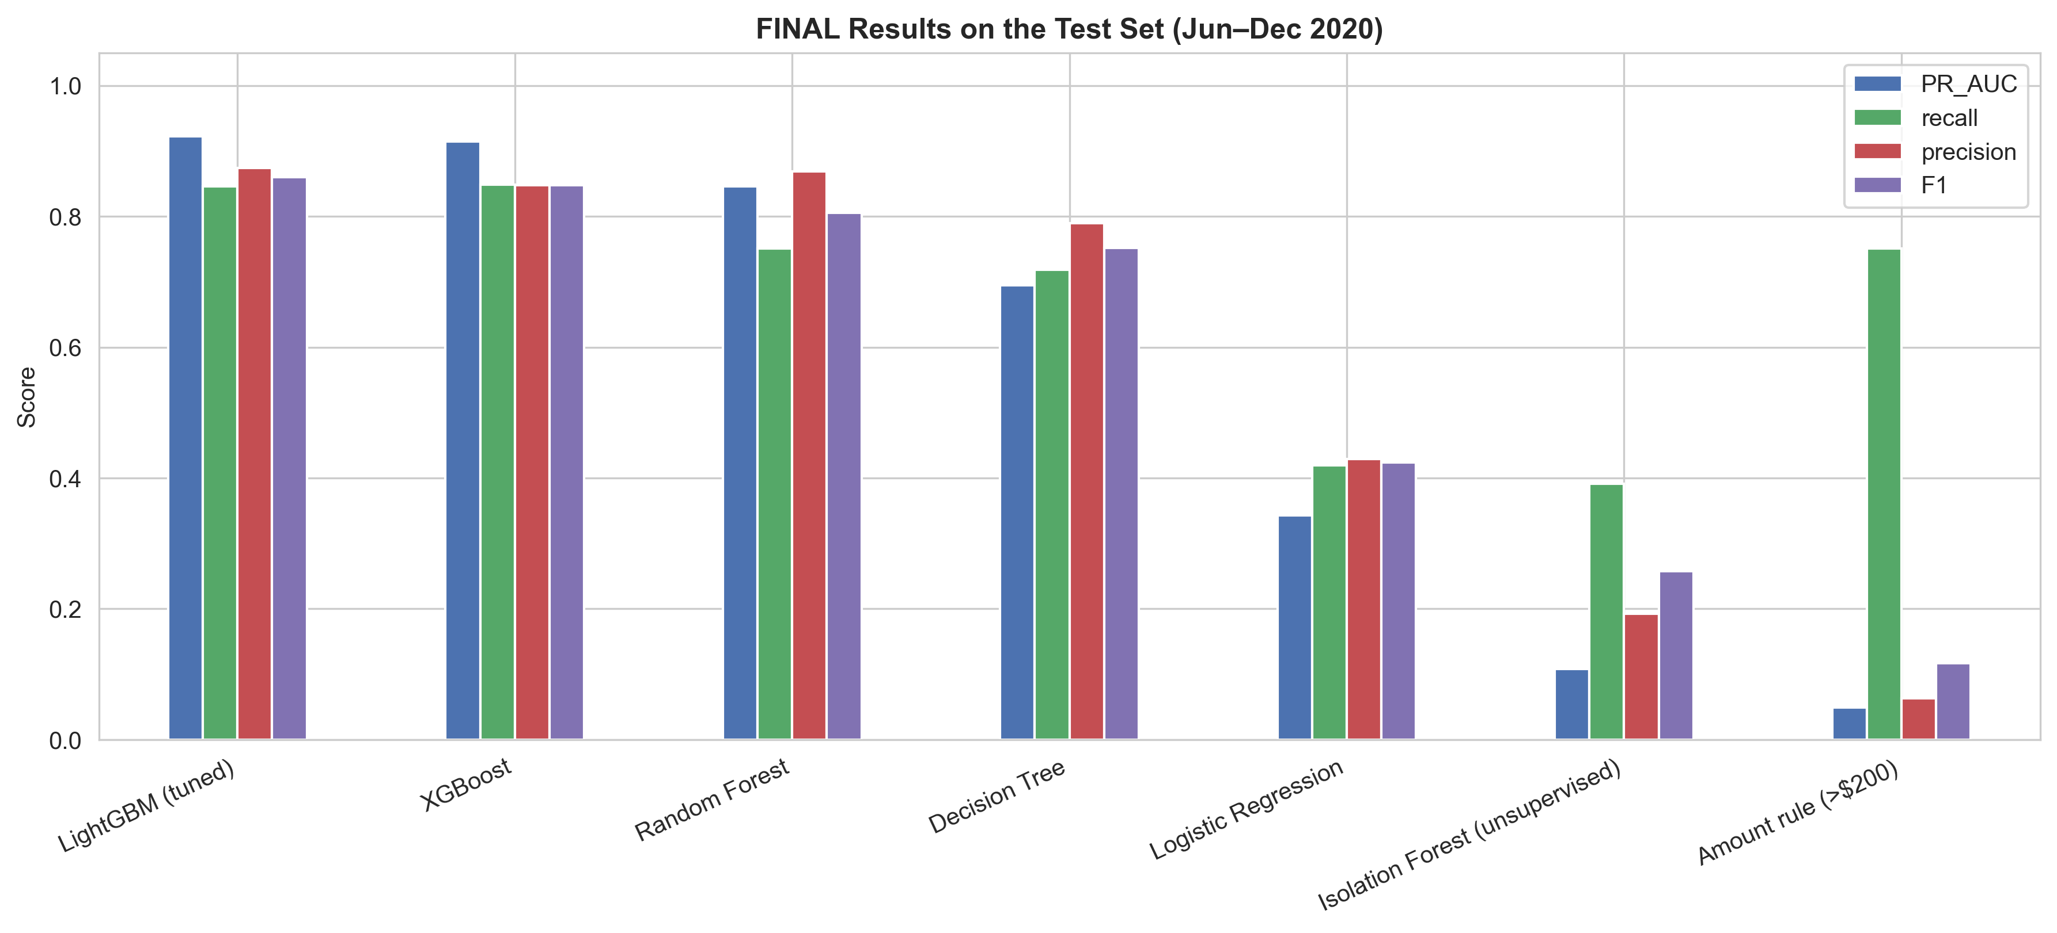
BUSINESS IMPACT
ML catches more fraud with far fewer false alarms
LightGBM (tuned)
1,815 caught · 330 missed
261 false alarms
Amount rule (> $200)
1,611 caught · 534 missed
23,738 false alarms
~91x
fewer false alarms than the $200 rule (261 vs 23,738), while catching more fraud (85% vs 75%)
Isolation Forest
840 caught · 1,305 missed
3,531 false alarms
Notes:
Every false alarm is a blocked customer or analyst review. The model reduces them by about 91 times compared with an amount-only rule.

Slide 16
KEY LESSON
What actually drove performance
Takeaway
Choosing a model that handles combined patterns, and fixing the class imbalance, mattered far more than fine-tuning settings.
Boosting wins because each new tree corrects earlier mistakes, capturing combinations like "night + large amount + unusual for this card".
Notes:
Model choice: 0.407 → 0.951. Sampling: 0.533 → 0.951. Trees 100 → 500: 0.925 → 0.953. Tuning: 0.951 → 0.953.

Slide 17
RECOMMENDATIONS
What a bank could do with these findings
Night-time step-up checks
Velocity alerts
1
Extra verification from 10 pm to 4 am, when 85% of fraud occurs
2
Flag rapid repeat use: compromised cards see ~10 frauds within 2 days
Spend-vs-usual check
Focus on high-risk categories
3
Alert when a payment is far above the card's normal spend (fraud ≈ 5x usual)
4
Online shopping & misc, in-store grocery: 69% of fraud
Replace amount-only rules
Watch for new fraud types
5
Use the LightGBM risk score: more fraud caught, ~91x fewer false alarms
6
Keep an unsupervised monitor (Isolation Forest) for unlabelled patterns
Notes:
Each recommendation links back to a finding: time, bursts, spend vs usual, categories, model results, unsupervised detection.

Slide 18
LIMITATIONS & NEXT STEPS
Being honest about the results
Limitations
Next steps
Synthetic data: sharp 10 pm / 4 am cut-offs and no fraud above $1,500 come from the simulator
Real-world performance is likely lower than PR-AUC 0.92
US transactions from 2019–2020 only
Decision threshold chosen for best F1, not actual business costs
SHAP analysis: explain which features drive each prediction
Cost-based threshold: weigh missed fraud vs false-alarm cost
Real-time features and drift monitoring as fraud tactics change
Validate the pipeline on real bank data
The method (time-based split, imbalance handling, model comparison, honest test) transfers to real data; the exact numbers would change.
Notes:
Be upfront: simulated data makes patterns cleaner than reality. The method transfers; the exact numbers would change on real data.

Slide 19
Thank you
Notebooks (live demo)
01 EDA
Questions?
02 Feature engineering
V Adithya · PRN 25030242063
03 Clustering & anomaly detection
04 Sampling, models, iterations & tuning
Notes:
Open the notebooks in VS Code for any detailed questions.

