Slide 1
BUTTONS

Slide 2
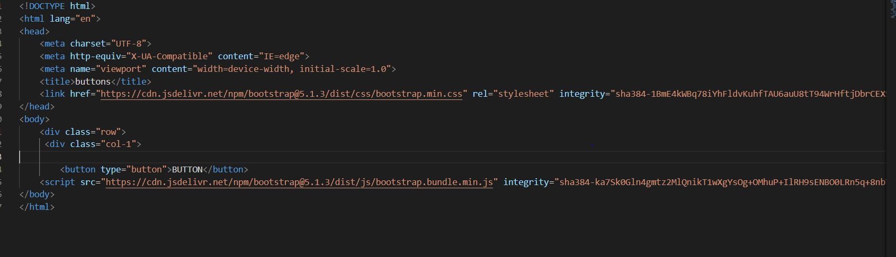
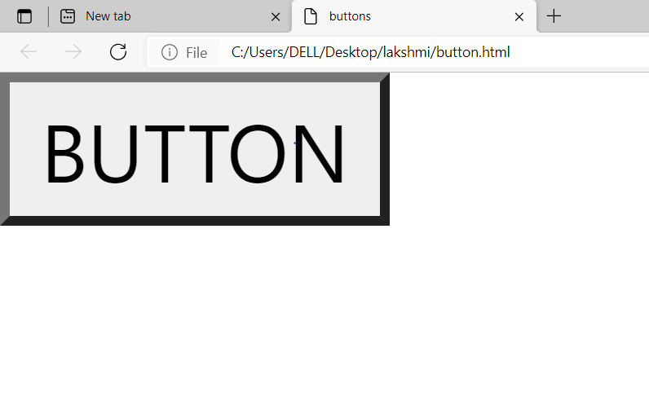
Normal Button without using bootstrap class=“btn”

Slide 3
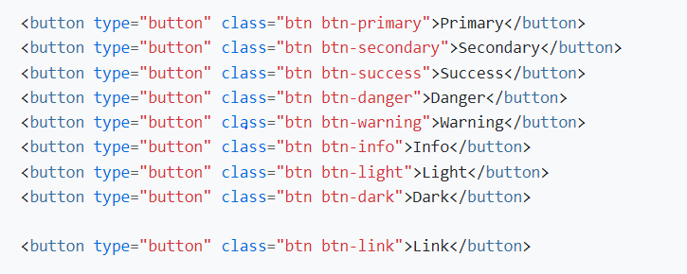

Button class=“btn” setting back-ground colour for button.

Slide 4
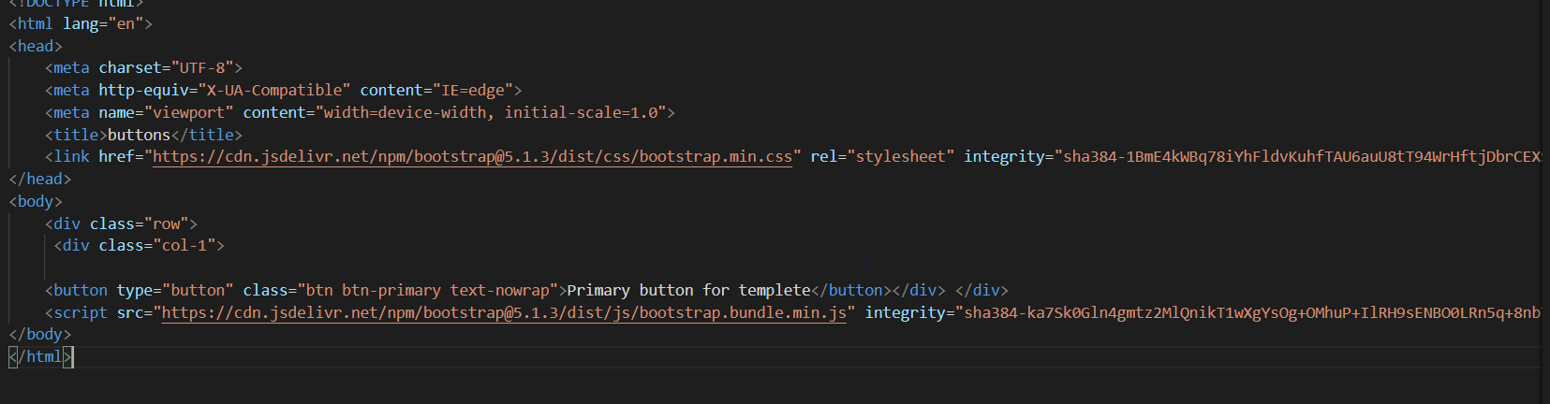
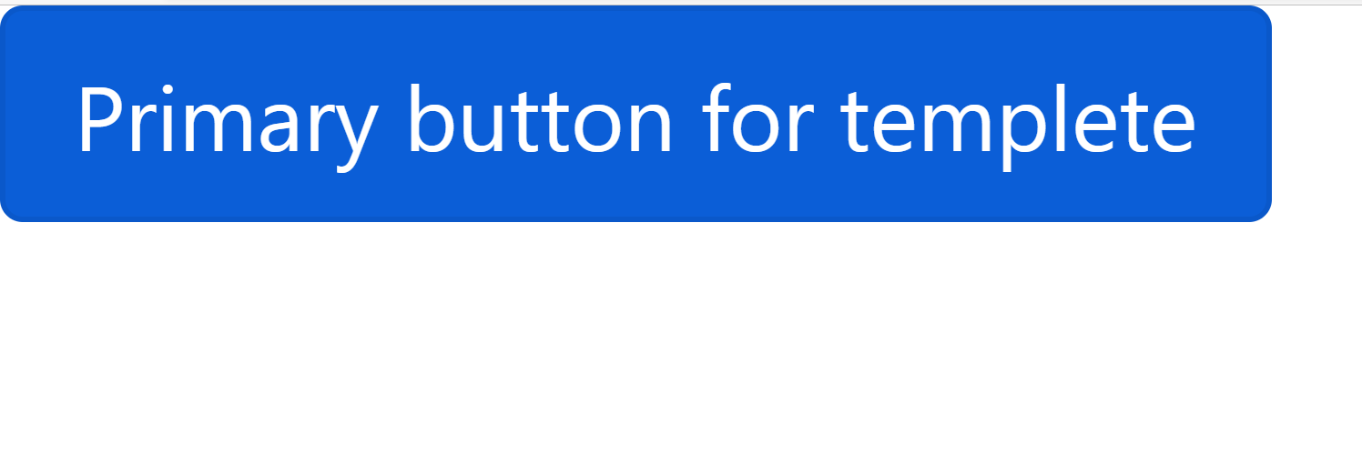
Text No Wrapping in buttons text-nowrap

Slide 5
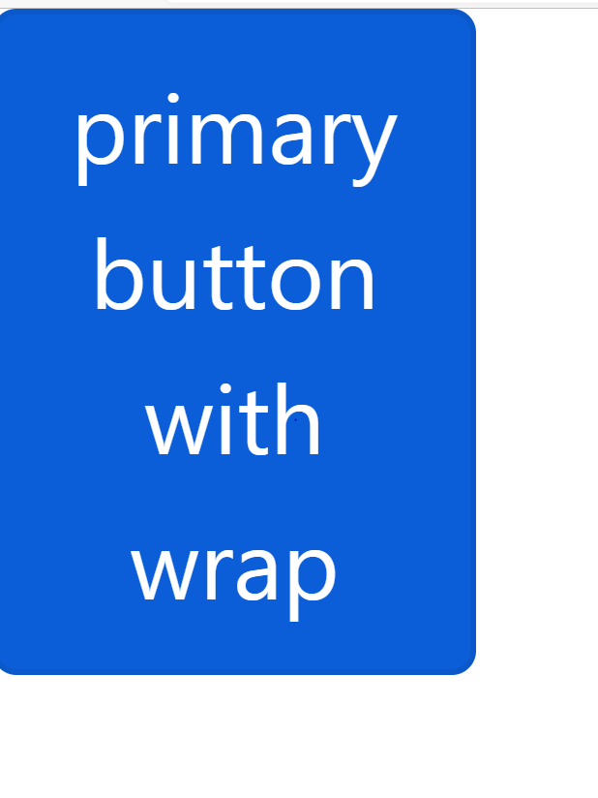
Text Wrapping in buttons text-wrap
<button type="button" class="btn btn-primary text-wrap">primary button with wrap</button>

Slide 6

.btn class using in <a> or <input> elements
<a class="btn btn-primary" href="#" role="button">Link</a>
<button class="btn btn-primary" type="submit">Button</button>
<input class="btn btn-primary" type="button" value="Input">
<input class="btn btn-primary" type="submit" value="Submit">
<input class="btn btn-primary" type="reset" value="Reset">

Slide 7
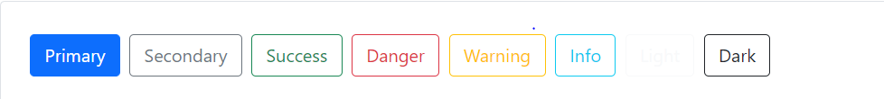
Outline buttons = btn-outline
<button type="button" class="btn btn-outline-primary">Primary</button>
<button type="button" class="btn btn-outline-secondary">Secondary</button>
<button type="button" class="btn btn-outline-success">Success</button>
<button type="button" class="btn btn-outline-danger">Danger</button>
<button type="button" class="btn btn-outline-warning">Warning</button>
<button type="button" class="btn btn-outline-info">Info</button>
<button type="button" class="btn btn-outline-light">Light</button>
<button type="button" class="btn btn-outline-dark">Dark</button>

Slide 8
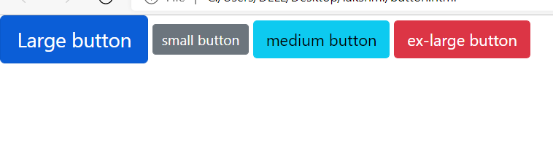
Button sizes using break point
<button type="button" class="btn btn-primary btn-lg">Large button</button>
<button type="button" class="btn btn-secondary btn-sm">small button</button>
<button type="button" class="btn btn-info btn-md">medium button</button>
<button type="button" class="btn btn-danger bt-xl">ex-large button</button>

Slide 9
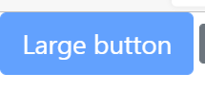

Disable state button using class disabled
<button type="button" class="btn btn-primary btn-lg disabled">Large button</button>
<a href="#" class="btn btn-primary btn-lg disabled" disabled="true">link</a>

Slide 10
Block Buttons
<div class="row">
<div class="col-6 d-grid">
<button type="button" class="btn btn-primary"> button</button>
</div>
</div>

Slide 11

Block Buttons align in center
<div class="d-grid gap-2 col-6 mx-auto">
<button class="btn btn-primary" type="button">Button</button>
<button class="btn btn-primary" type="button">Button</button>
</div>

Slide 12
Button Group = btn-group
Wrap a series of button with .btn in .btn group.
<div class="btn-group“>
<button type="button" class="btn btn-primary">Left</button>
<button type="button" class="btn btn-primary">Middle</button>
<button type="button" class="btn btn-primary">Right</button>
</div>

