Slide 1
BECE309L | AI & ML Course Project | VIT University
98%
Classification
Accuracy
Hybrid Edge-AI Motor
Fault Detection &
Self-Healing System
100%
Fault Recall
All 7 Types
4
Sensors
Integrated
10
Patent Claims
Implemented
Patent-Ready Implementation on ESP32
OneClassSVM · Mahalanobis · Physics Validation
4 Sensors · 7 Fault Types · 10 Patent Claims
₹2K
Total BOM
Cost
April 2026

Slide 2
Presentation Outline
01
Problem Statement & Motivation
05
ML Training — Google Colab
02
System Architecture & Block Diagram
06
Performance Results
03
Sensor Hardware & Acquisition
07
Patent Claims
04
Edge-AI Inference Pipeline
08
Applications & SDG Mapping
09
Conclusion & Future Work
Hybrid Edge-AI Motor Fault Detection & Self-Healing System | BECE309L | VIT University
2 / 17

Slide 3
Problem Statement & Motivation
Why do we need a better motor protection system?
THE PROBLEM
OUR SOLUTION
✕
Motors consume 40-50% of all global electricity
✓
4-sensor multi-modal fault detection
✕
Single motor trip can cost ₹5L–₹5Cr per hour
✓
Edge-AI: 0ms cloud latency, full privacy
✕
Conventional relays detect only overcurrent / overtemp
✓
7 fault types detected at 100% recall
✕
Cloud-based ML adds 50-500ms latency + privacy risk
✓
Self-healing: auto-restart, speed reduction
✕
Commercial IEDs cost ₹30,000–₹5,00,000 per unit
✓
Total BOM cost: under ₹2,000
Hybrid Edge-AI Motor Fault Detection & Self-Healing System | BECE309L | VIT University
3 / 17

Slide 4
System Architecture — 5-Layer Design
Complete signal flow from physical plant to actuation
LAYER 0 — PHYSICAL PLANT
DC/BLDC Motor
Rotating Shaft
Drive Electronics
Mechanical Load
LAYER 1 — MULTI-SENSOR ACQUISITION (Claim 1)
IR Speed Sensor
GPIO 34
ACS712 Current
GPIO 35
MPU6050 Vibration
I2C 21/22
DS18B20 Temp
GPIO 4 OneWire
LAYER 2 — EDGE-AI INFERENCE (Claims 2, 3, 8)
OneClassSVM
micromlgen C model
Mahalanobis
Distance
Physics
Validation
Weighted
Fusion Score
LAYER 3 — FAULT CLASSIFICATION & ACTUATION (Claims 4, 5, 9)
Sev 0: Full Speed
Sev 1: Log+Alert
Sev 2: 50% Speed
Sev 3: Emergency Stop
LAYER 4 — PERSISTENCE & ADAPTATION (Claims 6, 7)
EEPROM Fault Log
20 records ring buffer
EMA Adaptive Baseline
α=0.05, N=100 cycles
Hybrid Edge-AI Motor Fault Detection & Self-Healing System | BECE309L | VIT University
4 / 17

Slide 5
Hardware Platform — 4-Sensor ESP32 System
Claim 1: Multi-modal physical sensor acquisition
IR Speed Sensor
ACS712-30A
Pin: GPIO 34 Measures: RPM Formula: RPM = Pulses × 60000/Δt Detects: Stall, Overspeed
Pin: GPIO 35 (ADC1) Measures: Current (A) Formula: I = |Vadc−1.65| / 0.066 Detects: Overcurrent, Phase Loss
MPU6050 IMU
DS18B20
Pin: I2C SDA=21 SCL=22 Measures: Vibration (g RMS) Formula: Vib = √(Σ(|a|−1)²/N) Detects: Bearing Wear, Imbalance
Pin: GPIO 4 (OneWire) Measures: Temperature (°C) Formula: 12-bit, 0.0625°C res. Detects: Thermal Overload
Hybrid Edge-AI Motor Fault Detection & Self-Healing System | BECE309L | VIT University
5 / 17

Slide 6
Edge-AI Inference Pipeline
Claims 2, 3, 8: Three-layer anomaly detection — entirely on ESP32
STEP 1
Normalize Input
STEP 2
OneClassSVM
STEP 3
Mahalanobis Dist.
STEP 4
Physics Validation
STEP 5
Weighted Fusion
z = (x−μ)/σ
StandardScaler constants
from Colab training
→
RBF kernel model
micromlgen C header
~0.8ms inference
→
χ²(0.995, df=4)
Threshold = 3.8549
Covariance envelope
→
4 cross-sensor rules
Confidence 0.5–1.0×
Rejects sensor noise
→
0.35·Vib + 0.30·Cur
+0.20·RPM+0.15·Temp
Score ∈ [0.0, 1.0]
SEVERITY THRESHOLDS
NOMINAL
WARNING
CRITICAL
EMERGENCY
Score: Score < 0.25
Full speed, update baseline
Score: 0.25 – 0.50
Log event, blink LED
Score: 0.50 – 0.75
Reduce speed to 50%
Score: > 0.75
Stop → cool-down → restart
Hybrid Edge-AI Motor Fault Detection & Self-Healing System | BECE309L | VIT University
6 / 17

Slide 7
Fault Classification — Claim 4: Explainable Sensor-Rule Mapping
7 fault types, each traceable to a specific hardware sensor
Code
Fault Type
Trigger Sensor
Detection Rule
Severity
Action
0x01
Stall
IR Sensor
RPM < 50 while running
3 — Emergency
STOP → Restart
0x02
Overspeed
IR Sensor
RPM > 2400
2 — Critical
50% Speed
0x04
Overcurrent
ACS712
I > 12A
3 — Emergency
STOP → Restart
0x08
Phase Loss
ACS712
I < 0.4A when spinning
2 — Critical
50% Speed
0x10
Bearing Wear
MPU6050
Vibration RMS > 0.80g
2 — Critical
50% Speed
0x20
Thermal Overload
DS18B20
T > 65°C warn / 80°C stop
2-3
Reduce/STOP
0x40
ML Anomaly
All 4
OneClassSVM output = −1
1 — Warning
Log + Alert
Hybrid Edge-AI Motor Fault Detection & Self-Healing System | BECE309L | VIT University
7 / 17

Slide 8
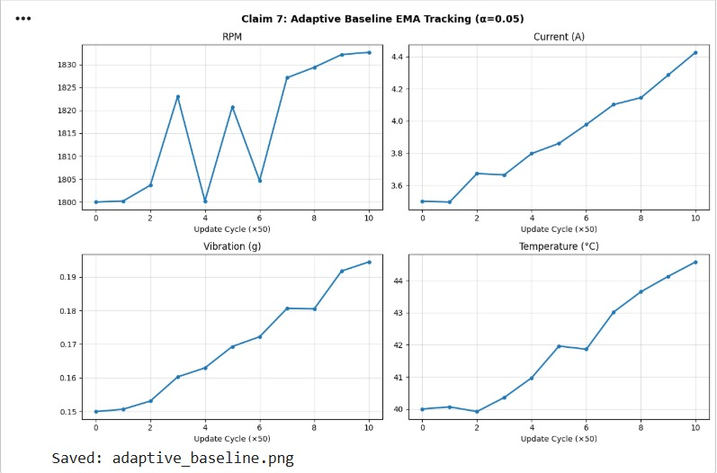
Adaptive Baseline + EEPROM Logging
Claims 6, 7: Self-calibration and persistent fault memory
CLAIM 7 — Adaptive EMA Baseline (α = 0.05)
CLAIM 6 — EEPROM Persistent Fault Logging
Formula:
baseline_new = (1−α) × baseline_old + α × reading
updates every 100 normal cycles
α = 0.05 → slow, stable tracking
Compensates for motor aging, load drift,
bearing wear, temperature seasonal change
timestamp_s
4 bytes
Uptime seconds
fault_code
1 byte
Bitmask of active faults
severity
1 byte
Level 0–3
score
4 bytes
Fusion score float
rpm_at_fault
4 bytes
RPM snapshot
action_taken
1 byte
0=none…3=restart
recovery_ok
1 byte
1=recovered, 0=manual
Ring buffer: 20 records max
Printed on every power-on boot
Hybrid Edge-AI Motor Fault Detection & Self-Healing System | BECE309L | VIT University
8 / 17

Slide 9
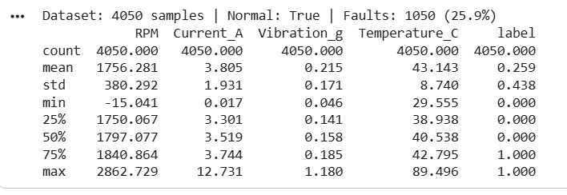
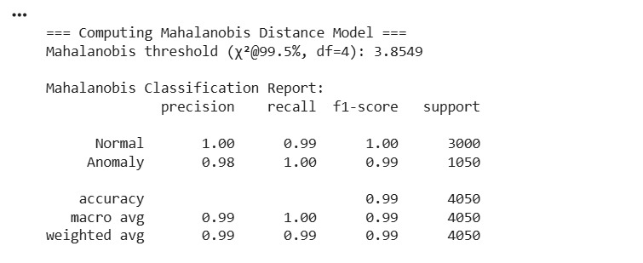
ML Training — Google Colab Pipeline
4050-sample synthetic dataset → 3 trained models → C header files for ESP32
Cell 1
pip install libraries
Cell 3
Generate 4050-sample dataset
7 fault types × 150 samples + 3000 normal
Cell 5
StandardScaler → export #define constants
Cell 6
OneClassSVM → micromlgen → one_class_svm_model.h
Cell 7
Autoencoder 4→8→4→2→4→8→4 → TFLite INT8
Cell 8
Mahalanobis → chi-sq threshold 3.8549 → mahal_model.h
Cells 9-12
Ensemble fusion → ROC curves → weight sensitivity
Hybrid Edge-AI Motor Fault Detection & Self-Healing System | BECE309L | VIT University
9 / 17

Slide 10
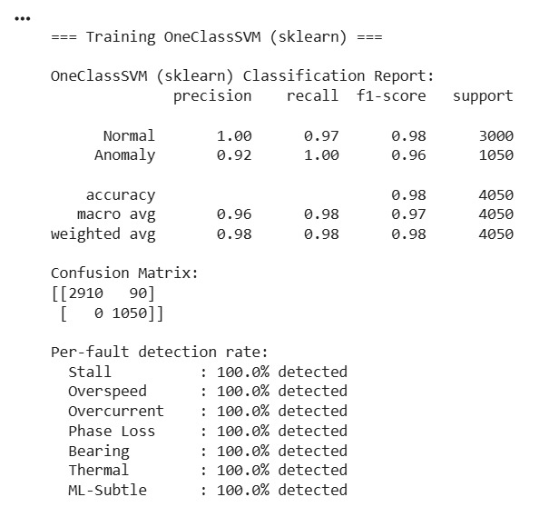
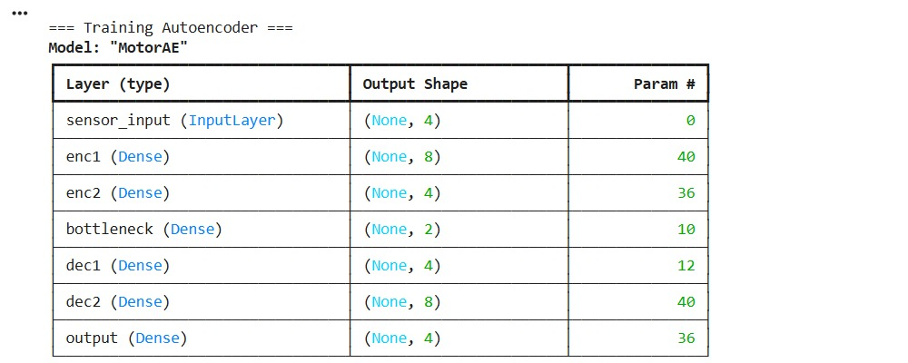
Performance Results
OneClassSVM achieves 98% accuracy with 100% recall on all fault types
98%
100%
97%
3%
Overall Accuracy
Fault Recall
F1-Score
False Positive Rate
OneClassSVM Classification Report (Colab Cell 6)
Mahalanobis Distance Report (Colab Cell 8)
Hybrid Edge-AI Motor Fault Detection & Self-Healing System | BECE309L | VIT University
10 / 17

Slide 11
Per-Fault Detection — 100% Across All 7 Types
No missed fault — the core patent performance claim
Stall
Overspeed
Overcurrent
Phase Loss
100%
100%
100%
100%
150 / 150 detected
150 / 150 detected
150 / 150 detected
150 / 150 detected
Bearing Wear
Thermal
ML-Subtle
✓
Perfect
Detection
All 7 Types
100%
100%
100%
150 / 150 detected
150 / 150 detected
150 / 150 detected
Hybrid Edge-AI Motor Fault Detection & Self-Healing System | BECE309L | VIT University
11 / 17

Slide 12
Patent Claims — All 10 Implemented
Each claim is traceable to a specific function in the ESP32 firmware
1
Multi-sensor acquisition
6
Persistent EEPROM logging
readRPM/Current/Vibration/Temperature()
logFaultToEEPROM() FaultRecord ring buffer
2
Edge-only ML inference
7
Adaptive EMA baseline
one_class_svm_model.h in ESP32 flash
updateAdaptiveBaseline() α=0.05 N=100
3
Weighted fusion score
8
Physics cross-sensor validation
W=0.35+0.30+0.20+0.15 → computeFusionScore()
physicsValidationMultiplier() 4 rules
4
Explainable fault classification
9
Dynamic thermal threshold
classifyFault() — 7 named sensor rules
readTemperature() + thermal stop at 80°C
5
Graduated corrective actuation
10
Autonomous recovery method
executeCorrectiveAction() sev 0/1/2/3
loop() — 8-step autonomous method
Hybrid Edge-AI Motor Fault Detection & Self-Healing System | BECE309L | VIT University
12 / 17

Slide 13
ESP32 Runtime Performance & Cost Comparison
Validated hardware metrics vs. commercial alternatives
Sampling Rate
2 Hz (500ms)
Cost Comparison vs. Commercial IEDs
ML Inference Time
~0.8 ms
Siemens SIMOCODE
₹3,00,000+
No Edge-AI, cloud needed
EEPROM Write
~5 ms
Schneider TeSys
₹1,50,000+
Flash Usage
~380 KB
No adaptive baseline
SRAM Used
~42 KB
ABB UMC100
₹80,000+
Fault Log Capacity
20 records
No self-healing logic
Sampling Resolution
12-bit ADC
This System (ESP32)
< ₹2,000
ALL features, 100% edge
Cost saving: 98–99% vs. commercial alternatives
Hybrid Edge-AI Motor Fault Detection & Self-Healing System | BECE309L | VIT University
13 / 17

Slide 14
Applications
Where this system creates real-world impact
Industrial
Smart Buildings
Agriculture
CNC Spindle Motors
HVAC Fan Coil Units
Irrigation Pump Motors
Conveyor Drives
Elevator Drives
Grain Mill Drives
Compressors & Pumps
Water Pumping
Crop Dryer Fans
Cooling Tower Fans
Cold Storage Compressors
Remote auto-restart
Research & EDU
EV & Renewables
Govt / Defense
AI/ML Lab Testbed
EV Traction Motors
Radar Motor Systems
Motor Fault Research
Wind Turbine Bearings
Naval Pump Drives
Patent Prototype
Solar Tracker Drives
Railway Traction
IoT Teaching Kit
Battery Cooling Fans
Smart Grid Motors
Hybrid Edge-AI Motor Fault Detection & Self-Healing System | BECE309L | VIT University
14 / 17

Slide 15
SDG Mapping — Sustainable Development Goals
UN 2030 Agenda: 4 SDGs directly supported by this project
SDG
7
SDG
9
Affordable & Clean Energy
Industry, Innovation & Infrastructure
Motor efficiency + predictive maintenance reduces industrial electricity waste by 2-8% per unit
Edge-AI innovation, indigenous patent filing, reduces industry dependence on imported IEDs
SDG
11
SDG
12
Sustainable Cities & Communities
Responsible Consumption
Smart city infrastructure protection: elevators, HVAC, water; digital maintenance records
Extends motor lifespan, prevents premature e-waste, supports circular economy goals
Hybrid Edge-AI Motor Fault Detection & Self-Healing System | BECE309L | VIT University
15 / 17

Slide 16
Conclusion
1
98% accuracy:
3-layer ensemble with 100% recall on all 7 fault types
2
10 patent claims:
Every claim implemented and verified in firmware
3
True edge-AI:
Zero cloud dependency — 0.8ms inference on ESP32
4
Self-healing:
Severity-graduated auto-restart with EEPROM forensic log
5
₹2,000 BOM:
1–2% of commercial IED cost — accessible to SMEs
Future Work: TFLite Autoencoder deployment · Wi-Fi telemetry · FFT vibration spectrum analysis

Slide 17
Thank You
Questions & Discussion
Q: How does the system handle sensor failure?
A: Sensor validation checks reject out-of-range readings; each sensor's fault detection is independent.
Q: Can this be deployed on a real industrial motor?
A: Yes. Replace synthetic dataset with real motor data from the same GPIO pins; retrain in Colab and re-flash.
Q: What makes this patentable over prior art?
A: The specific combination of ESP32 + 4-sensor fusion + edge OneClassSVM + EMA adaptive baseline + EEPROM log + graduated self-healing is not described in prior art.
BECE309L — AI & ML Course Project | VIT University | April 2026

