Slide 1
Agentic RAG Chatbot for Multi-Format Document QA (with MCP)
A modular RAG system using Gemini, FAISS, Streamlit, and Model Context Protocol (MCP)
Vadla Shirisha

Slide 2
What is RAG (Retrieval-Augmented Generation)?
Retrieval-Augmented Generation (RAG) is a technique that improves the factual accuracy of language models by retrieving relevant information from external sources (e.g., documents) and using it as context in prompt generation.
RAG = → Retrieve relevant knowledge from a source → Augment it into the model prompt → Generate accurate, grounded answers

Slide 3
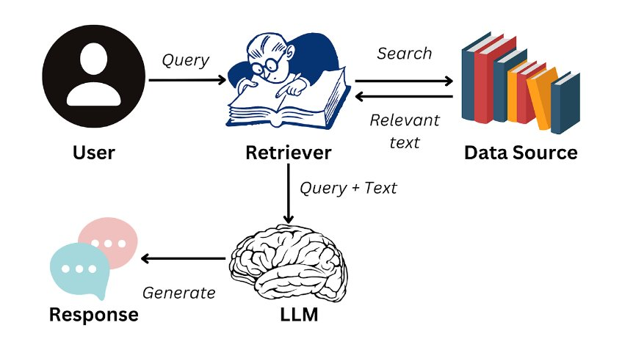
Working of Rag System

Slide 4
What is Agentic AI?
Agentic AI refers to building modular, intelligent agents that interact with each other and the environment in a structured way to complete a task.
Each agent handles:
One responsibility (e.g., ingestion, retrieval, generation)
Communicates using messages
Can be reused or orchestrated flexibly

Slide 5
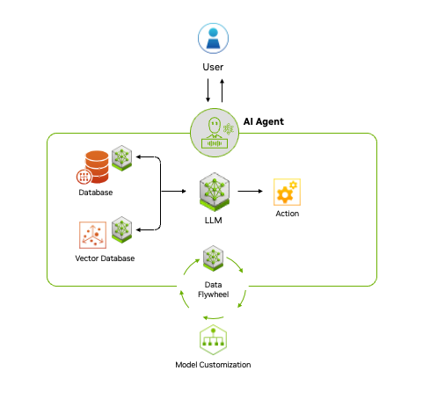
Agentic AI workflow

Slide 6
Project Overview
This project implements an Agentic RAG Chatbot using Gemini models and a custom Model Context Protocol (MCP) to process and answer questions over documents like: PPTX,PDF,CSV etc
It includes:
A user interface to upload files and ask questions
A 3-agent architecture: IngestionAgent, RetrievalAgent, LLMResponseAgent
Gemini 1.5 Flash for answer generation
FAISS + Gemini Embeddings for retrieval
Streamlit UI for interactive chatbot experience

Slide 7
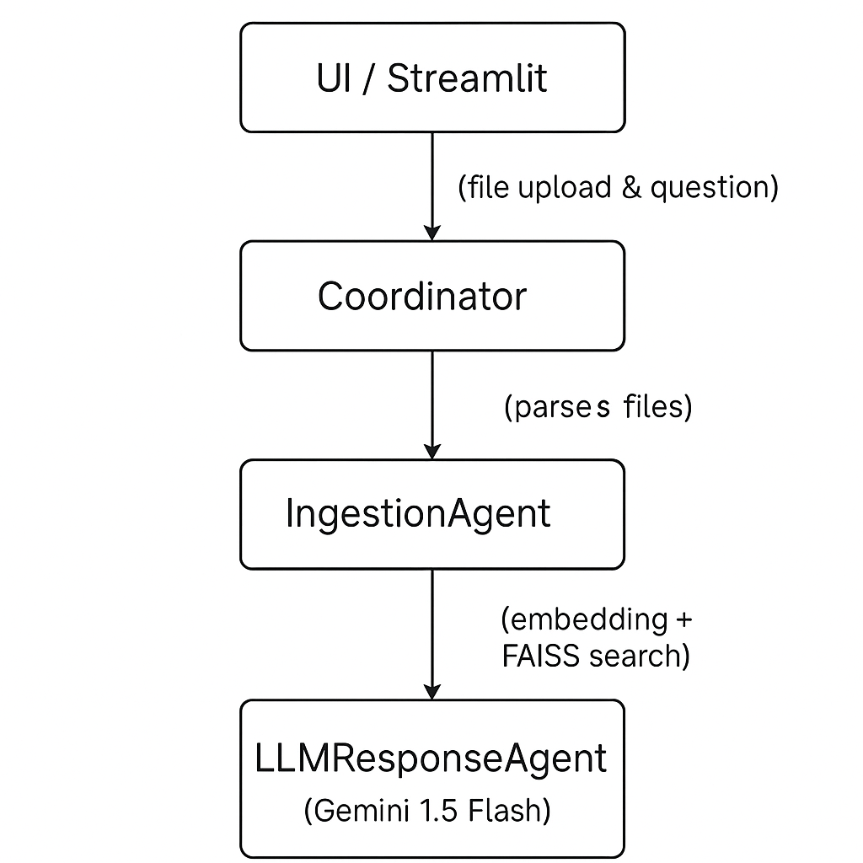
Model Architecture

Slide 8
Tech Stack
Layer | Tools / Libraries
LLM | Gemini 1.5 Flash (google.generativeai)
Embeddings | Gemini models/embedding-001
Vector Store | FAISS (in-memory)
Parsing Docs | PyMuPDF, python-docx, pptx, pandas
UI | Streamlit
Protocol | Custom Model Context Protocol (MCP)
Utilities | dotenv for API key loading

Slide 9
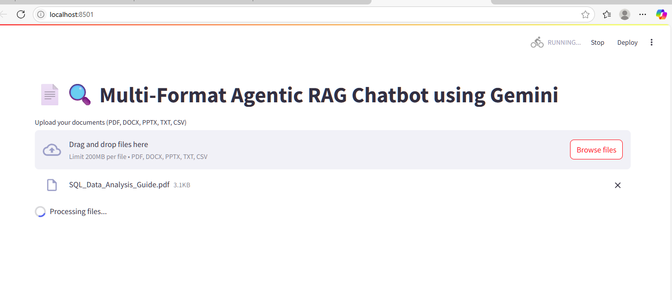
UI Screenshots
Uploading multiple files (PDF, CSV, DOCX, etc.)

Slide 10
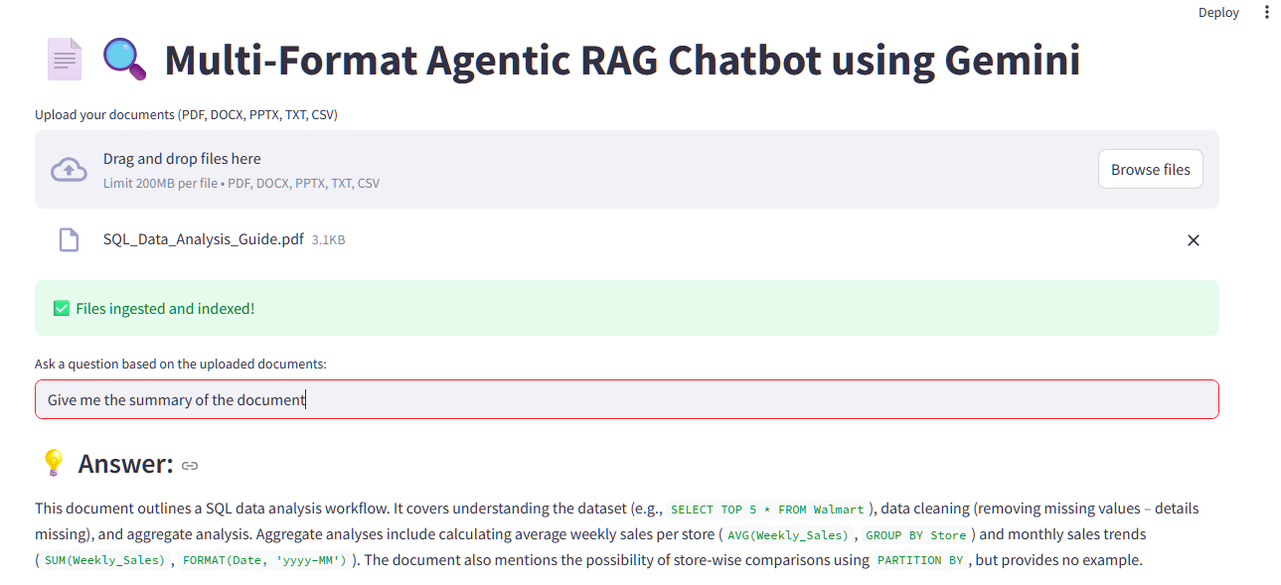
Answering the User Query

Slide 11
Challenges Faced & Future Scope
Challenges:
Handling multiple file formats consistently
Gemini embed_content() API failed without proper env key loading
Token limits while chunking large files
Streamlit file state reset on refresh
Future Scope:
Add login & chat history per user
Integrate multiple embedding models (e.g., OpenAI, Cohere)
Asynchronous Agent orchestration (via Celery or LangGraph)
Move from local FAISS to ChromaDB or Pinecone for scale

Slide 12
Thank You

