Slide 1
Security Testing Automation in a CICD Pipeline

Slide 2
Security/Penetration Testing
What is Penetration Testing?
Software testing designed to identify Security Vulnerabilities
Why do Penetration Testing?
To protect business information against hacking and theft
To protect software from being exploited by malicious user
To measure company’s compliance of security policies

Slide 3
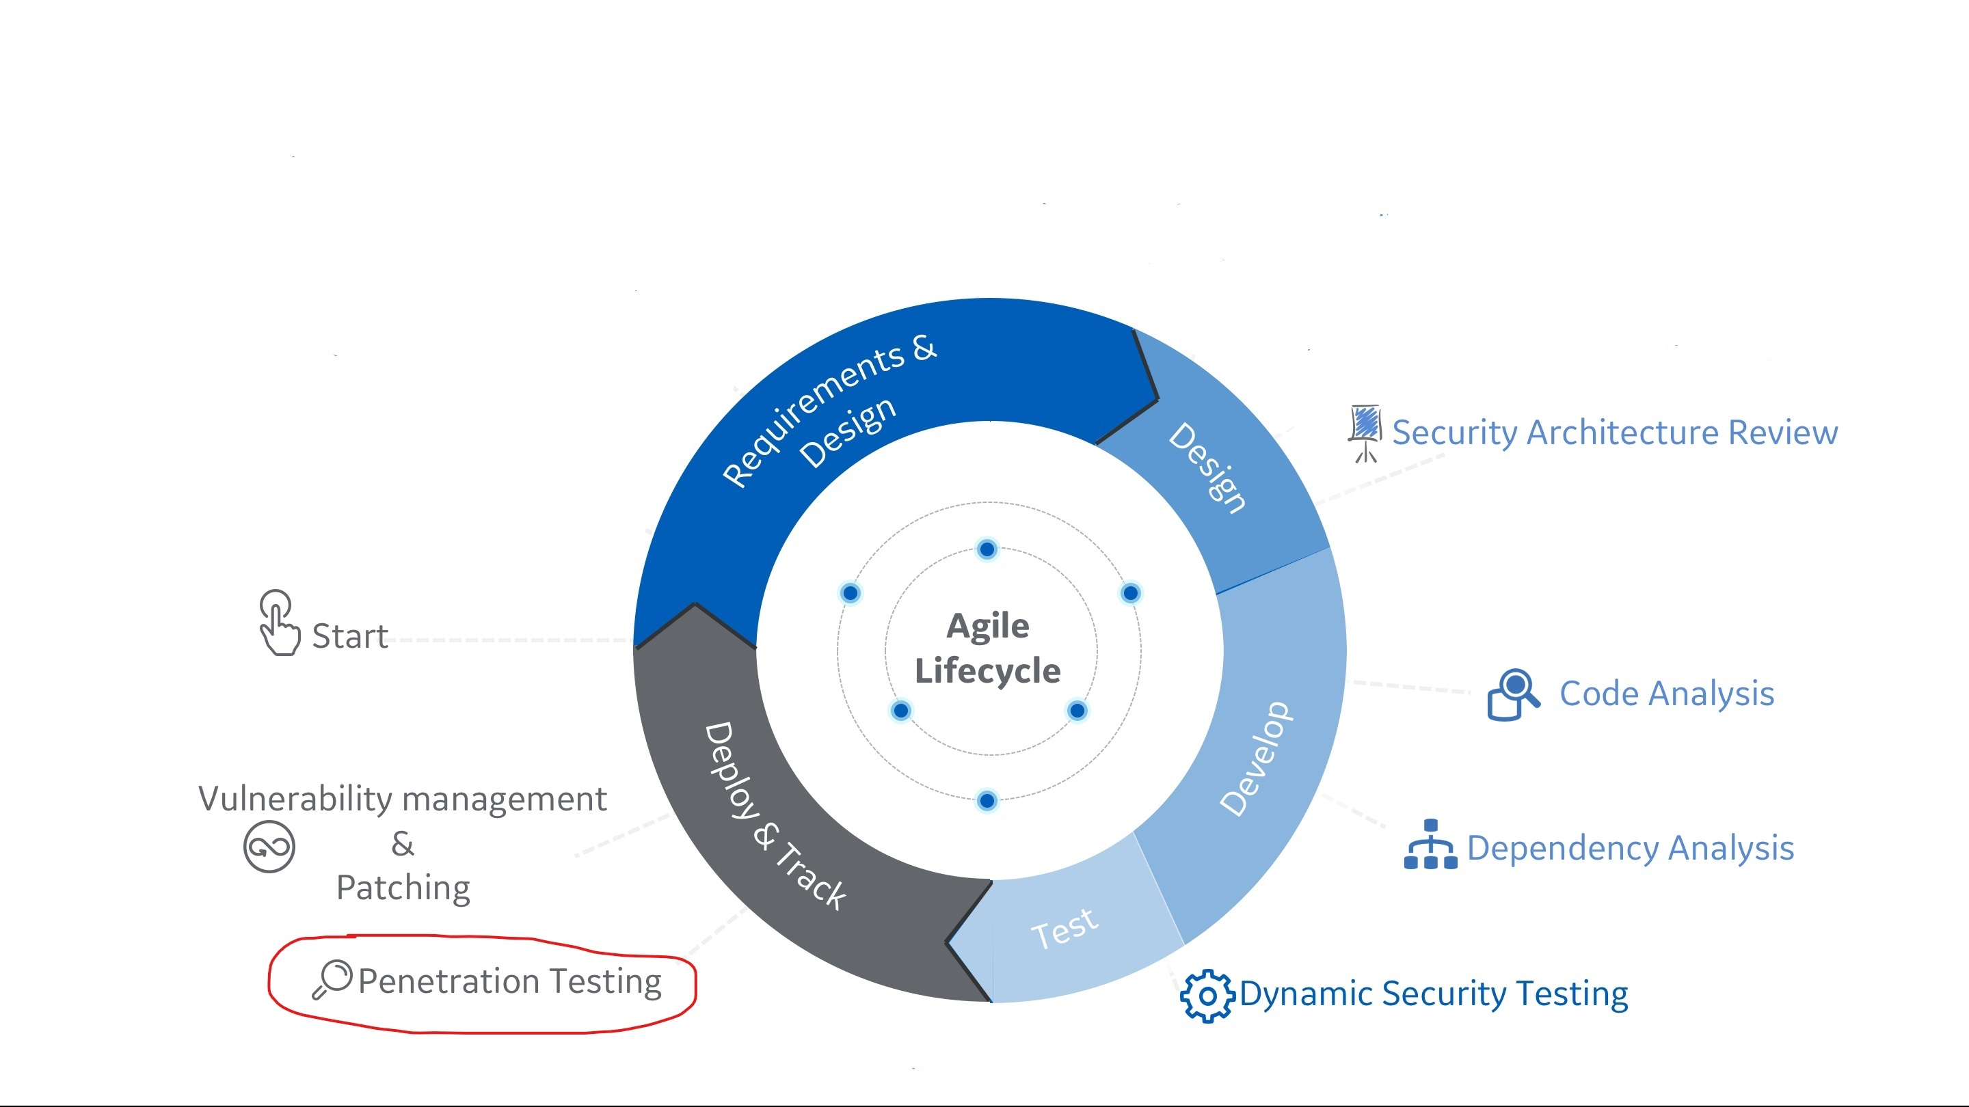
Security in the Agile Lifecycle

Slide 4
Use Case/Problem
Security/Penetration testing is manual, time-consuming and repetitive
Security testing of web applications is not performed for all the releases
Developers and functional testers do not know much about Security testing

Slide 5
Security Testing Automation
Objective
To use OWASP ZAP to automate finding security vulnerabilities in a CI/CD pipeline
Solution
Integrate security tests with web-automation framework
Run security tests automatically with the functional tests
Use Selenium automation scripts to drive security tests using ZAP API
Generate custom reports

Slide 6
OWASP Zed Attack Proxy (ZAP)
What is OWASP ZAP?
Free security tool used to find Security Vulnerabilities
Tests can be done using ZAP UI manually
ZAP API can be used to test using scripts

Slide 7
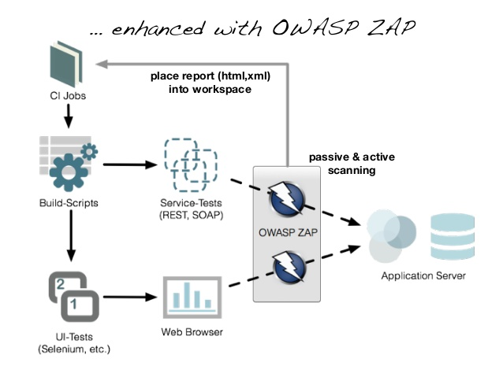
CI flow with OWASP ZAP

Slide 8
Security Testing Automation
CI/CD Pipeline Steps
Start ZAP (Needed to capture alerts and vulnerabilities)
Start Selenium automation (ZAP Proxy and API are used)
Generate alerts and reports

Slide 9
DEMO

