Slide 1



Tree Species Classification
AICTE Student ID: STU64ec253cc5a301693197628
AICTE Internship ID: INTERNSHIP_1748923002683e727a876ea

Slide 2

Learning Objectives:
Understand the importance of tree species classification in ecology.
Collect and preprocess relevant image or sensor data.
Extract meaningful features from leaf, bark, or spectral data.
Apply ML/DL models (e.g., SVM, CNN) for species classification.
Evaluate model performance using accuracy, precision, recall, etc.
Optimize models through tuning and validation.
Visualize and interpret classification results.
Explore real-world applications and deployment strategies.
GOAL
Source :
www.freepik.com/

Slide 3

Tools and Technology used:
Languages: Python, R
ML Libraries: Scikit-learn, TensorFlow, Keras, PyTorch
Image Processing: OpenCV, PIL
Geospatial Tools: QGIS, Google Earth Engine
Visualization: Matplotlib, Seaborn
Development: Jupyter Notebook, Streamlit, Flask
Hardware: GPU support for deep learning

Slide 4
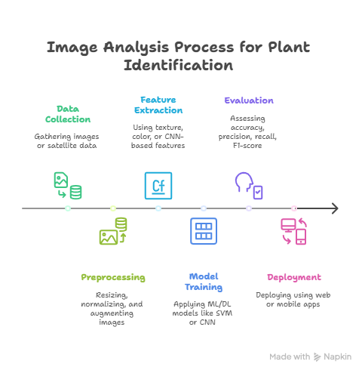
Methodology:

Slide 5
Problem Statement:
Identifying tree species manually is time-consuming, error-prone, and requires expert knowledge. The goal is to develop an automated and accurate tree species classification system using machine learning techniques, leveraging image or sensor data to support environmental monitoring, biodiversity conservation, and forest management.

Slide 6
Solution:
Develop a machine learning-based model that automatically classifies tree species using image data (e.g., leaves, bark, or satellite imagery). The solution involves data preprocessing, feature extraction, and training ML/DL models (like SVM or CNN) to accurately identify species. The model can be deployed via a web or mobile application for real-time use in the field.
GitHub Repository:
https://github.com/vadlameghana/tree-species-classification.git

Slide 7
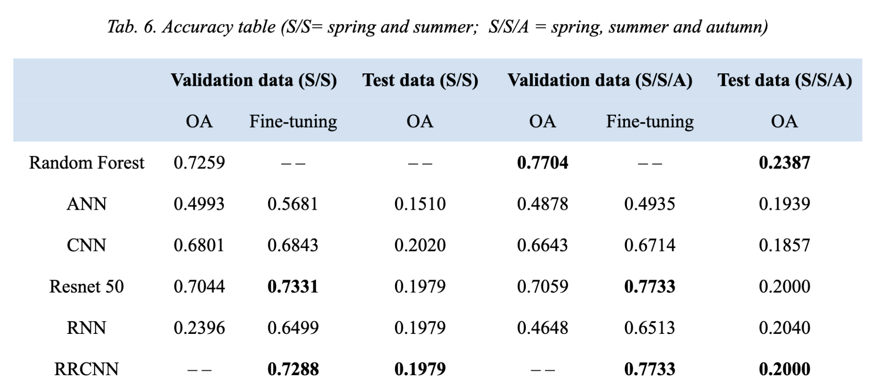
Screenshot of Output:

Slide 8
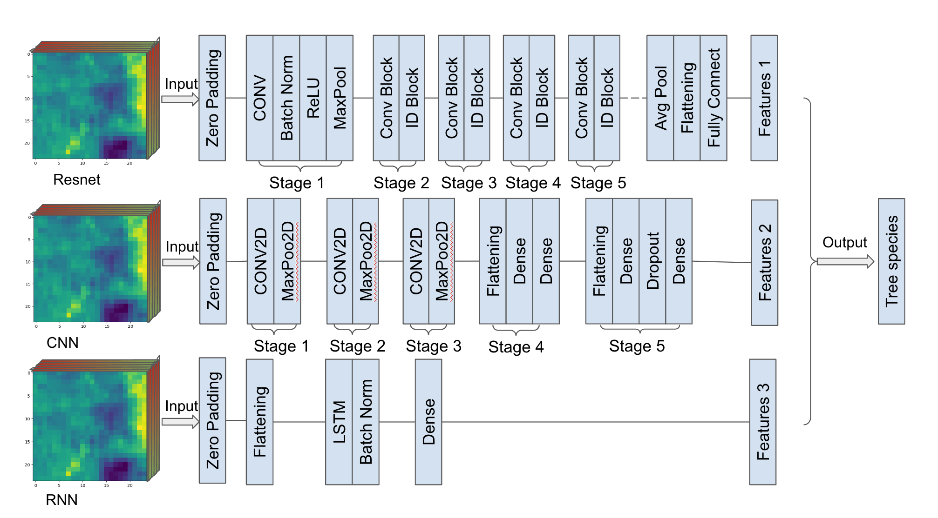
Screenshot of Output:

Slide 9
Conclusion:
Tree species classification using machine learning offers an efficient, scalable, and accurate alternative to manual identification. By leveraging image data and advanced algorithms, the proposed system can assist researchers, conservationists, and forest officials in real-time species detection, promoting better ecological monitoring and biodiversity conservation.

Slide 10
Thank You…!!

