Slide 1



Tree Species Classification
Student Name: V. Meghana
AICTE Student ID: STU64ec253cc5a301693197628
AICTE Internship ID: INTERNSHIP_1748923002683e727a876ea

Slide 2

Learning Objectives:
Understand the importance of tree species classification in ecology.
Collect and preprocess relevant image or sensor data.
Extract meaningful features from leaf, bark, or spectral data.
Apply ML/DL models (e.g., SVM, CNN) for species classification.
Evaluate model performance using accuracy, precision, recall, etc.
Optimize models through tuning and validation.
Visualize and interpret classification results.
Explore real-world applications and deployment strategies.
GOAL
Source :
www.freepik.com/

Slide 3

Tools and Technology used:
Languages: Python, R
ML Libraries: Scikit-learn, TensorFlow, Keras, PyTorch
Image Processing: OpenCV, PIL
Geospatial Tools: QGIS, Google Earth Engine
Visualization: Matplotlib, Seaborn
Development: Jupyter Notebook, Streamlit, Flask
Hardware: GPU support for deep learning

Slide 4
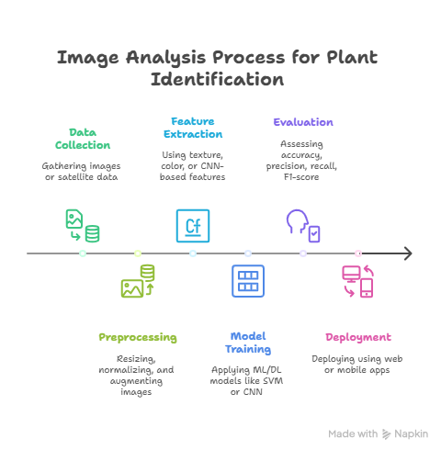
Methodology:

Slide 5
Problem Statement:
Identifying tree species manually is time-consuming, error-prone, and requires expert knowledge. The goal is to develop an automated and accurate tree species classification system using machine learning techniques, leveraging image or sensor data to support environmental monitoring, biodiversity conservation, and forest management.
The Issue: Accurately identifying tree species can be time-consuming and requires specialized knowledge. Automating this process using computer vision is a key challenge in environmental science.
Impact: A reliable classification system could aid in ecological surveys, forestry management, and conservation efforts.
Scope: This project focuses on classifying 30 specific tree species from a prepared image dataset using deep learning techniques.

Slide 6
Solution:
Develop a machine learning-based model that automatically classifies tree species using image data (e.g., leaves, bark, or satellite imagery). The solution involves data preprocessing, feature extraction, and training ML/DL models (like SVM or CNN) to accurately identify species. The model can be deployed via a web or mobile application for real-time use in the field.
GitHub Repository:
https://github.com/vadlameghana/tree-species-classification.git

Slide 7
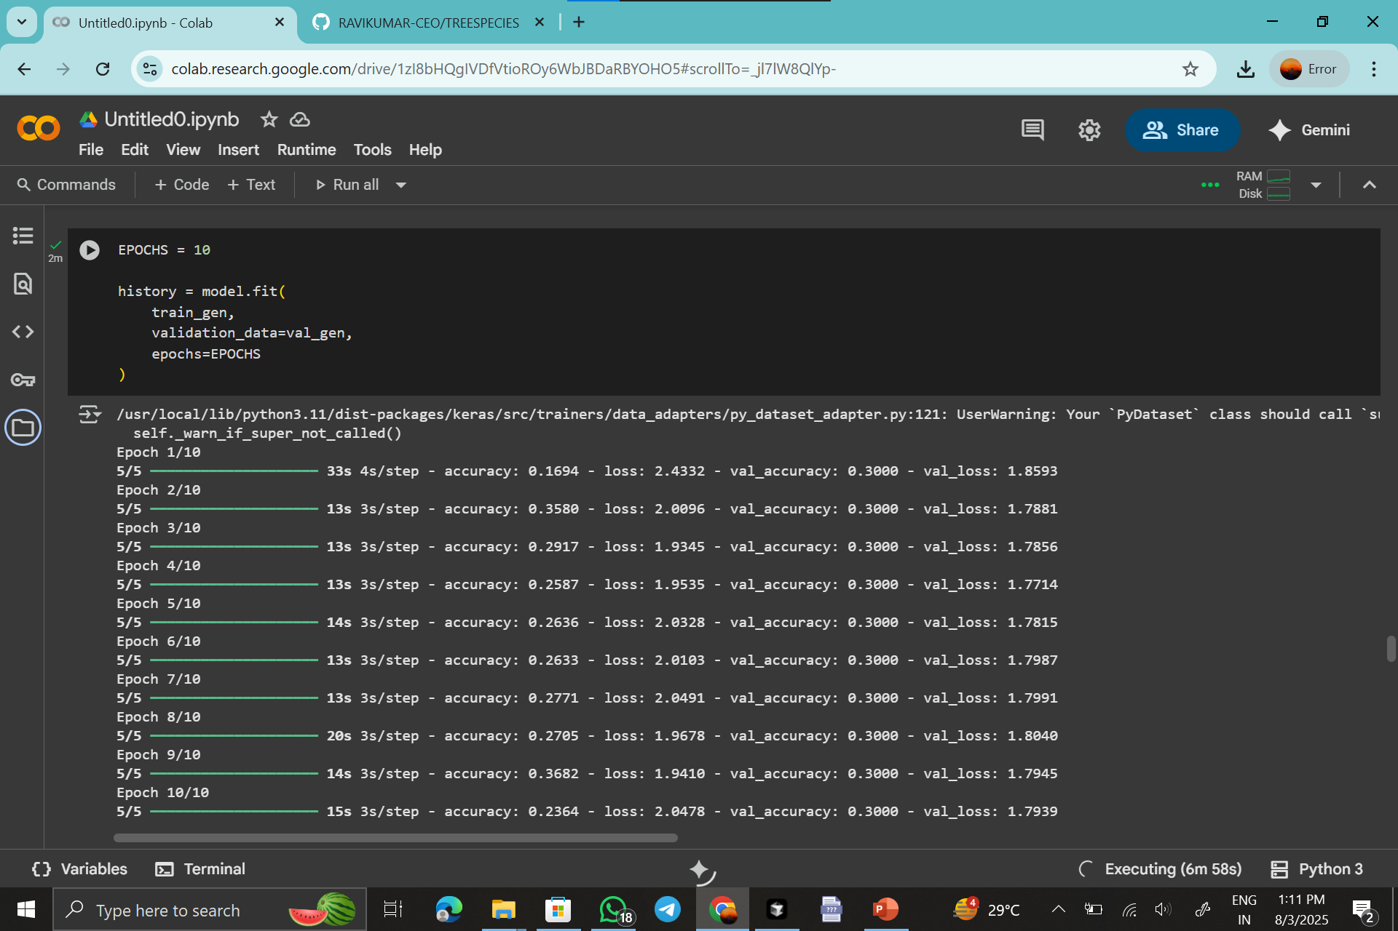
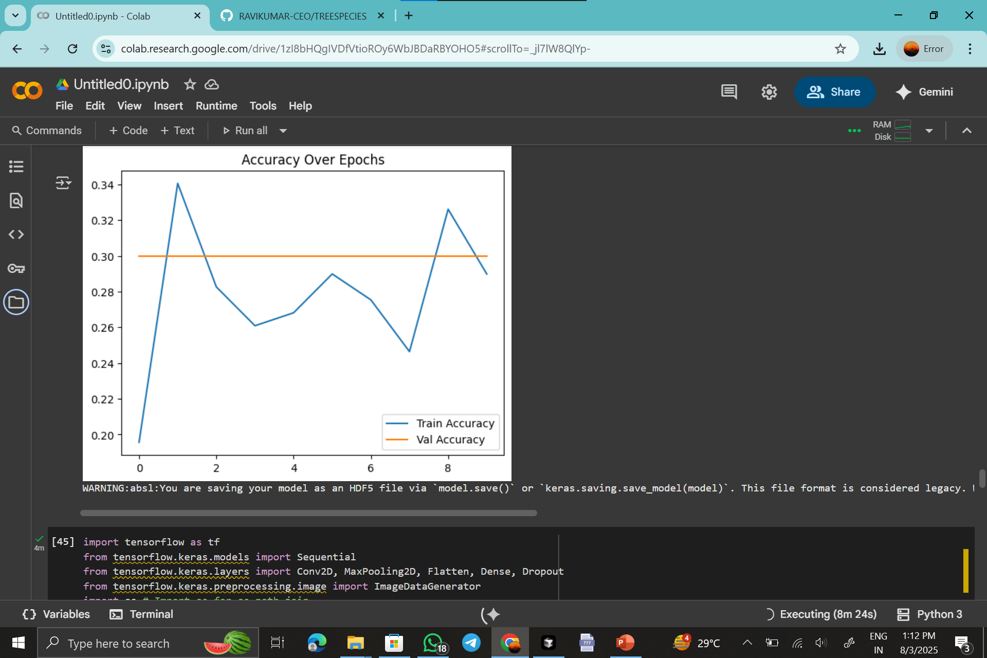
Screenshot of Output:

Slide 8
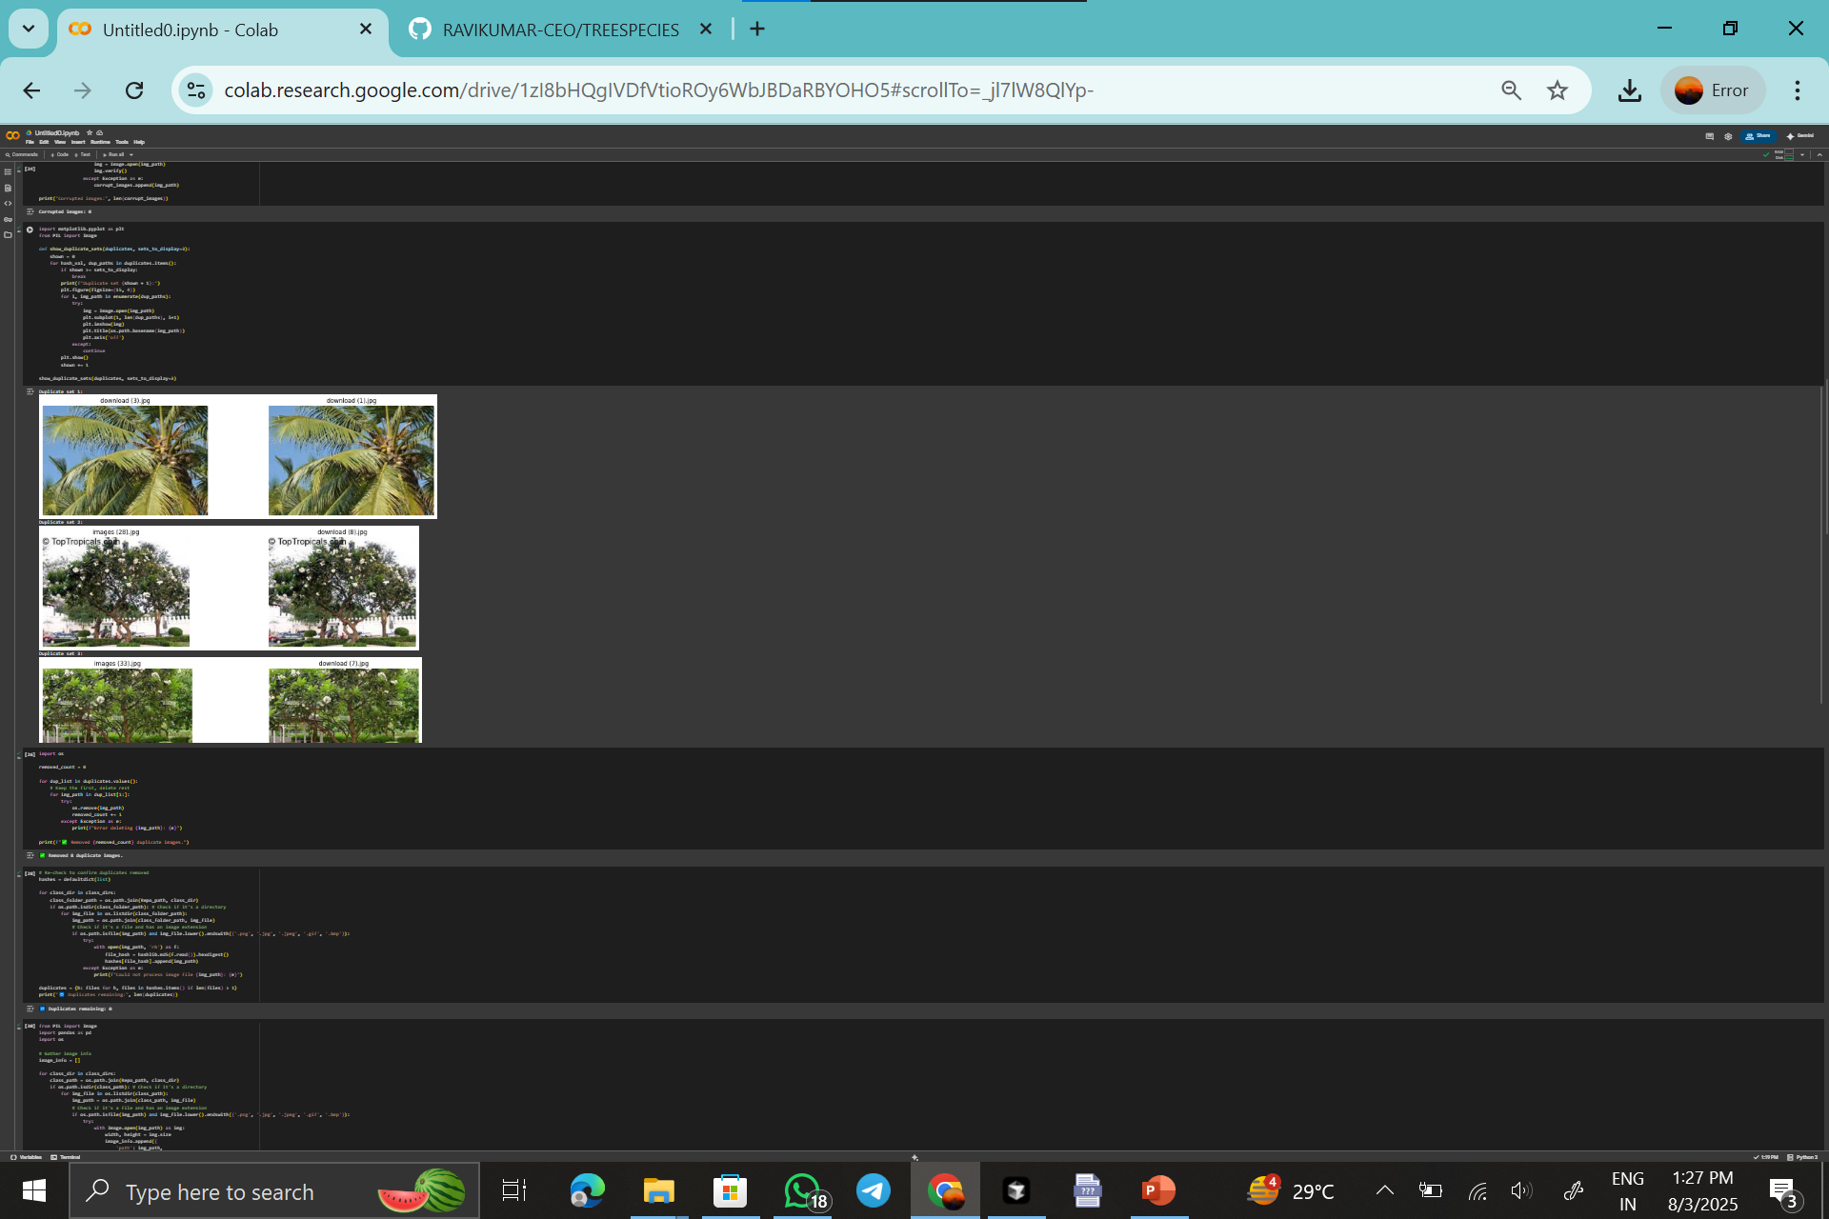
Screenshot of Output:

Slide 9
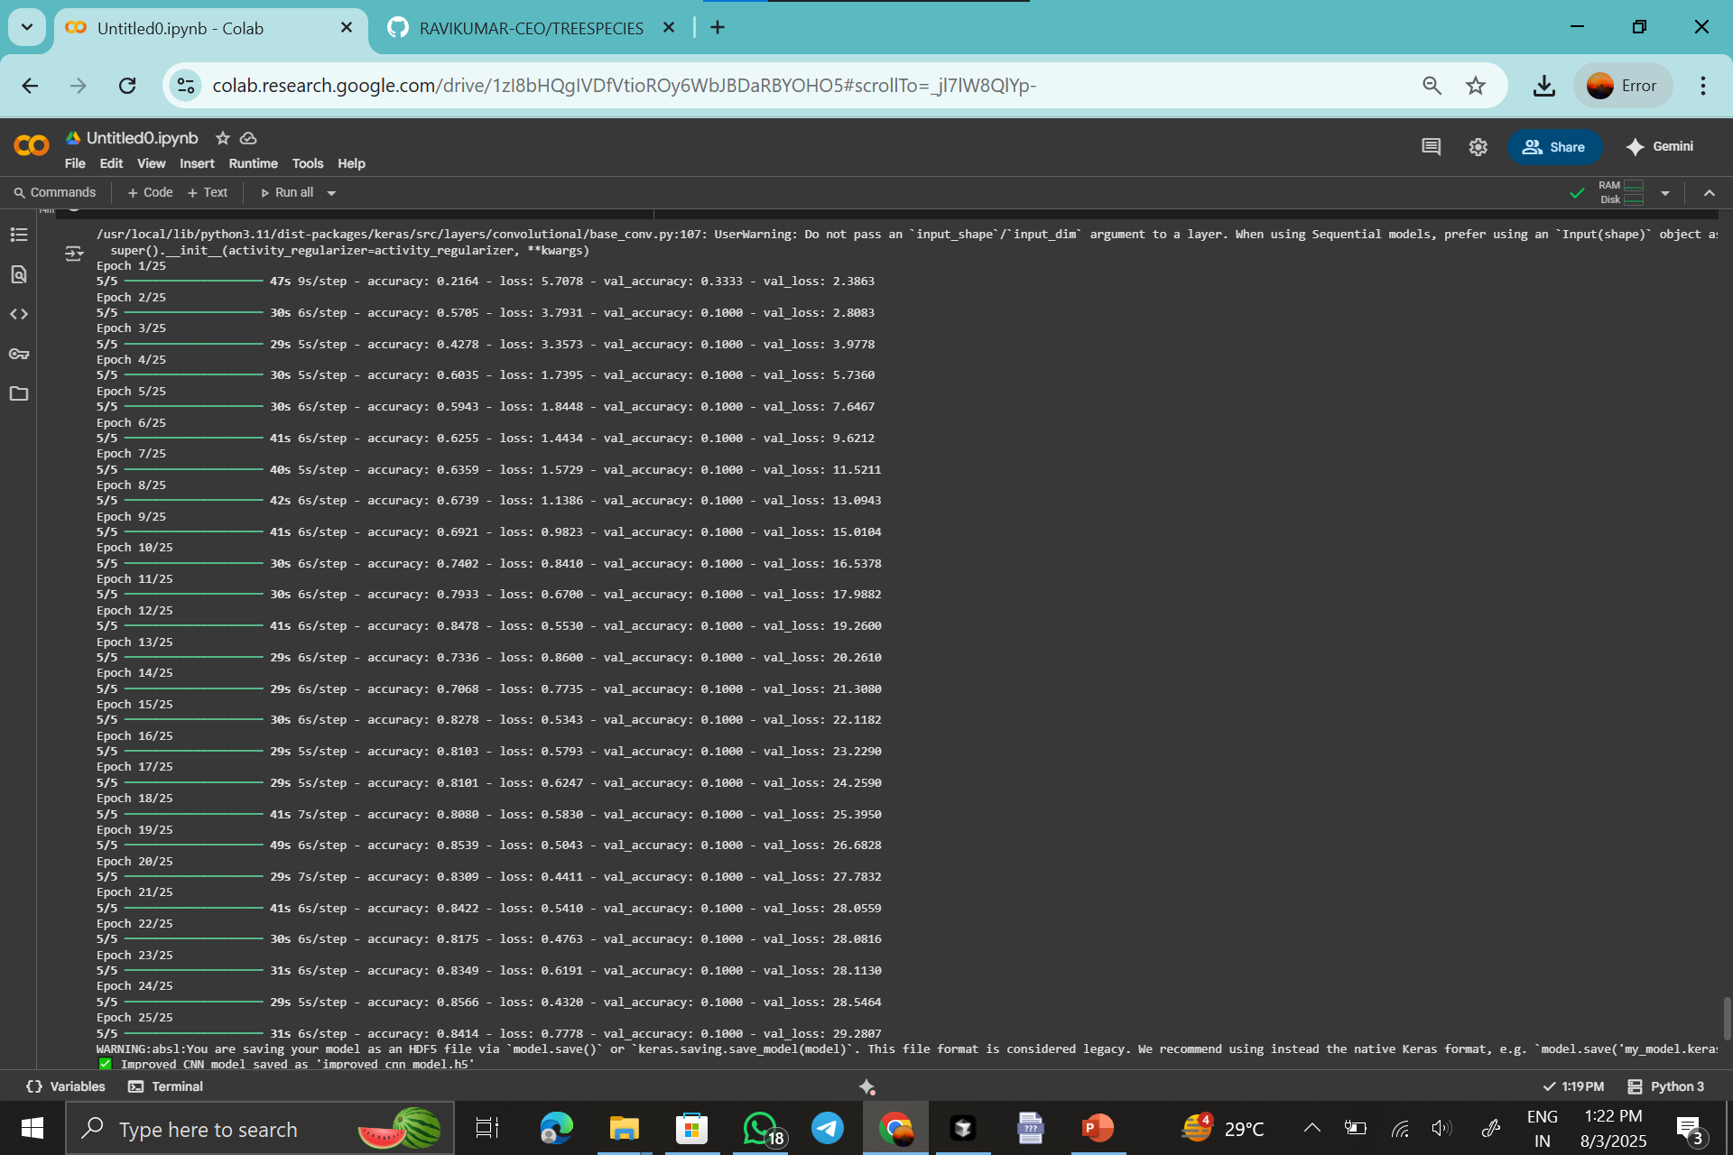
Screenshot of Output:

Slide 10
Conclusion:
Tree species classification using machine learning offers an efficient, scalable, and accurate alternative to manual identification. By leveraging image data and advanced algorithms, the proposed system can assist researchers, conservationists, and forest officials in real-time species detection, promoting better ecological monitoring and biodiversity conservation.
What I Learned
Throughout this project, I gained valuable experience with the entire deep learning project lifecycle. This included everything from data cleaning and preprocessing to model training and performance evaluation.
Future Scope
Looking ahead, there are several ways to build upon this work:
Fine-tuning: I plan to fine-tune the EfficientNetB0 model further by unfreezing and traditional layers.
Data Expansion: Expanding the dataset with a wider variety of images.
Optimization: I want to explore more advanced data augmentation techniques and hyperparameter tuning to further optimize the model's performance.

Slide 11
Thank You…!!

