Slide 1
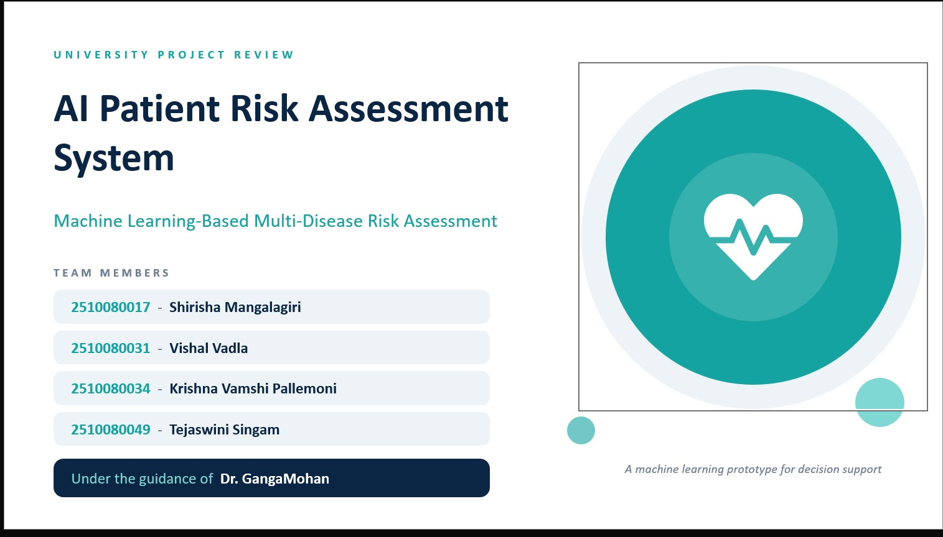



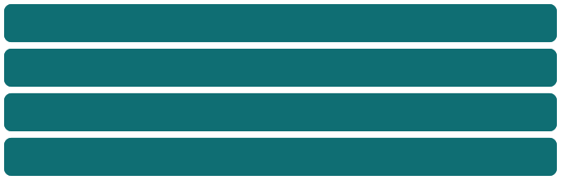
Intelligent Healthcare
System for Multi-Disease Risk Assessment
Your paragraph text

Slide 2
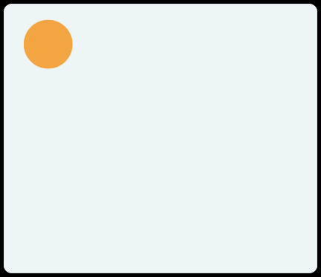
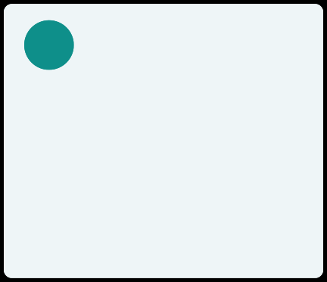
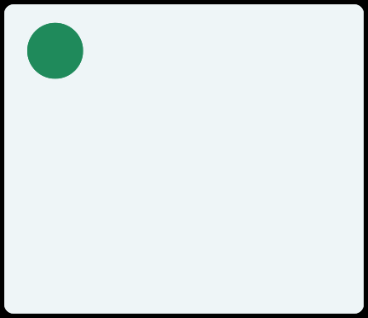




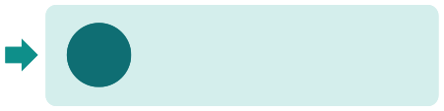




Problem and Solution
The Existing Problem
Our Proposed Solution
Why It Is Useful
A patient can have more than one condition at the same time, such as diabetes with high blood pressure. Checking every combination by hand is slow, tiring and easy to get wrong. Health records are large, so hidden patterns are easy to miss.
A machine learning model learns patterns from past health records.
For new measurements, it predicts 1 of 8 classes: normal, one disease, or a combination.
A simple interface makes the result easy to read.
Gives a quick and consistent first assessment.
Looks at several conditions together, not one at a time.
Can highlight cases that may need a doctor's attention.
1 Input
2 Model
3 Output
Patientmeasurements are entered
RandomForest finds the pattern
Oneof8disease-combination classes
Important: this system supports health assessment. It is not a replacement for a doctor or a confirmed diagnosis.
AI Patient Risk Assessment System
2

Slide 3
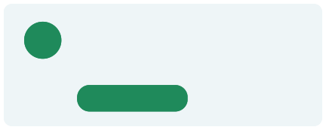



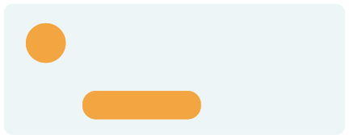
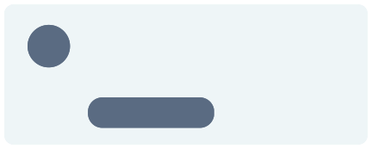
Project Objectives
1
Prepare and clean the healthcare dataset
2
Explore the data with graphs and statistics
3
Build a multiclass machine learning model
Completed
Completed
Completed
4
Predict one of eight disease- combination classes
5
Select useful input features
6
Evaluate the model with suitable metrics
Completed
Completed
Completed
7
Build a user-friendly frontend
8
Plan a backend linked to the saved model
9
Display results clearly and responsibly
In progress
Planned
In progress
The six machine learning objectives are completed. The three application objectives are in progress or planned.
AI Patient Risk Assessment System
3

Slide 4
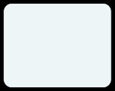
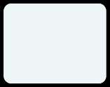
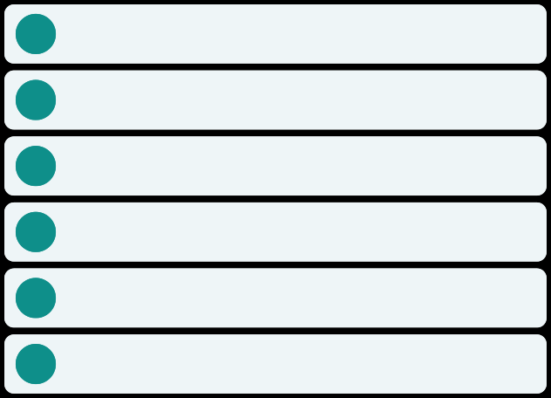


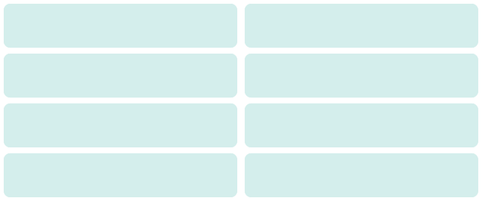

Dataset and Data Preparation
278,701
39
2,284
0
Data cleaning and EDA
Rows after duplicate removal
Original columns
Duplicates removed
Missing values
1
Check missing values
0 missing values were reported.
41
15
80 / 20
42
2
Remove duplicates
2,284repeatedrowsfound and removed.
Columns after encoding
Final selected features
Train / test split (stratified)
random_state
3
Inspect the data
Checkdatatypesand how values are spread.
Target column: sublabel (8 classes)
4
Handle outliers
N Normal
DI_HY Diabetes + hypertension
FindthemwiththeIQR method; cap selected continuous features.
5
Explore patterns
DI Diabetes
DI_HT Diabetes + heart disease
Classcounts,age,BMI, glucose, HbA1c, class comparison, correlation heatmap.
6
Prepare for training
HY Hypertension
HT_HY Heart disease + hypertension
One-hotencodecategories; remove target-leakage columns.
HT Heart disease
DI_HT_HY Diabetes + heart disease + hypertension
Note: outlier capping can change extreme but real values. We do not claim it automatically improves the model.
AI Patient Risk Assessment System
4

Slide 5
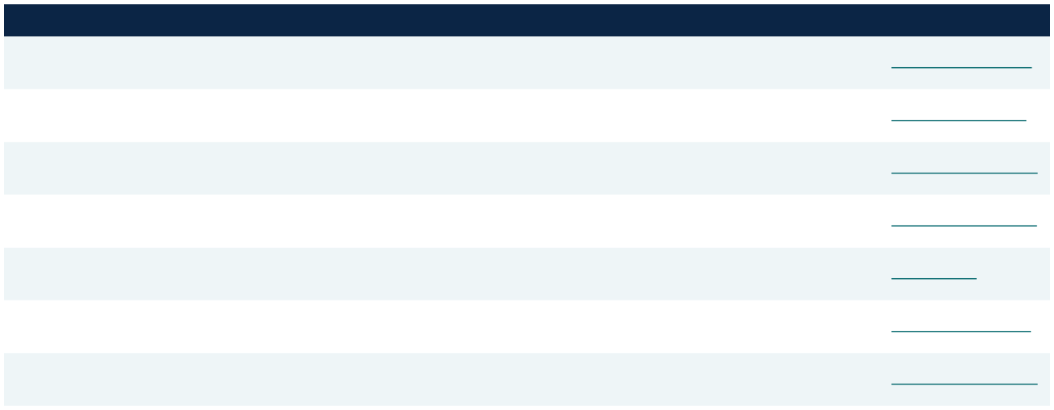
Literature Review and Research Gap
Paper
Key finding
Relevance to our project
DOI link
Breiman (2001)
Many trees voting give accurate predictions and resist overfitting.
Our core model
10.1023/A:1010933404324
Random Forests
Khalilia et al. (2011)
Predicted 8 chronic diseases on imbalanced hospital data; average AUC 88.79%.
Random forest, imbalance, many diseases
10.1186/1472-6947-11-51
Disease risks from imbalanced data using random forest
Uddin et al. (2019)
Reviewed 48 studies; random forest was best in 9 of the 17 studies using it.
Supports choosing random forest
10.1186/s12911-019-1004-8
Comparing supervised ML algorithms for disease prediction
Sutton et al. (2020)
Decision support helps clinicians but carries risks; careful design is needed.
Why we frame this as decision support
10.1038/s41746-020-0221-y
Overview of clinical decision support systems
Chawla et al. (2002)
Synthetic minority examples plus under-sampling improved classifier results.
Possible fix for rare classes
10.1613/jair.953
SMOTE: Synthetic Minority Over-sampling
Sokolova & Lapalme (2009)
Different measures capture different aspects of performance.
Why macro F1 is reported with accuracy
10.1016/j.ipm.2009.03.002
Performance measures for classification tasks
Lundberg et al. (2020)
Explains tree-model predictions locally and globally.
Future explainability work
10.1038/s42256-019-0138-9
Explainable AI for trees
Research gap: many studies focus on one disease or on diagnosis history. We build an eight-class prediction workflow with a user interface. It is a prototype, not a proven medical breakthrough.
AI Patient Risk Assessment System
5

Slide 6
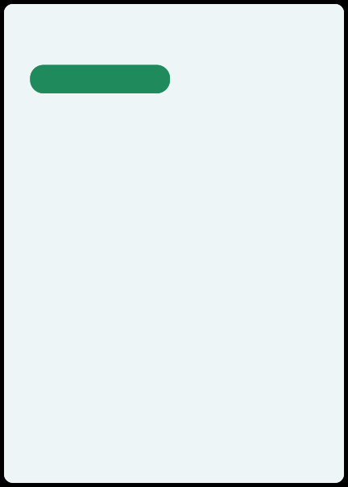
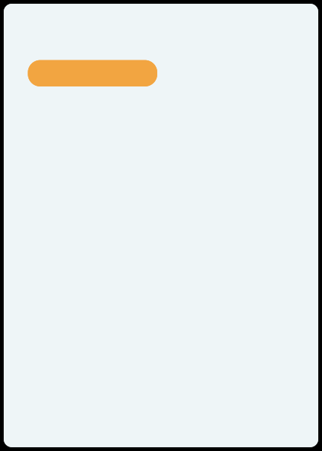

Technology Stack
ML and Data
Frontend
Backend
Used in notebook
In project setup
Planned
Python
React
builds theuser interface
JavaScript
FastAPI
Python web framework that serves the model
Uvicorn
server that runs FastAPI
Pydantic
checks input names, types and ranges
Joblib
loads thesaved model
main programming language
Pandas
loadsandcleanstabledata
app logicandforms
NumPy
Vite
fast development and build tool
HTML
page structure
CSS
colors andresponsive layout
fast number calculations
Scikit-learn
MLtoolsandmetrics
Random Forest Classifier
thepredictionmodel
Joblib
savesthetrainedmodel
Jupyter Notebook
step-by-step code and results
Matplotlib and Seaborn
draw graphs
AI Patient Risk Assessment System
6

Slide 7
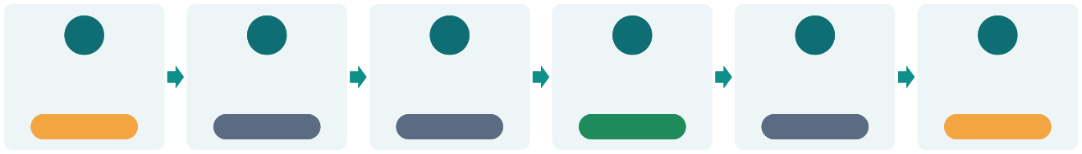
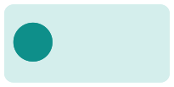



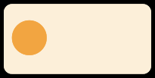


System Architecture and Workflow
ARCHITECTURE
1
2
3
4
5
6
React Frontend
FastAPI Backend
Validation + Feature Alignment
Planned
Saved Random Forest Model
Trained
Prediction Response
Results Page
In progress
Planned
Planned
In progress
WORKFLOW
1
Dataset
2
Data Cleaning
3
Exploratory Analysis
4
Feature Preparation
5
Train / Test Split
6
Random Forest Training
7
Feature Selection
8
Model Evaluation
9
Save Model
10
User Input
11
Backend Prediction
12
Results Display
Machine learning phase
Application phase (in progress / planned). Backend, API and history are not claimed as working.
AI Patient Risk Assessment System
7

Slide 8
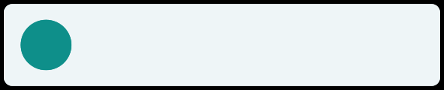


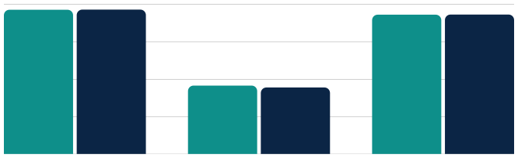



Model Development and Results
Test-set metrics (scale 0 to 1)
Random Forest
Manydecisiontrees vote; the most-voted class wins.
15-feature model
41-feature baseline
1.0
0.8
0.8
0.8
Multiclass
0.7
0.7
Themodelpicks 1 of 8 classes, not just yes or no.
0.6
0.4
0.4
0.4
80/20 split, stratified
0.2
Testonunseendata;eachclass keeps its share.
0
1.0
2.0
3.0
15 features: slightly lower accuracy (77.10% vs 77.18%), slightly higher macro F1. Macro F1 is still low: rare classes have very low recall, so accuracy alone is not enough.
Research prototype. Not clinically validated.
Feature selection
41featuresreducedto 15. Model saved with Joblib.
Final 15 features: HbA1c_level, bmi, glucose, age, age_normalized, high_blood_pressure_Yes, systolic_bp, ldl, alcohol_intake, diastolic_bp, hdl, heart_rate, blood_pressure, triglycerides, salt_intake
AI Patient Risk Assessment System
8

Slide 9
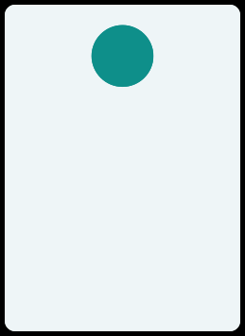















Outputs and Main Features
Predicted Class
Model Probabilities
Validation Messages
Prediction Summary
Assessment History
The model picks one of 8 classes, for example N (normal) or DI_HY (diabetes + hypertension).
Shows how strongly the model favours each class,
if supported. Not a medical risk percentage.
Warns when a value is missing or out of range, before any prediction is made.
A readable result: entered values, predicted class and a reminder that it is not a diagnosis.
Saves past assessments for review. Only if saving is built (planned).
Main application features and status
Clinical-style dashboard
Patient assessment form
Eight-class prediction (model)
Prediction results page
In progress
In progress
Implemented
In progress
Assessment history
Responsive design
Model integration
Clear medical disclaimer
Planned
In progress
Planned
In progress
AI Patient Risk Assessment System
9

Slide 10
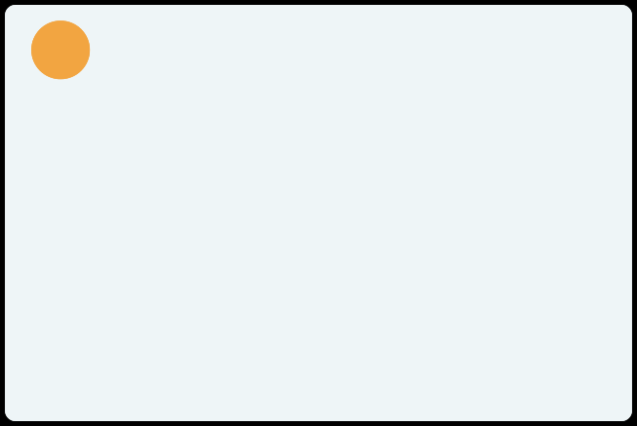
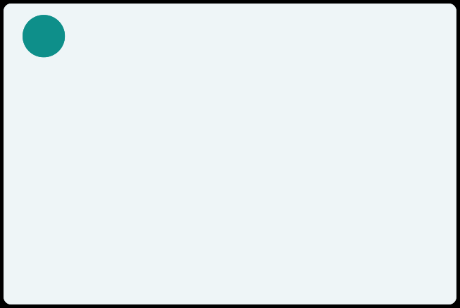



Limitations, Future Work and Conclusion
Limitations
Future Work
Classes are imbalanced
Some rare classes have very low recall
Possible leakage if inputs are not known at prediction time Dataset source and label quality need checking
No test on independent real-world data
Probabilities are not calibrated medical risks
Needs privacy, security, fairness and clinical validation
Improve minority-class performance
Compare models by macro F1 and class-wise recall Tune hyperparameters
Validate on independent datasets
Study probability calibration and explainability Finish and test frontend and backend integration Add secure assessment history if required
Conclusion
Webuilt aneight-class Random Forest model on 278,701 records with 15 features: 77.10% accuracy and 0.3664 macro F1. A friendly interface can make it easy to use. It is a machine learning prototype for decision support, not a replacement for professional medical diagnosis.
AI Patient Risk Assessment System
10

