Slide 1

Usain Bolt
<h1>ASK
{{ THE SUPER SPRINTER }}
MATE</h1>

Slide 2
{% for day in week[:4] %}
{{ day }} | {{ day }} | {{ day }} | {{ day }}
Getting used to the new environment SI week Q&A Sprint plan | Implementing tasks with 1000 business value Finishing SI weeks assignment | Implementing tasks with lower business value | Style formatting with CSS Presentation
{% endfor %}

Slide 3
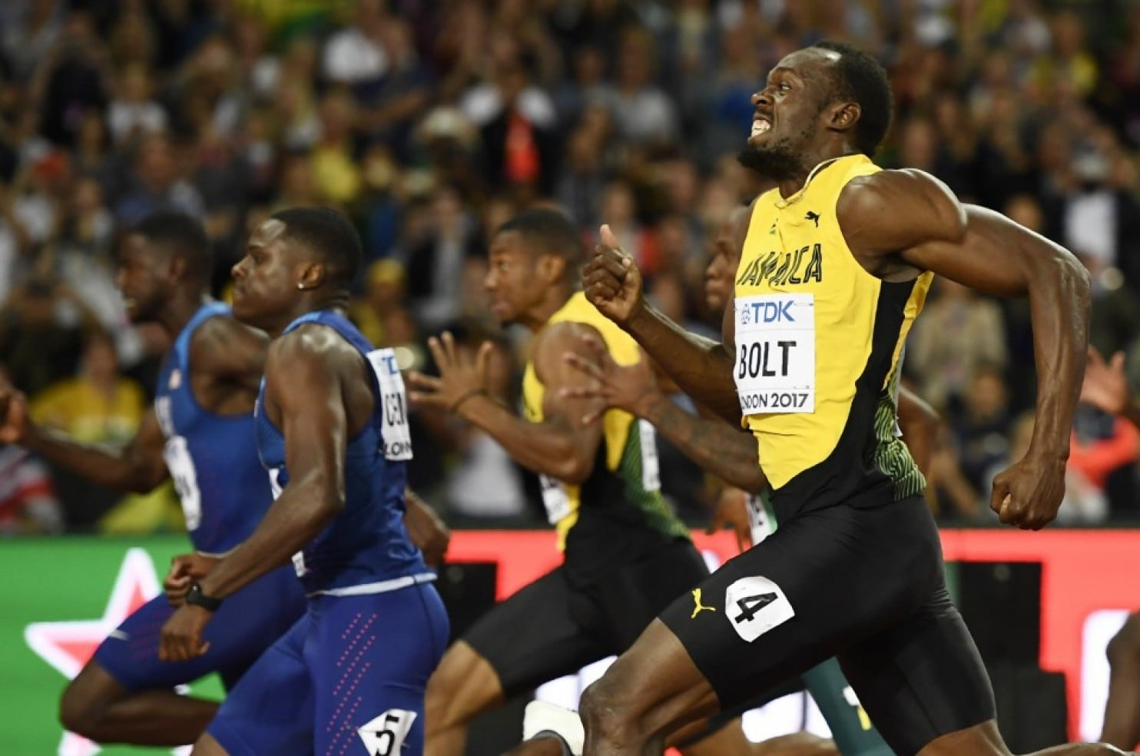
D
E
M
O
D
A
Y

Slide 4
Title | Business value | Status
List questions | 1000 | Done
Display a question | 1000 | Done
Ask a question | 1000 | Done
Post an answer | 1000 | Done
Vote | 700 | In progress
Sort questions | 600 | In progress
Delete question | 600 | Done
Add image | 500 | In progress
Edit a question | 400 | In progress
Delete an answer | 400 | In progress

Slide 5
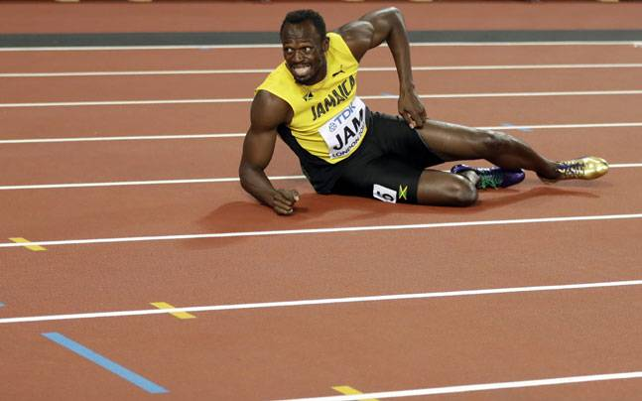
FINISHING TW WEEK IN TIME
<a href="{{url_for("route_project")}}">

Slide 6
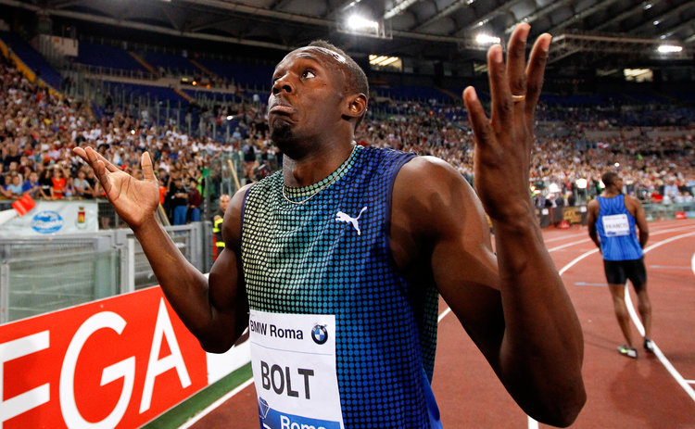
FURTHER PLANS

Slide 7
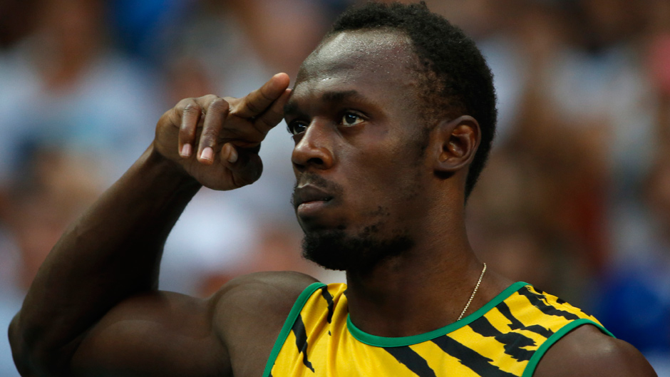
SEE YOU
NEXT WEEK

