Slide 1
AskMate
vol.2
Presented by
Réka, Kincső, Gigi, Dávid

Slide 2





Objectives of the week
New design
CSV → SQL
Implement new User Stories
Have daily stand-ups

Slide 3
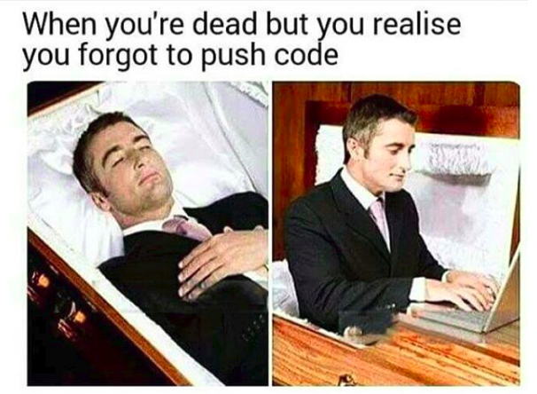
Obstacles of the week
Git
Git
Git

Slide 4
User Stories
Business value | Title | Status
2000 | use database | DONE
1200 | add comment to question | DONE
1100 | add comment to answer | DONE
1100 | search questions | DONE
1000 | edit answer | DONE
800 | edit comments | DONE
800 | delete comments | DONE
800 | display latest questions | DONE
600 | sort questions | DONE
400 | fancy search results | Aborted
9800

Slide 5

Summary
Intense sprint
Great teamwork
Daily stand-up
Fantastic webpage
success!

Slide 6
Questions?
To be continued...

