Slide 1

Enhancing Rust with BTF Debug Format Support
MICHAL ROSTECKI
Rust Engineer at Exein

Slide 2

INTRODUCTION
What is eBPF?
  How it differs from kernel modules?
  What is BTF? How is it produced?
You can write eBPF in Rust! But there is still some work to be done to meet 100% feature parity.

Slide 3
INTRODUCTION
There are two ways of extending the Linux kernel
  Kernel modules
  eBPF programs

Slide 4

Kernel modules vs eBPF
The difference
Kernel modules
  Have full access to kernel internals.
  Need kernel sources for building.
  It’s encouraged to submit them upstream, to the main kernel repo.
  Can crash the kernel.
  Great for device drivers, filesystems and extending kernel’s functionality directly.

Slide 5

Kernel modules vs eBPF
The difference
eBPF
  Built independently from the kernel. You just need a compiler supporting BPF target.
  Cannot crash the kernel.
  Great for third-party tools which hook into Linux internals – firewalls, tracers, security monitors.

Slide 6
How eBPF works?
Tell me more
It’s a virtual machine
  It comes with its own architecture and assembly.
  Forces programs to be small, on purpose.
  That’s why it can’t crash the kernel.
  Compilers (LLVM and GCC) support BPF target.

Slide 7





Kernel modules vs BPF C vs Rust

Slide 8
Aya
Writing BPF in Rust
Rust library for writing eBPF
  https://aya-rs.dev
  Rustup and cargo is all you need!

Slide 9
Pulsar
Security observability framework for IoT devices (but not only!)
Security monitor, using Rust and Aya
  https://pulsar.sh/
  Lightweight.
  Designed mostly for IoT devices. Has support for ARM and RISC-V.
  But useful on x86 as well.

Slide 10

Using eBPF for network tracing XDP

Slide 11

Using eBPF for network filtering XDP

Slide 12

What is Debug Info?
Here be dragons
Metadata that is generated by compilers and stored alongside the binary.
Basically what debuggers use to figure out which line of code are you in.
But there is also an another use case!

Slide 13

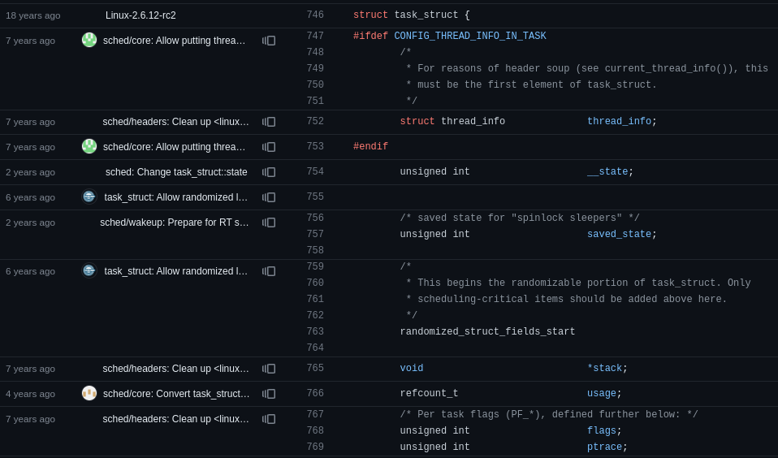
Let’s look at some kernel type to trace Whoops, we have a problem!

Slide 14
How to support many kernel versions?
Compatibility
Different kernel versions can have different definitions of types you want to inspect.
We need some mechanism for handling these differences.
Guess what… debug info is helpful!

Slide 15
DWARF
The most popular format
The most popular debug information standard.
Again, that’s basically what your debugger uses!
It’s quite big! It can take megabytes.

Slide 16
BTF
Here it comes
BPF Type Format
Enables single compilation of eBPF programs for various kernel versions.
Minified information about types and their fields with offsets.
Enhanced debugging: Stack trace visibility when eBPF program load fails

Slide 17
LLVM How does Debug Information get produced?
clang
rustc
C code
LLVM IR + LLVM DI
Rust code
Clang AST
HIR
LLVM BC + LLVM DI
MIR
Machine code + DI

Slide 18
LLVM Debug Info Example
!28223 = distinct !DICompositeType(tag: DW_TAG_structure_type, name: "sockaddr_in6", file: !6, line: 22816, size: 224, elements: !28224)
!28224 = !{!28225, !28226, !28227, !28228, !28229}
!28225 = !DIDerivedType(tag: DW_TAG_member, name: "sin6_family", scope: !28223, file: !6, line: 22817, baseType: !682, size: 16)
!28226 = !DIDerivedType(tag: DW_TAG_member, name: "sin6_port", scope: !28223, file: !6, line: 22818, baseType: !990, size: 16, offset: 16)
!28227 = !DIDerivedType(tag: DW_TAG_member, name: "sin6_flowinfo", scope: !28223, file: !6, line: 22819, baseType: !971, size: 32, offset: 32)
!28228 = !DIDerivedType(tag: DW_TAG_member, name: "sin6_addr", scope: !28223, file: !6, line: 22820, baseType: !9016, size: 128, offset: 64)
!28229 = !DIDerivedType(tag: DW_TAG_member, name: "sin6_scope_id", scope: !28223, file: !6, line: 22821, baseType: !899, size: 32, offset: 192)

Slide 19
BTF Example
[200] STRUCT 'sockaddr_in6' size=28 vlen=5
'sin6_family' type_id=19 bits_offset=0
'sin6_port' type_id=24 bits_offset=16
'sin6_flowinfo' type_id=14 bits_offset=32
'sin6_addr' type_id=35 bits_offset=64
'sin6_scope_id' type_id=15 bits_offset=192

Slide 20
How do they work?
BTF relocations
BPF programs contain the BTF for all types.
Fields of these types are accessed by a compiler intrinsic – preserve_access_index.
preserve_access_index gets compiled to a CO-RE relocation in BPF assembly.
BPF VM knows what to do the relocation.

Slide 21
preserve_access_index Intrinsic
declare <ret_type>
@llvm.preserve.union.access.index.p0s_union.anons.p0s_union.anons(
<type> base, i32 di_index)
declare <ret_type>
@llvm.preserve.struct.access.index.p0i8.p0s_struct.anon.0s(
<type> base, i32 gep_index, i32 di_index)

Slide 22
BTF relocations How do they work?
Older kernel
Newer kernel
MyStruct
MyStruct
u32 old_field_a
u32 old_field_a
u32 old_field_b
u32 new_field_a
u32 old_field_b

Slide 23
BTF relocations How do they work?
Program’s BTF
Kernel’s BTF
MyStruct
MyStruct
old_field_a offset=0
old_field_a offset=0
old_field_b offset=32
new_field_a offset=32
old_field_b offset=64

Slide 24
BTF - Aya's Feature Gap
The Challenge
Rust doesn’t support preserve_access_index intrinsic.
In theory, emitting BTF should just work. But it didn’t work.
  BTF was made with assumptions about C types.
  Initially, it was crashing the LLVM BPF backend (we fixed it).
  Kernel assumes C types as well.

Slide 25
What does the kernel assume?
Be more precise, please
It gets annoyed by Rust-specific types
  Data-carrying enums.
  Non-alphanumeric type names (e.g. types with generics).
It expects types Rust doesn’t support
  BPF map types have to be anonymous structs.
  Universal eBPF program compilation for all kernel versions
  Simplified debugging with stack traces

Slide 26
Stages of BTF support
How can we fix it
Emitting BTF
  1st stage: sanitizing LLVM Debug Info in bpf-linker
  2nd stage: teaching kernel to support Rust types
BTF relocations
  preserve_access_index in Rust compiler

Slide 27

Sanitizing LLVM DI
The 1st stage
It can be done in bpf-linker.
To meet the expectations:
  Remove children of data carrying enums.
  Introduce a marker for anonymous types.
  Sanitize names of all types.

Slide 28
What is bpf-linker?
But...
It’s a bitcode linker.
Linking BPF in C is optional and mostly not done.
Linking in Rust in mandatory, everything is a crate.
Traditional linkers (e.g. lld) don’t work for BPF.

Slide 29

How bpf-linker works? Linking crates as bitcodes
core
core.o
bpf-linker
my-ebpf-crate
my-ebpf-crate.o
Final object

Slide 30
Sanitizing
LLVM DI
A sneaky solution
Work in progress on feature/fix-di branch of github.com/aya-rs/bpf-linker
Shoutout to everyone making it happen!
  https://github.com/davibe
  https://github.com/qjerome
  https://github.com/tamird
Before releasing, we want to
  Provide test cases with the whole Rust types spectrum.
  Statically link LLVM to bpf-linker.

Slide 31
Rust compiler
Adding the BTF relocation support in
preserve_access_index is an LLVM IR intrinsic.
Works similar to GEP (getElementPtr) instruction.
We need to add it to core::intrinsics and rustc_codegen_llvm.

Slide 32
Teaching the kernel to accept non-C types
Long-term, correct solution
Probably would make sense to do when introducing BTF to Rust-for-Linux (kernel moules need BTF for their types).
Would be nice to teach Rust to emit only BTF (other way than debug=2).
Downside: will take years to be adopted.

Slide 33

Thank you
for listening!

Slide 34

MICHAL ROSTECKI
michal@exein.io

