Slide 1
CMSC 508 SQL Injection
Aditya Vadrevu

Slide 2
What is SQL Injection
SQL Injection is inserting SQL code where it was not meant to be inserted
This is caused by not cleaning user input
Mainly a problem in PHP Web Applications
3 Main Kinds of Injections
In-Band (Get access to information such as database errors)
Blind (No response but can database behavior is observable)
Out-Band (Uncommon. Needs multiple ways to access the database)

Slide 3
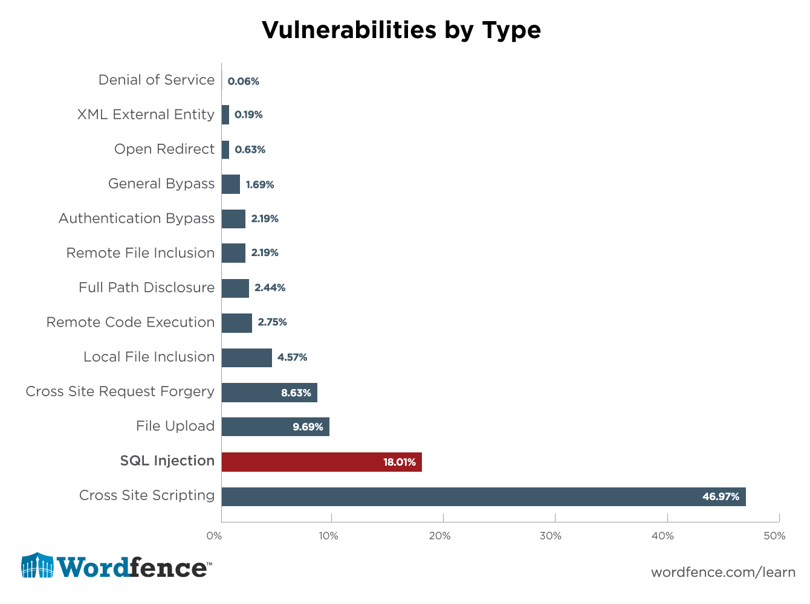
Why is this a big deal?
SQL injection is one of the most devastating attacks that can happen
It can put all private information out into the public
All personal info can be dumped in only a few lines of code
Some major attacks include
Equifax (145 Million People)
Wordpress plug-ins (Still on going in some Plugins)
Facebook (2016)

Slide 4
How does it work?
SQL Injection primarily occurs in web applications which use PHP or ASP
It works by sending the user inputted info into the web server which then queries the database
If user input is not properly sanitized it could lead to many issues

Slide 5
How to inject
To know if a web app is able to be injected a simple test can be run
For username enter any valid email address
For password enter a single quote
Lets try it out: https://trade-portal.codebashing.com/log_in

Slide 6
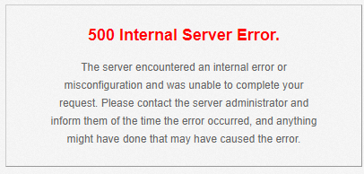
How to inject

Slide 7
Why does this happen
The query in the backend might look something like this:
select * from users where (email ='" + email +"' and password ='" + password + "');
So when we enter the values the query changes to this:
select * from users where (email ='" + test@test.com +"' and password ='" + ‘ + "');
This throws an error in the database and sends it back to the web application

Slide 8
Basic Injection
To gain access to an account we must get the database to return as valid
If we type in an incorrect username and password combination then database will return false
How do we transform the SQL code into a valid query?
select * from users where (email ='" + alice@bank.com +"' and password ='" + password + "');

Slide 9
Basic Injection
select * from users where (email ='" + alice@bank.com +"' and password ='" + password + "');
We can replace the password with a single quote and add our own query
select * from users where (email ='" + alice@bank.com +"' and password ='" + ’ OR 1 = 1) -- + "');
This query is valid all the time because 1 always equals 1

Slide 10
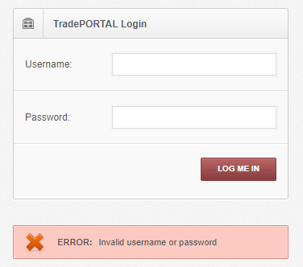
Basic Injection Example
Lets try it out: https://trade-portal.codebashing.com/log_in
It shouldn’t matter what we type for the username
Password should be ‘ OR 1=1)--

Slide 11
Basic Injection Example
This database is using Mysql instead of Oracle
Syntax differs between the two versions
Comment in MySQL is #
Try again with # instead of --

Slide 12
Other uses of SQL Injection
We can do many more operations
http://sqlzoo.net/hack/
' OR (SELECT COUNT(*) FROM users)>10 AND ''=‘
Checks to see if there are more than 10 users
' OR EXISTS(SELECT 1 FROM dual WHERE database() LIKE '%j%') AND ''=‘
Checks to see if there is a J in the name of the current database

Slide 13
Advanced SQL Injection
Other more advanced topics include
Union Operations
Hex Based Injection
If statement SQL Injections
Many others
http://pentestmonkey.net/cheat-sheet/sql-injection/oracle-sql-injection-cheat-sheet

Slide 14
How to prevent SQL Injection
ALWAYS clean user input
Use prepared statements wherever possible
Use escape characters wherever symbols are used
Store sensitive information as an encrypted values
Avoid concatenating user input in SQL statements
Use common sense and reasoning when saving personal Info
NEVER trust user inputs

Slide 15
Questions?

