Slide 1
British Airways Task 1
INSIGHTS ON CUSTOMER REVIEWS

Slide 2


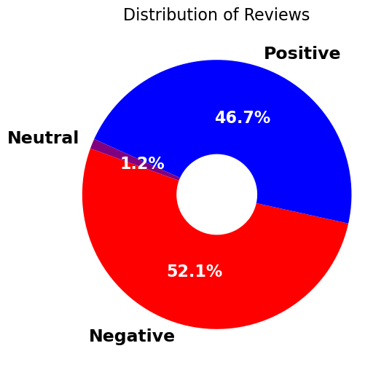
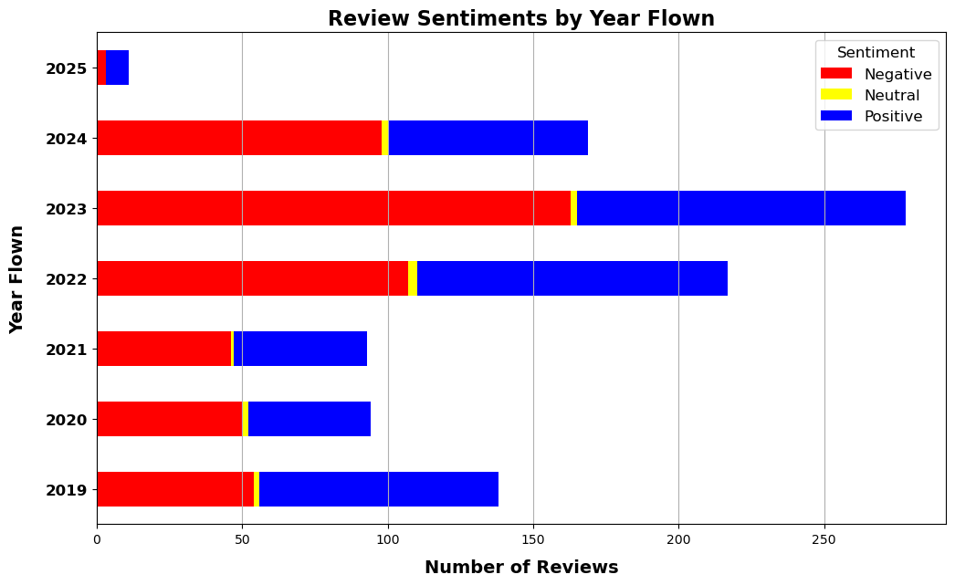

ANALYSIS ON REVIEWS
About 52% of the reviews are negative, and 688 people claimed that they wouldn’t recommend the airlines. Majority reviews came from the year 2023.
Further Steps:
Positive and Negative reviews can be further analyzed by:
segregating reviews by types of customers
And areas of dissatisfaction in inflight entertainment, cabin service etc.

