Slide 1
British Airways
Predicting Customer Bookings - Key Insights

Slide 2

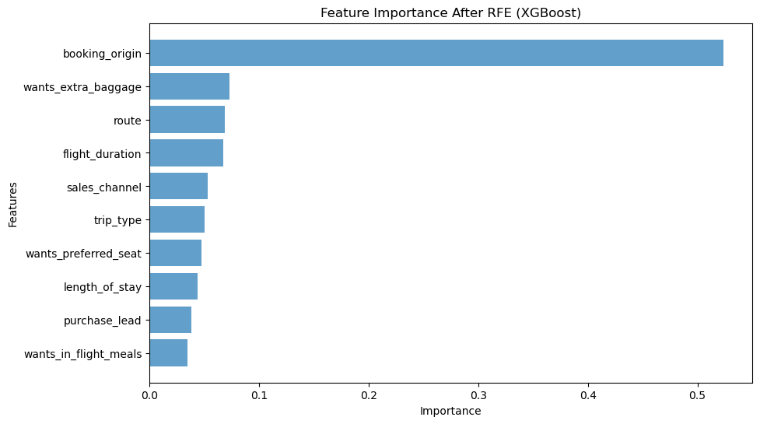
Project: To Predict Customer Bookings
Business Goal: Customer Acquisition
We cannot let interested users slip away→ High recall is important.
We correctly identified 72% of potential customers who booked a flight.
→ This is crucial because missing a potential customer means lost revenue.
72 % Recall
The booking_origin feature is by far the most predictive.
Possible reason: Certain regions or markets have stronger purchase intent than others.

