Slide 1
Wind Lease Areas And Offshore Resources

Slide 2
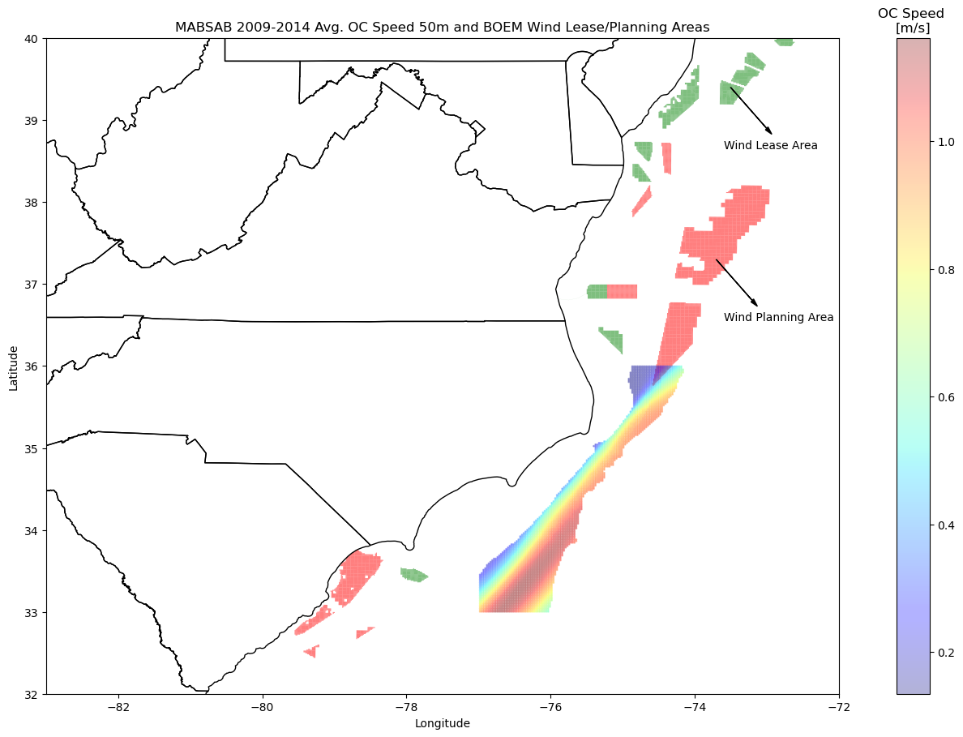

Slide 3
9M$
315M$

Slide 4
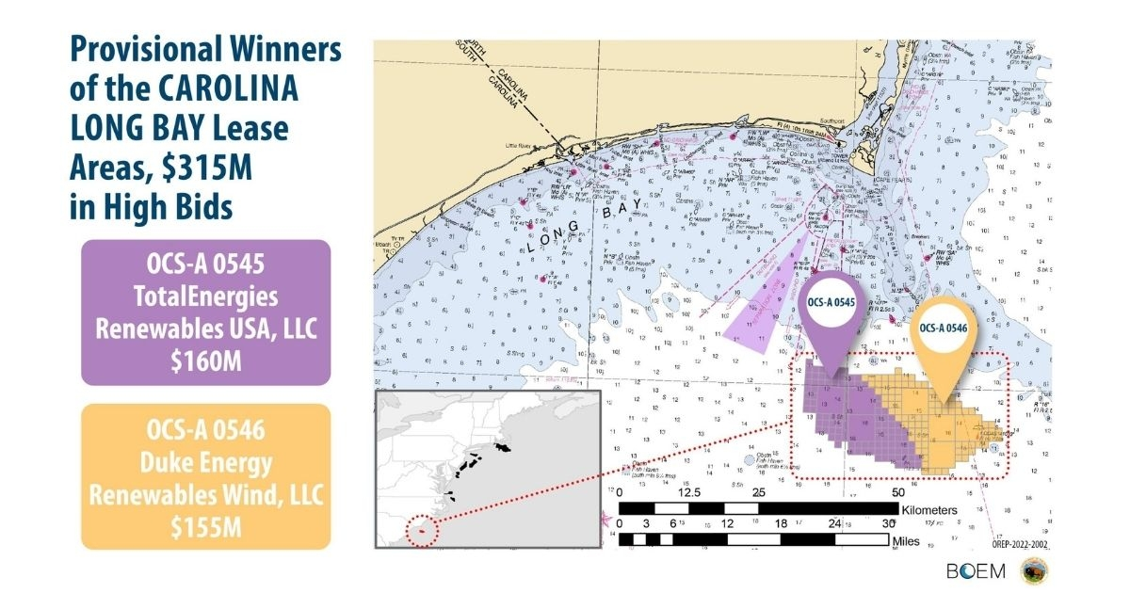

Slide 5
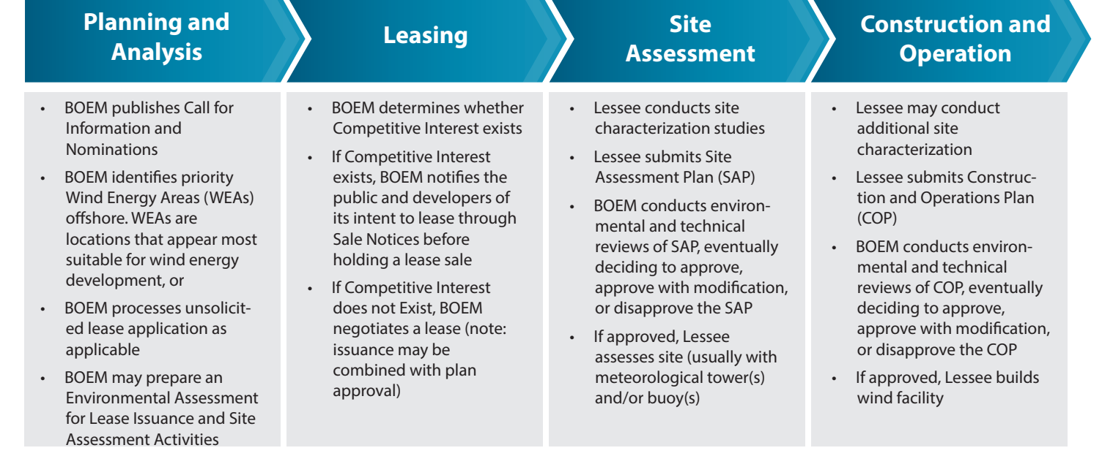
In 2009, Department of the Interior announced final regulations for the Outer Continental Shelf (OCS) Renewable Energy Program, which was authorized by the Energy Policy Act of 2005 (EPAct). DOI’s Bureau of Ocean Energy Management (BOEM) is responsible for implementing these regulations, which provide a framework for issuing leases, easements and rights-of-way for OCS activities that support production and transmission of renewable energy, including offshore wind, ocean wave energy, and ocean current energy.
BOEM Link
*A commercial lease gives the lessee the exclusive right to subsequently seek BOEM approval for the development of the leasehold. The lease does not grant the lessee the right to construct any facilities

