Slide 1

Spring-boot
Spring Boot Starter Guide for Novice By Warit Wirunkawat

Slide 2
Tools
Spring Tool
Sourcetree
MySQL (Database)
MySQL Workbence (RDBMS)
Postman
Java JDK 1.8

Slide 3
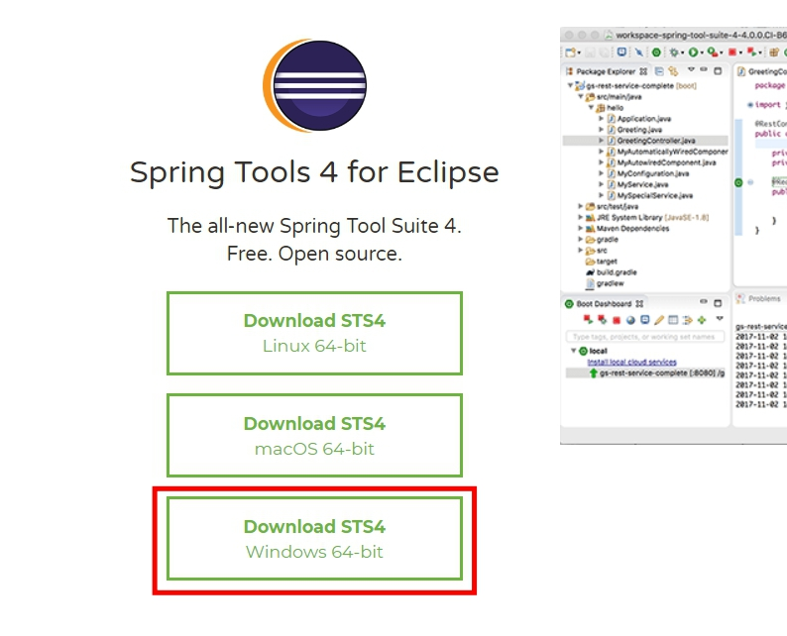
Spring Tool
Download : https://spring.io/tools
โหลดมาแล้ว Extract File และใช้งานได้เลย

Slide 4
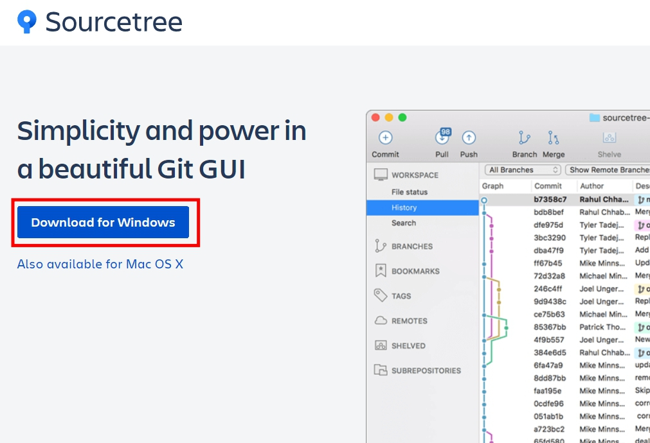
Sourcetree
Download : https://www.sourcetreeapp.com/

Slide 5
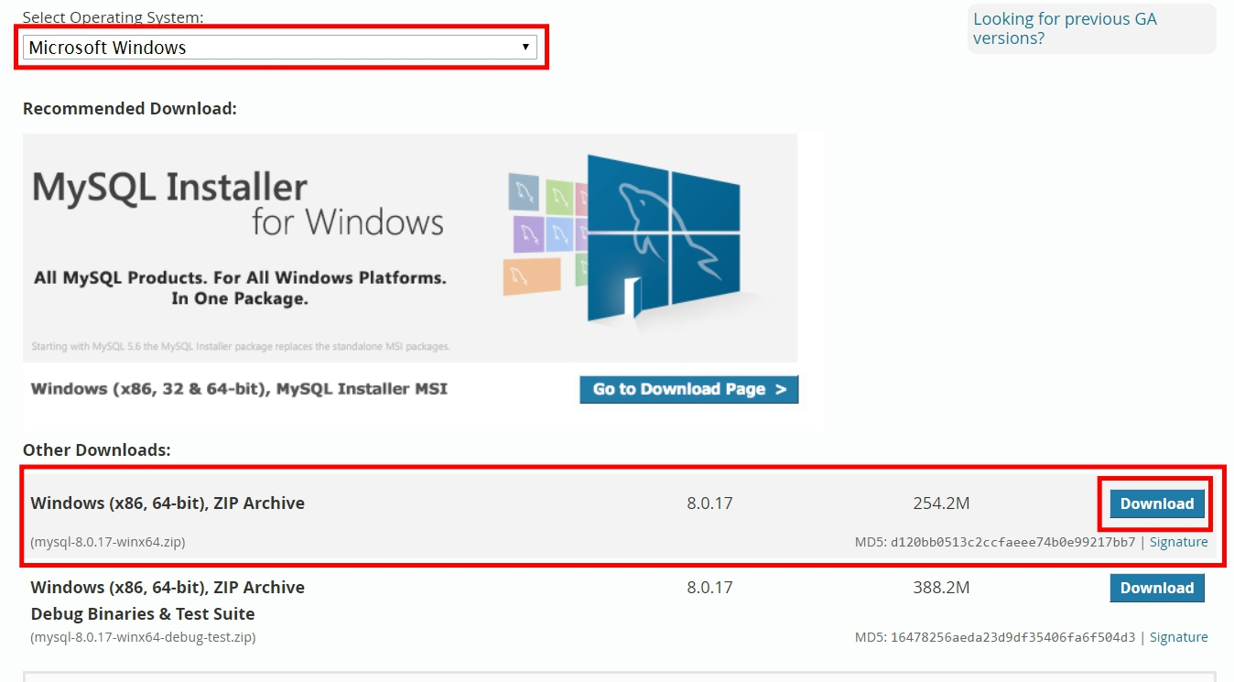
MySQL & Workbench
Download : https://dev.mysql.com/downloads/mysql/

Slide 6
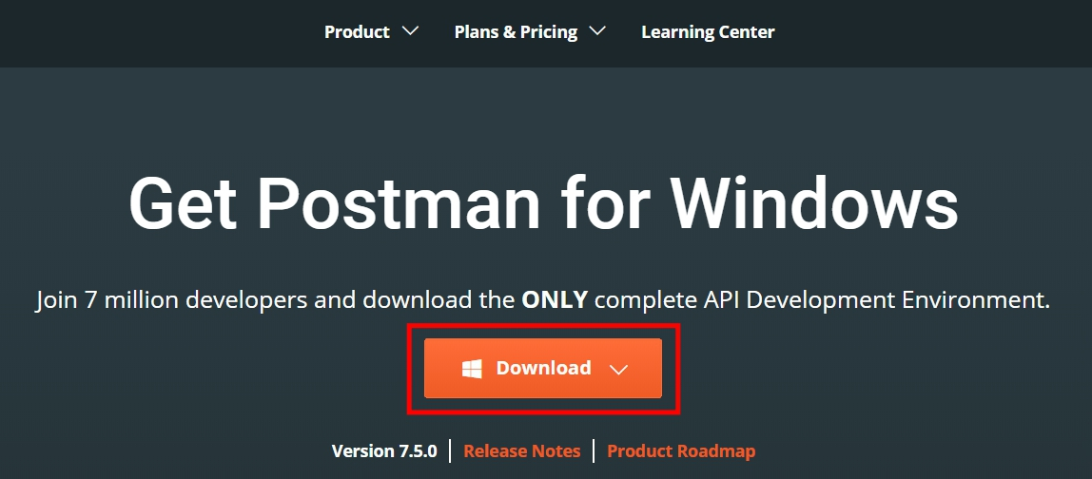
Postman
Download : https://www.getpostman.com/downloads/

Slide 7
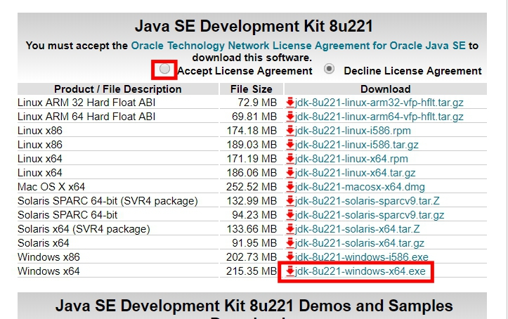
Java JDK 1.8
Download : https://www.oracle.com/technetwork/java/javase/downloads/jdk8-downloads-2133151.html
ติ๊ก Accept License Agreement
กด Download
ทำการ setting environment ตามลิงค์นี้ : https://www.mkyong.com/java/how-to-set-java_home-on-windows-10/

Slide 8
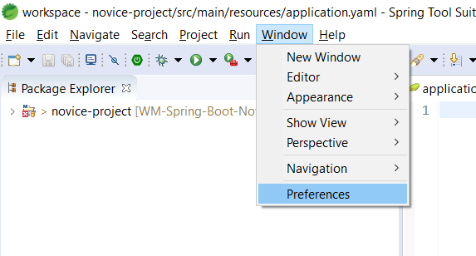
IDE Setting

Slide 9
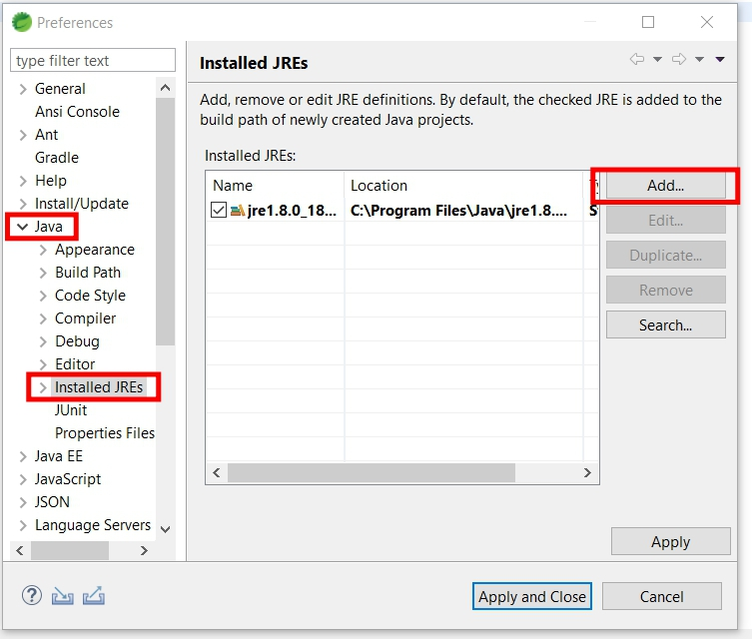
IDE Setting

Slide 10
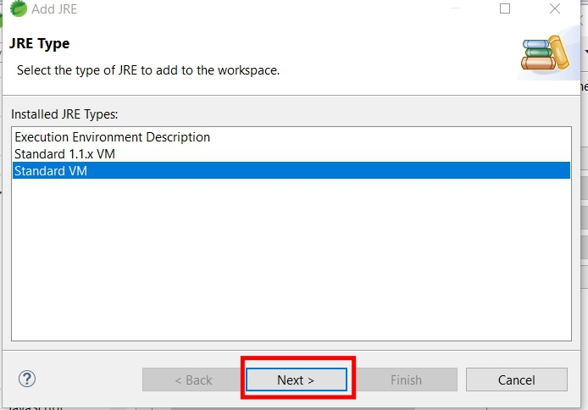
IDE Setting

Slide 11
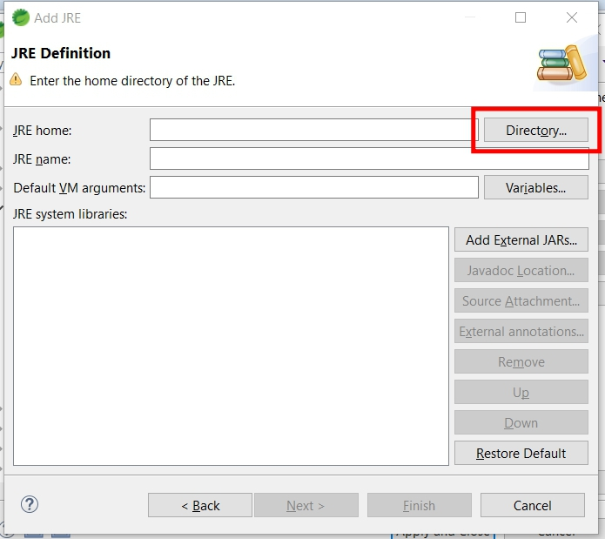
IDE Setting

Slide 12
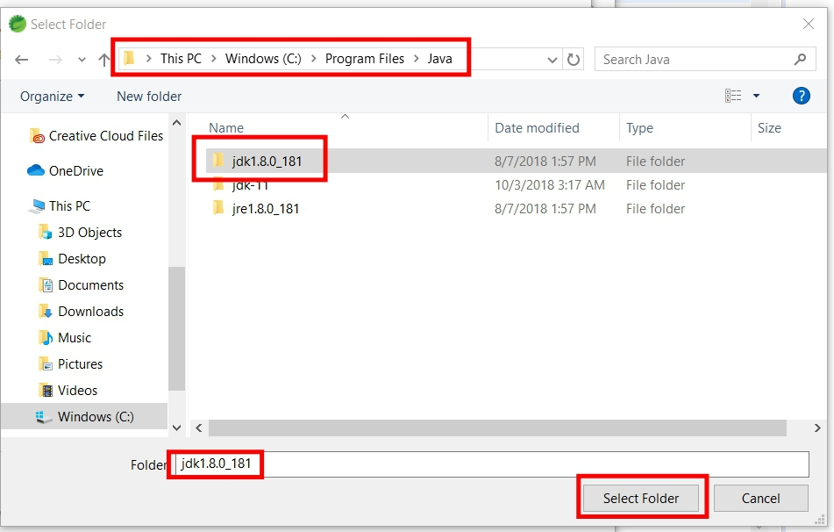
IDE Setting

Slide 13
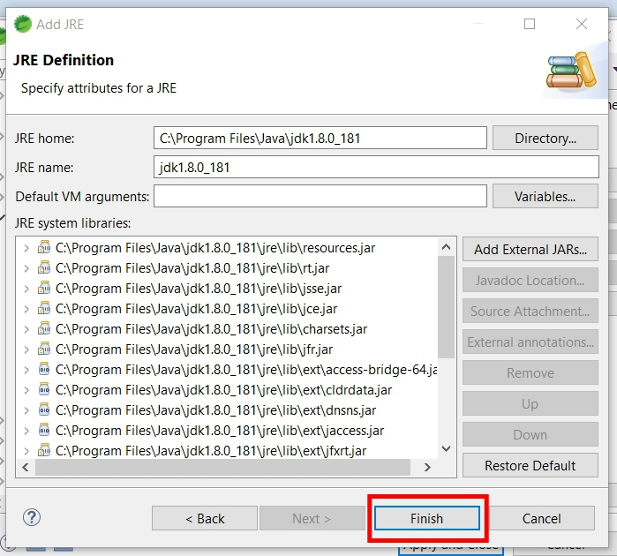
IDE Setting

Slide 14
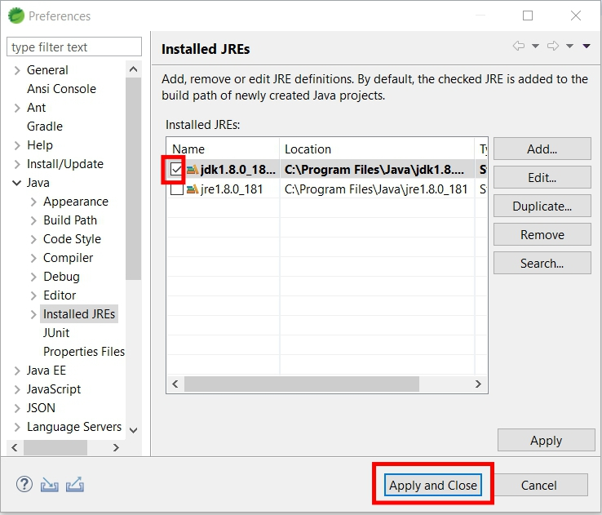
IDE Setting

Slide 15
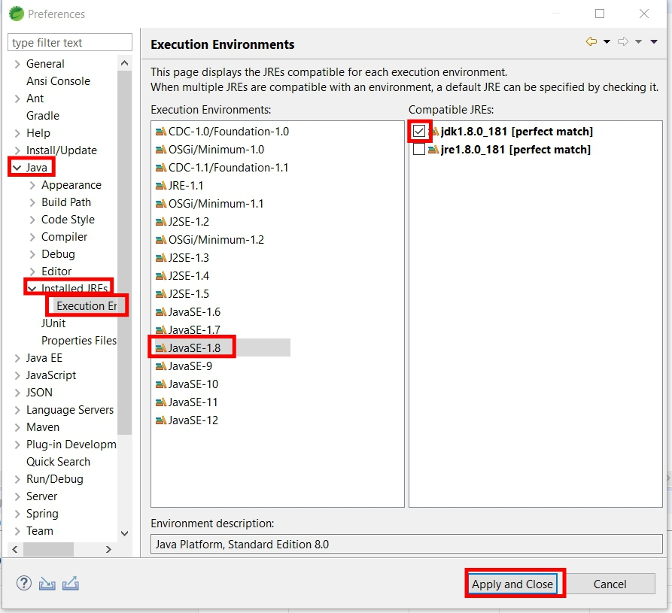
IDE Setting

Slide 16
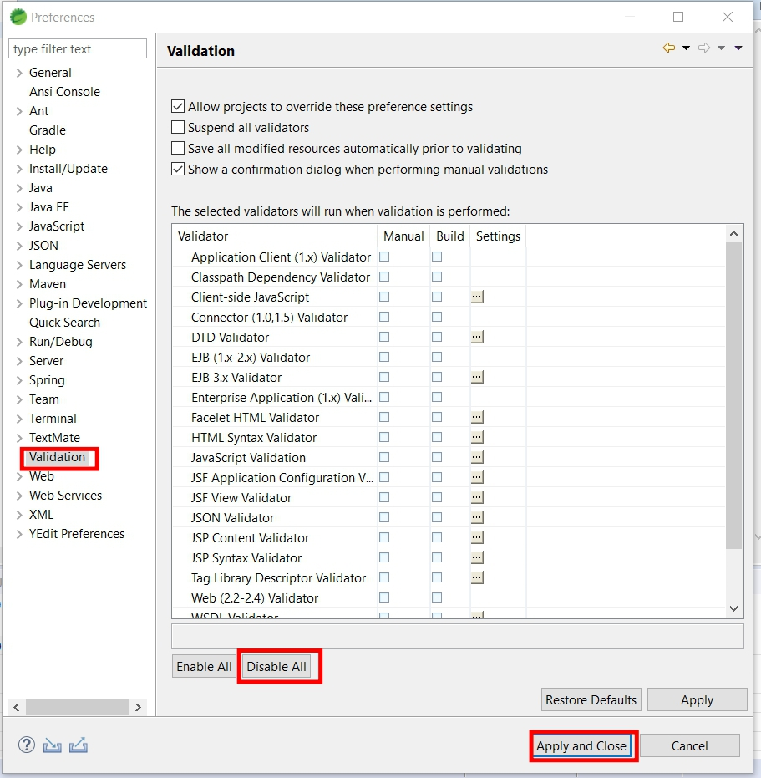
IDE Setting

