Slide 1
HEALTHCARE AI MODULE · LECTURE 1
Honest probabilities in
clinical prediction
AI & Uncertainty School and Workshop 2026
Mauritius, 16-20 November
Alireza Vafaei Sadr
Penn State College of Medicine · github.com/vafaei-ar/ai-uncertainty-2026-healthcare
Notes:
Open by asking the room: your model says 0.30 for this patient - what does that mean? You will get ranking answers and frequency answers. That split is the whole lecture.

Slide 2
A deployed model does not output a ranking.
It outputs a number a tired registrar at 3am
will read as a probability, and act on.
This session is about whether that number deserves to be read that way.
Notes:
Let the question sit for a moment before moving on. Do not answer it yet.

Slide 3
WHERE WE ARE GOING
Six ideas, one hour and a half
1
A point estimate is not an answer
4
A synthetic EHR you can break
Posteriors, intervals, and what evidence actually buys you
Every failure mode is a named argument
2
Discrimination versus calibration
5
The model meets a second hospital
Only one of them survives a change of hospital
And which monitoring check notices
3
Epistemic versus aleatoric
6
The information in a blank cell
The distinction decides what you do next
Missingness is a recorded clinical decision
Notes:
Everything runs on a free Colab CPU. Synthetic data, so no credentialing, and any result can be re-drawn with a new seed.

Slide 4
A point estimate is not an answer
1
A new sepsis alert has fired 10 times. 8 of those led to an intervention the team judged appropriate. Is the alert useful?

Slide 5
TEN ALERTS, EIGHT OF THEM USEFUL
Three honest ways to report the same evidence
0.80
0.71
0.46 - 0.91
Point estimate
what gets reported
Posterior mean
under a Beta(2,2) prior
95% credible interval
what you actually know
The point estimate says 0.80. The interval says the true rate is somewhere between roughly one in two and nine in ten. Those two statements support very different decisions, and only one of them is honest about ten observations.
Notes:
Worth saying out loud: the prior did real work. Beta(2,2) plus 10 observations gives a posterior mean of 0.71, not 0.80. Ask whether that shrinkage is a bug - it is the same mechanism that saves the small hospital in Lecture 2.

Slide 6
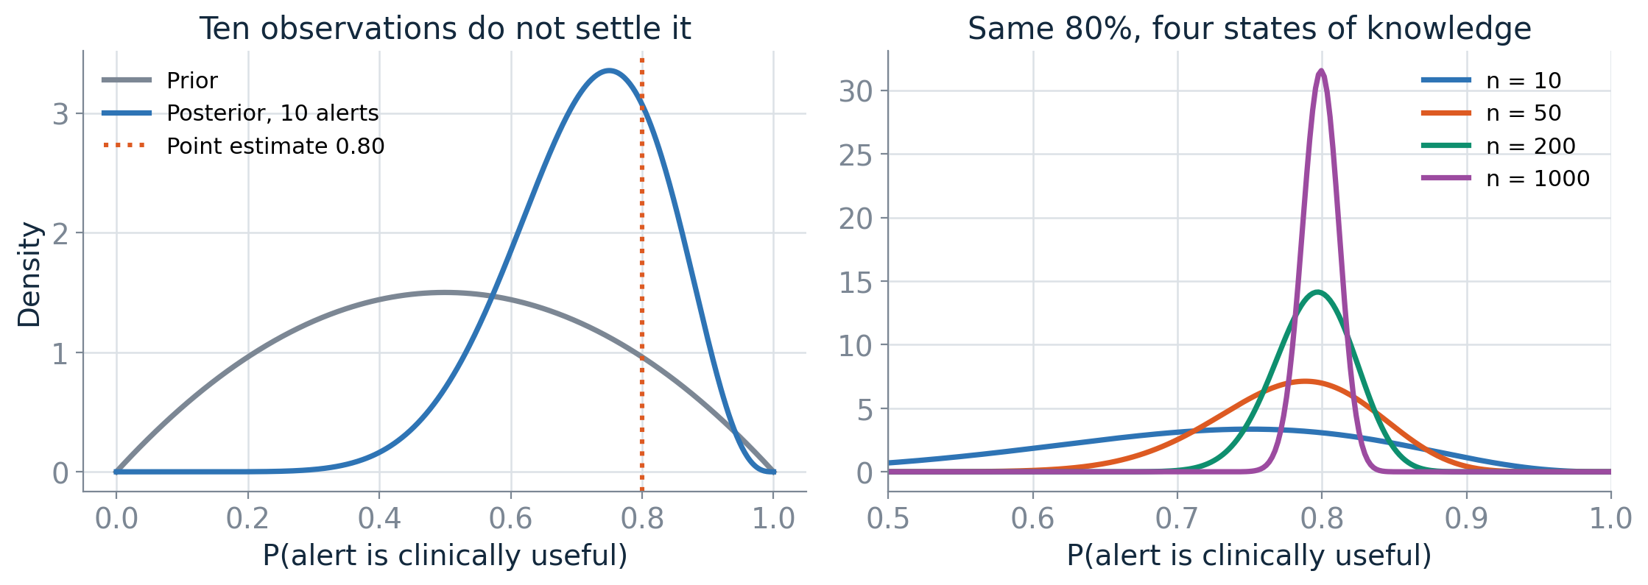
BAYESIAN UPDATING
Evidence narrows belief, it does not settle it
The 95% interval width falls from 0.45 at n = 10 to 0.05 at n = 1000 - roughly as 1 over the square root of n. This is epistemic uncertainty: a statement about what you do not yet know, and data removes it.
Notes:
Hold on to that shape. In section 3 we meet the kind of uncertainty that does not go away.

Slide 7
Discrimination is not calibration
2
One asks about order. The other asks about meaning. Deployment breaks meaning first.

Slide 8
TWO DIFFERENT QUESTIONS
What each metric is actually asking
AUROC asks about order
Calibration asks about meaning
Given a patient who deteriorated and one who did not, how often does the model score the first one higher?
Invariant to prevalence.
Invariant to any monotone rescaling.
Those are exactly the two things that change when you move a model to a new hospital.
Among the patients you assigned a risk of 0.3, did about 30% actually deteriorate?
Measured by Brier score, log loss, expected calibration error, and the reliability curve.
This is the property a threshold, a bed allocation and a clinical conversation all depend on.
The metric most often reported is the metric most blind to the most common deployment failure.

Slide 9
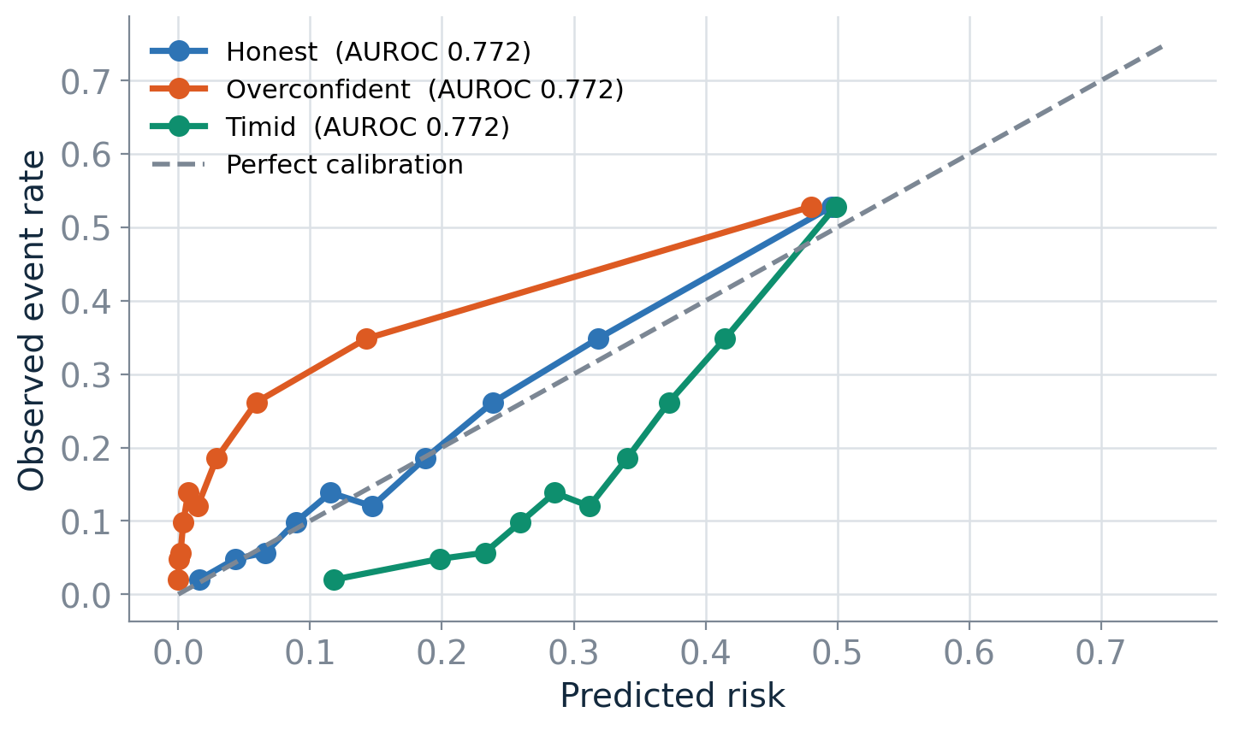
THREE MONOTONE TRANSFORMATIONS OF ONE SCORE
Same ranking. Same AUROC to four decimals.
The overconfident model promises a risk far above what the ward delivers, so a fixed threshold floods the ICU. The timid model does the opposite and lets patients through. AUROC cannot tell them apart; Brier, log loss and ECE separate them immediately.
Notes:
Exercise in the notebook: recover the temperature that broke the overconfident model. It lands near 2.4 because that is how the damage was generated - recalibration works when you have correctly guessed the shape of the damage.

Slide 10
Epistemic and aleatoric uncertainty
3
Two reasons a prediction can be uncertain, and only one of them is a modelling problem.

Slide 11
THE DISTINCTION IS NOT ACADEMIC
It determines what you should do next
Epistemic
Aleatoric
You are unsure about the model, because you have seen few patients like this one.
Shrinks as you collect more of the same kind of data.
Response: collect more records. Or refuse to answer for patients outside the region you have covered.
The outcome is genuinely stochastic given everything you recorded. Two identical charts, different outcomes.
Does not shrink with more of the same data.
Response: measure something new. No amount of extra rows on the same columns will help.
Collapse them into one number and you lose the ability to say which response is the right one.

Slide 12
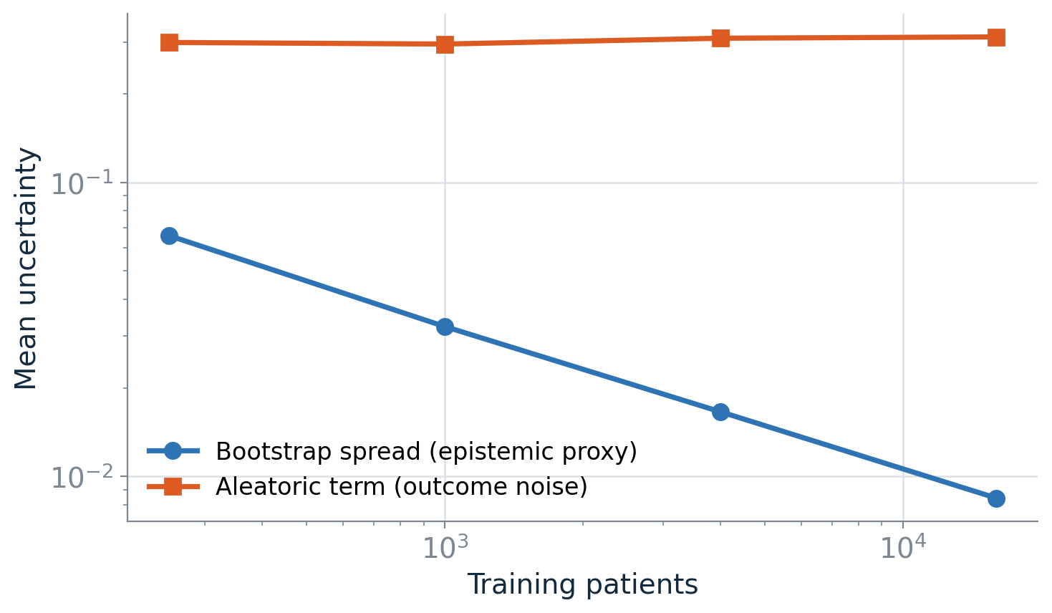
BOOTSTRAP ENSEMBLE OVER FOUR TRAINING SIZES
More data removes one of these, not the other
Bootstrap spread - our proxy for epistemic uncertainty - falls steadily from 250 to 16,000 training patients. The aleatoric term barely moves; it is a property of the cohort, not of your sample size.

Slide 13
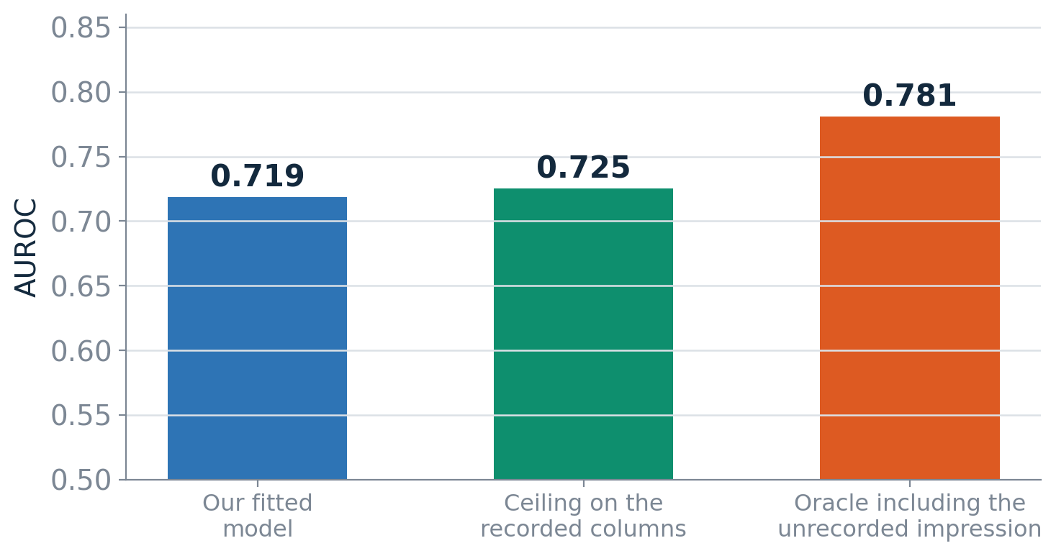
THE ALEATORIC FLOOR, MADE VISIBLE
The gap to a perfect model was never in your columns
1
An unrecorded impression
The simulator holds a clinical-concern variable that moves the outcome and appears in no column - exactly like the thing the nurse noticed at the bedside.
2
Our model is at the ceiling
0.719 fitted against a 0.725 ceiling on the recorded features. There is almost nothing left to extract from these columns.
3
Not a deeper network
Moving the ceiling means recording something new. When a reviewer asks why AUROC is not 0.90, that is a claim about the data, not an apology.
Notes:
If the room only takes one thing from Lecture 1, make it this: know your aleatoric floor before you promise anyone an improvement.

Slide 14
A synthetic EHR you can break on purpose
4
Vitals, labs, comorbidities and a 48-hour deterioration outcome. Every failure mode is a named argument.

Slide 15
THE SIMULATOR'S FAILURE-MODE KNOBS
Turn one on, watch what it does, turn it off
Argument | What it represents in a hospital
prevalence_shift | Baseline risk differs between hospitals
measurement_noise | Instruments and assays drift
missingness_strength | Labs get ordered for a reason
label_noise | Chart review is imperfect
subgroup_shift | A subgroup carries different baseline risk
subgroup_interaction | ...or a different risk relationship entirely
ood_fraction | Patients unlike anything in development
Each of the six becomes one team's hidden problem in the project block this afternoon.

Slide 16
THE ROW THAT GETS REPORTED IN A PAPER
A respectable internal validation - with an interval on it
0.727
0.699 - 0.754
0.056
Validation AUROC
the number that gets published
95% bootstrap interval
on 2400 patients
Interval width
wider than most claimed gains
Two models whose AUROCs differ by 0.01, or by 0.02, are indistinguishable on this much data. A large share of reported improvements in the clinical ML literature are narrower than this interval, and are reported without one.
Notes:
Ask how many papers they have read that report a 0.01 AUROC gain as an improvement, and how many reported an interval.

Slide 17
The model meets a second hospital
5
Site B has a sicker intake. Site C runs older analysers. Nothing about the model changes.

Slide 18
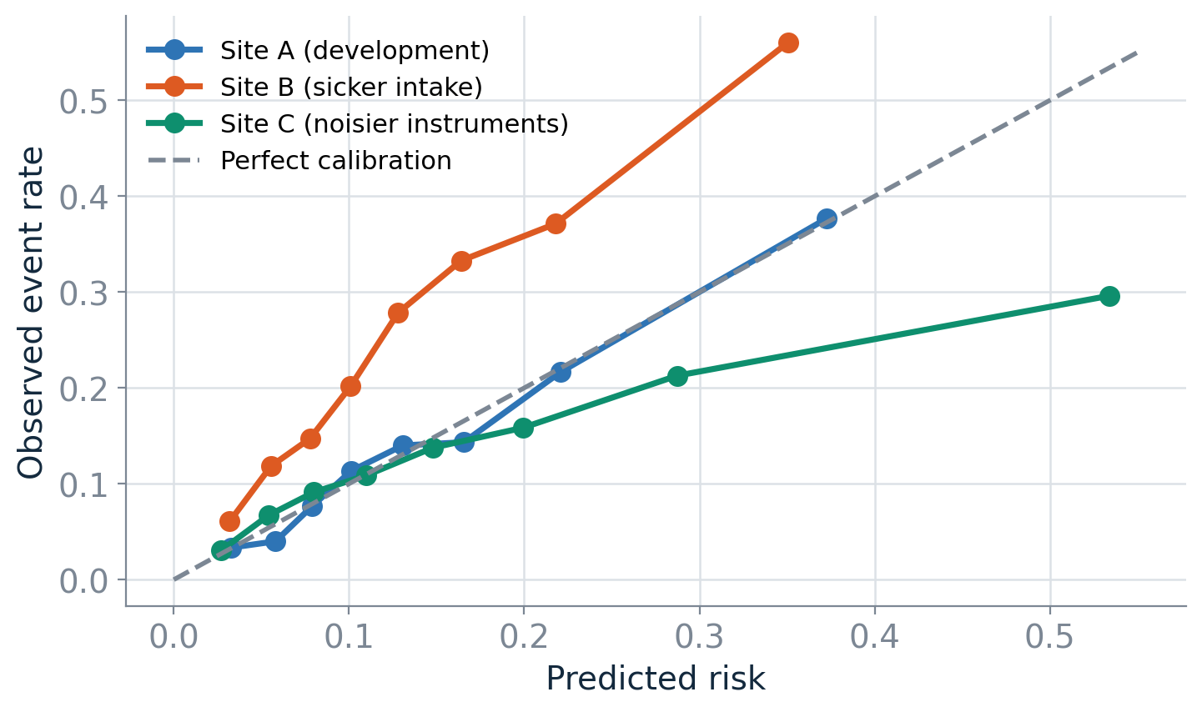
SAME MODEL, THREE HOSPITALS
Ranking transfers. The numbers do not.
At site B, AUROC holds up and the model understates risk by roughly a factor of two across the whole range. Leave the alert threshold at 0.5 and the model essentially stops firing on a ward where a quarter of patients deteriorate.

Slide 19
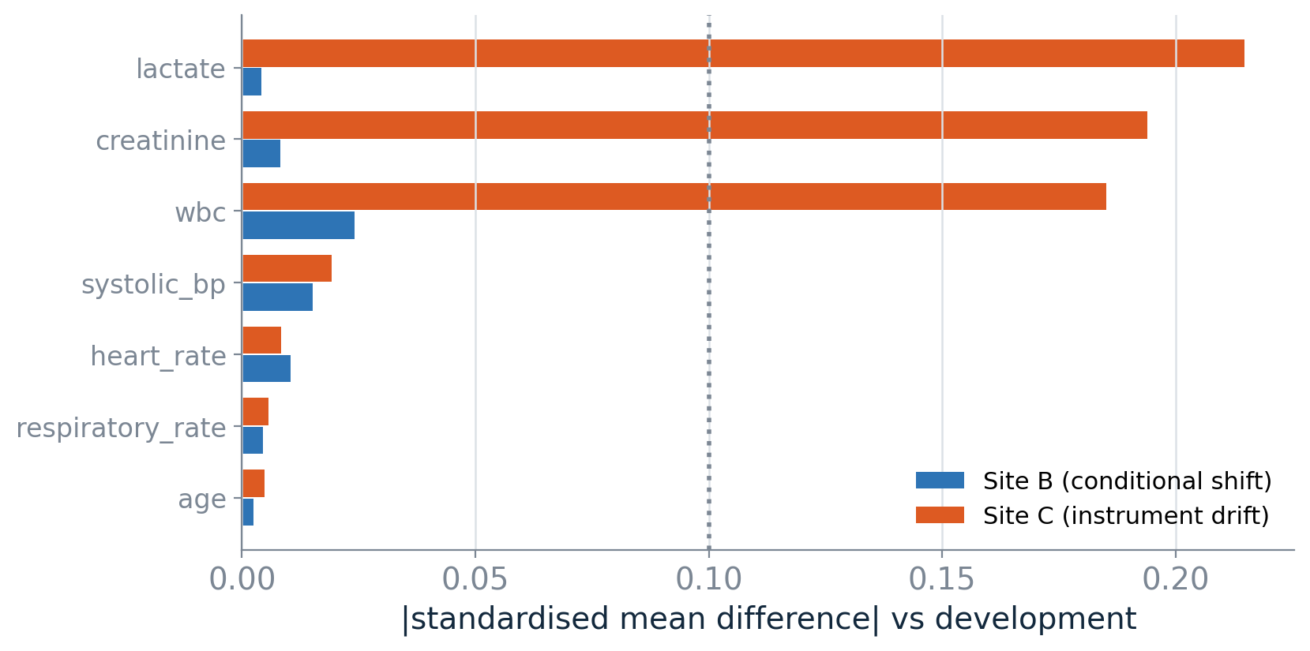
COULD YOU HAVE SEEN IT COMING, WITHOUT WAITING FOR OUTCOMES?
Covariate monitoring sees one of these two failures
1
Site C is a covariate shift
Large standardised mean differences on lactate, creatinine and WBC. A drift alarm fires on day one, with no outcome labels needed.
2
Site B is a conditional shift
Every standardised mean difference is under 0.03. The inputs are unchanged; the risk they carry moved. Not label shift - that assumes a stable P(X given Y), which fails here.
3
So the gap is structural
Input monitoring watches the inputs. It cannot license a claim about the risk attached to them, however green the dashboard looks.

Slide 20
The absence of observed input drift is not
evidence that the model is still valid.
Input monitoring never had access to the thing that moved at site B, so it cannot establish that the conditional risk has held. Confirming that takes outcome data, or a surrogate you have validated against outcomes. Most deployed monitoring is an input-drift dashboard, which makes a green dashboard a much weaker statement than the people reading it believe.
Notes:
If time is short, this is the slide to protect. It is the one finding in the lecture that changes what people build on Monday.

Slide 21
The information in a blank cell
6
A lab is missing because nobody ordered it, and nobody ordered it because nobody was worried.

Slide 22
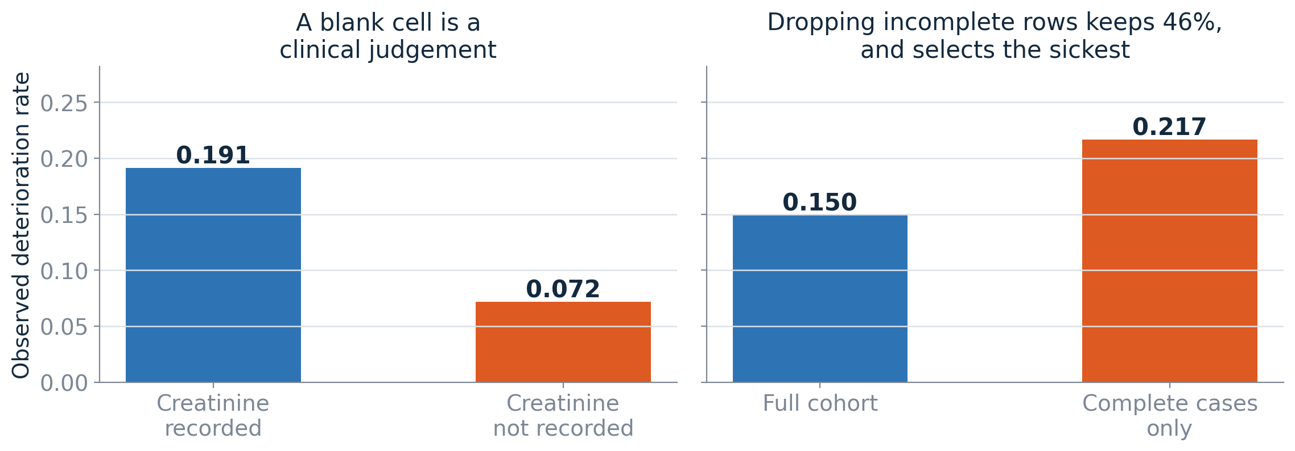
MISSING NOT AT RANDOM
Two standard responses, both wrong
Patients whose creatinine was never sent deteriorate at well under half the rate of those whose was. Drop the incomplete rows and you keep 46% of the ward - silently selected toward the sickest, with an event rate of 0.217 against 0.150 overall.
Notes:
In the notebook exercise, adding explicit missingness indicators recovers most of what median imputation destroys. Caution to carry forward: the indicator encodes local ordering practice, so it is a useful feature and a fragile one at the same time.

Slide 23
LECTURE 1
What to take away
1
Report a distribution, or an interval
4
Know your aleatoric floor
A point estimate on ten observations is not a finding
Some of the gap was never in your columns
2
AUROC measures order, not meaning
5
A green input dashboard proves little
Deployment breaks meaning first
It cannot license a claim about conditional risk
3
Separate the two uncertainties
6
Missingness is a recorded decision
They call for different responses
Model it. Never drop the rows.

Slide 24
In Lecture 2: what you do about all this.
Repairing calibration at a new site and what it costs in labelled patients. Using ensemble disagreement to decide when a model should refuse to answer. Choosing an operating threshold from clinical costs rather than from 0.5. Borrowing strength across hospitals with hierarchical models. Then the project: six teams, one task, six different reasons not to deploy.

