Slide 1
HEALTHCARE AI MODULE · LECTURE 2
Deciding under
uncertainty
AI & Uncertainty School and Workshop 2026
Mauritius, 16-20 November
Alireza Vafaei Sadr
Penn State College of Medicine · github.com/vafaei-ar/ai-uncertainty-2026-healthcare

Slide 2
WHERE LECTURE 1 LEFT OFF
A good model, offered to a new hospital
0.26
0.15
0.71
Observed event rate
on the new ward
Mean predicted risk
the model's claim
AUROC
barely moved
The ranking transferred. The numbers did not. The model tells site B that 15% of their ward is at risk while 26% of it deteriorates. This lecture is about what you do next.

Slide 3
WHERE WE ARE GOING
From a broken number to a defensible decision
1
Repairing calibration
4
Thresholds from clinical costs
And what it costs in labelled patients from the new site
Not from 0.5, and usually far lower than expected
2
Ensembles as an epistemic signal
5
Subgroup reliability
The one check you can run with no outcome data
Why the aggregate number lies
3
Letting the model abstain
6
Hierarchy and simulators
Risk-coverage curves and who gets deferred
Borrowing strength, and posteriors without a likelihood

Slide 4
Recalibration, and what it costs
1
Every repair needs labelled patients from the new site. That is the real cost of deployment, and it is usually left out of the project plan.

Slide 5
THREE REPAIRS, INCREASING FLEXIBILITY
Match the fix to the labels you can actually get
Method | What it fits | Params | When it is the right choice
Intercept correction | A shift on the logit scale | 1 | Prevalence changed, the risk ordering did not
Platt scaling | Slope and intercept on the logit scale | 2 | Ordering is right but the spread is wrong too
Isotonic regression | Any monotone map | many | Plenty of labels and a distortion of unknown shape
None of the three reorders anyone, so AUROC is untouched by all of them. What they repair is the meaning of the numbers.

Slide 6
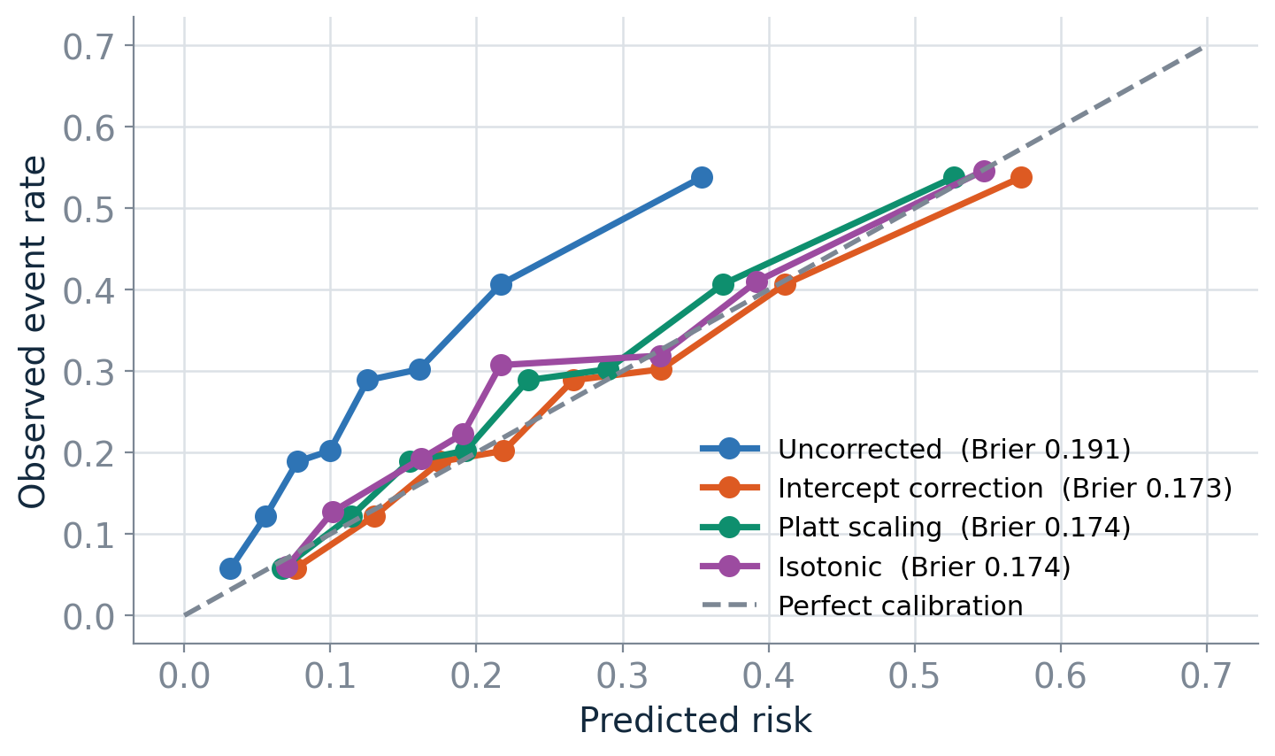
SITE B, RECALIBRATED ON 2400 LABELLED PATIENTS
One parameter fixes most of it
A single intercept recovers most of the gain, because a single intercept is exactly the damage that was done. Brier, log loss and ECE improve sharply; AUROC does not move at all.

Slide 7
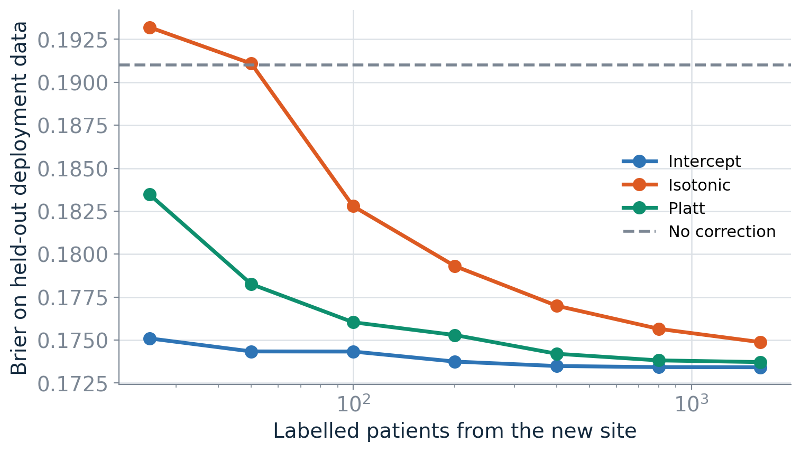
HOW MANY CHARTS DOES A FIX ACTUALLY NEED?
Flexibility you cannot afford makes things worse
1
One parameter, 100 charts
The intercept correction is close to its ceiling at around 100 labelled patients from the new site.
2
Isotonic needs 10x more
Below a few hundred labels it is worse than doing nothing at all - it spends its flexibility fitting noise.
3
So plan the label budget
A one-parameter fix on 100 charts beats a non-parametric fix on the same 100 charts, every time.
Notes:
Ask what happens if the model is recalibrated on the first 100 patients of a seasonal wave. The correction inherits whatever period it was estimated in - recalibration is a maintenance commitment, not a one-off task.

Slide 8
Ensembles as an epistemic signal
2
Refit on bootstrap resamples. Where the models agree, the data pinned the answer down. Where they disagree, the prediction is an extrapolation.

Slide 9
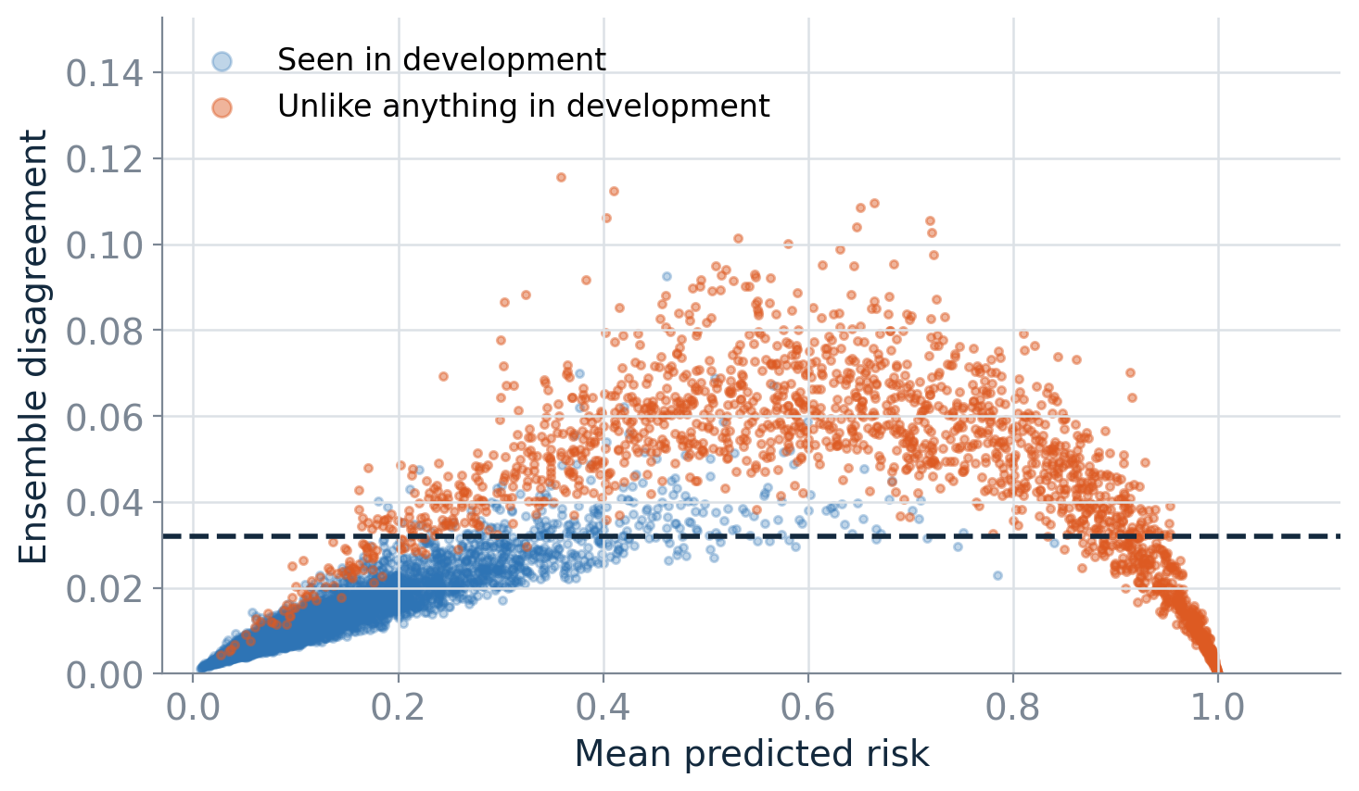
A WARD WHERE 30% OF PATIENTS ARE UNLIKE ANYTHING IN DEVELOPMENT
Disagreement finds patients the model was never trained for
The threshold is the 95th percentile of disagreement measured on the development data alone - so it can be set before the model goes live.

Slide 10
A GATE SET ON DEVELOPMENT DATA, APPLIED TO A NEW WARD
The check you can run on day one
25%
87%
73%
0
of the new ward
flagged by the gate
of those flagged
are genuinely out-of-distribution
of the truly unfamiliar
patients are caught
outcome labels
required from the new site
That last number is why this is worth more than it costs. Every other diagnostic in this lecture waits on outcomes; this one does not.

Slide 11
Bootstrap disagreement measures sensitivity to the training sample, not distance from the training distribution.
A patient far outside the data can still receive confident, wrong, unanimous predictions if the model form extrapolates smoothly. Treat this as a screen, not a guarantee. Deep ensembles, MC dropout and conformal prediction differ in machinery and play the same logical role - conformal is worth naming, because its coverage guarantee assumes exchangeability, and exchangeability is exactly what site B broke.

Slide 12
Letting the model abstain
3
A deployed model does not have to answer every question. Rank by uncertainty, hand the worst back to a clinician, and measure what remains.

Slide 13
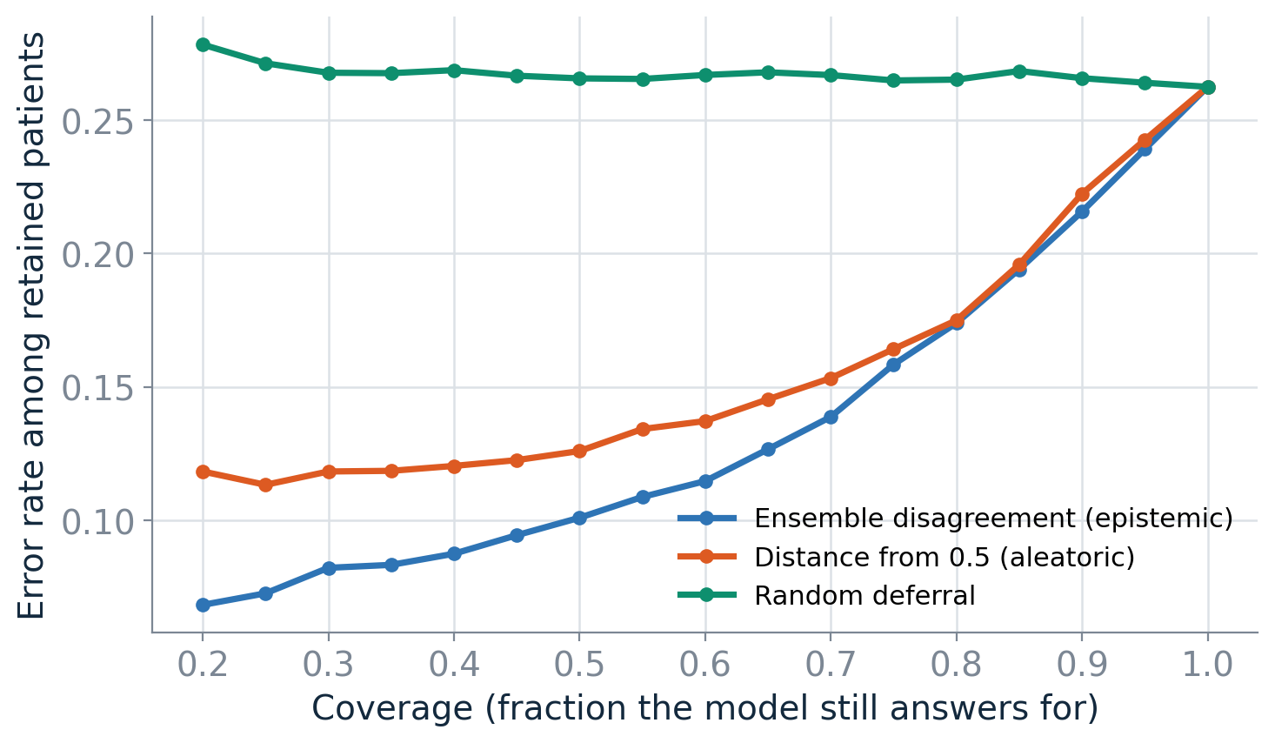
RISK-COVERAGE ON THE UNFAMILIAR WARD
Does the model know what it does not know?
Random deferral is the null: it shrinks the cohort and improves nothing, so its curve is flat. Any ranking worth using must beat it.

Slide 14
TWO SIGNALS, TWO DIFFERENT JOBS
They defer different patients, and that is the point
Aleatoric: distance from 0.5
Epistemic: ensemble disagreement
Defers genuinely borderline patients.
Mechanically reduces classification error, so it usually looks strongest on a risk-coverage plot.
Use it to triage the borderline cases into human review.
Defers patients the model was never equipped to judge.
Improves the error rate less, and protects you from confidently harming someone.
Use it as a hard gate on patients outside the model's competence.
Do not collapse them into one score. Report both, and use them for different things.
Notes:
Notebook exercise: a service that can review 20% of admissions by hand builds a two-stage rule - epistemic gate first, then spend whatever budget remains on the most borderline of the rest.

Slide 15
The threshold is a clinical decision
4
predict >= 0.5 encodes the assumption that a missed deterioration and an unnecessary escalation cost the same. No clinician believes that.

Slide 16
IF A MISSED EVENT IS R TIMES AS COSTLY AS A FALSE ALARM, THE OPTIMAL THRESHOLD IS 1 / (1 + R)
Where the operating point actually sits
Cost ratio R | Threshold | Alert rate, uncorrected | Alert rate, recalibrated
2 : 1 | 0.333 | 6% | 30%
5 : 1 | 0.167 | 29% | 71%
10 : 1 | 0.091 | 61% | 91%
20 : 1 | 0.048 | 86% | 99%
The useful range is nowhere near 0.5. Reporting accuracy at 0.5 describes a decision nobody would make - and the uncorrected model under-alerts worst exactly where the clinical value lives.

Slide 17
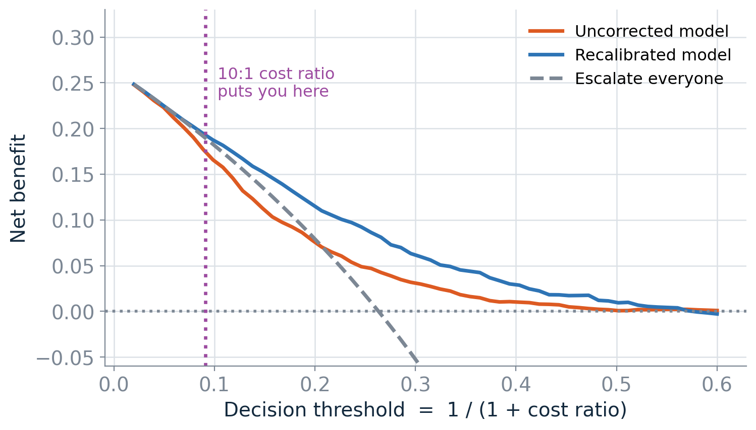
DECISION CURVE ANALYSIS
Is the model better than what we would do without it?
At a 10:1 cost ratio the recalibrated model earns a net benefit of about 0.19 against roughly 0.19 for escalating the entire ward. On a ward with a 26% event rate, at that cost ratio, the model is not adding much over a blanket policy.
Notes:
Where does R come from? Not from the data - from the service. ICU bed availability, staffing, what the escalation actually involves. Getting a clinician to state R is often the most valuable hour of a deployment project, and the number is rarely what the modelling team assumed.

Slide 18
The aggregate number lies
5
A model can be well calibrated overall and badly calibrated for every subgroup in it, because the subgroup errors cancel.

Slide 19
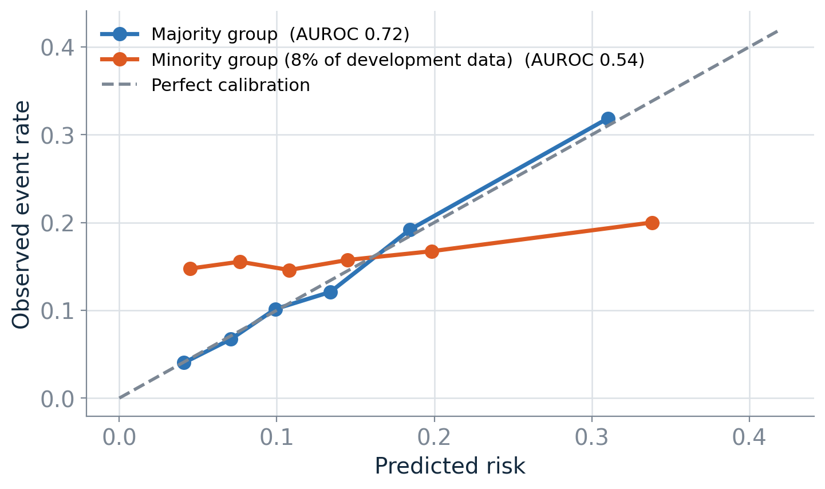
A SUBGROUP THAT WAS 8% OF DEVELOPMENT DATA AND IS 39% OF THIS WARD
One ward, two very different models
1
A coin flip for 39% of the ward
AUROC 0.72 for the majority group, 0.54 for the minority - and their risk is understated throughout.
2
A shift report finds nothing
The covariate distributions are fine. What differs is the conditional relationship between labs and outcome.
3
A sample-size problem
657 training patients could never have identified that interaction. This is the case for the next section.
Notes:
Always report stratified: by every categorical column, by age band, and by whether key labs were recorded. If a stratum is too small to evaluate, that is itself the finding.

Slide 20
Hierarchy, and simulators
6
Four hospitals report deterioration rates. One of them saw four patients and one event.

Slide 21
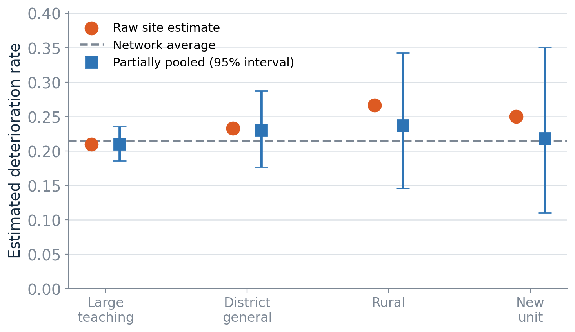
PARTIAL POOLING ACROSS FOUR HOSPITALS
How far each site is pulled is estimated, not chosen
The large teaching hospital is barely moved; the new unit almost entirely. That is what separates hierarchical modelling from fitting each site alone (the new unit gets a 25% rate) or one model for all sites (site differences vanish).
Notes:
This is the principled answer to the subgroup problem: give the small group its own parameters, and let the data decide how far to shrink them.

Slide 22
WHEN THE MODEL IS A SIMULATOR
A posterior over parameters that mean something
Rejection sampling (ABC)
Neural posterior estimation
Simulate from the prior, keep the runs whose summaries resemble what you observed.
12,000 simulations to keep 240. The acceptance rate collapses as soon as the parameter has more than one or two dimensions.
Train a density estimator on the simulations, so every one of them contributes.
Amortised: once trained, the posterior for a new observation comes out without rerunning the simulator.
Why a clinical audience should care: a progression rate or an effect size is something a clinician can argue with.
Notes:
Notebook 04 does this with the sbi package and includes a coverage check - the neural posterior is sharper but slightly over-confident, which ties straight back to the calibration theme of Lecture 1.

Slide 23
LECTURE 2
What to take away
1
Recalibrate, and budget the labels
4
The threshold comes from the costs
Match the flexibility of the fix to what you can collect
And is usually far below 0.5
2
Ensemble spread needs no outcomes
5
Report everything stratified
The check you can run on day one
A stratum too small to evaluate is itself a finding
3
Keep the two uncertainties apart
6
Let the data decide the pooling
They belong in different parts of an abstention rule
Small sites and small subgroups borrow strength

Slide 24
Your project
7
Six teams. One task. Six different reasons the model should not be trusted.

Slide 25
The task is not to raise AUROC.
Each team gets development data and six months of shadow-mode records from one hospital - the model scored every admission, nobody acted on the scores. Identical columns, identical task. Work out what is wrong, who it is wrong for, when the model should refuse to answer, and whether you would switch it on. Five minutes, three or four slides.
Read project/PROJECT_BRIEF.md and start from notebooks/90_team_project_starter.ipynb.

