Slide 1
Viet Anh Phan
Social Engineering

Slide 2
Social Engineering: Content
Content:
What is social engineering?
Types of social engineering
Countermeasures

Slide 3

Social Engineering: Basics to Succeed
What is social engineering?
The attempt to control social behavior with the use of sensitive methods – psychological manipulation.
The 3 Critical Success Factors:
trust
satisfaction
relationship

Slide 4

Social Engineering: Types
Types of Social Engineering Techniques:
Baiting
Phishing
Smishing
Vishing
Scareware
…

Slide 5
Baiting
The attacker lures the victim with attractive offers or rewards.
Malvertising (scam)
Physical baiting (leaving USB or QR code)

Slide 6
Phishing
The attacker baits to catch a fish
Malicious link
Phishing website
Whaling

Slide 7
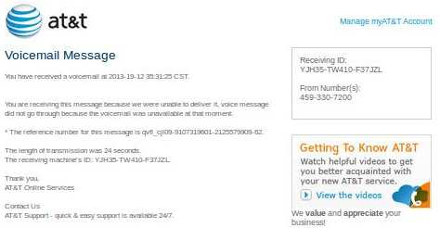
Smishing
Phishing with new lethal-strains of ransomware

Slide 8
Vishing
IVR and robocalls for sensitive information
We are the police! Please provide us your personal information

Slide 9
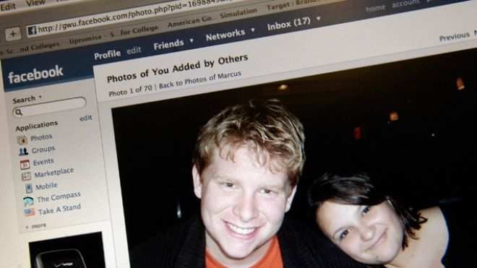
Social Engineering: Practical example
How to use Facebook to ruin someone’s life
(attack on an employee)

Slide 10

Social Engineering: Practical example
1st step: Protect your identity
Install new operation system on a new disk
Encrypt your disk
Use anonymous proxy
Use free Wi-Fi in a bar
Preform attack drinking cold beer

Slide 11
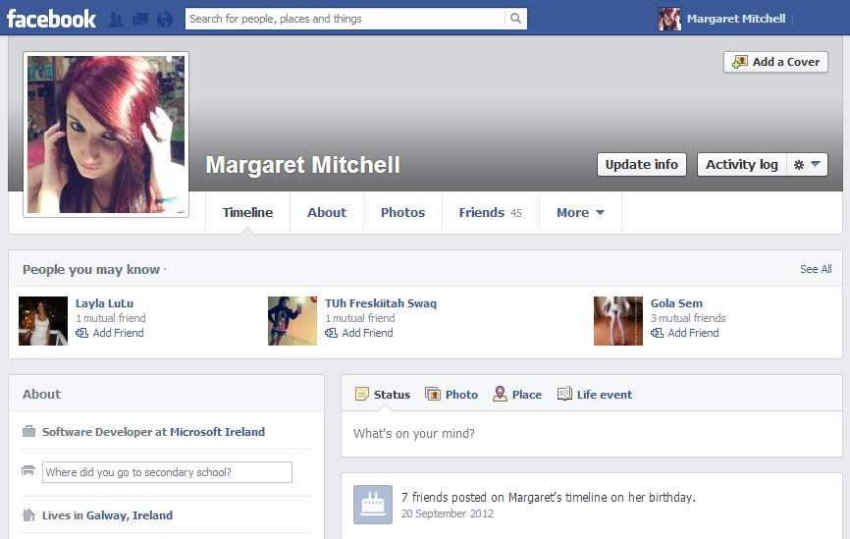
Social Engineering: Practical example
2nd step: Fake e-mail and Facebook account
The character must be:
Woman*
25 to 35 years old
Single
High educated
Interesting
* Statistically is proven that the success rate using a woman character is more than 100 times (!) higher than using a male profile.

Slide 12
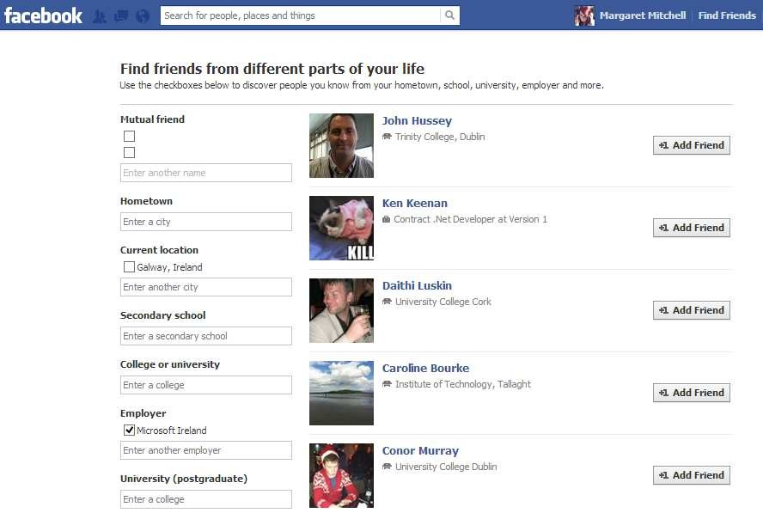
Social Engineering: Practical example
3rd step: Select the victim(s)
Before sending the invitation:
Get him/her friends
Get him/her interests

Slide 13
Social Engineering: Practical example
4th step: Get the victim(s) as friend
Start chatting and get sensitive information
Start chat and get “sensitive” photos
Post link to an infected site
…

Slide 14

Social Engineering: Countermeasure
Social Engineering Countermeasure
Slow down and Research the facts
Delete any request for financial information or passwords.
Reject requests for help or offers of help
Don’t let a link in control of where you land
Do not post your personal data or photos
Do not reveal sensitive data (e.g., passwords)
Report any suspicious activity

Slide 15

Social Engineering: The end
Thank you!

